Slide 1
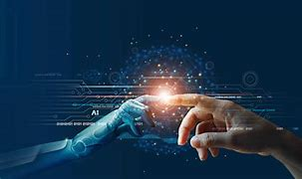
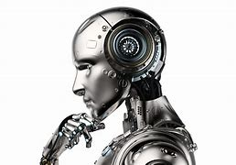
Conference presentation on contemporary them artificial intelligence!
By
Nirmra Imran
2018843

Slide 2
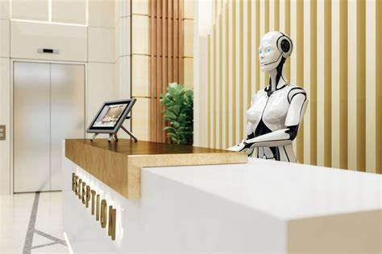
Introduction!
Notes:
Introduction.
My name is Nimra Imran. Today I will be presenting A contemporary theme technology for our research paper. My particular technological thing which I selected for this research paper was artificial intelligence.
Artificial intelligence enables new forms of interaction. Students teachers can speak, gesture, sketch and use of natural modes of communication to interact with computational resources. Another definition of artificial intelligence is a family of a technology that can recognise, analyse, act, learn and demonstrate features of human intelligence in the process of problem solving. It is important in hotel industry because it enhances operational efficiency, improves customer and ultimately leading to higher profitability.
R. Anyola ( 2017) defines artificial intelligence invented in the early 20th century with a heartless Tin Man for a movie Wizard of Oz. In 1950 there were many scientists mathematical of artificial intelligence. 1st and called Alan Turing For explore mathematical of Artificial intelligence and suggested that humans should make use of available information to store problems and make decisions by using robots to do these kind of activities.

Slide 3

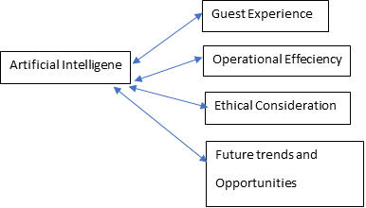


Overview of Literatuture
A conceptual model of Artificial intelligence. In the hotel industry gives off what the future may hold for hotels and their guests.
Notes:
Overview of literature.
Recent paper was asked to provide a overview of key theories and concepts related to a contemporary technology of artificial intelligence as well as impacts on hospitality industry. Research discovers what analysis of artificial intelligence as follows:
Strength- Artificial intelligence increase workplace productivity and cuts of long hours of work of repetitive work. Benefits are to the hotel is saves times for personal cost and non compliance fee as well as improves quality of life.
Weakness- People working in jobs requires a touch of humanity. Feel safe. It can communicate with humans, but cannot communicate or grasp Information emotionally.
Opportunity- Artificial intelligence is connected to others. A form of technology includes machine and use of Internet. It is more advantaged to people with disability and less strain on employees.
Threats- Adapting to artificial intelligence will lose of their jobs and have a less control.
Theories related to artificial intelligence or. There are many number of conceptual models of artificial intelligence that provides guest experience, operational efficiency, ethical consideration and future trends as well as opportunity.
Function based model works on a basis. Function of Explain ability methods as the importance of the classification model to use and extract information.
Machine learning is a technique that allows a computer to identify pattern, make prediction that are more accurate, refined via experience without being programmed to do so.

Slide 4
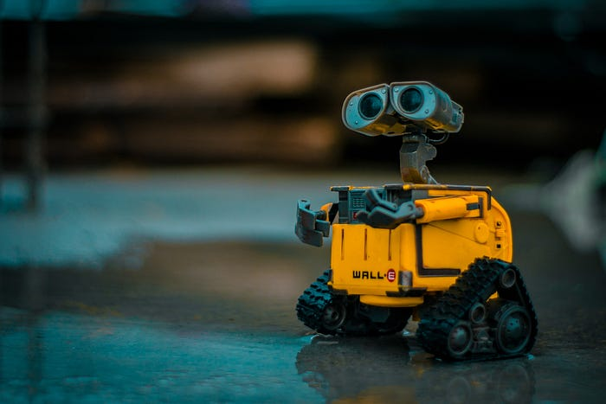
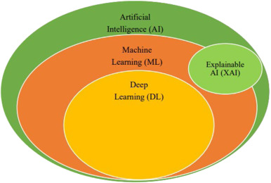
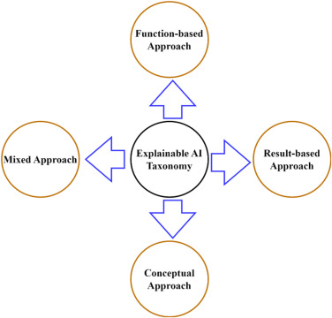
Overview of Literature....
Conceptional model
Machine Learning Technique
Funtions- based approach model

Slide 5
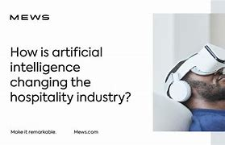

Overview of Literature....
Impacts of Artificial Intelligence on hospitality Industry....
Notes:
Impact of artificial intelligence to hospital industry.
K. Kadagide ( 2023) states impact of artificial intelligence to hotel industry has improved operational efficiency. It can predict another analytics analysis, forecast demands, operates accordingly. Moreover, it can help with reducing waste profitability, optimize operations and increase revenue.
Benefits of Artificial Intelligence For hotel has increased efficiency, cost saving, improved quality and labor cost. The challenges are lack of technical experts, privacy concern. And the impact of operational opportunity, cost saving and quality of service etc.

Slide 6
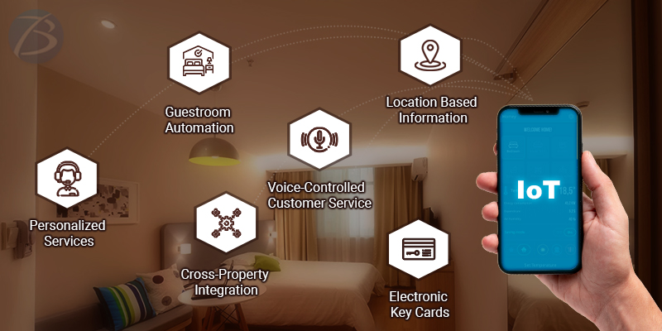
Application to the Hotel and Hospitality SectoR
Notes:
Application to the hotel and hospitality sector.
For this particular research paper front. Office Department has been selected focusing on front office employees. It examines real impact of artificial intelligence has created and management response to contemporary issues reflecting level of impacts of strength and limitation.
Artificial intelligence improves efficiency and productivity. It also improves decision making, also creates new opportunity.
Flock (2022 ) Declares optimal implementation of artificial intelligence for wide generation with hotel industries. It offers high quality experience tailored to individuals needs and preferences with Data sets different information can be stored retrieved in a large data than normal human brain. Artificial intelligence is easy to use, interactive. It enhances services value offered to our guest during a stay in the hotel.

Slide 7
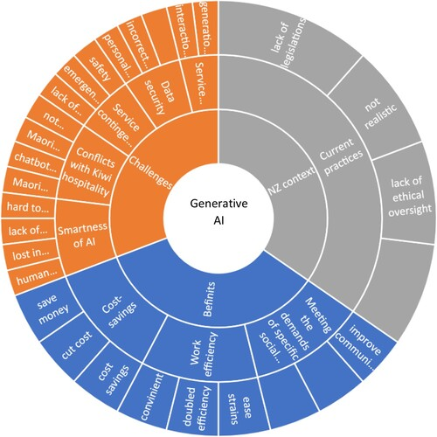

Evaluate Future Policy and Management options
https://thereceptionist.com/blog/the-evolving-role-of-ai-in-office-management/ https://www.sciencedirect.com/science/article/pii/S0160791X2300235X
https://www.nature.com/articles/s41599-023-01843-3
https://aiello.ai/blog-en/7-technology-trends-hospitality-industry-2024/#:~:text=Artificial%20Intelligence%20(AI)%20Voice%20Assistants&text=They%20can%20provide%20guests%20with,better%20service%20to%20their%20guests.
Notes:
Here are the list of Recommendations .

Slide 8
Evaluate Future Policy and Management options Continue....
https://acropolium.com/blog/top-hospitality-technology-trends/
https://www.bu.edu/hospitality/2023/01/26/technology-trends-in-hospitality/
https://www.revfine.com/technology-trends-hospitality-industry/
http://tesi.luiss.it/31139/1/723651_BAJROVIC_BELMINA.pdf
https://www.mdpi.com/1424-8220/23/8/3826
https://www.modul.ac.at/uploads/files/Theses/Bachelor/Undergrad_2022/BBA_2022/51839854_FLOECK_Jennifer_BBA_Thesis.pdf

Slide 9
References....
A. Saranya et al (2023) A systematic review of Explainable Artificial Intelligence models and applications: Recent developments and future trends, Available at: (https://www.sciencedirect.com/science/article/pii/S277266222300070X) Accessed on 26 February 2024

Slide 10


Thank you
Thank you! For listening to me, I hope you enjoyed the information session within this conference.
Notes:
Thank you! For listening to me, I hope you enjoyed the information session within this conference.

