Slide 1
OSI Reference Model
Wireless Networks (WN)
Dr. Carlene Campbell

Slide 2
OSI Model
Application
Presentation
Session
Transport
Network
Data link
Physical
Notes:
Ways to remember the 7 layers:
All People Seem to Need Data Processing or Please Do Not Throw Sausage Pizza Away
ALL= application
People= presentation
Seem = session
to = Transport
Need = Network
data = data link
Processing = Physical

Slide 3
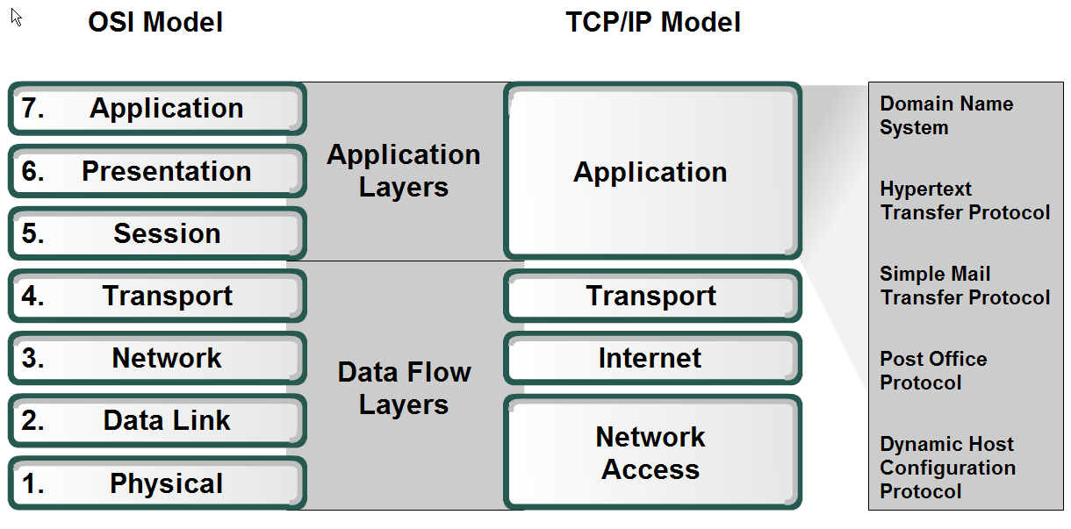
OSI & TCP/IP Model

Slide 4
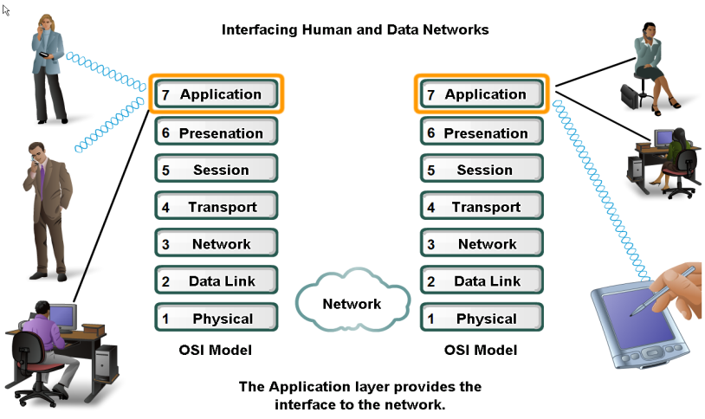
Application Layer

Slide 5
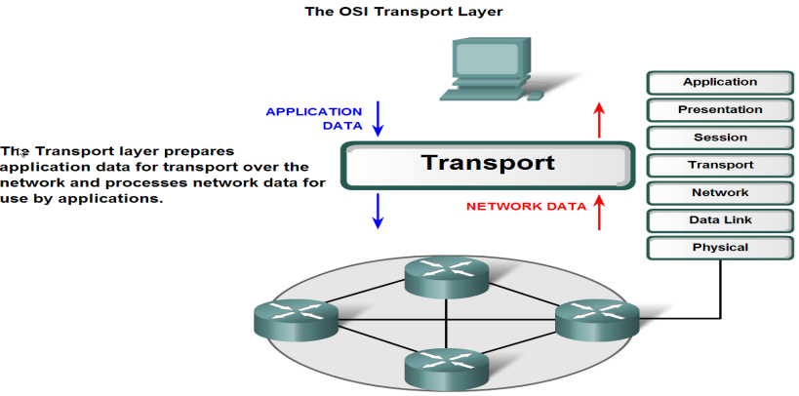
Transport Layer
Notes:
Two main transport protocols: TCP & UDP

Slide 6
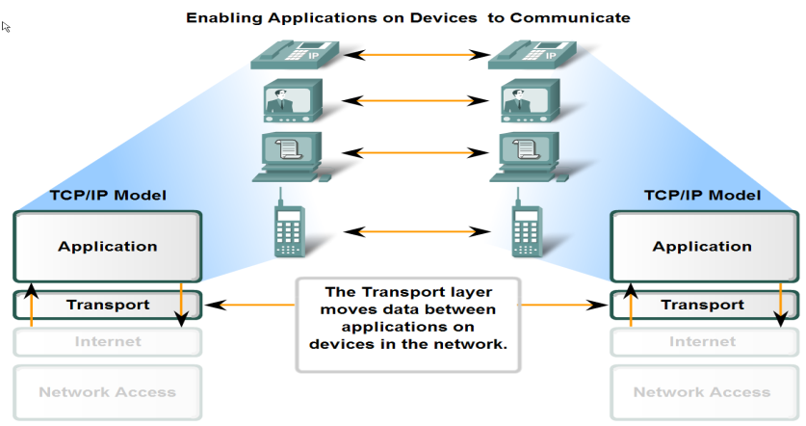
Major Function of Transport Layer

Slide 7
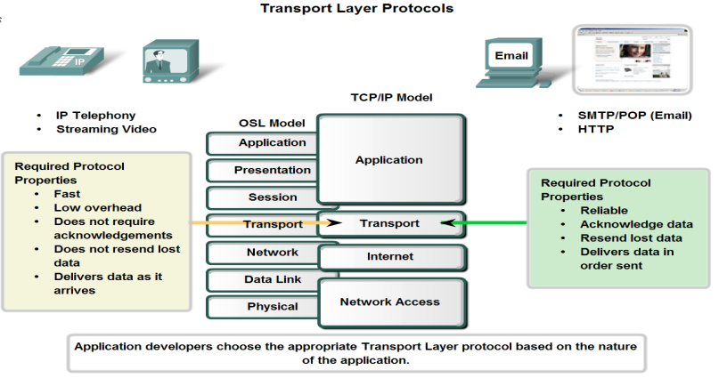
Supporting Reliable Communication

Slide 8
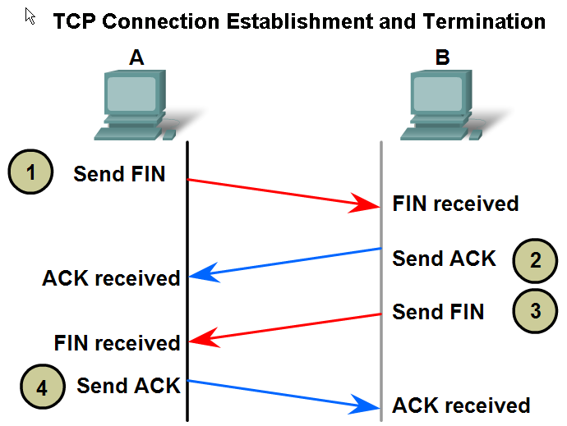
Three-way Handshake

Slide 9
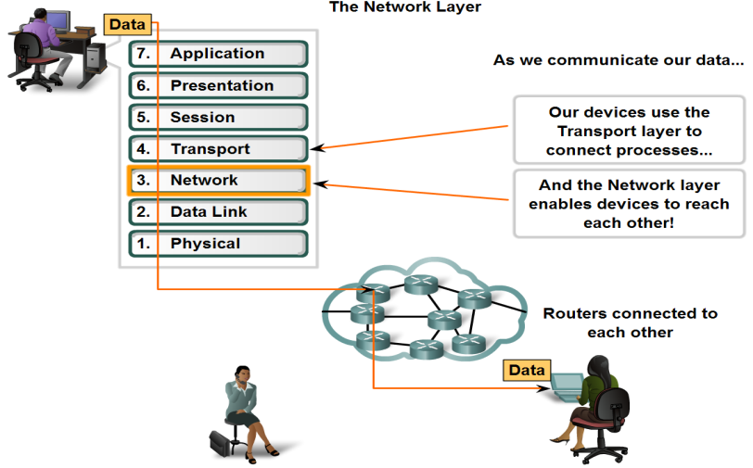
Network Layer

Slide 10
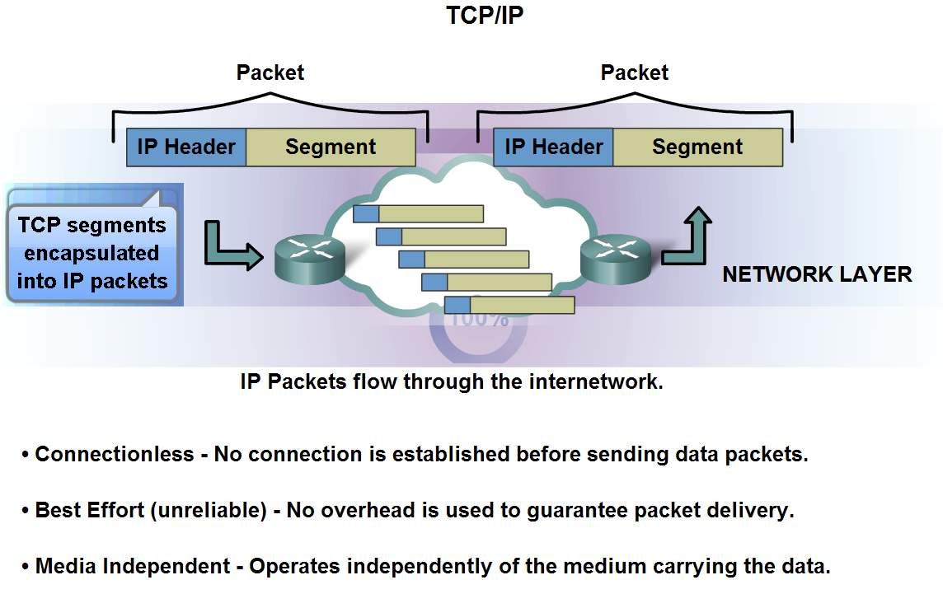
Network Layer – IPv4 Protocol

Slide 11
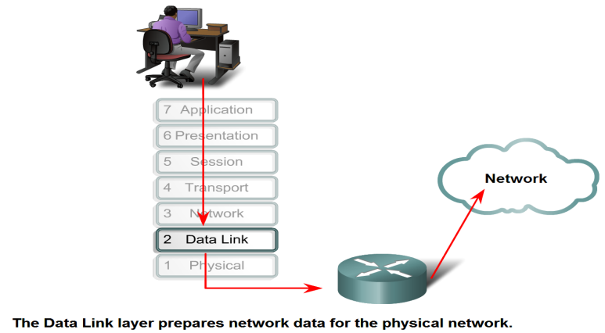
Data Link Layer

Slide 12
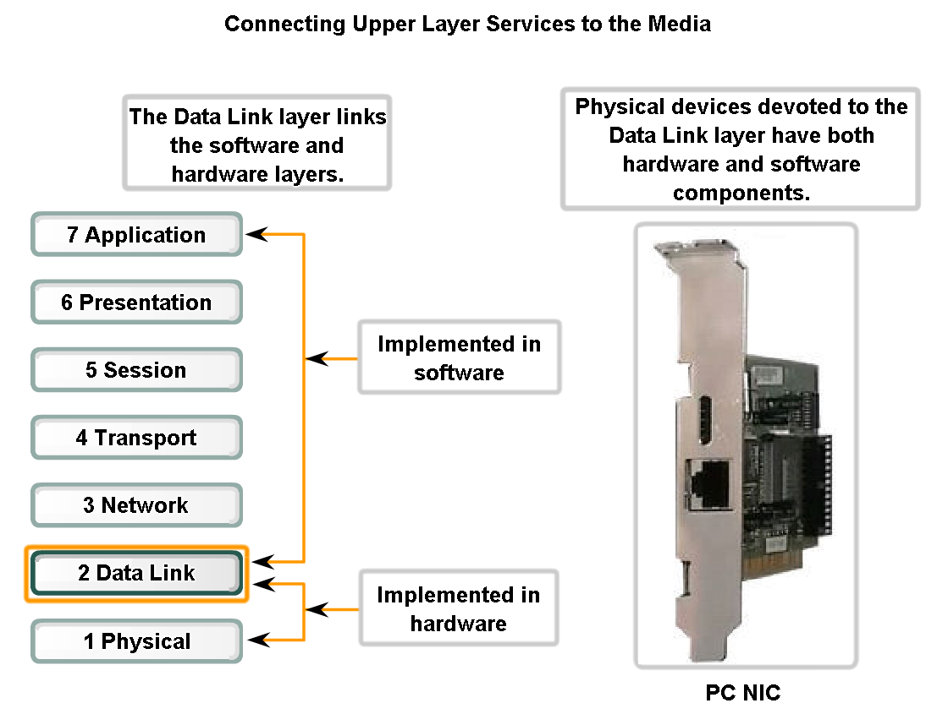
Data Link Layer

Slide 13
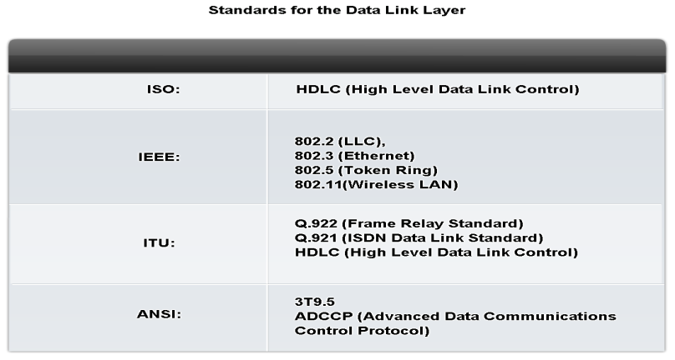
Data Link Layer Protocols and Standards

Slide 14
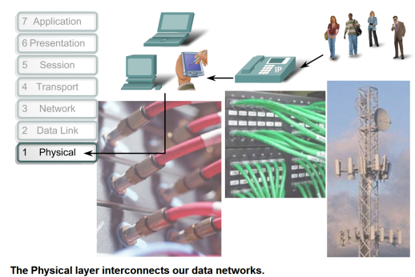
Physical Layer
LAN
  Straight through
  Crossover
  Rollover
WAN
  Serial links

Slide 15
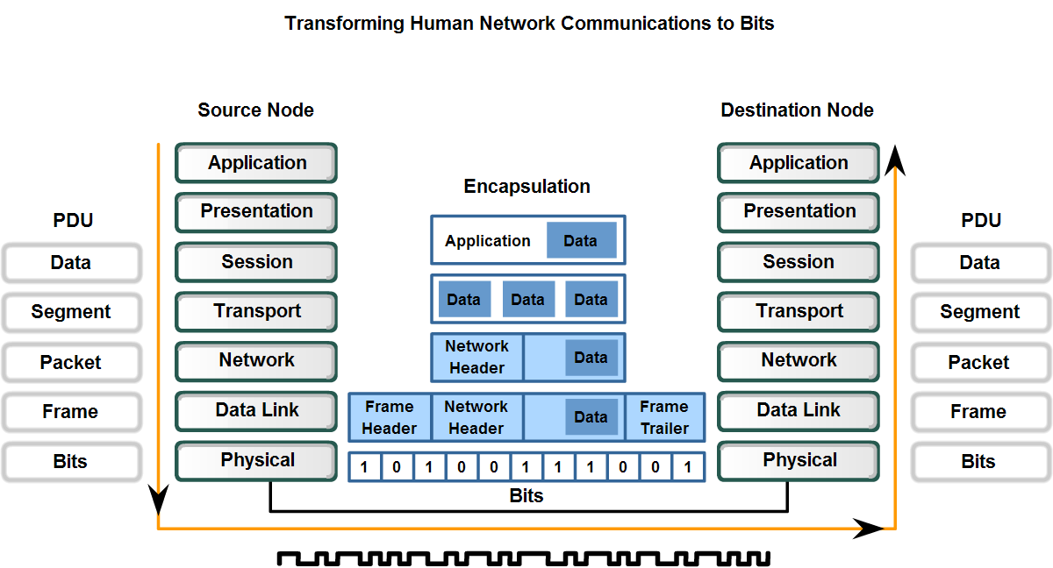
Physical Layer Service
Notes:
PDU – Protocol Data Unit

Slide 16
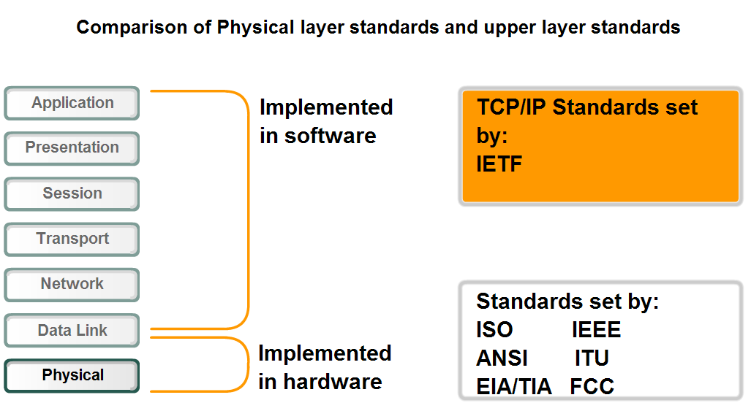
Physical Layer Standards
Notes:
IETF – Internet Engineering Task Force
ISO – International Standard for Organization
IEEE – Institute of Electrical and Electronics Engineering
ANSI – American National Standard Institute
ITU – International Telecommunication Union
EIA/TIA - Electronic Industries Alliance / Telecommunications Industry Association
FCC - Federal Communications Commission

Slide 17
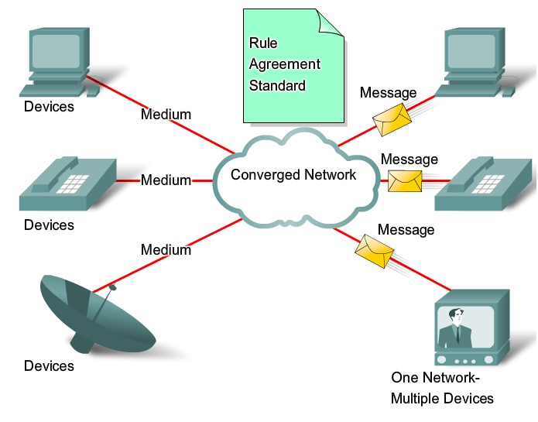
Converged Network

Slide 18
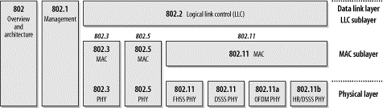
802.11(wireless) and the OSI
The diagram shows the relationship between the various components of the 802 family and their place in the OSI model.
Notes:
802.11 is a member of the IEEE 802 family, which is a series of specifications for local area network (LAN) technologies.
IEEE 802 specifications are focused on the two lowest layers of the OSI model because they incorporate both physical and data link components. All 802 networks have both a MAC and a Physical (PHY) component. The MAC is a set of rules to determine how to access the medium and send data, but the details of transmission and reception are left to the PHY.
It’s not a replacement for fixed networks it is an excellent complement for that technology just the same way mobile telephones complement fixed-line telephony.

Slide 19
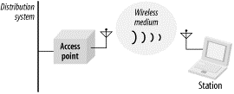
Physical Components
Four major physical components for WLANs

Slide 20
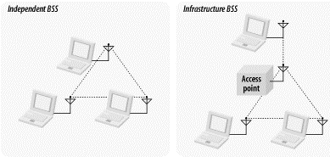
Building block for WLAN
The basic building block of an 802.11 network is the basic service set (BSS), which is simply a group of stations that communicate with each other

Slide 21
IP Addressing
IP Address Class
  Class A 0 – 127
  Class B 128 – 191
  Class C 192 – 223
Subnetting

Slide 22
Questions?

