Slide 1
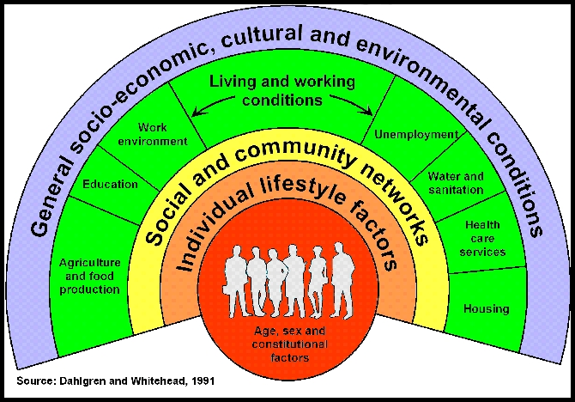
Determinants of Health

Slide 2


Learning Objectives
1
Explain the concepts of health
and well-being
2
Recognize the responsibility of UK government to uphold the health of their population
3
Identify the socioeconomic, biological and behavioural factors that influence health
4
Explain the social determinants
of health
Notes:
Briefly summarize the key objectives for this lecture.

Slide 3

Definition of Health
Health is a state of complete physical, mental
and social well-being, and not merely the
absence of disease or infirmity (World Health Organization, 1948).
Health is an individual right and a social justice issue. It is also a public good.
Governments have a responsibility for the health of their peoples which can be fulfilled only by the provision of adequate health and social measures.
Notes:
The Constitution of the World Health Organization (1948) conceptualises health as being more than the absence of disease, illness and physical health. Fundamentally, health is about physical, mental, and social well-being, and it is understood that health and well-being can be adversely affected by social policies.
There are different ways of viewing health as articulated in different international agreements. Often the WHO definition is cited. Other examples of where a definition of health is stated include: the United Nations Universal Declaration of Human Rights (1948), the International Covenant on Economic, Social and Cultural Rights (1966), and the Ottawa Charter for Health Promotion (1986).
The enjoyment of the highest attainable standard of health is one of the fundamental rights of every human being without distinction of race, religion, political belief, economic or social condition.
Governments have a responsibility for the health of their peoples. Health is a priority for the whole of society.
Additional note of interest: The Constitution of the World Health Organization was adopted by the International Health Conference held in New York from 19 June to 22 July 1946, signed on 22 July 1946 by the representatives of 61 States and entered into force on 7 April 1948. The WHO definition of health has not been amended since 1948.

Slide 4
By the end of the session you should understand:
Health is multidimensional.
Should able to tell-determinants of health.
Health is affected- Genetic / Biological factors Environmental factors.
Socioeconomic factors , Life- style.

Slide 5
Determinants of health
Health is multi factorial.
Some are inside the body-genetic/intrinsic
• Some are - External factors /environmental
• Interaction of them may be- health promoting --deleterious.

Slide 6
Common determinants of health
Genetic factors (biological)
Environmental factors
Lifestyle Behavioral & socio-cultural
Gender & Age
Socioeconomic conditions Education, Occupation, Income
Health services –utilization Immunization, Family welfare nutritional…

Slide 7
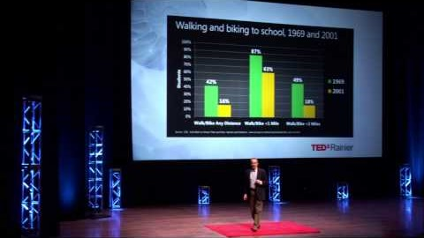
Environmental factors and health

Slide 8
Factors Determining Health
Clinical care is less important than many people think
whereas socioeconomic factors and the physical environment
are quite influential on health and well-being.
Genetic characteristics are also less significant
than many people think.
Whether people are healthy or not, is determined by their circumstances and environment – the social, economic and environmental conditions which affect the health of the population.
Notes:
Many factors combine to affect the health of individuals and communities. People’s health is affected by their living conditions not just their genetic or behavioural choices.
Factors such as where we live, the state of our environment, genetics, our income and education level, and our relationships with friends and family all have considerable impacts on health, whereas the more commonly considered factors such as access and use of health care services often have less of an impact.
The earlier mentioned definition of health supports the focus on the wider context of health and well-being, beyond just ill health and disease (and curative health care).

Slide 9


Why frame health in terms of societal conditions?
Impact: 30 - 50% or more
Mc Giniss
et al (2002)
Canadian Institute of Advanced Research (2012)
Health care
(up to 15%)
Social circumstances
& environmental exposure (45%)
Health behaviour patterns (40%)
Health care
(up to 25%)
Socioeconomic (50%)
Environmental (10%)
Genetics (15%)
Figure: Estimates of the contribution of the main drivers of health status.
Source: Donkin, A., P. Goldblatt, J. Allen, V. Nathanson and M. Marmot (2017).
"Global action on the social determinants of health." BMJ Global Health.
Notes:
Societal conditions have a direct impact on health, accounting for an impact of 30-50% or more on levels of the populations’ health, as outlined in this slide.

Slide 10

WHAT ARE THE Social Determinants
of Health?
The social determinants of health are the conditions in which people are born, grow, live, work and age. These circumstances are shaped by the distribution of money, power and resources at global, national and local levels.
The social determinants of health are mostly responsible for health inequities – the unfair and avoidable differences in health status seen within and between countries.
The social determinants of health are multi-layered
and range from societal to individual factors.
Notes:
The social determinants of health matter because they set the conditions for the health of individuals, communities and populations, and if the social determinants of health are not distributed fairly, they can lead to health inequities.
Dahlgren and Whitehead describe layers of influence on health, as presented on the following slide.

Slide 11
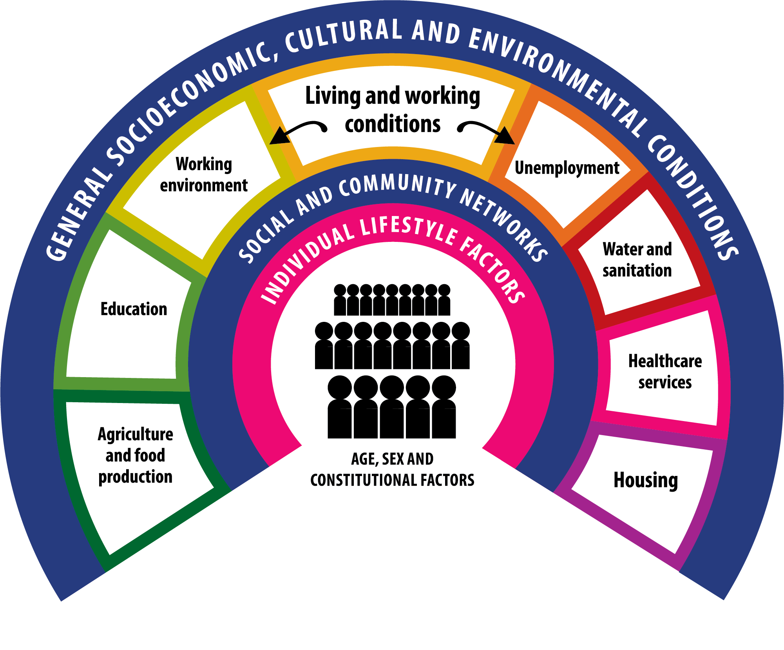
THE Social Determinants
of Health
Source: Dahlgren G and Whitehead M (1991)
Policies and strategies to promote social equity in health. Stockholm, Institute of Future Studies.
Notes:
All of these factors are what we refer to collectively as the social determinants of health.
Dahlgren and Whitehead’s model maps the relationship between the individual, their environment and disease. Individuals are at the centre with a set of given genes. Surrounding them are influences on health that can be modified. The Dahlgren and Whitehead social determinants of health framework is a widely cited model of the main determinants of health, and a recognized framework which identifies the range of social determinants.
The first layer is personal behaviour and ways of living that can promote or damage health (e.g. choice to smoke or not). Individuals are affected by friendship patterns and the norms of their community. The next layer is social and community influences, which provide mutual support for members of the community in unfavourable conditions but they can also fail to provide support or have a negative effect. The third layer includes structural factors: housing, working conditions, access to services and provision of essential facilities. The fourth layer captures the broader political, cultural and environmental conditions in which all these other factors occur.
Importantly, many of the determinants of health lie outside of the control of the health care system – so the health sector does not have control of these determinants.
This creates an opportunity for us to think more broadly about the complexity of health issues such as climate change and obesity and highlights the need to work across sectors to tackle these kinds of issues.
Other models have been developed to describe the social determinants of health and these are outlined in the next few slides.

Slide 12
Other determinants of health
Food & agriculture
Education.
Science & technology.
Standard of living.
Social justice, equity, human rights.
Govt Polices to raise stand of living
Inter sectoral contributions
Dissemination of information (IEC)

Slide 13
Biological
Genetic make-up (Heredity)
It is permanent & can not be altered.
Transmitted by hereditarily.
No treatment.
Many be Prevented to some extent.

Slide 14
Environmental factors-
Internal environment/Micro
External environment/Macro Physical-air,
Water, soil Biological-plants, animals,microbes
Social-culture,beliefs,traditions
Dynamic equilibrium is Health

Slide 15
Behavioural & socio-cultural
Depends on economic status (rich & poor)
Cultural values vegetarianism-Non-vegetarianism
Social values Status of women
Personal habits Smoking…..
• Behavioral pattern High risk behavior

Slide 16
Lifestyle nurture or nature?
Learnt by observations by –parents, teachers, peer groups, mass media….. Includes cultural pattern, social value & behavior…
The way people thinks & live - developed through process of socialization& social interaction. (traditional lifestyles)
So cultivate healthy lifestyles like proper nutrition & sleep, exercise, avoid drug abuse,

Slide 17

Epigenetics

Slide 18
Life-style makes the difference!
Malnutrition.
Population explosion.
Mental health problems.
Cancer.
Diabetes mellitus
Cardiovascular diseases
AIDS & STDs.
Environmental pollution.

Slide 19

Socioeconomic conditions

Slide 20
Indicators of health
To measure health status.
To compare
To assess the health needs
To plan & implement
To evaluate health care

Slide 21
Health is measured multi-dimensionally & indirectly
Mortality indicator
Morbidity indicators
Disability indicators
Nutritional status indicators
Health care delivery indicators
Utilization rates

Slide 22
Morbidity indicators
Incidence rate
Prevalence rate.
Notification rate.
Outpatients attendance rate.
Hospital admission rate
Duration of stay in the hospital.

Slide 23
Determinants of health

Slide 24
Resources for timed assessment
https://lshubwales.com/news/addressing-health-inequalities-wales#:~:text=Addressing%20Health%20Inequalities%20in%20Wales%201%20Unequal%20from,number%20of%20reports%20to%20...%20More%20items...%20
https://www.sochealth.co.uk/national-health-service/public-health-and-wellbeing/poverty-and-inequality/the-black-report-1980/
https://www.gov.uk/government/publications/independent-inquiry-into-inequalities-in-health-report

