Slide 1
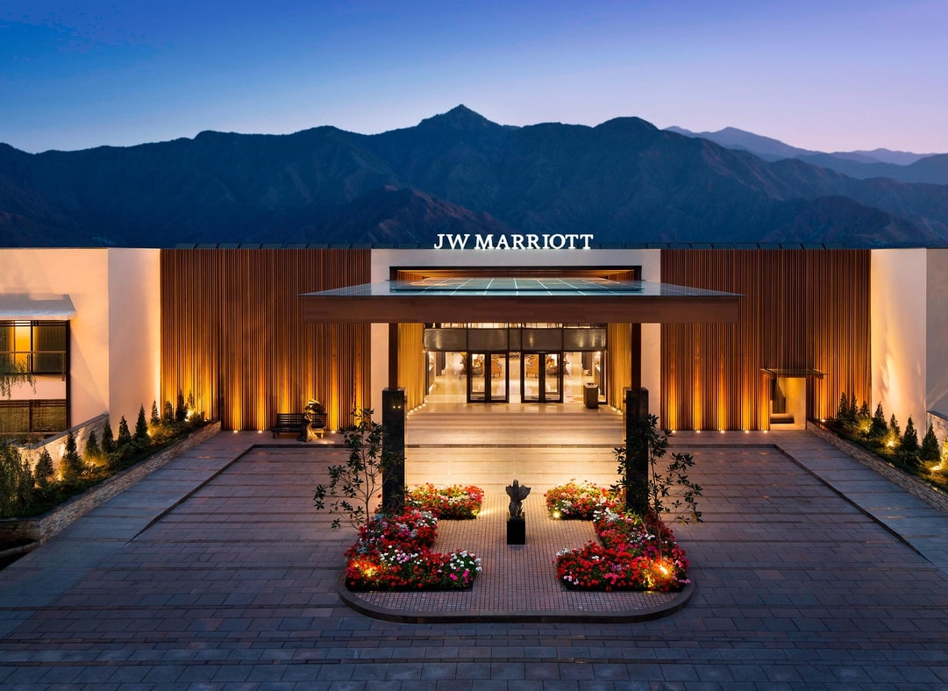
The role and importance of Hospitality & Guest Services within the
hotel industry
Referring to JW Marriott
Presentation created by:
Jayson Anthony Luba
2245377

Slide 2
Table of Content
History JW Marriott
JW Marriott now
Potential guests of JW Marriott
Clarification of terms
Tangible and intangible assets
Importance of quality service and WOW factor
Hotel Loyalty Programs
The WOW factor in JW Marriott Hotels - Breathtaking Environment & Exceptional Interiors
The WOW factor in JW Marriott Hotels - Special care for guests and environment
Loyalty Programs in JW Marriott - Reward Program
Loyalty Programs in JW Marriott - Membership Program
References

Slide 3
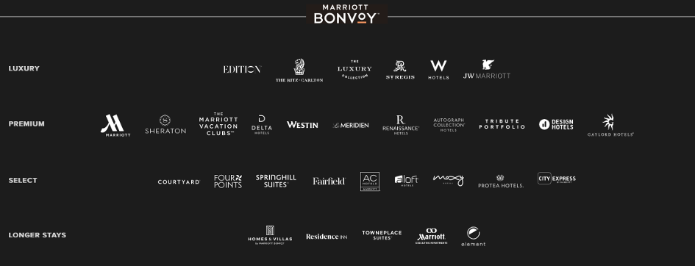

History JW Marriott
Part of Marriott International – Luxury Group
Luxury Group: delivers customized, high-quality amenities and services
JW Marriot was named after the founder of Marriott International: J. Willard Marriott
First JW Marriott Hotel opened in 1984 in Washington DC (JW Marriott, 2023)

Slide 4
JW Marriott now
113 properties all over the world by the end of 2022
124 properties at the moment (October 2023)
Latest openings: JW Marriott Hotel Madrid, JW Marriott Hotel Berlin, JW Marriott Hotel Goa
Motto: The Destination is All Yours
Mission: JW Marriott offers an environment and experience designed to allow guests to focus on feeling present in mind, nourished in body, and revitalized in spirit. (JW Marriott, 2023)
Geographic distribution of JW Marriott properties at the end of 2022 (Marriott International Inc, 2022)
 | U.S. & Canada | Europe | Middle East & Africa | Asia Pacific | Caribbean & Latin America | Total
Properties | 33 | 7 | 10 | 47 | 16 | 113
Rooms | 18,796 | 2,387 | 4,427 | 17,009 | 4,296 | 46,735

Slide 5
Potential guests of JW Marriott
Main consumers: Luxury travellers (Juhász, 2023)
Attributes
Wealthy people, more likely to spend without looking at the price
Older generations – who already have enough money
They plan trips, choose hotels carefully
What they expect
Beautiful environment, comfortable and luxurious interior
Top-of-the-line, personal service
Wide variety of high-quality services and facilities (spa, bar, restaurant, etc.)
Access to exclusive events
How to attract them
Exceptional service, attention to the details
Learning about guest’ preferences prior arrival
Personalized program recommendation
Spotless, luxury environment

Slide 6
Clarification of terms
Guest service: is the interaction between a service organization and its customers/clients, and may take varying forms: face-to-face, over the telephone, by letter, or by automated means. (Lewis & Mitchell, 1990, pp.11.)
Service quality: refers to the overall level of service provided to customers, including the quality of the product or service, the reliability and responsiveness of the staff, and the overall customer experience. (Prince, 2023)
Service excellence: service excellence refers to the ability of service providers to consistently meet and occasionally even exceed customers’ expectations. (Yoong, 2022)

Slide 7
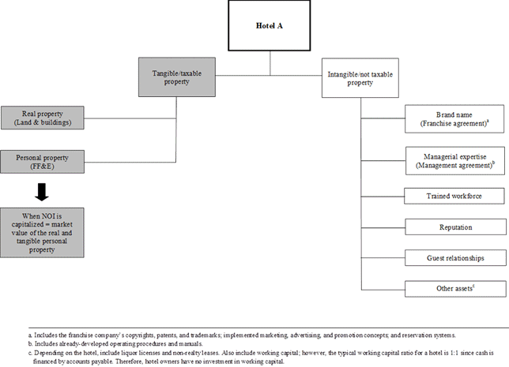
Tangible and intangible assets
Important tangible assets in hotel industry: clean, comfortable rooms, amazing food in restaurant, additional luxury facilities
Important intangible assets in hotel industry: personal attention, security, speed of service
Source: Elgonemy, 2013

Slide 8
Importance of quality service and WOW factor
Quality Service
Quality service closely linked with customer satisfaction.
Satisfied customers tend to become loyal to the hotel. – loyalty programs
Loyal customers contribute to competitive advantages, business performance and sustainable development.
Long term loyal customers are likely to recommend the hotel to their friends and family. (Marić et al., 2016)
WOW factor
WOW factor etymology: WOW is an interjection used to express excitement.
Wow factor is a term commonly used to describe when a company goes above and beyond customer expectations in delivering a great product and service experience. (Kokemuller, 2023)
Has important role in customer experience.
Helps the hotel in staying competitive.
Motivates guests to join loyalty programs. (Pantelic, 2017)
Conclusion: Lots of similarities between the effects of quality service and the WOW factor, but WOW factor ads a little extra.

Slide 9
Hotel Loyalty Programs
Loyalty programs are strategic tools to attract and retain customers. (Shin et al., 2022)
Reward Programs
Offers benefits or points.
Can be transferred into discounts and free nights.
Guest must pay first, reward comes later.
Only available after at least one stay.
Only returning guests can benefit from it.
Membership programs
Alternative option, mostly available at luxury hotels.
Pay for membership, enjoy benefits right away. – instant gratification
Can be hotel & bar or hotel & restaurant membership. – includes local elite

Slide 10
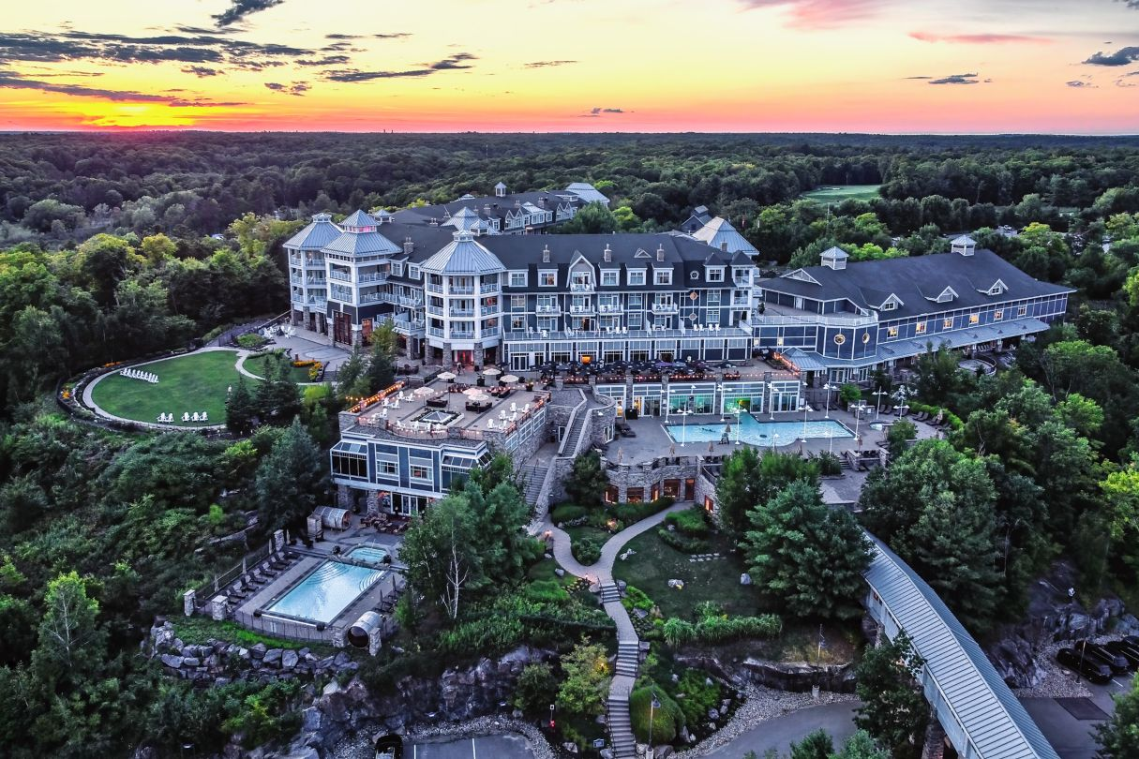
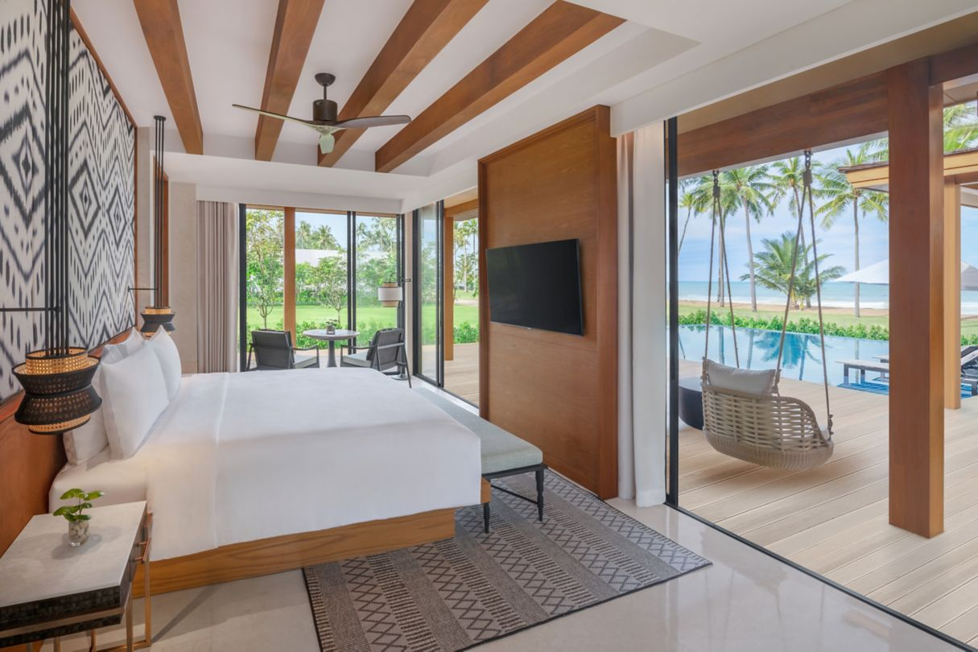
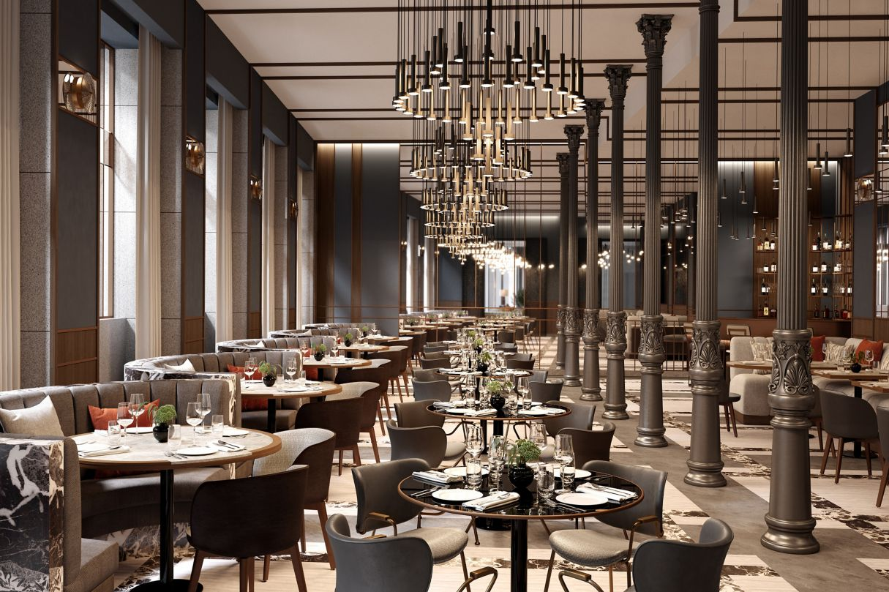

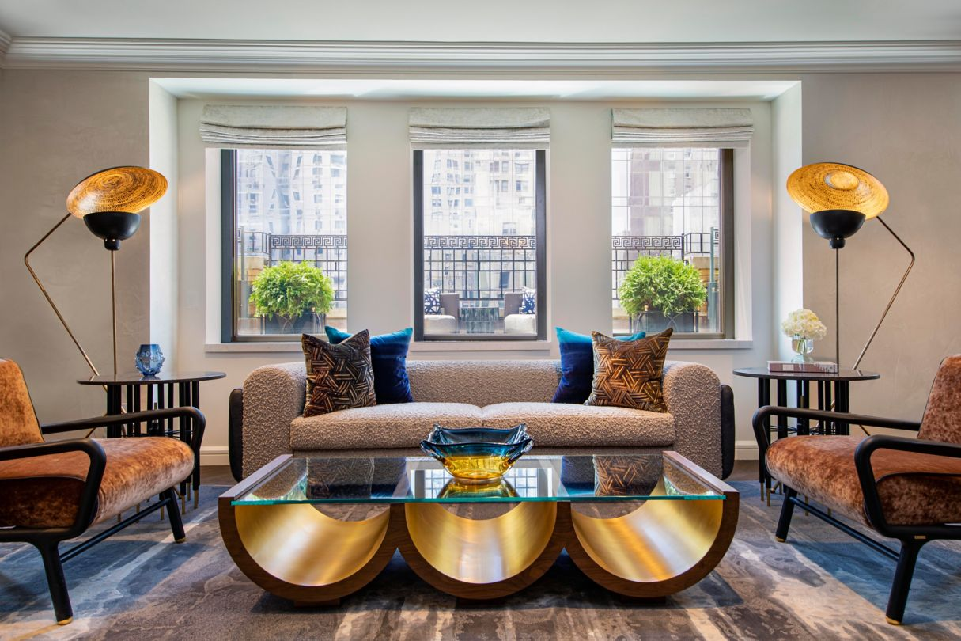
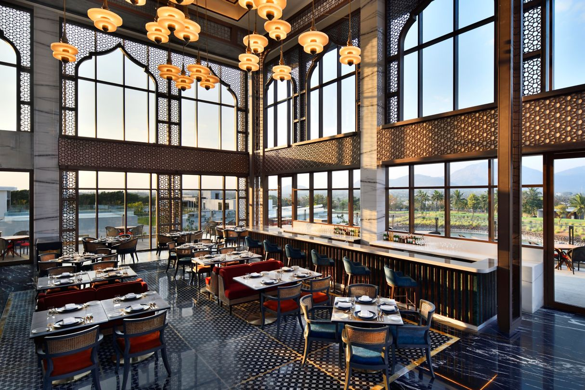
The WOW factor in JW Marriott Hotels
Breathtaking Environment & Exceptional Interiors
Source: marriott.com, 2023

Slide 11



The WOW factor in JW Marriott Hotels
Special care for guests and environment
JW Marriott hotels aim to please their guest and be gentle with the environment at the same time. (JW Marriott, 2023)
Guided meditation sessions on site.
Nearby activities listed on every properties' website.
In room dining experience, with fresh and healthy options.
Dishes include ingredients from their own gardens.
Drinking water extracted from the humidity in the air. – JW Marriott Phuket Resort
Olive grove where guests can harvest or relax – JW Marriott Venice Resport & Spa

Slide 12
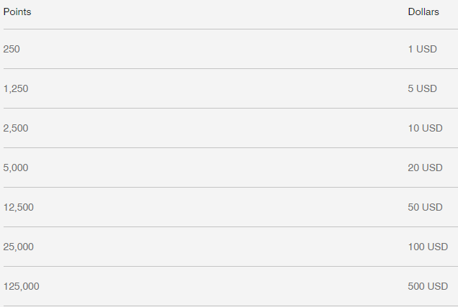
Loyalty Programs at JW Marriott
Reward Program
Marriott International offers 3 different ways for guests to earn points. JW Marriott is part of this program as well. (JW Marriott, 2023)
Guests can earn points by spending nights in Marriott Hotels – at JW Marriott guests earn 10 points per 1 USD spent.
Guests can transfer reward points from Marriott International’s partner companies. (American Express, Chase Ultimate, etc.)
Guests can link their credit cards to Marriott Bonvoy and earn points by spending money in participating hotels. This way guests do not have to stay in the hotel, it is enough to eat in the restaurant.
What do the points worth?
Points can be used on nights or on other charges, such as restaurant charges, golf charges, etc.
If it’s used for hotel nights, point’s worth is different in every resort. 1 USD can be 150-600 points.
If it’s used for other charges, the exchange rate is the following:

Slide 13
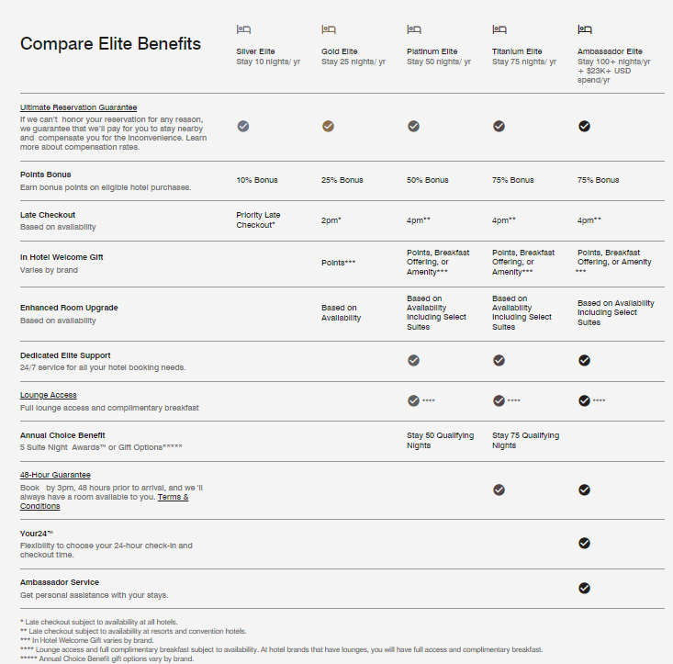
Loyalty Programs in JW Marriott
Membership Program
Marriott International offers different membership programs with different benefits.
(JW Marriott, 2023)
With this program guests do not have to stay at the hotel first to enjoy the benefits.

Slide 14
Reference list
Elgonemy, Anwar (2013) Clarifying Misunderstandings About Intangible Asstets of Hotels, Available at: https://www.hotel- online.com/News/PR2013_1st/Feb13_IntangibleAssets.html (Accessed: 4 October 2023)
Juhász-Dóra Katalin (2022) ‘Temporal dimensions of transformation of the luxury hotel milieu.’ Turizmus Bulletin, XXII.(1), pp. 13-25. DOI:10.14267/TURBULL.2022v22n1.2
JW Marriott (2023) Destinations. Available at: https://jw-marriott.marriott.com/destinations/ (Accessed: 4 October 2023).
Kokemuller, Neil (2023) The WOW factor in business, Available at: https://smallbusiness.chron.com/effective-sales-marketing-techniques-815.html (Accessed: 7 October 2023)
Kumar, Prince (2023) Service Quality in the Hospitality Industry: Understanding and Improving Customer Satisfaction, Available at: https://hmhub.in/the-service- quality/ (Accessed: 6 October 2023)
Lewis, Barbara R. & Mitchell, Vincent W., (1990) ‘Defining and Measuring the Quality of Customer Service’, Marketing Intelligence & Planning, Vol. 8 Iss 6 pp. 11 – 17 Available at: http://dx.doi.org/10.1108/EUM0000000001086 (Accessed: 5 October 2023)
Marić, Dražen & Marinković, Veljko & Marić, Radenko & Dimitrovski, Darko. (2016). ‘Analysis of tangible and intangible hotel service quality components’. Industrija. 44. 7-25. DOI: 10.5937/industrija1-8437.
Marriott International, Inc. (2022) Annual Report 2022. Available at: https://marriott.gcs-web.com/static-files/b82978a6-9d28-4e38-9855-fc4ae2cebe11 (Accessed: 6 October 2023).

Slide 15
Reference list
Pantelic, Vladan. (2017). Factors influencing hotel selection: Decision making process. Unpublished Dissertation. The Emirates Academy of Hospitality Management
Shin, M., Back, K.-J., Lee, C.-K., & Lee, Y.-S. (2022). ‘The Loyalty Program for Our Self-Esteem: The Role of Collective Self-Esteem in Luxury Hotel Membership Programs.’ Cornell Hospitality Quarterly, 63(1), 19-32. DOI:10.1177/19389655211017449
Yoong, Kimberly (2022) What is service excellence? The service excellence definition for 2022, Available at: https://hospitalityinsights.ehl.edu/what-is-service- excellence (Accessed: 7 October 2023)

