Slide 1

Group Project Analysis
Presentation
Morgan James (1251151)

Slide 2
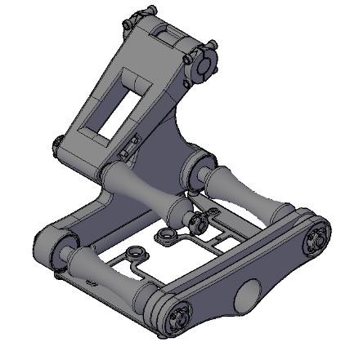
Project analysis slide 2
Project Analysis
PHASED ARRAY
CORROSION MAPPING
THICKNESS MEASURMENT
ADJUSTABLE
AUTOMATED
SAFER THAN RADIOGRAPHY

Slide 3
Project analysis slide 2
Project Analysis
GANTT CHART
DESIGN SPECIFICATION
PAUT SCANNER PROJECT
ORGANISATIONAL CHART
DEVELOPMENT
TESTING
CAD DRAWINGS

Slide 4

Project analysis slide 3
Project Analysis
MARKET ANALYSIS
TECHNICAL ANALYSIS
FINANCIAL ANALYSIS
ECONOMIC ANALYSIS
TIMESCALE ANALYSIS
Looking at existing products for design inspiration and isolation of areas lacking in design
Through interviews with PAUT technicians an understanding of what changes could be made to improve the technologies effectiveness
Taking information from the financial analysis and understanding sales requirements, manufacturing costs to establish forecast profit margins
Breaking down the budget between wages, materials and tools. Utilising the Gantt charts resource allocation to predict the financial forecast
Implementation of a Gantt chart with an analysed critical path accompanied by PERT analysis gave a prediction for the timeline

Slide 5
Project analysis slide 4
Project Analysis
Reasons for Analysis.
Approach Findings
Management style
PDS
Project Failure
Meta Literature Review
Fundamental Issues
Time Management
Gantt Chart
Assist future projects
Communication
Org chart

Slide 6
Project analysis slide 5
Project Analysis
Performance
In service environment
Life in service
Maintenance
Target product cost
Competition
Shipping
Packing
Quantity
Manufacturing
Size
Weight
Aesthetics
Materials
Product life span
Standards and specifications
Ergonomics
Customer
Quality and reliability
Shelf life storage
Time scale
Testing
Safety
legal
Company constraints
Market constraints
Patents literature and product data
Political social implications
Instillation
Energy requirements
User training
Sales potential
Documentation
Disposal
Product Design Specification
Conformance
Estimated cost to conform
34
53
£ 22,570
Title areas were assessed during the specification, addressing all necessary specifics.
Specific areas of non conformance
Increasing the cost beyond the budget further

Slide 7
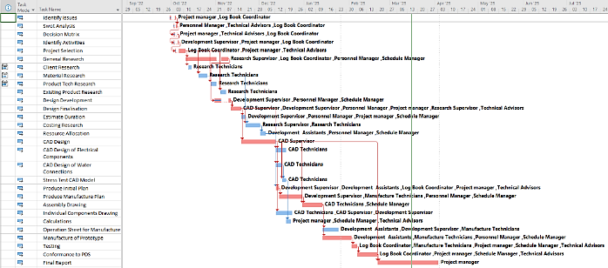
Project analysis slide 5
Project Analysis
Gantt Chart
Critical Path/PERT analysis
Resource Allocation
30
-4.5
£ 170,449.24
Steps within the Gantt chart, taking a proposed total of 7 months to complete.
Days estimated upon completion of the critical path
Was the total cost of the projects resources, £449.24 over budget

Slide 8
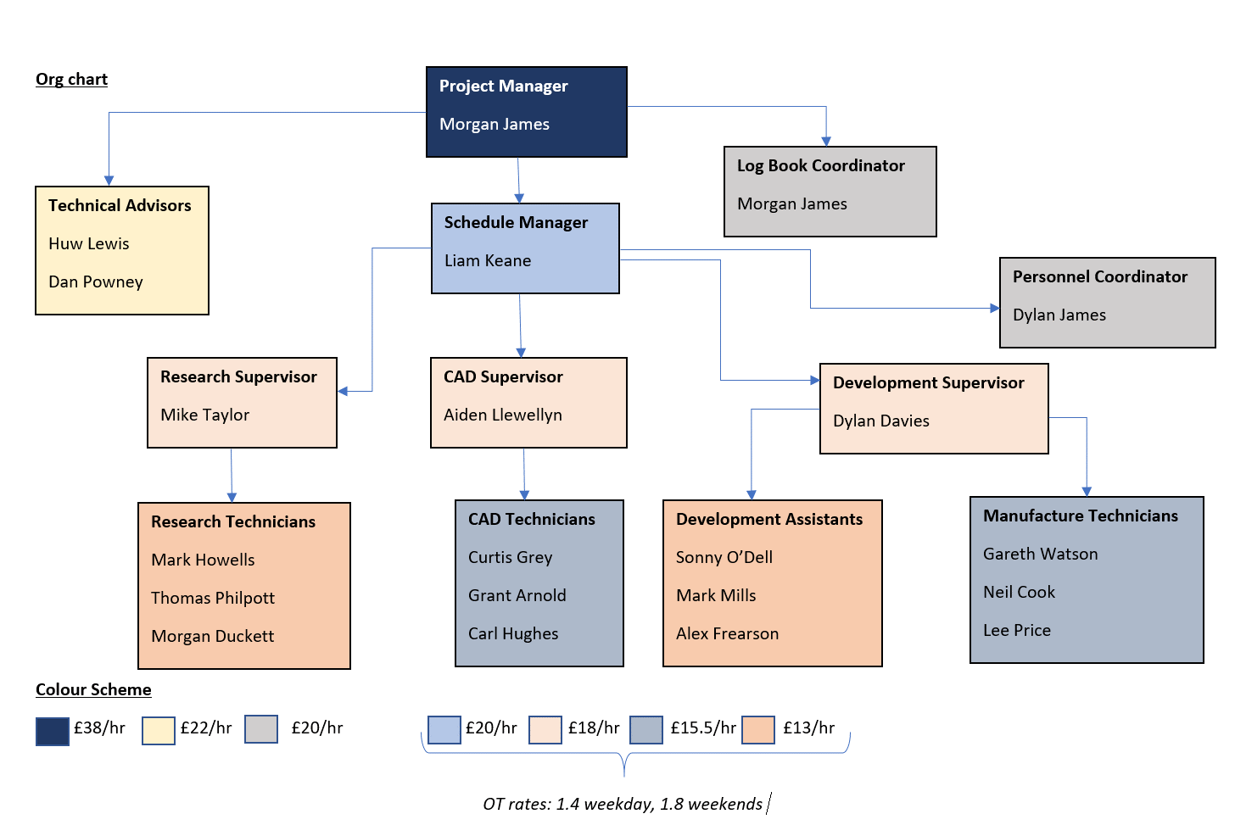
Project analysis slide 5
Project Analysis
Org Chart
Chain of command
cost
20
7
£ 81,372.25
Members of staff included on the chart
Levels of hierarchy
For the total cost of wages throughout the project

Slide 9
Project analysis slide 6
Project Analysis
Management style has been identified as a problem area for not distributing enough efforts towards understanding the product requirements
Time management fundamentally left the product at an unfinished state when the customer lost interest
Communication bottlenecks disrupted the flow of interdepartmental collaboration
This manifested through the PDS which had minimal engagement with the VOC.
Naturally the Gantt chart is identified as a fundamental issue with research into task duration being highlighted as the cause of failure
Issues within the org chart have been acknowledged as too strictly regimented

Slide 10
Project analysis slide 8
Project Analysis
QUALITY FUNCTION DEPLOYMENT
POSITIVE
NEGATIVE
STRENGTH
WEAKNESS
Customer-Centric Focus
Efficiency and Cost Reduction
Enhanced Quality and Innovation
Clarity of Requirements
Complex and Time Consuming
Resource Intensive
Management Commitment for Propper Application
INTERNAL
OPPORTUNITY
THREAT
Market differentiation
Technological Feature Integration
Continuous Improvement
Expansion into New Markets
Market Dynamics
Competition
Economic Factors
Regulation Changes
EXTERNAL

Slide 11
Project analysis slide 8
Project Analysis
TODOIST
POSITIVE
NEGATIVE
STRENGTH
WEAKNESS
User Friendly Interface
Feature Rich
Customisation & Integration
Productivity Insights
Cost
Complex to New Users
Limitations to Customisation
Feature Overlap
INTERNAL
OPPORTUNITY
THREAT
Market Expansion
New Integrations
Mobile App Enhancements
Intense Competition
Changing User Interface
Economic Factors
Technological Risk
EXTERNAL

Slide 12
Project analysis slide 8
Project Analysis
SHANNON WEAVER MODEL
POSITIVE
NEGATIVE
STRENGTH
WEAKNESS
Enhanced Clarity and Structure
Improved Message Encoding and Decoding
Identification and Reduction in Communication Disruptions
Enhanced feedback System
Complexity in Implementation
Potential Rigidity
Dependent on Communication Skills
Overlooked Communication Nuances
INTERNAL
OPPORTUNITY
THREAT
Enhanced Organisational Efficiency
Technology Integrations
Improved Employee Engagement
Scalable Practises
Resistance to Change
Technological Challenges
Dynamic Environments
Resource Constraints
EXTERNAL

Slide 13
Thank You

