Slide 1
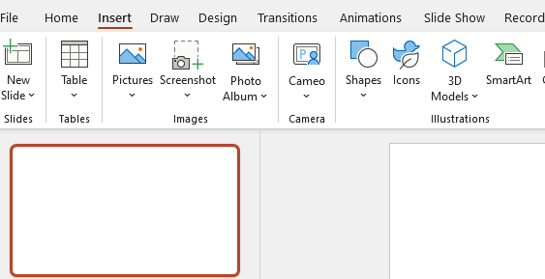
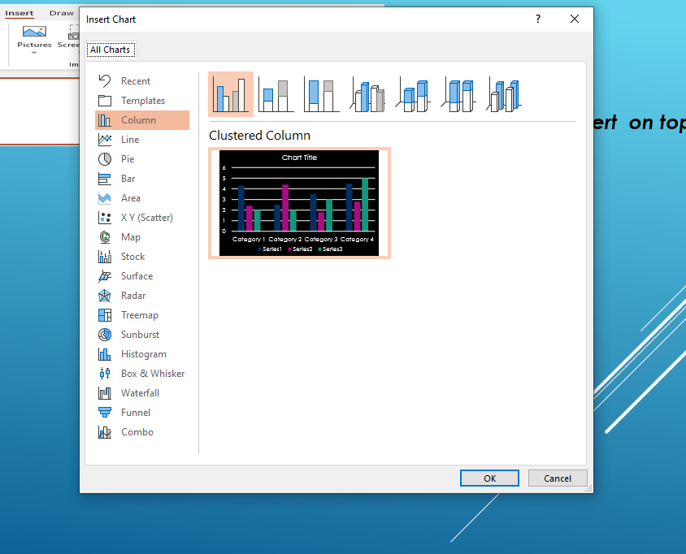
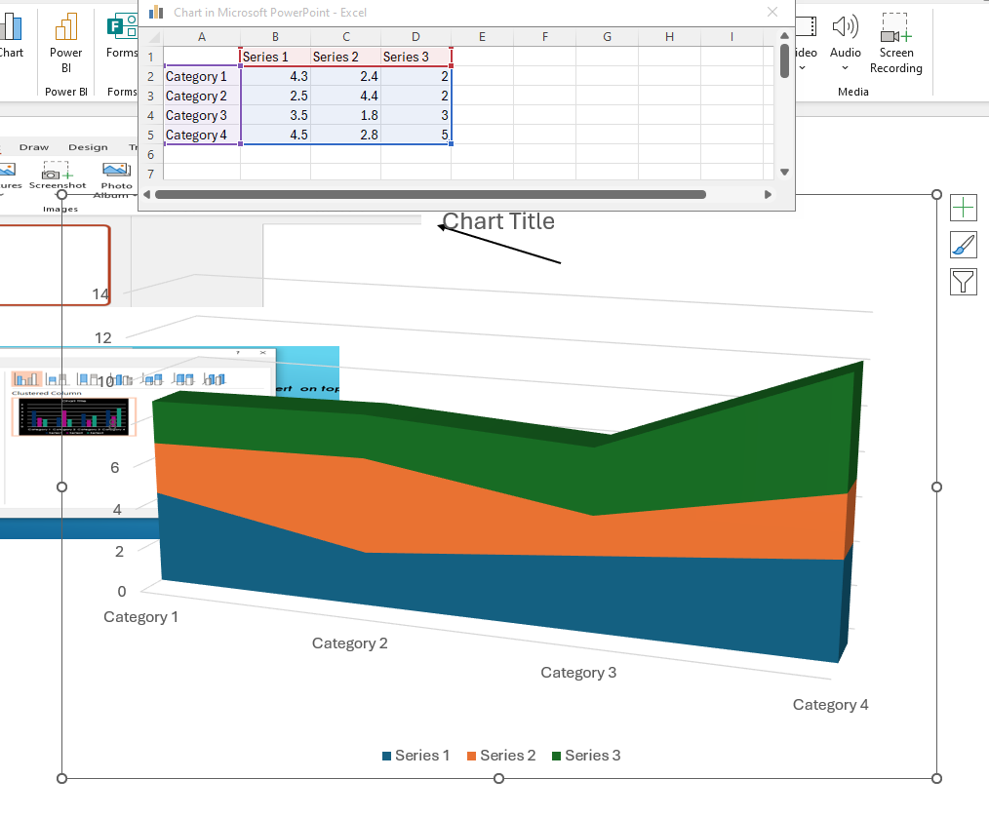


Juan Francisco Martinez Posada
Group 4
Student ID – 2439868
Lecture – Rejwan Bin Sulaiman
Step 1.
Click Insert on top toolbar
Step 2.
Click on Chart section and Click
and look for the Chart most usefully for you
Step 3. Select the Chart and you will need to add Mathematic information to be able that the Chart represents on a 3D version
The Information.

