Slide 1
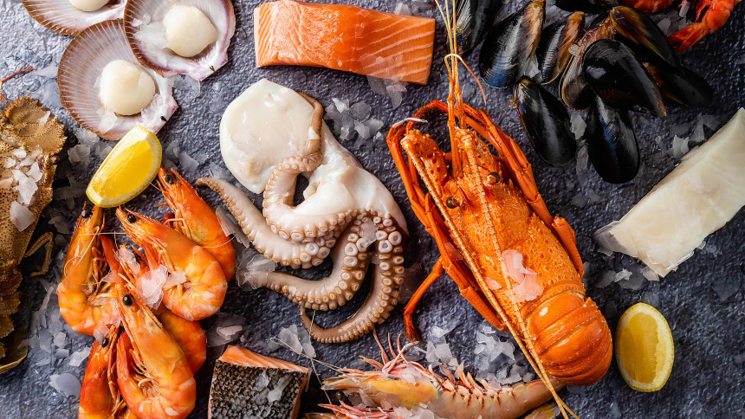


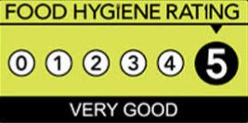
HOTEL TRINITY
Take-Away menu
Dessert
Ice cream vanilla/caramel/chocolate 6.50
Chocolate mousse served with vanilla ice cream 9.00
Tart: orange, apple, strawberry a sweet white wine, Moscato d’Asti L’Armangia 2012, offered separately is a fantastic match for our fruit tarts 8.50
Cinnamon roll cherry served with ice cream7.45
Drinks
Wine – bottle 750ml
Vasse Felix Chardonnay 2019 12.5% 30.00
Moscato d’Asti L’Armangia 2012 12.5% 24.50
Vergelegen reserve Sauvignon Blanc 2018 14% 34.00
Seresin Leah Pinot Noir 2017 13% 32.55
Coffee/Hot drinks
Americano 120ml 2.50
Cappuccino 180ml 2.50
Espresso 30ml 2.50
Hot chocolate 200ml 3.00
Green tea 100ml 2.25
Soft drinks
Coke, Diet Coke 330ml 2.00
Fruit Juice/ Milkshakes 4.25
Appetisers
Garlic bread with olives 3.65
Avocado and salmon canapés 4.25
Smoked salmon pâté 3.95
Starters (with parmesan flavoured
with tomato, garlic, red peppers)
Fish soup 12.50
Tomato soup 12.00
Bouillabaisse 12.95
Mains
Fish and chips served with sauce 15.55
Lobster risotto a rich white wine, Vasse Felix Chardonnay 2019, offered separately, pairs nicely with our fresh lobster 36.69
Seafood gratin in a white wine and cream sauce with emmental topping 25.95
Seafood pizza served with tomato sauce with herbs 23.25
Caraibean chilli crab with garlic, chilli 32.00
Sides
Spring salad 4.00
Rice with glazed carrots 4.50
Potatoes fried/baked/boiled 3.50
Haloumi cheese 3.95
OPENING HOURES
Tuesday-Sunday
(11:00 – 21:30)
Swansea, South Wales, SN12JA
Tel: 07711166990
Order online: www.hoteltrinityswansea.co.uk
Download the apps
(delivery fees may applies)
! Please be advised that food prepared in our restaurant may contain these allergents: Cereals, Crustaceans, Eggs, Fish, Peanuts, Soya, Milk, Nuts,Celery, Mustard, Seasame, Sulphite, Lupins, Mollusc !

