Slide 1
Self-Awareness Presentation: Communication in Health and Social Care
Name: Kerry wall
Student Number: 2511436
Module code: LCHS4009
Course: Health and Social Care
Component 1: Self-Awareness Presentation
Skill chosen: Communication

Slide 2

Introduction
The key skill I have chosen is communication.
Communication is used every day in health and social care.
It helps professionals understand and support service users.
It can include speaking, listening, body language and written records.
Good communication supports dignity, respect and safe care (Care Quality Commission, 2024).
This presentation will explain why communication is important and how I would use it in practice.
Notes:
For this presentation, I have chosen communication because it is one of the most important skills in health and social care. Professionals use communication every day when speaking to service users, families, carers and other staff members. Good communication helps people feel listened to, respected and safe. It also helps professionals understand individual needs and provide the right support. The Care Quality Commission (2024) explains that people receiving care should be treated with dignity and respect, and communication is a key part of this. In this presentation, I will explain what communication means, why it matters in professional practice, and how I would apply it in a real health and social care setting.

Slide 3
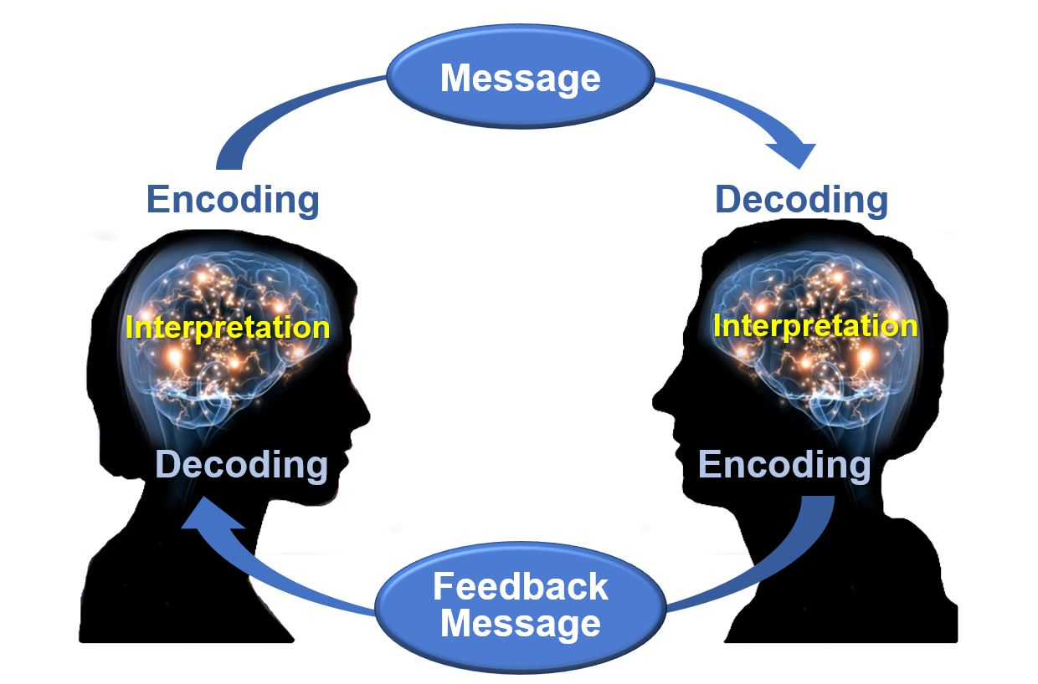
What is communication
Communication is how people share information, feelings, needs and ideas.
It can be verbal, non-verbal or written.
Verbal communication includes speaking clearly and respectfully.
Non-verbal communication includes eye contact, facial expressions and body language.
Written communication includes care notes, reports and records.
Active listening means listening carefully and showing understanding (Egan, 2019).
This Photo by Unknown Author is licensed under CC BY
Notes:
Communication means sharing information between people. In health and social care, this is very important because professionals need to understand the needs, choices and concerns of service users. Communication can be spoken, written or shown through body language. For example, a support worker may speak to a service user about their care, write notes about what happened during a shift, or use calm body language to make someone feel safe. Active listening is also important because it shows the person that their feelings and views matter. Egan (2019) explains that effective helping skills include listening, empathy and responding in a supportive way.

Slide 4
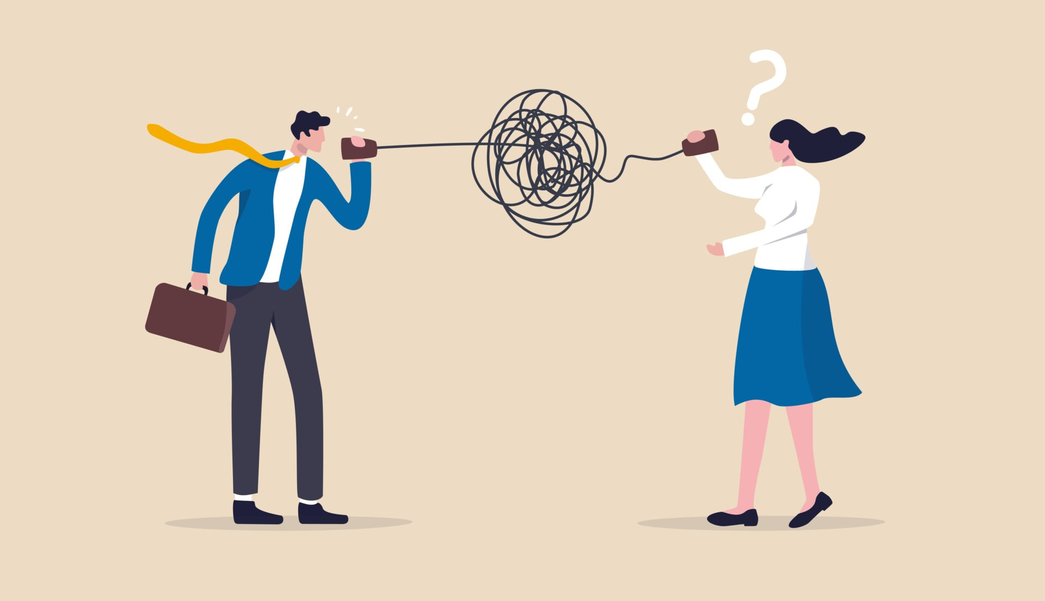
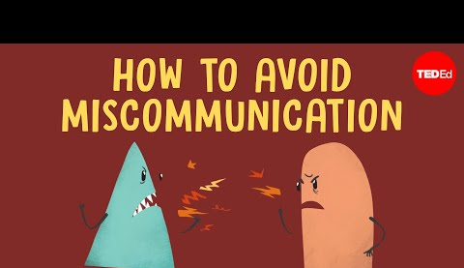
Why Communication is Important
Builds trust with service users.
Helps professionals understand individual needs.
Reduces mistakes and confusion.
Supports safeguarding and accurate reporting.
Promotes dignity, respect and person-centred care (Care Quality Commission, 2024).
Poor communication can lead to distress or unsafe care.
Improves teamwork between professionals (Nursing and Midwifery Council, 2018).
This Photo by Unknown Author is licensed under CC BY-SA
Notes:
Communication is important in health and social care because service users may be vulnerable, anxious or unsure about what is happening. When professionals communicate well, it helps to build trust and makes the person feel valued. It also helps staff understand what support the person needs. For example, if a service user is in pain but cannot explain it clearly, a care worker needs to listen carefully, observe body language and report concerns properly. Good communication also reduces mistakes, especially when sharing information with nurses, doctors, social workers or family members. The Nursing and Midwifery Council (2018) highlights that professionals should communicate clearly, keep accurate records and work cooperatively with others. This shows why communication is important for safe and effective care.

Slide 5
Communication in Professional Practice
Communication should be clear and respectful (Nursing and Midwifery Council, 2018).
Information should be kept confidential.
Professionals should communicate in a non-judgemental way.
Communication should be person-centred.
The approach should be adapted to the individual.
Age, disability, language, culture and emotional state should be considered.
Notes:
In a professional setting, communication must be clear and respectful. Health and social care workers should avoid confusing language and should not speak in a way that makes the service user feel embarrassed or ignored. Communication should also be confidential. This means private information should only be shared with the right people and only when necessary. It is also important to adapt communication to the individual. For example, a person with dementia may need simple sentences and reassurance. A child with additional needs may need visual prompts or extra time to respond. A person who is upset may need a calm voice and patience. This links to person-centred care because the professional is focusing on the individual rather than treating everyone the same. The Nursing and Midwifery Council (2018) also states that professionals should communicate clearly and respect people’s dignity.

Slide 6

Practical Example in a Care Setting
Example: Supporting an elderly service user in a care home who refuses personal care.
Speak calmly and respectfully.
Ask open questions, such as “Can you tell me what is upsetting you?”
Listen without interrupting.
Watch body language and facial expressions.
Give the person time to respond.
Explain what I am doing before providing care.
Record and report concerns to senior staff (Nursing and Midwifery Council, 2018).
Notes:
A practical example could be working in a care home. If an elderly service user refuses personal care, I would not force them or become frustrated. Instead, I would use calm and respectful communication. I would ask open questions to understand why they are upset. They may be in pain, embarrassed, confused or frightened. I would listen carefully and look at their body language. I would also explain each step before doing anything, because this can help the person feel more in control. If I was concerned about their wellbeing, I would report this to a senior staff member and write clear notes. This links to the Nursing and Midwifery Council (2018), which explains that professionals should keep clear and accurate records and communicate effectively with others. This shows that communication supports dignity, safety and professional responsibility.

Slide 7
My Self-Awareness and Conclusion
My strengths:
I am caring and approachable.
I can listen to people and show empathy.
I try to understand how others may be feeling.
Areas I can improve:
Building confidence when speaking professionally.
Using clearer professional language.
Making written notes detailed and accurate.
Staying calm during stressful situations.
Conclusion:
Communication is essential in health and social care.
It supports safe, respectful and person-centred care (Care Quality Commission, 2024).
It helps build trust and understand service users’ needs.
It reduces mistakes and improves teamwork.
Improving this skill will help me become more confident in professional practice.
Notes:
As part of self-awareness, I understand that communication is one of my important strengths, but it is also something I can continue to develop. I feel that I am caring and approachable, which can help service users feel comfortable talking to me. I also try to listen and understand how people feel. However, I know I can improve my confidence when speaking in professional situations, especially when talking to other professionals. I can also improve my written communication by making sure care notes are clear, accurate and detailed.
To conclude, communication is a key skill in health and social care because it affects the quality and safety of care. Good communication helps service users feel respected and understood. It also supports safeguarding, teamwork and accurate record keeping. Communication is not just about talking; it includes listening, observing, writing and adapting to the needs of each person. The Care Quality Commission (2024) explains that dignity and respect are important parts of good care, and communication helps professionals put this into practice. Improving this skill will help me become more confident and professional in future health and social care practice.

Slide 8
References
Care Quality Commission (2024) Regulation 10: Dignity and respect. Available at: https://www.cqc.org.uk/guidance-providers/regulations-enforcement/regulation-10-dignity-respect Accessed: 12 July 2026.
Egan, G. (2019) The Skilled Helper: A Problem-Management and Opportunity-Development Approach to Helping. 11th edn. Boston: Cengage Learning.
Nursing and Midwifery Council (2018) The Code: Professional standards of practice and behaviour for nurses, midwives and nursing associates. London: NMC. Available at: https://www.nmc.org.uk/standards/code/ Accessed: 13 July 2026.

