Slide 1



LCHS4009
Professional Development within Health and Social Care
Self-Awareness Presentation
Student Name: Rene Bogyah
Student ID: 2332913
Lecturer: Olubukola Adegbite

Slide 2
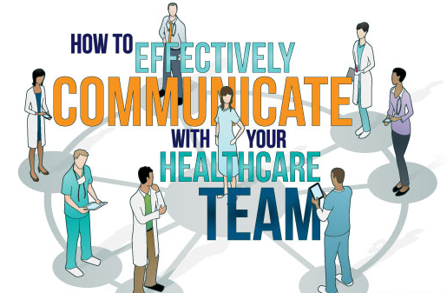
The Role of Communication
in Healthcare

Slide 3
Table of Contents
Introduction
Importance in Health and Social Care
Types of Communication
Practical Example
Benefits of Good Communication
Conclusion
References

Slide 4

Introduction
Communication is clearly and effectively sharing information.
Forging relationships with medical patients.
Fostering teamwork in healthcare.
Fewer misunderstandings and fewer medical mistakes (Yang et al, 2024).
Developing patient wellbeing and care.
Notes:
Communication is a form of transferring important messages and information from one person to another. It is one of the most important skills in health and social care. The professionals should exchange information with patients, family, and other professionals in an understandable manner. Trust is built, coordination is improved, and effective and safe care delivery is facilitated through communication. Without communication, mistakes and confusion may affect patient well-being and the quality of the healthcare services provided.

Slide 5
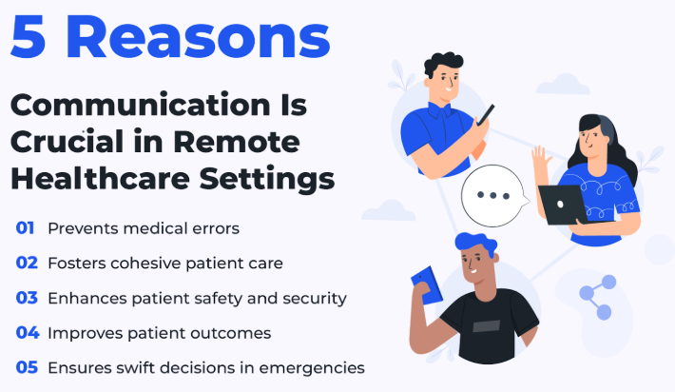
Importance in Health and Social Care
Assistance to patients in explaining healthcare instructions (Jenstad et al, 2024).
Building strong relationships with professionals.
Helping patients with their emotions.
Development of proper and efficient care plans.
Encouraging safety in the context of healthcare treatment.
Notes:
Communication is a fundamental aspect in health and social care since patients need to be well informed regarding treatment, medicine and support services. Communication also helps professionals to collaborate with peers. Effective communication makes patients feel respected and appreciated, and care plans are implemented in a proper manner. It also enhances safety as it minimises the chances of making medical errors.

Slide 6
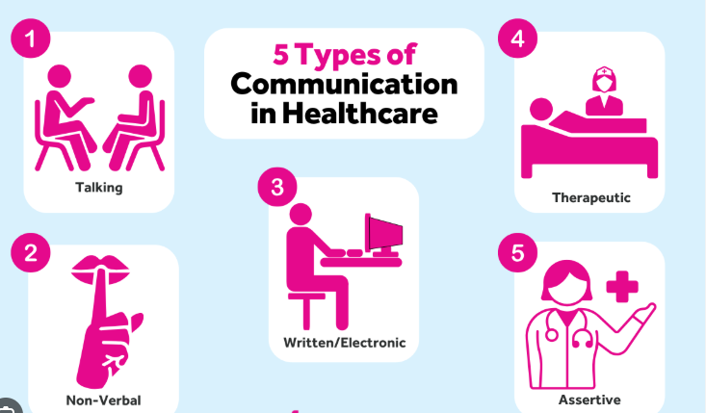
Types of Communication
Verbal discussions with healthcare patients
Non-verbal communication through body language
Written exchange in the form of care records.
Engaging in active listening when talking to patients (Primeau et al, 2024).
E-communication in healthcare organisations.
Notes:
Various forms of communication are in use by healthcare professionals on a daily basis. Verbal communication involves talking with staff members and patients. Eye contact, facial expressions and body language are elements of non-verbal communication. Patient records and reports are a form of written communication. Listening is also vital since it enables professionals to comprehend the patient's issues. The use of digital communication has grown in healthcare organisations today.

Slide 7

Practical Example
Hospital support of elderly patients (Sisk and Dubois, 2022).
Clearly explaining the medication instructions.
Listening attentively to patient issues.
Communicating with nurses in healthcare.
Offering emotional support/ consolation.
Notes:
One of the aspects in which I can enhance my communication is in elderly care, as elderly patients often face more communication challenges. I would communicate the instructions concerning medication in an understandable manner, slowly. I would hear out the patient with keen interest and pass significant information to nurses. Effective communication would make the patient feel comfortable, respected, and confident with treatment and recovery.

Slide 8
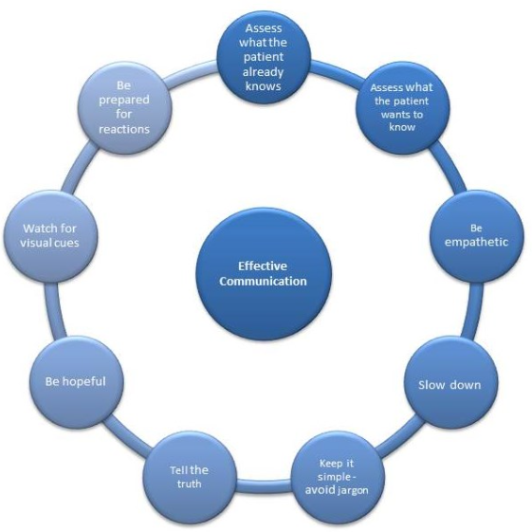
Benefits of Good Communication
Enhancing the collaboration of the healthcare personnel (Sarella and Mangam, 2024).
Raising the level of patient satisfaction.
Avoiding misunderstandings in healthcare facilities.
Enhancing the trust in medical practitioners.
Increasing the quality of care and patient outcomes.
Notes:
Good communication provides many benefits in health and social care settings. It builds teamwork as employees are able to exchange information. Patients feel revered and satisfied when they feel listened to. Communication also avoids misunderstandings and enhances trust amongst health care providers. In general, effective communication skills are related to improved patient outcomes and high-quality care services.

Slide 9

Conclusion
Professional healthcare practice is facilitated by communication.
Critical to patient-centred healthcare services.
Developing trust and patient understanding.
Improving quality healthcare service delivery
Important lifelong professional healthcare skill
Notes:
Lastly, communication is an important health and social care skill. It aids in professional practice, which improves teamwork, patient comprehension, and quality of service. There is a need to be unambiguous and respectful with care workers in any case. In order to be able to provide care that is patient-centred, there is a need to become an effective and responsible medical practitioner in the future by improving communication skills.

Slide 10
References
Jenstad, L.M., Howe, T., Breau, G., Abel, J., Colozzo, P., Halas, G., Mason, G., Rieger, C., Simon, L. and Strachan, S. (2024) Communication between healthcare providers and communicatively-vulnerable patients with associated health outcomes: A scoping review of knowledge syntheses. Patient education and counseling, 119, p.108040. https://doi.org/10.1016/j.pec.2023.108040
Primeau, C., Chau, M., Turner, M.R. and Paterson, C. (2024) August. Patient experiences of patient–clinician communication among cancer multidisciplinary healthcare professionals during “breaking bad news”: A qualitative systematic review. In Seminars in Oncology Nursing (Vol. 40, No. 4, p. 151680). WB Saunders. https://doi.org/10.1016/j.soncn.2024.151680
Sarella, P.N.K. and Mangam, V.T. (2024) AI-driven natural language processing in healthcare: transforming patient-provider communication. Indian Journal of Pharmacy Practice, 17(1), pp.21-26. https://www.ijopp.org/
Sisk, B. and Dubois, J.M. (2022) The microethics of communication in health care: a new framework for the fast thinking of everyday clinical encounters. Hastings Center Report, 52(4), pp.34-43. https://doi.org/10.1002/hast.1407
Yang, Z., Xu, X., Yao, B., Rogers, E., Zhang, S., Intille, S., Shara, N., Gao, G.G. and Wang, D. (2024) Talk2care: An llm-based voice assistant for communication between healthcare providers and older adults. Proceedings of the ACM on Interactive, Mobile, Wearable and Ubiquitous Technologies, 8(2), pp.1-35. https://doi.org/10.1145/3659625

Slide 11
Thank You

