Slide 1

Networking, Social Capital and Collaboration Negotiation

Slide 2

Contents Page
Agency and Structure
Social capital
Components of social capital
Types of social capital
Measurement of social capital
Networking
Establishing networks
Collaboration

Slide 3

Introduction and Icebreaker
Reflect on one person in your life who has helped you achieve something you could not have done alone.
Think about this while we are going through our lecture today
It should help you understand the practical importance of social capital and networking.

Slide 4
What is Agency?
An individual's capacity to determine and make meaning from their environment through purposive consciousness and reflective and creative action
The ability of individuals and groups to exercise free will and to make social changes on a small or large scale
‘Agency implies the ability of individuals or groups to act on their situations, to behave as subjects rather than objects in their own lives, to shape their own circumstances and ultimately achieve change’
Agency can be individual, proxy and collective.
Notes:
Agency in this context is the capacity to act with free will and shape circumstances.
Key idea: people are subjects of their lives, not just shaped by society.
Can be individual (personal decisions), proxy (on behalf of others), or collective (groups driving change).
Example: choosing to go to university despite pressure not to, or communities campaigning for change.
Prompt for students: Think of a time you acted to influence your situation- what enabled or limited you?

Slide 5
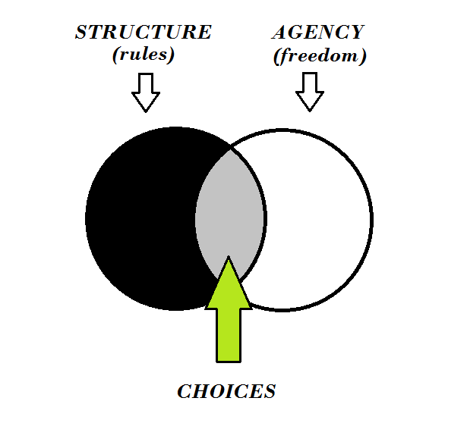
Structure
‘The distinctive, stable arrangement of institutions whereby human beings in a society interact and live together’
The established and organised systems, rules, and practices that shape the behaviour, opportunities, and interactions of individuals within society.
These structures include social, cultural, and institutional frameworks that influence how people live, work, and relate to one another.
While individuals exercise agency (the ability to make choices), structures can limit or enable these choices by shaping the environment in which they operate.
Structure and Agency influence each other and are said to be ‘two sides of the same coin’.
Notes:
Structure in this context is - organised systems, rules, and institutions shaping behaviour and opportunities.
Includes social, cultural, and institutional frameworks (e.g., family, class, education, healthcare, law).
Structures can enable or limit agency – they shape the environment in which choices are made.
Key point: Structure and agency are interconnected, two sides of the same coin.
Prompt for students: Can you think of an example where social rules or systems influenced someone’s choices?

Slide 6
Examples of Structures
Social Structures:
Family: Family dynamics and roles (e.g., patriarchal or matriarchal setups) influence individual decisions and opportunities.
Class Systems: Socioeconomic class determines access to resources, education, and employment opportunities.
Peer Networks: Social groups or communities that can support or hinder individual progress based on shared values or norms.
Cultural Structures:
Traditions and Norms: Cultural expectations around behaviour, gender roles, or work ethics that influence an individual's actions (e.g., expectations of caregiving roles for women).
Religion: Religious practices or values that shape social behaviour, decision-making, and the moral framework of a community (e.g., attending church or following dietary restrictions).
Language: The dominant language in a society, which affects communication and access to information or services.
Notes:
Social structures: Family roles, class systems, and peer networks all influence opportunities and decisions.
Cultural structures: Traditions, religion, and language shape behaviour, norms, and access to resources.
Key idea: These frameworks can support or limit individual agency.
Example: Language barriers restricting job opportunities, or class background influencing access to education.
Prompt: Which of these structures do you think has the biggest impact on people’s career paths?

Slide 7
Examples of Structures
Institutional Structures:
Healthcare Systems: Formal institutions like the NHS, which determine how individuals access healthcare based on rules, regulations, and funding models.
Educational Systems: Schooling and higher education institutions that shape learning opportunities, career paths, and social mobility.
Legal Systems: Laws and legal frameworks that govern societal behaviour, rights, and responsibilities (e.g., equality laws, the welfare system
Notes:
Healthcare: Systems like the NHS regulate access to care through rules and funding.
Education: Schools and universities shape opportunities, careers, and social mobility.
Law: Legal frameworks (e.g., equality laws, welfare) govern behaviour, rights, and responsibilities.
These institutions can open or restrict opportunities, influencing life outcomes.
Prompt: Which institutional structure do you think has the strongest impact on people’s chances in life?

Slide 8
Activity 1. Discussion
Reflect on a moment in your personal or professional life where you exercised agency (i.e., took action to influence an outcome in your environment).
Think about how structure (social, cultural, institutional) influenced your ability to act.
Notes:
Ask students to reflect on a time they took action to change an outcome (agency).
Encourage them to link this to social, cultural, or institutional structures that either supported or limited their action.
Examples:
Applying for a job despite family expectations.
Accessing education shaped by school policies.
Religious or cultural norms influencing choices.
Facilitate small group discussion, then invite a few to share insights with the class.

Slide 9
What is Capital?
Physical Capital
An asset, such as land, buildings, equipment, etc. that is owned by a company organisation or person and used to produce goods or services
Human Capital
The collective skills, knowledge, or other intangible assets of individuals that can be used to create economic value for the individuals, their employers, or their community
Cultural Capital
The accumulation of knowledge, behaviours, and skills that a person can tap into to demonstrate their cultural competence, and social status or standing in society
Notes:
Physical capital: Tangible assets (land, buildings, equipment) used to produce goods/services.
Human capital: Skills, knowledge, and abilities of individuals that generate value for themselves, employers, or communities.
Cultural capital: Knowledge, behaviours, and skills that signal competence or social status (e.g., education, cultural awareness).
Point out that these forms of capital affect opportunities and social mobility.
Prompt: Which type of capital do you think has the strongest influence on career success today?

Slide 10
Social Capital?
The concept of social capital has received a lot of attention within the realm of sociology. However, there is no consensus regarding its definition.
“. . . social organisation constitutes social capital, facilitating the achievement of goals that could not be achieved in its absence or could be achieved only at a higher cost”(Coleman, 1990, p. 304).
.” . . social capital . . . refers to features of social organisation, such as trust, norms, and networks that can improve the efficiency of society . . .” (Putnam, Leonardi and Nanetti, 1993, p. 167).
“Social capital is the shared knowledge, understandings, norms, rules and expectations about patterns of interactions that groups of individuals bring to a recurrent activity (Ostrom, 2000, p. 176)
Notes:
No single definition - different scholars emphasise different aspects.
Coleman (1990): Social capital - social organisation that helps achieve goals more efficiently.
Putnam (1993): Focus on trust, norms, and networks improving social efficiency.
Ostrom (2000): Shared knowledge, norms, and rules guiding group interactions.
Key idea: Social capital explains how relationships and networks create value and opportunities.
Prompt: Which definition makes the most sense to you, and why?

Slide 11
Social Capital
Social capital is generally understood as a measure of neighbourhood trust, safety and civic engagement
A society with high social capital is rich in the following elements:
  Connections
  Co-operation
  Trust
With the intentions to “provide information and access to opportunities and spend time for the ‘common good’”.
Notes:
Social capital equals trust, safety, and civic engagement within communities.
High social capital equals strong connections, cooperation, and trust between people.
These elements encourage sharing resources, information, and opportunities for the common good.
Example: Neighbours working together to improve local safety, or networks supporting job searches.
Prompt: Can you think of an example where trust or cooperation in your community created opportunities?
‘a society with high social capital as one rich in connections, co-operation and trust, where people help each other, provide information and access to opportunities and spend time for the ‘common good’.

Slide 12
Informal Social Capital
Casual, loosely organised spontaneous activities
Casual Sport Games
Drinks in the Pub
Mums meeting in the Park
People going to watch football matches
Formal Social Capital
Organisation and activities of a complex and official nature
Parent Teacher Associations
Sports Leagues
Credit Unions
Political Groups
(Streich, 2016)
Notes:
Informal social capital: Everyday, casual interactions (pub, sports, park meetups). Builds trust and belonging in relaxed settings.
Formal social capital: Structured organisations (PTAs, sports leagues, unions, political groups). Provide resources, influence, and wider opportunities.
Both types are important – informal builds quick connections, formal provides organised support and long-term benefits.
Prompt: Which do you think has more impact on career opportunities - informal or formal networks? Why?

Slide 13

Social Capital has Three Critical Components…
Bonding
Bridging
Linking

Slide 14
Bonding
This component of social capital refers to establishing strong ties and connections with individuals within tight-knitted groups or communities.
The ties can be established by achieving:
  Trust
  Reciprocity
  Shared norms and values
Bonding social capital typically occurs among individuals who are similar in terms of
  Ethnicity
  Culture
  Religion
  Other common characteristics (Political, Gender, Sexual Orientation, Age, Nationality).
Notes:
Bonding ties are strong connections within close-knit groups (family, cultural, religious, ethnic).
Provide identity, belonging, support, and cultural continuity.
Strength: emotional and practical help, trust, reciprocity.
Limitation: can be insular, leading to exclusion of outsiders and narrow self-interests.
Prompt: Where do you see bonding social capital in your own life (family, faith, friendship groups)?

Slide 15

Bridging
Bridging social capital focuses establishing connections and ties with:
  Diverse individuals
  Diverse social groups
Unlike bonding social capital bridging social capital involves:
  Weaker ties but serves to connect people with different perspectives, experiences, and resources.
  For example, friends of friends, acquaintances, work colleagues.
Notes:
Bridging - connections across diverse groups and individuals.
Ties are often weaker but bring new perspectives, resources, and opportunities.
Examples: acquaintances, colleagues, friends-of-friends.
Benefit: helps people access information or opportunities outside their usual circles.
Limitation: less emotional support compared to bonding ties.
Prompt: Can you think of a time when a loose connection (not a close friend/family) helped you access an opportunity?

Slide 16

Linking
Linking social capital refers to the connections and networks between individuals or communities and formal institutions or organisations (people in power) It is hierarchical and vertical:
  Governmental Agencies
  Non-Governmental organisations
  Businesses
These connections facilitate access to resources, information, and support from these institutions.
Linking social capital is particularly significant for disadvantaged communities:
  Supporting accessing services
  Access to opportunities
Notes:
Linking social capital refers to connections with formal institutions and people in positions of power.
These are hierarchical and vertical relationships with agencies, NGOs, and businesses.
They provide access to resources, information, and support that individuals or communities cannot generate alone.
Especially important for disadvantaged groups in accessing services and opportunities.
Example: a charity helping local residents connect with government housing services.
Prompt: Why might linking social capital be more critical for vulnerable or marginalised groups?

Slide 17
Social Capital Within Employment
Pre-existing networks: Family, school, neighbourhood, community ties.
  Research (UK, 2025) shows cross-class friendships raise future earnings for low-income individuals by over £5,000 a year.
Self-created networks: Deliberately built connections through volunteering, education, professional activities.
  Bridging and linking ties improve access to diverse opportunities, higher-paying jobs, and formal services.
  Both forms of social capital are important, especially for disadvantaged groups who may rely more on building networks.
Notes:
Older framework (pre-existing vs self-created) still useful but now supported by newer evidence.
Pre-existing: inherited or community ties that influence outcomes (e.g., school friends, local networks).
Self-created: actively built ties that expand career opportunities (e.g., volunteering, joining professional groups).
Current studies show both are vital — especially bridging/linking ties for social mobility.
Prompt: Do you think most students here rely more on pre-existing networks (family/community) or on self-created ones?

Slide 18

Pre-existing Social Capital
Preexisting social capital refers to an environment where structures, connections and ties with personnel and/or organisations are in place.
  This can be used as a resource for newcomers within an organisation
  Formal or informal
Benefits:
  Friends and relatives ( and their networks) can help with orientation
  This informal social capital supports employment search
Notes:
Refers to inherited networks already in place (family, friends, community).
Helps with orientation and informal support when entering jobs or organisations.
Formal examples: alumni groups, professional associations.
Link to recent evidence: research shows cross-class friendships and school-based ties influence long-term income and mobility.
Prompt: How might pre-existing ties help or limit someone entering a new workplace?

Slide 19
Self-Created Social Capital
Self-created social capital refers to the practical endeavours to generate networks, connections and relationships.
  Volunteer work
  Community work
  Joining recreational classes (gym, book and sports clubs etc.)
Any newcomer within an organisation or community will consciously and deliberately make more considerable effort to develop their social capital.
(Usha and Ferzana, 2009).
Notes:
Built consciously and deliberately through volunteering, education, community involvement.
Expands opportunities beyond one’s immediate circle (bridging and linking).
Especially important for disadvantaged groups lacking strong pre-existing networks.
Examples: internships, networking at events, joining professional bodies.
Prompt: Can you think of ways you are already building your own networks outside family and friends?

Slide 20

Measuring Social Capital
Structural:
degree of trust,
social network structure and position
network membership quantity
social connections and relationships
Relational:
social interactions,
social relationships,
social support,
social cohesion
Cognitive:
shared goals
shared culture
reciprocity,
feelings of safety
Notes:
Structural dimension: looks at the “shape” of networks (who you know, how many, how connected they are).
• Example: size of LinkedIn contacts, number of community memberships.
Relational dimension: focuses on the quality of relationships (trust, reciprocity, support).
• Example: a mentor who offers career guidance.
Cognitive dimension: shared values, culture, and goals that make collaboration effective.
• Example: belonging to a professional group that shares common ethics or practices.
These dimensions help explain why some networks create more opportunities than others.
Employers increasingly value not just technical skills, but also the ability to leverage and contribute to networks.
Prompt: Which of these three dimensions do you think matters most when trying to find a job? Why?

Slide 21

Activity 2.
You can find full instructions for this in the week 2 tile on Moodle
Get into small groups of 3-6 (depending on the size of the class)
Read the case study provided and answer the questions given.
Feedback your findings to the class.

Slide 22

The Power of Networking
Phillips and Ellinas (2014,p.1) simply explain that networking is nothing more than the development of relationships which can be measured by the number and quality of relationships one has.
Effective network: strong relationships
Support network: close relationships
Collaborative network: mutually beneficial relationships.
Social network: informal relationships.
Business network: formal relationships.
Social business network: balanced relationships.
Trusted network: reliable and dependable relationships.
Referral network: informed and motivated relationships.
Notes:
Networking is simply about building and maintaining relationships; quality is as important as quantity.
Different types of networks serve different purposes:
• Support networks - family/friends offering encouragement.
• Collaborative/business networks - partnerships and professional opportunities.
• Trusted/referral networks - help you gain credibility and recommendations.
Encourage students to see that not all networks are equal; they provide different benefits.
Link to employability: employers value candidates who can navigate both formal and informal networks.
Prompt: Which of these networks do you already use, and which do you need to strengthen for your future career?

Slide 23

Brainstorming:
Establishing Connections through Networking
What do you think the process of networking involves?
How can you develop your own network?
Do you thinking there is a right or wrong way in developing a network?
Notes:
Ask students to reflect on how networking actually happens in practice.
Guide discussion around:
• What activities or behaviours help people connect?
• How can you build a network intentionally?
• Is there a “right” or “wrong” way to network?
Stress that networking is not just formal (conferences, LinkedIn) but also informal (casual conversations, community events).
Link to employability: networking can directly impact access to jobs, mentoring, and new opportunities.
Prompt: Think about a time when you made a useful connection by chance - how could you create those moments more deliberately?

Slide 24

Process of Building a Network
Phillips and Ellinas (2014) provide practical steps to build a network:
  Identify
  Connect
  Meeting
  Listen
  Help
  Support
  Trust
  Cheering
  Ask
  Thanking
Notes:
Identify: You may not always foresee who may be a good protentional connection
Connect: Offline or online
Meeting: Follow up your connection to establish a stronger connection
Listen: Communicate and demonstrate active listening
Help: Reciprocate help
Support: Demonstrate empathy and think about how you can support your network
Trust: Empathy, listening and reciprocation establishes a degree of trust
Cheering: Celebrate, encourage and praise (confidence can develop)
Ask: Do not be afraid to ask for help if or when required.
Thanking: demonstrating appreciation leads to further help and support
Emphasise that consistency and authenticity matter more than one-off interactions.
Link to employability: students should think about how these steps apply to careers - e.g., reaching out to professionals, maintaining LinkedIn contacts.
Prompt: Which step do you think is easiest for you, and which might be the most challenging?

Slide 25
How Big Should My Network Be?
Living in an interconnected world provides numerous opportunities to develop connections, but how many should one have?
Dunbar’s Law argues that our brains lack the capacity to maintain more than 150 connections.
Types of Networking
Closed
Selective
Open
Hybrid
(Phillips and Ellinas, 2014)
Notes:
Dunbar’s Law: humans can manage around 150 meaningful connections.
Closed networking – strong sense of belonging and identity, but limited reach.
Selective networking – efficient and focused on relevant contacts, but risks missing wider opportunities.
Open networking – wide-reaching, often online (LinkedIn, Twitter), but time-consuming to maintain.
Hybrid networking – combines focus with breadth; balance between efficiency and openness.
Prompt: Which type of networking style do you think you use most? Do you think it works for you, or do you need to adjust?

Slide 26
Networking Spheres
Career Network:
Learn about new career
Diversity assists in landing new positions
Social Network:
Developed unknowingly
Gravitate towards people who share similar values and aspirations (Bonding, Closed networking).
Support Network:
Typically, friends and family
Support in identifying employment opportunities
Community Network:
Overlooked area
This area can have potential impact on the other networks.
(Phillips and Ellinas, 2014)
Notes:
Networking happens across different areas of life, not just in the workplace.
Key spheres include:
• Career – professional contacts, mentors, colleagues.
• Social – friends, acquaintances, community groups.
• Support – family, close friends, people who provide practical or emotional help.
• Community – volunteering, local organisations, faith or cultural groups.
Emphasise that these spheres often overlap and can open unexpected opportunities.
Prompt: Which of these spheres do you rely on most right now? Which could you develop further to support your future career?

Slide 27
Networking in Live Environments
If you were required to attend an employment fair or work event , how would you network?
Notes:
Networking is not only online - face-to-face environments matter (events, conferences, career fairs, community gatherings).
Benefits: stronger personal connections, quicker trust-building, and opportunities to make a lasting impression.
Encourage students to be proactive: introduce themselves, ask questions, and show genuine interest.
Highlight that body language, listening skills, and first impressions are key in live networking.
Prompt: Think of a situation where you met someone new in person - what helped make that interaction positive?

Slide 28

How to Work a Room
Phillips and Ellinas (2014) clearly asserts that the first rule of networking is to ‘not work the room’.
  The five steps are:
    1) Plan
    2) Meet
    3) Connect
    4)Enlist
    5)Follow up
Notes:
The first step of ‘working the room’ is to not work the room. The events are just opportunities to collect business and providing information to as many people as possible.
Focus instead on genuine, quality conversations.
Introduce the five key steps (Plan, Meet, Connect, Enlist, Follow-up).
The next few slides will break these down one by one.
Prompt: Why do you think “not working the room” is good advice?

Slide 29
How to work a Room: Planning
Knowing who is in the room provides:
  Feelings of safety and comfortability
  This may be considered as closed networking
Why are you attending?
  Socialise
  Build existing relationships
  To learn
  Meeting new contacts
Notes:
Set a clear purpose: know why you are attending (e.g., to meet people in your field, learn about opportunities, gain advice).
Focus: planning prevents feeling overwhelmed and helps you make more meaningful connections.
Encourage students to think about the difference between going to an event with a goal versus just “showing up.”
Prompt: What might be a realistic goal for attending a networking event as a student?

Slide 30

How to Work the Room: Planning
Preparation is the foundation for successful outcomes.
  Resources:
    Business cards
    Appropriate attire
  Information:
    Sources to provide clarity
  Knowing what to say:
    Don’t over rehearse
    Strive for authenticity
    Communicate effectively and consistency
Notes:
Planning builds confidence and credibility at events.
Resources: bring business cards (or ensure LinkedIn is updated) and dress appropriately for the setting.
Information: do some background research so you can ask meaningful questions.
What to say:
• Avoid over-rehearsing — conversations should feel natural.
• Be authentic and approachable.
• Aim for clear, consistent communication.
Prompt: What small thing could you prepare before an event that would make you feel more confident?

Slide 31

How to Work a Room:
Meeting
What do people say and feel about you once you’ve left the room?
    Be your authentic self
    Be different
    Be helpful
    Accentuate features
Notes:
The aim when meeting others is to leave a positive, lasting impression.
Focus on:
• Authenticity - be yourself, people value honesty.
• Difference - stand out by sharing something unique about you.
• Helpfulness - offer support, ideas, or useful connections.
• Accentuating strengths - highlight what makes you memorable (skills, passions, experiences).
Encourage students to think: What will people say about me when I leave the room?

Slide 32

How to Work the Room: Connect
Presenting gifts such as your attention and time are significantly invaluable within this process.
Conversations should be organic and avoid being a closed book
Exchange details
Notes:
Connection is about giving time and attention - showing genuine interest is more valuable than talking about yourself.
Keep conversations organic and open; avoid being guarded or overly rehearsed.
Look for common ground to build rapport.
Always exchange details (business cards, LinkedIn, email) to keep the relationship going.
Prompt: What small action can make someone feel you are genuinely interested in them?

Slide 33

How to Work the Room: Enlist
The question of: “what do you do?” will inevitably pop up within a conversation, therefore, it is important to have a pre-planned summary: ‘a message in a bottle’
  It should be short and concise (approx. 15-90 seconds)
  The information provided should allow the other person to generate referrals
  Provide listeners a sense of specificity
  Memorable
Notes:
This step is called Enlist because it is your first chance to share information that allows others to help or support you.
Think of it as your “message in a bottle” - a short, clear summary of what you do and what you are looking for.
Keep it concise (15-90 seconds), specific, and memorable.
The goal is to make it easy for the other person to refer you or connect you with others.
Prompt: If someone asked you today “What do you do?”, how would you answer in one sentence?

Slide 34
How to Work the Room: Follow Up
This step of the working the room process is arguably the most important step in securing connections at live events.
  Same day:
  Utilise digital technology ( take pictures and social media)
  Next day:
  Follow up through sending a message or provide additional information of promised
  Soon:
  Arrange future meetings
Notes:
Follow-up is the most important step - without it, connections are easily lost.
Same day: use social media or quick digital contact (e.g., LinkedIn invite, tagging a picture).
Next day: send a short message to thank them, or share promised information.
Soon after: arrange a meeting or call to build the relationship further.
Stress that follow-up shows professionalism, reliability, and genuine interest.
Prompt: How would you feel if someone you met followed up with you quickly? What impression would that give?

Slide 35
How to Work the Room: Summary
The 5 Key Steps:
  Plan - Set your purpose and be prepared.
  Meet - Be authentic, positive, and make a strong first impression.
  Connect - Build genuine conversations and exchange details.
  Enlist - Share your “message in a bottle” so others can support you.
  Follow up - Maintain contact and nurture the relationship.
  Networking is about quality, not quantity.
Notes:
Reinforce that networking is a step-by-step process, not a one-off event.
Each stage builds towards creating trust and long-term opportunities.
Stress that quality matters more than numbers - one good connection is worth more than 20 business cards.
Encourage students to reflect: Which of the 5 steps do you already do well, and which could you improve?

Slide 36
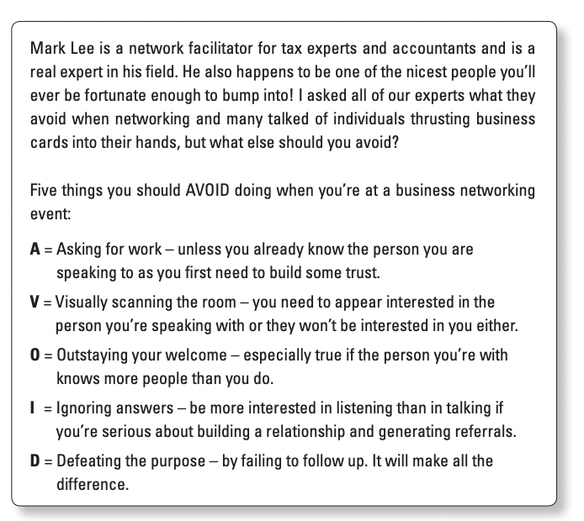
Working the Room: The Don'ts

Slide 37

Personality Types
Notes:
Explain that both introverts and extroverts bring value to networking, but they approach it differently.
Introverts – tend to prefer small groups or one-to-one conversations, often listen more, and may need time to reflect before engaging.
Extroverts – gain energy from larger groups, are often comfortable starting conversations, and may thrive in busy networking events.
Emphasise that neither is better or worse - success comes from knowing your strengths and adapting your style.
Prompt: Ask students: Do you identify more as an introvert or extrovert when networking? How does this shape your approach?

Slide 38
Introverted Personality
  Reflective
  Self-aware
  Take time making decisions
  Feel comfortable being alone
  Don't like group work
  Prefer to write rather than talk
  Feel tired after being in a crowd
  Have few friendships, but are very close with these friends
  Daydream or use their imaginations to work out a problem
  Retreat into their own mind to rest
Notes:
Introverts are often reflective and thoughtful, bringing depth to conversations.
They may prefer one-to-one interactions and can struggle with large group settings, where energy is quickly drained.
Emphasise that introverts can be excellent listeners, which is a valuable skill in networking and building trust.
Point out that introverts often have fewer but stronger friendships, showing quality over quantity in relationships.
Encourage students to see introversion not as a weakness, but as a different style of engaging with others that can be just as effective.
Prompt: Ask students - which of these traits do you recognise in yourself, and how might it affect the way you network?

Slide 39
Extroverted Personality
Enjoys being at the centre of attention
Enjoys group work
Feels isolated by too much time spent alone
Likes to communicate by talking
Likes to talk about thoughts and feelings
Looks to others and outside sources for ideas and inspiration
Numerous, broad interests
Tends to act first before thinking
Notes:
Ambivert: are individuals who share characteristics of both.
Extroverts thrive on social interaction and often feel energised when working with others.
They are usually comfortable being the centre of attention and enjoy large group activities.
Extroverts often prefer to talk through their ideas and express their thoughts openly.
They are good at building broad networks due to their outgoing nature and willingness to engage.
A challenge for extroverts can be the tendency to act before reflecting, so balance is important.
Prompt: Ask students - how can extroverts use their strengths effectively without overwhelming quieter voices in a group?

Slide 40


Slide 41
Effective Collaboration
Using the following links, please select and watch the following videos:
https://www.linkedin.com/learning-login/share?account=77966930&forceAccount=false&redirect=https%3A%2F%2Fwww.linkedin.com%2Flearning%2Fcollaboration-principles-and-process%3Ftrk%3Dshare_ent_url%26shareId%3D0zTSrvoLTkSW2oZW91OdnA%253D%253D
5 challenges of collaboration:
5 benefits of collaboration:
Plan for foreseeable barriers:
Assign roles and responsibilities
Notes:
Student’s may be required to log in to their university library account to watch videos (12-15mins approx.)
Students are required to take notes for each video as questions will be asked as a method of formative assessment.

Slide 42
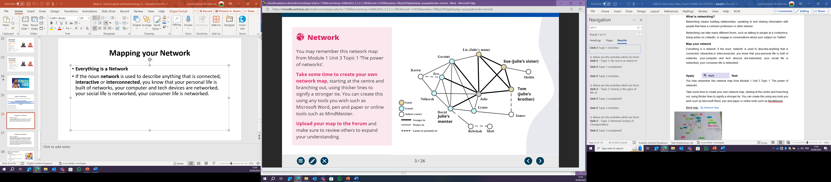
Mapping your Network
Everything is a Network!
If the noun network is used to describe anything that is connected, interactive or interconnected, you know that…
  Your personal life is built of networks
  your computer and tech devices are networked
  your social life is networked
  your consumer life is networked.
Notes:
Emphasise that networks are everywhere: personal, social, digital, and professional.
Use the diagram to explain strong ties (close family/friends) versus weak or potential ties (acquaintances, colleagues).
Highlight that weak ties are often just as important for new opportunities.
Encourage students to reflect on their own networks: who are their strong ties, and who could become valuable new contacts?

Slide 43
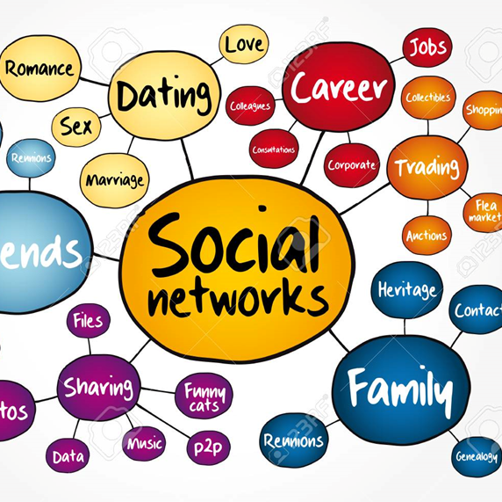
Task 2- Mapping your Network
Each of the seven tasks will be combined and submitted to form Assessment 1-
A Template for submission can be found in the Assessment Guidance Tile
For task two, take some time to create your own network map, starting at the centre and branching out, using thicker lines to signify a stronger tie.
You can create this using any tools you wish such as Microsoft Word, pen and paper or online tools such as MindMeister
(if you use pen and paper, you must photograph it and paste it onto a word document)
You will find a more detailed copy of this task in the Week 2 Tile.
Notes:
Clarify that this task forms part of their assessment, so it is important to complete carefully.
Stress that the aim is not just to draw names, but to visualise how connections are linked and how strong or weak those ties are.
Explain that reflecting on their network can highlight gaps, opportunities, and support systems they might not have considered.

Slide 44
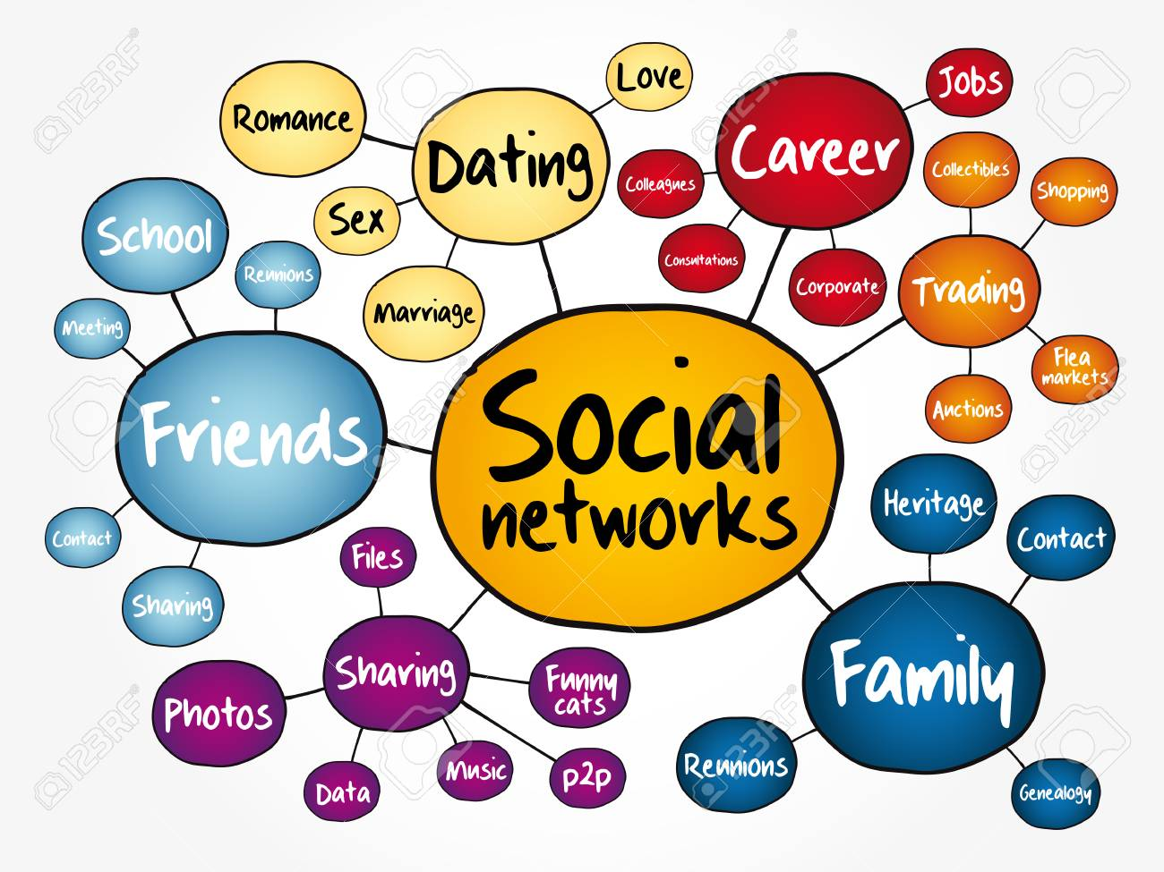
Conclusion
Social capital and networking work hand-in-hand.
Establishing connections and building relationships through collaboration is important for personal development
So you need to…
  Employ methods to start building your social capital
  Reflect on the importance of your network.
Notes:
Social capital is about using networks and connections to support personal and professional development.
Reinforce the link between networking and employability: building connections can directly influence job opportunities and career growth.
Stress the reflective element: it is not just about making contacts, but understanding the quality of relationships and their impact.
End with a motivating point: students should actively start building their networks now, even in small ways, as these will pay off in their future careers.

Slide 45
Reference List
Coleman, J. (1990). The Foundations of Social Theory. Cambridge: Harvard University Press.
Ostrom, E. (2000). “Social capital: A fad or fundamental concept?”. In: Dasgupta, P., Seragilden, I. (eds.), Social Capital: A Multifaceted Perspective. WashingtonDC: World Bank. pp. 172–214.
Putnam, R., Leonardi, R. and Nanetti, R. (1993). Making Democracy Work: Civic Traditions in Modern Italy. Princeton: Princeton University Press.
Usha, G. and Ferzana, C. (2009) ‘Social Capital and Employment South Asian Women’s Experiences’, Journal of Women and Social Work. 24 (4): pp. 394-405
Phillips, S. and Ellinas, S. (2014). The complete guide to professional networking : the secrets of online and offline success. London: Kogan Page.
Raman, P. (2018) Collaboration Principles and Process. Carpenteria, CA: linkedin.com.

