Slide 1

My PDP
Dion Miles-Pengilly

Slide 2
Manifesto Research
Bourbié (2015) states that in the 20th century manifestos played an important role in many art movements, F. T. Marinetti (No Date, as cited in Bourbié , 2015) recommended that artists "imbue their manifestoes with 'violence and precision'" in order to rouse a group against a common enemy. This showcases how artist manifestos have been used in past years, however there are many types of manifesto and mine is a personal one.
In her blog Anna Butera (Butera, 2021) states that it is important "to take time to clarify our thoughts, ideas and feelings" and writing a manifesto is one way to do this especially if your work is being viewed. Butera presents some questions that could be used to make an artist's manifesto: " What does it mean to be an artist? What do I want from my art? What part do I want art to play in my life?, Who are my artist role models? What brings me joy? What is my biggest dream?". Pencil Kings (no date) suggest it can not only help you "define who you are as an artist" but they also suggest that having a manifest is also a way to help you start developing creative ideas.
Yuko Miki (2016) compares an artist manifesto to a personal statement. Miki (2016) calls a manifesto a set of guiding principles that you are able to "live your creative life by", Miki (2016) also states "When you feel lost in your creative journey, you can always come back to it, and it'll help you make a decision that is best for you."
Yuko Miki (2016) also gives a set of questions that can be used to create a manifesto, "What makes you happy? What do you need to thrive as a person, not just survive? What do you value when working with people? What strengths and skills do you bring to the world? How do you describe your artistic style? How does your creativity help you and other people? How do you feel when you're being creative? What inspires you?"
However, in a site relevant to my industry Heather Hiatt wrote an article about an actor's manifesto for Backstage.com (Hiatt, 2018) as this more closely relates to my chosen field, I decided to work off the questions she asked but substituting actor with set designer; this is also placed on my personal website, available at https://dionpengilly.wixsite.com/design.
Why am I an actor?
What do I love about acting?
How does acting make me feel?
How do I react to the way others feel about my dreams or when I tell them I’m an actor?
What are my non-negotiables as it relates to my career and dreams?
What am I willing to give up to make my passion a reality?

Slide 3
Manifesto
I specialise in all aspects of design as I enjoy creating unique and individual ideas for costume, set designs and props, I especially enjoy the variety of tasks this offers me and by varying my skills set between these areas I then learn much more that I am able to adapt between roles. I also appreciate that you rarely design or create the same thing twice and this means that I am always challenged to come up with new ideas.
I also enjoy working as crew backstage as it gives me a better appreciation of all the work that goes in from first script read to final show and ‘get out’, as I also enjoy watching and being a part of this process. I also really enjoy not only watching and participating in this collaborative process but also the clear role separation and responsibilities between each member of the crew and how smoothly everything runs once everyone is in their role. A particular aspect of my role that I enjoy is being able to create an escape from reality for people.
Being a part of a production makes me feel more creative as I continue learning about how things can be done as each performance gives me new experiences and ideas to work from. I also feel at ease and comfortable with the hectic backstage atmosphere. I also find myself really enjoying the atmosphere of working on a show in both the creative phase and the performance phase.

Slide 4
PDP Research
During my research I found that in both my sources Personal Development Plans (PDP) are referred to as road maps to achieving your goals.
According to MindManager Blog (mindmanager.com, 2022) only 8% of people who set goals actually achieve them. MindManager states the difference between the 8% and the 92% is that the 8% had "plans in place to meet specific, measurable goals." (blog.mindmanager.com, 2022). MindManager Blog, 2022 also states that having a PDP helps people organise their overall performance.
MindManager Blog says to begin your PDP with a self-assessment, it also mentions the importance of a SWOT diagram to help with construction of your PDP. It states that once you are aware of your knowledge, interests, and skills it will be easier to identify the areas in which you need to improve.
Your PDP should be done using SMART goals (Abdn.ac.uk, No Date; Mindtools, No Date) which ensures your PDP is:
Specific and able to state exactly what you want to achieve.
Measurable having quantifiable goals helps you track your progress.
Attainable your goals should be challenging but not impossible to achieve within a set time scale.
Relevant each goal should contribute to the main objective of the PDP.
Time-bound your PDP should include deadlines to keep you on track with achieving the goal of the PDP.
A SMART goal should always be realistic and attainable, using this format ensures you understand what resources you require and that you have a way to measure your progress. SMART goals helps you break down what you want to do and how to do it. It also gives focus as it gives you a way to see how much you have done and helps keep you on track (Mindtools.com, No Date).
The PDP should be a break-down of your SMART goals and state what action needs to be taken to get you closer to the main goal and should consist of short-term objectives. Taking this approach will help you achieve your goals one step at a time, keeping you focused on how to obtain the larger goal (Abdn.ac.uk, No Date).

Slide 5
A SWOT analysis helps someone objectively analyse how they work, what improvements are needed and what they can do with what is available to them at the time. For example, in my situation I have tutors available who are in the industry, and I can call on their experience for advice and help.
A SWOT analysis can identify your weaknesses and then you can plan for them. For example, if you know you miss deadlines then you can plan for this ahead of time and give yourself an earlier deadline to work towards as part of your planning. It also objectively breaks down how you work and what areas you need to improve upon (Haan, 2024; White and Bottorff, 2024).

Slide 6
My Long-Term Goal
My main goal is to work with the Jim Hensen company, Blumhouse productions (Mccluskey, 2024) or similar companies. The reason I would like to work with these companies is their focus on both fantasy and horror respectively and these are the two areas that I want work in. Their sets, costumes and props are always well thought out and designed with a purpose and an attention to detail which is something I value. I also want to eventually become proficient in pyrotechnics as it is a skill not many have and is well sought after in the industry.
To reach my goal, long-term I need to learn how to use pyrotechnics. I think this is a good skill to have and it is not a common one and it is an area I am genuinely interested in. Short term I need to further develop my construction skills and this will improve my set design skills which is one of my main interests.
I need to work on my general horror / fantasy design, but in a performance aspect because there are different standards required when comparing professional standards to personal ones. So far, my construction / design have been done privately as we have not done productions around fantasy.
On a personal level, I need to improve my confidence in my own skills. I just need to become more confident in what I can do in front of others as I find it difficult when I am put on the spot. I have the ideas and had previous experience in college, but I find it difficult to express this in my current work

Slide 7
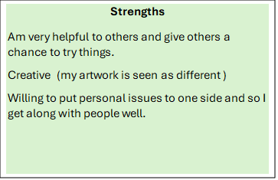
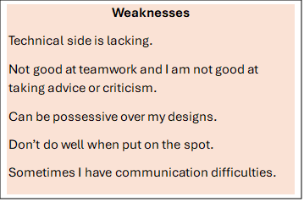
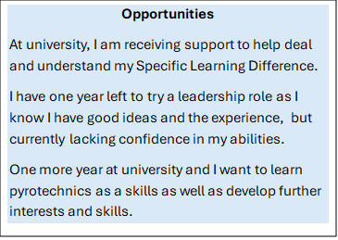
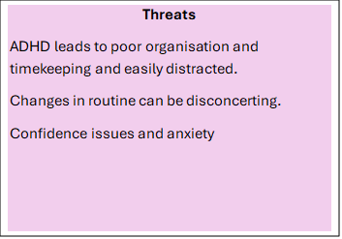
My SWOT Analysis

Slide 8
SMART Goals for Construction Skills
Specific: I need to further develop my construction skills, experience and confidence in how sets are built and put together, because currently I am capable of designing a set, but have little idea of how it would be constructed to achieve the effect I desire in reality.
Measurable: To achieve this, I will need to be more proactive and involve myself with the construction aspect. As far as I am aware once the construction begins the job of a set designer is done with only needing to be available for questions about the design. Currently I tend to only observe as my low confidence means I do not push myself to get more involved. I have knowledge of what to do and how it may be done, but I need to implement my knowledge more. To measure my growth, I will keep note of how much I have built/ assisted with building on each set going forward.
Attainable: This goal is attainable as I am not learning construction from 'scratch' as I have had previous experience and I simply need to develop my skills and confidence.
Relevant: Construction is a relevant skill to designing a set as it would improve my overall design and ability to communicate the design if I am knowledgeable of how it needs to be built to achieve the desired effect. It will mean I will gain confidence in my knowledge of how sets are built meaning I can design more effectively.
Time-bound: This is achievable because I have a complete academic year where we are working on a number of different productions.

Slide 9
SMART Goals for Fantasy and Horror Skills
Specific: I need to work on and practice set, costume and props in relation to the Fantasy and Horror genre.
Measurable: At the moment we have had limited opportunity to work on these genres. Currently I can work privately on my own designs and build a relevant portfolio of my own work. I will measure this by how much my portfolio grows.
Attainable: Currently this goal is not fully attainable, but I will be asking my tutors and researching via the internet for work experience in these two particular genres and will have gained proficiency by the end of my degree.
Relevant: Theses are the areas in which I want to specialise in and I have a number of skills that I have developed relevant to these genres. For example, I have created things in clay, have designed horror and fantasy elements and have researched people who have specialised in these areas.
Time-bound: This is a long-term goal and as such is an ongoing project in my personal time, that incorporates what I learn in university and from websites including using resign and latex to make things. I hope to be more proficient in this by the end of my third year. This will all go towards this long-term goal.

Slide 10
Bibliography
Abdn.ac.uk (No Date) Guide to SMART Goals. Available at: https://www.abdn.ac.uk/careers/resources/documents/4742.pdf (Accessed 30th May 2024)
Bourbié, K. (2015) How to Make an Artist’s Manifesto: Recipe for Revolution Available at: https://www.mfah.org/blogs/inside-mfah/how-make-artists-manifesto-recipe-revolution#:~:text=In%20his%20pithy%20style%2C%20Tzara,create%20a%20movement's%20urgency%20and (Accessed 4th Jun 2024)
Butera, A. (2021) Are You an Artist? Writing an Artist's Manifesto Available at : https://www.mygiantstrawberry.com/blog/are-you-an-artist-writing-an-artists-manifesto (Accessed 30th May 2024)
Haan, S. (2024) SWOT Analysis Available at: //www.cipd.org/uk/knowledge/factsheets/swot-analysis-factsheet/ (Accessed 29th May 2024)
Hiatt, H. (2018) Why you need an actor manifesto Available at: https/ /www.backstage.com /magazine/article/why-you-need-an-actor-manifesto-65541/ (Accessed 30th May 2024)
Mccluskey, M. (2024) The best Blumhouse horror movies, ranked Available at: https//time.com/6837569/best-horror-movies-blumhouse-ranked/ (Accessed 30 May 2024).
Miki, Y. (2016) A Step-by-Step Guide to Creating Your Own Artist Manifesto Available at: https://honeyberrydiary.com/wp-content/uploads/2016/02/a-guide-to-creating-your-artist-manifesto.pdf (Accessed 4th June 2024)
MindManager.com (2022) Personal development plans and how they can benefit your organization. Available at: https://blog.mindmanager.com/personal-development-plans-and-how-they-can-benefit-your-organization/ (Accessed 30th May 2024)
Mindtools (No Date) SMART Goals: How to make your goals achievable. https ://www.mindtools.com/a4wo118/smart-goals (Accessed 30th May 2024).
Pencil Kings (No Date) 5 Ways To Write Your Own Artistic Manifesto Available at: https://www.pencilkings.com/how-to-write-an-artistic-manifesto/ (Accessed 4th Jun 2024)
White, J. and Bottorff, C. (2024) What Is A SWOT Analysis? Available at: https: ://www.forbes.com/ advisor/business/what-is-swot-analysis/ (Accessed 30th May 2024)

