Slide 1
Planning
Applied Practice in Action

Slide 2
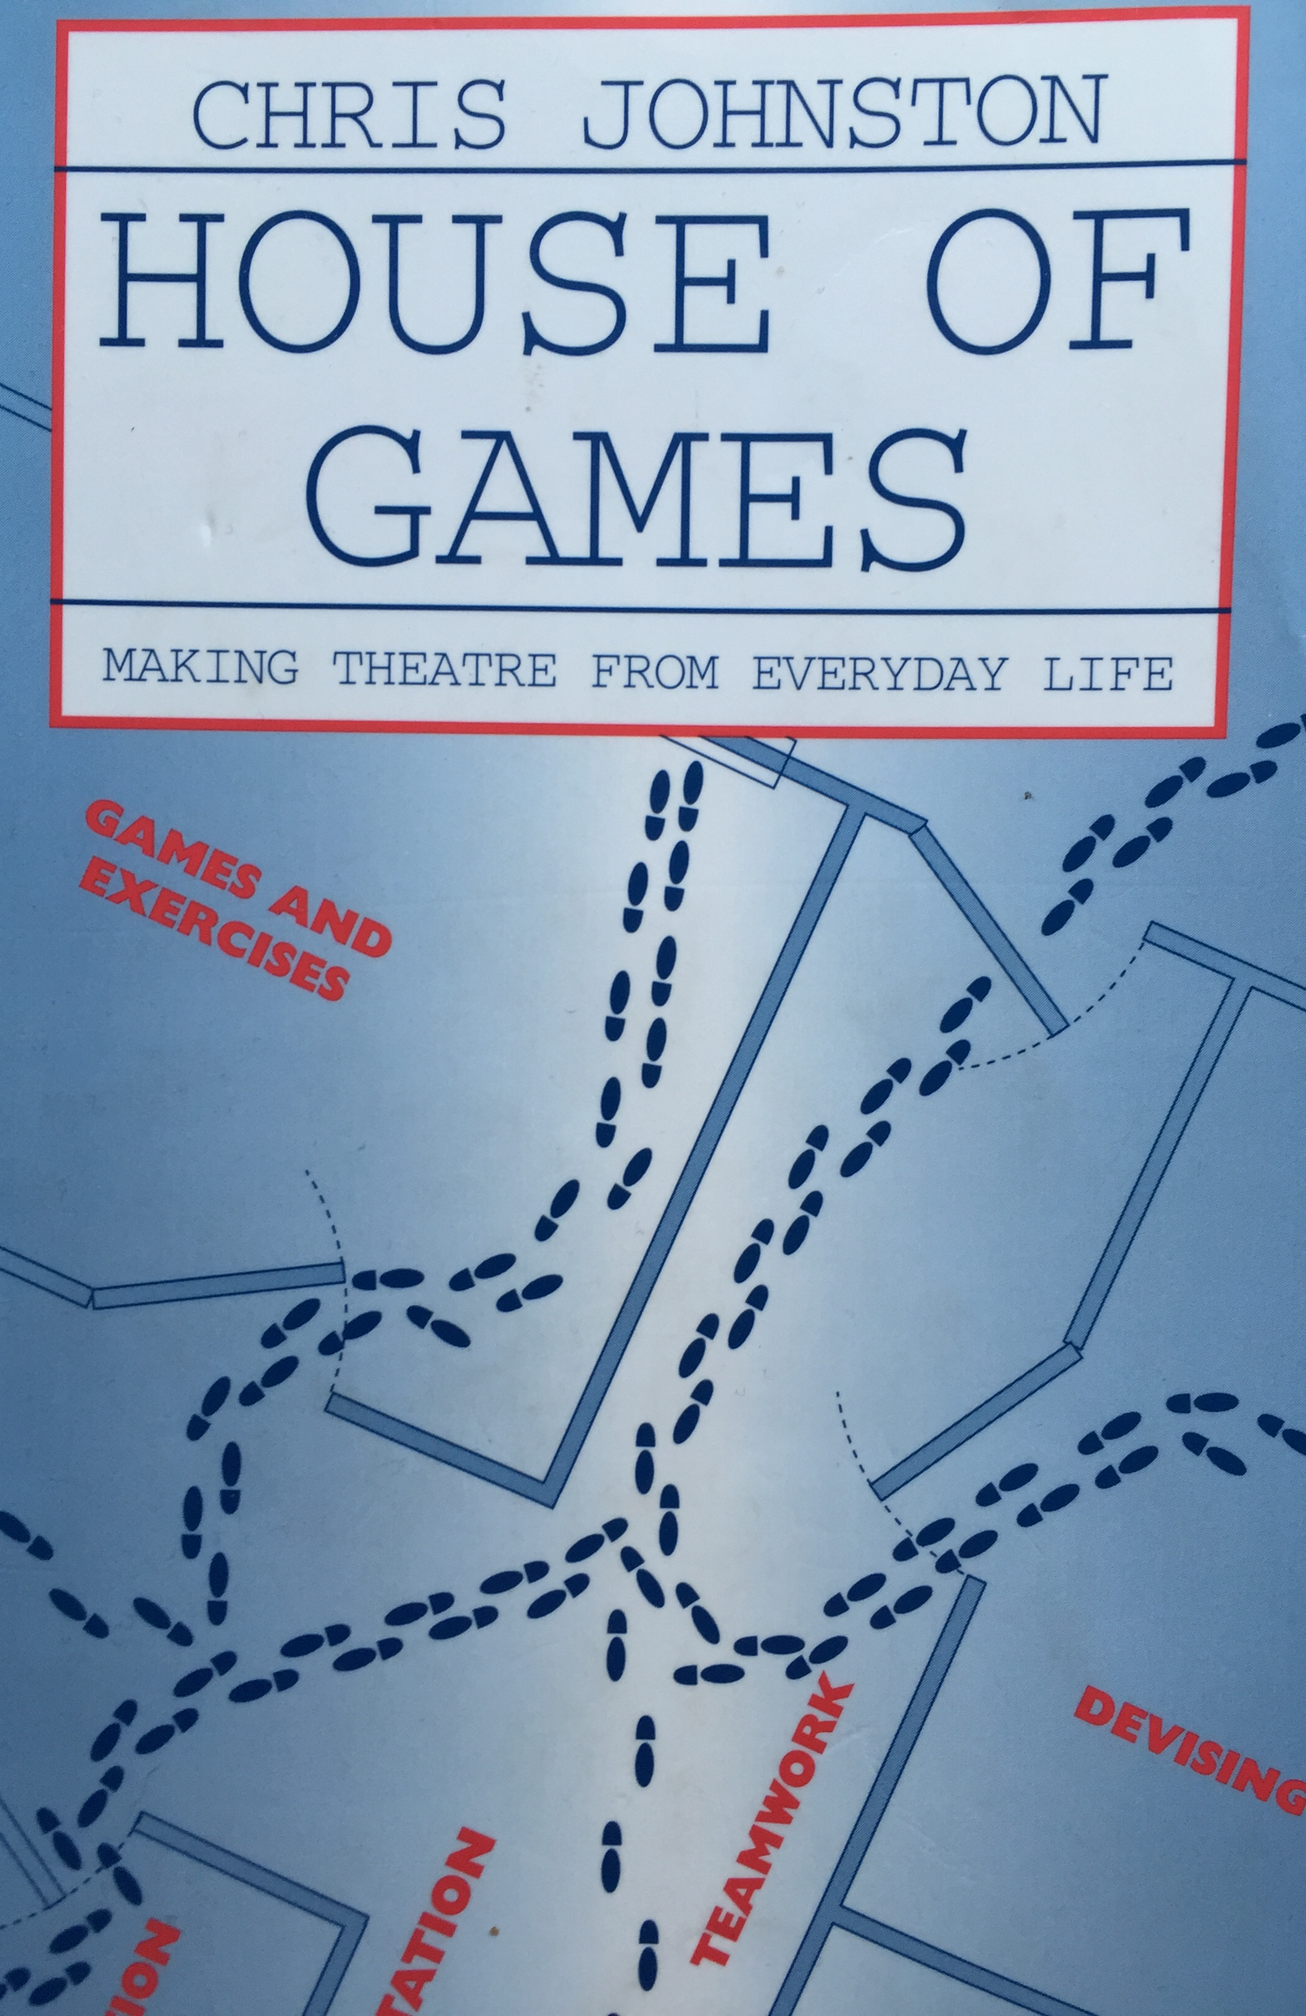
House of Games: Making Theatre from Everyday Life
Chris Johnston
1998 Nick Hern - London
pps. 107-114
Workshop Planning

Slide 3
The Invitation
Is there a group in place, or are you building it from scratch?

Slide 4
The Group
What is the situation of the group?
Are they already acquainted and is there a sense of being a group?
What’s the balance between friends and those who don’t know anyone?
If they are an existing group, what activities have they done before?
Getting to know the characteristics of the group - what makes this group unique?

Slide 5
The Staff
Did the project initiate with the staff?
How realistic are staff expectations?
How much involvement do you want from existing staff?

Slide 6
The Space
Does it have disabled access?
How big is it?
What kind of space?

Slide 7
The Format
What is the format of the sessions?
How long is each session?
How many sessions will you run?
What are the targeted outcomes?
What kind of evaluation will you use?
Have you planned to end with a performance?

Slide 8
The Session Plan
Preparation is ALWAYS necessary, whereas detailed planning may not always go to plan
Meeting a new group usually requires a facilitator to have a tight plan
Reading the group informs more spontaneous decisions.
Your enthusiasm for the focus of your workshop goes a long way

