Slide 1

Methods and Approaches in Interfaith Studies
Dr Angus M Slater

Slide 2
Contextual Hermeneutics and Interfaith Studies

Slide 3

Revision
In the last section before the visual hermeneutics seminar, we examined the key considerations of the field called Philosophical Hermeneutics: its genesis with Schleiermacher, its influence through Heidegger, and the key role that Gadamer played in its development.
I realise that this is a complicated topic with a number of implications for the way in which we visualise and engage with interfaith matters – hopefully the visual hermeneutics seminar offered an example of the hermeneutical process in practice and helped to clarify some of the applicability of the theoretical sketching we undertook.

Slide 4

Revision
You also had four readings to complete (Jasper, Sugirtharajah, Michaelides, & Hedges) which attempted to cover a variety of approaches to the area of philosophical hermeneutics – Jasper hopefully gave you a solid grounding in the introductory material, while Sugirtharajah applied this directly to interfaith hermeneutics.
The other two pieces related the work on philosophical hermeneutics to an aspect of study we have already covered – Hedges to comparative theology and Michaelides to aspects of interculturality and ethics.

Slide 5
Contextual Hermeneutics and Interfaith Studies

Slide 6

Contextual Hermeneutics
In this section, I want us to examine two different approaches to hermeneutics and interfaith relations that are often described as ‘contextual’ in nature.
The immediate question is, of course, what does this mean and is this term a useful one.
By contextual, we mean that these approaches highlight the specific context of their analysis and ground their thinking within it – in these cases, in the context of women’s experiences and feminism, and the context of non-Eurocentric experiences and post-colonialism.

Slide 7

Contextual Hermeneutics
Of course, as enlightened and rarefied post-modern scholars, we should swiftly realise that ALL positions are necessarily contextual – emerging from a specific horizon of meaning and carrying with them the baggage that emerges from it.
The very fact we sort feminist and post-colonial approaches as ‘contextual’ while not doing the same to say, visual hermeneutics or comparative theology, betrays a sense of marginality – precisely the thing these ‘contextual’ approaches aim to deconstruct.

Slide 8
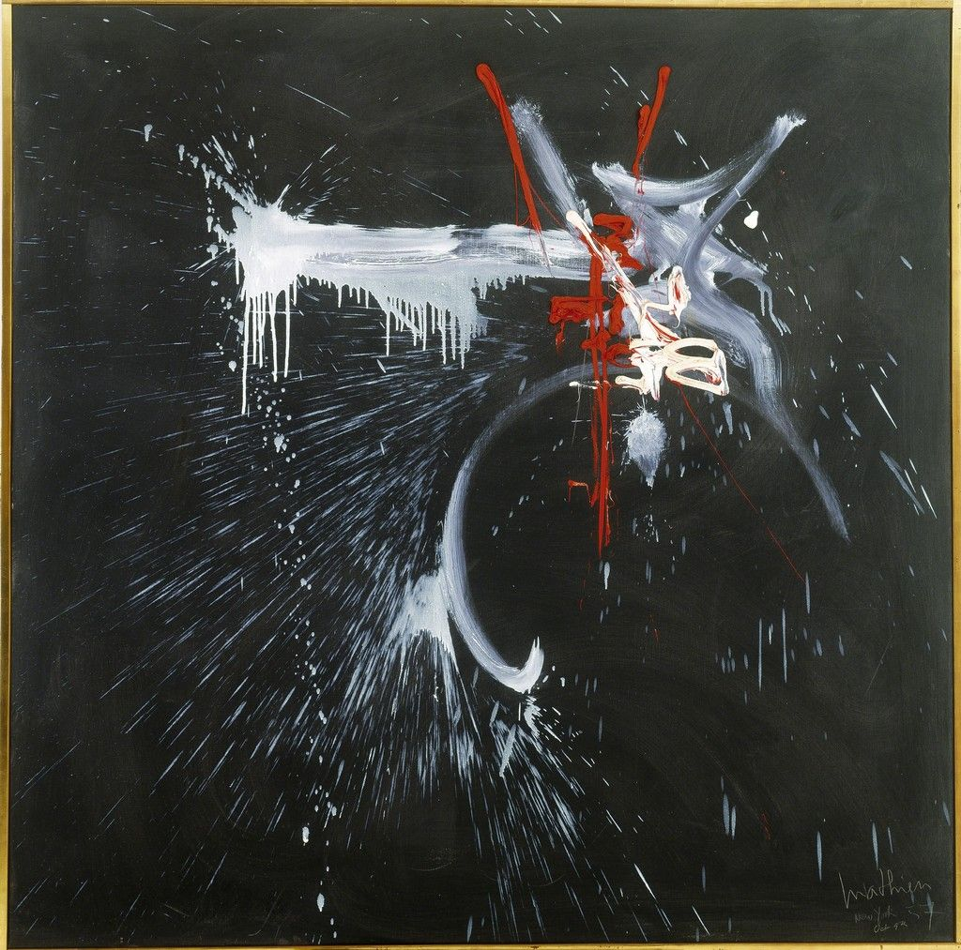
Contextual Hermeneutics
I want us to very quickly deal with the broad outlines of both postcolonialism and feminism, as I am sure you are already somewhat aware of their concerns.
Having done so, I want to focus our attention on the way in which these approaches may question the assumptions which operate within interfaith relations and may influence the questions we choose to ask of interfaith studies.
These will largely take the form of the questions that these different approaches raise for us to try and answer in the context of our work.

Slide 9
Feminism and Feminist Approaches to Interfaith Studies

Slide 10

Feminism and Feminist Approaches to Interfaith Studies
We begin our short introduction to feminism by considering a useful definition, before examining the generally accepted historical trends.
As a definition, the following offers a useful starting point, which we can assess as we move along:
‘Feminism is a range of political movements, ideologies, and social movements that share a common goal: to define, establish, and achieve political, economic, personal, and social equality of sexes’

Slide 11

Feminism and Feminist Approaches to Interfaith Studies
Generally the history of feminism is divided into three ‘waves’ which occur in historically defined times and generally have different goals in addressing forms of gender imbalance (Rampton, 2008).
These three waves begin in around 1850 and continue to today, with some scholars identifying a fourth wave as our current period.
The form and history of feminism is a contested subject, with, as we shall see, difficult interactions with matters of race, ethnicity, and gender throughout its history.

Slide 12
1st Wave & 2nd Wave
The first wave of feminism is generally seen as a wave of social and political activism that occurred across the western world in the late 19th / early 20th century.
Its focus was largely on the establishment of legal equality between genders, such as the right to vote or property ownership, and access to equal educational opportunities.
This form of feminism aimed to address structural and legal inequality between genders which privileged males to the disadvantage of females.
It was driven largely by independently wealthy individual white women from the upper and middle classes and, while aiming to expand opportunity for all women, was largely focused only on those areas of concern to the type of women involved – education and politics.
(Wroath, 1998)
Second-wave feminism is a period of feminist activity and thought that first began in the early 1960s in the United States, and eventually spread throughout the Western world and beyond.
Second-wave feminism broadened the debate from 1st wave to a wide range of issues: sexuality, family, the workplace, reproductive rights, de facto inequalities, and official legal inequalities
Generally second wave feminism was driven by largely white middle class women in the developed world, in reaction to the increased domesticity of feminine roles post WW2.
Significant legal victories of the movement in the US were extending full affirmative action rights to women, the Women's Educational Equity Act ,the outlawing of marital rape, and Supreme Court cases such as Roe v. Wade in 1973.
(Lear, 1968)

Slide 13
3rd Wave & 4th Wave
Many historians view the second-wave feminist era in America as ending in the early 1980s with the intra-feminism disputes of the feminist sex wars over issues such as sexuality and pornography, which ushered in the era of third-wave feminism in the early 1990s (Evans, 2015)
Born in the 1960s and 1970s, third-wave feminists embraced individualism and diversity and sought to redefine what it meant to be a feminist
This focus on the individuality of women, as opposed to the binarism of male / female, drove an increasing focus on issues of race and gender and the intersection between them.
While second wave feminism is largely seen as being driven by white middle class concerns, third wave feminism is seen as focused on matter of race and class.
Cochrane (2013) describes the fourth wave as focusing on sexual harassment (including street harassment), workplace discrimination, body shaming, sexist imagery in the media, online misogyny, assault on public transport, and intersectionality, relying on social media for communication and online petitioning for organizing.
Criticisms include its overwhelming reliance on technology / aesthetics (which involves issues of class, access, and ableism), its focus on individuality and individualism drawing focus away from shared experiences that define social categories of gender, its limited political and social activism beyond cyberspace, and the factionality seen in contemporary divisions within 4th wave feminism.

Slide 14

Feminist Theory
Feminist theory explores both inequality in gender relations and the constitution of gender.
It is best understood as both an intellectual and a normative project, one that explores inequalities and attempts to change them.
Whereas feminist theories first began as an attempt to explain women’s oppression globally, following a grand theoretical approach akin to Marxism, the questions and emphases in the field have undergone some major shifts.
Two primary shifts have been: from universalizing to particularizing and contextualizing women’s experiences and; from conceptualizing men and women as categories and focusing on the category “women”, to questioning the content of that category and moving to the exploration of gendered practices.

Slide 15
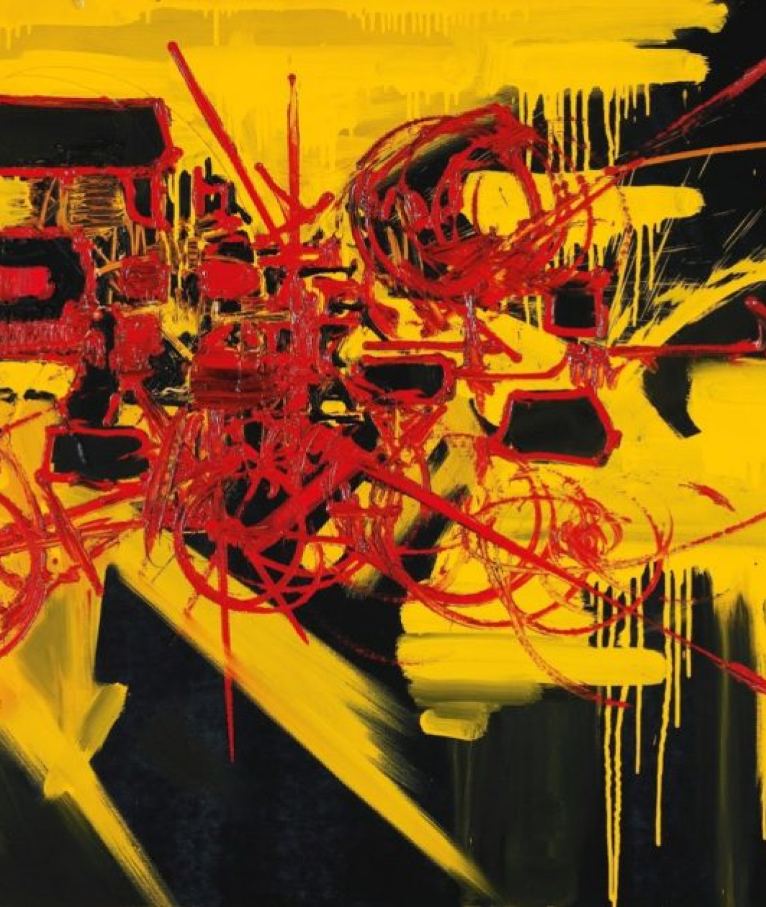
Feminist Theory
Feminist theory in general is a way of looking at current social institutions and forms, and critiquing the gender norms that underlie them.
Through that critique, it aims to expose the inequality present in contemporary society and cause change in institutions, attitudes, and social constructions.
This has obvious connections to our earlier discussions, not just of religions, but also of interfaith interactions. The intersectionality of feminist critiques should be apparent!

Slide 16
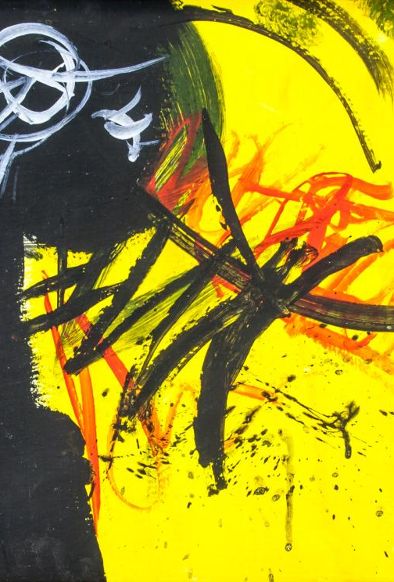
Feminism and Religion
It should be obvious, I hope, where and how the insights of feminism and feminist theory overlap with aspects of the study of religion. For example:
If we are to study a religion, then we are studying those individuals who make up that religion, 50% of whom will be female.
Religions are social institutions that encourage their believers to interact in certain gendered ways.
Religions tell stories about human nature, including aspects of gender and sex, that make up the “innate” natures of the individual.

Slide 17

Feminism and Religion
Religions offer social patterns for individuals that are only open to particular genders.
Religions have a big impact on the secular valuation of gendered individuals and their social roles
Religions, through doctrines and stories told, value genders differently and distinctly
Religions, through doctrines and stories told, value different aspects of different genders differently.
Religions connect aspects of social performance to aspects of gender and sex, telling us the appropriate ways of enacting our gender.

Slide 18

Feminism and Religion
This overlap opens up significant questions that we need to engage in when examining the interaction between feminism and religious questions. These include:
How might a religion be read through a feminist lens?
How central to religions are beliefs about the nature of gender?
Why are matters of sex and gender so central to the social presentation of religions and their self-conceptions of society?
Each of these questions has significant implications for our study of religion, and then inter-religious interaction.

Slide 19

Feminism and religious dialogue
A very interesting example of this overlap is the work of Majorie Suchocki, who states that feminist approaches to religion and feminist approaches to matters of inter-religious dialogue share similar ground (2003).
She does this on the basis that the critique of absolutism / exclusivism is the goal of both a theology of religions and a feminist theology – a critique of exclusivism predicated on the false universality of a specific position.
In each case, a position that is specific, has been presented as universal – Christianity & misogyny respectively.

Slide 20

Feminism and religious dialogue
She connects religious absolutism with gender absolutism – resulting in a tendency towards religious pluralism in feminist approaches to dialogue.
Her work explores this convergence between feminist critiques of misogyny and pluralist critiques of exclusivism, ultimately resulting in arguing that a feminist approach to the theology of religions requires a pluralist position.
An awareness of the necessity of multiple perspectives on matters of gender, necessitates the same awareness when it comes to religious truth (Suchocki, 2003)

Slide 21

Feminism and religious dialogue
Take some time to reflect on the questions that this general approach, and Suchocki’s particular approach, raise in this context, such as those below:
How can feminist insights be brought into the practice of interfaith dialogue?
Why has interfaith dialogue been so andro-centric in practice?
How do feminist approaches open / close dialogue with alternative traditions?
Where does the feminist narrative regarding gender arise from?
Is it religiously situated? If it is, how does this relate to other religious traditions?

Slide 22
Postcolonialism and Postcolonialist Approaches to Interfaith Studies

Slide 23

Postcolonialism and Postcolonialist Approaches to Interfaith Studies
The second of the ‘contextual’ approaches I want us to get to grips with in this section is the post-colonial approach – an approach which aims to disrupt the Eurocentric assumptions of much of our current thinking.
This is particularly important in the field of religious studies, and interfaith studies, as many of the assumptions we operate with emerge from a European Christian perspective – just think of the prominence of salvific models in the theology of religions and how awkwardly they work for non-Abrahamic religious faiths.
In order to begin this exploration of post-colonialism, I want to begin by introducing the related concept of Orientalism, originating with Edward Said, with which you may be familiar.

Slide 24
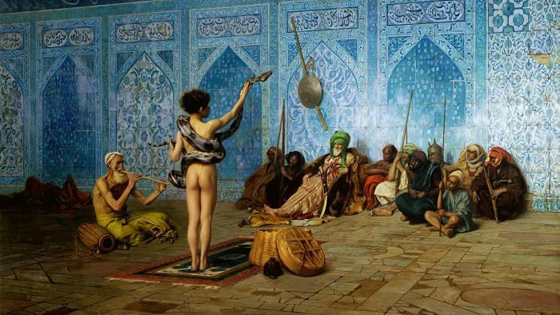
Orientalism
We begin with orientalism because it functions as a precursor to many of the later post-colonial critique and explains many of the foundations that they emerge from.
As a term, Orientalism is popularised by the scholar Edward Said as a way of explaining the dynamic between the concepts of the ‘East’ and the ‘West’ as well as the structures of power which uphold this distinction.
For Said (1978), Orient signifies a system of representations framed by political forces that brought the “Orient” into Western learning, Western consciousness, and Western empire.
The Orient exists for the West, and is constructed by and in relation to the West. It is a mirror image of what is inferior and alien (‘other‘) to the West.

Slide 25
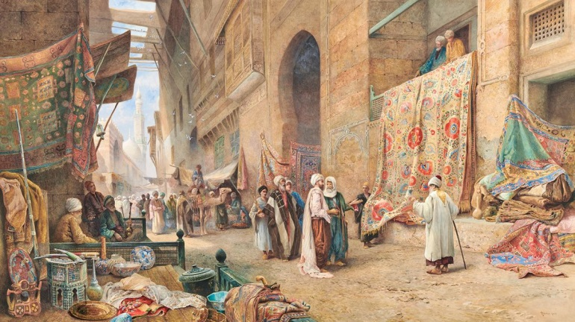
Orientalism
Central to Said's idea of Orientalism is its function of helping the West define itself by constructing an "Other" whose characteristics were understood as being in opposition to the West – it is a prism not only for the West to come to understand the East, but also to understand itself.
As an example, the Orient was understood to be static in time and place. It was understood as being eternal, uniform and incapable of defining itself. This was in opposition to the West which saw itself as being dynamic, innovative, and expansionist.
These oppositions don’t always have to be connected – the East is seen by the West as simultaneously sexually liberated and louche, and also intensely conservative and authoritarian socially.

Slide 26
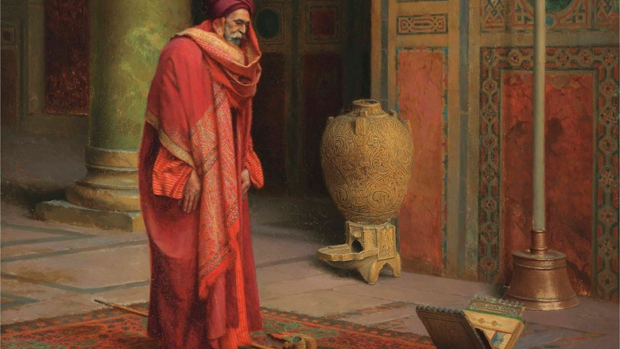
Orientalism
This invention and construction of the non-West as a category of being was not just limited to the intellectual sphere, but also functioned in service to the economic, political, and religious impulses that drove colonialism across the world.
Colonialism needed a rationale, which orientalism provided – a series of legitimising and underpinning reasons for its righteousness and for its inevitability (Bhabha, 1994)
This legitimisation involved the construction of the non-West as undeveloped, unowned, uncivilised, and passive – and therefore a legitimate target.

Slide 27
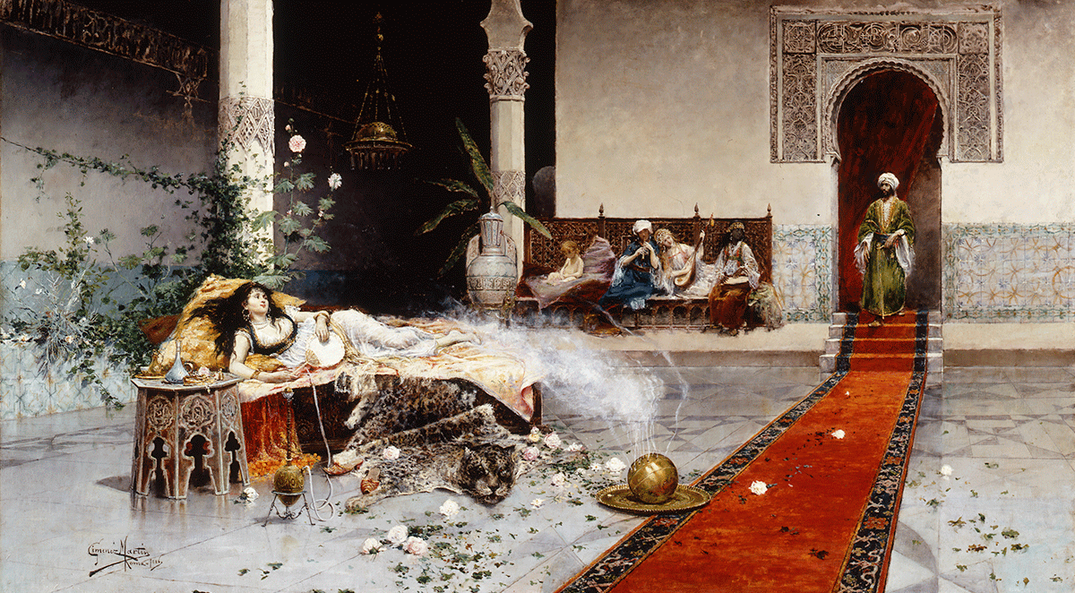
Orientalism
This construction of the Orient took place political, intellectually, and epistemologically.
Said (1978) used the term Orientalism in three interdependent senses:
Orientalism as an academic field (while we now have Middle Eastern or China Studies, the term Orientalism was once a similar institutional designation);
Orientalism as a style of thought based upon distinctions made between “the Orient” and “the Occident”;
Orientalism as “a Western style for dominating, restructuring, and having authority over the Orient.

Slide 28

Post-Colonialism
The position of post-colonialism extends and deepens Said’s Orientalist critique of the way in which western systems of knowledge seek to control and position non-western forms of experience.
This critique emerges in the 1990’s, drawing from both post-modern and orientalist critiques, and mounting an attack on universalist assumptions of truth, on the basis that universal claims necessarily ignore the reality of religious, cultural, social, and racial difference.
There is a strong focus on the uniqueness of regional, national, cultural, ethnic, religious, and social differences and the differences of context and priority (like particularism!), and a concomitant argument that given this difference is real, then the specific white euro-centric perspective should not be privileged over others.

Slide 29

Post-Colonialism
Post-colonialism, like feminism, contains within it both conceptual critiques of the way things are and descriptions of strategies to cause change.
Generally, the first step for the “colonized” is to reclaim their own past - a realization that history did not begin with the Europeans, but is embedded within the indigenous culture, language, and religions.
The second step is to erode colonialist ideology that devalued that past, through a process of reclamation and challenge – challenging social attitudes promoted by the colonial power and reclaiming agency on behalf of subjective perspectives.

Slide 30

Post-Colonialism
This results in a series of strategies and tactics to challenge the social power of the euro-centric social narratives. These include a concern with indigenous language - some conclude the colonizer's language is permanently tainted and to write in it involves acquiescence in colonial structures – this challenges the linguistic and epistemological erasure of the colonized people (Spivak, 2009).
We also see an emphasis on identity as doubled or unstable (identifying with coloniser and colonized cultured) and the hybridisation of identity, which deconstructs the division between identities (Bhabha, 1994).
This is picked up again in a stress on cross cultural interactions between the colonised and colonizer and the work that historical and social trends of racial categorisation and hierarchy played in maintaining these divisions.

Slide 31

Post-Colonialism
Beyond these direct critiques, we also see post-colonialism highlighting the intersectionality of the impact of colonialism and the continuation of colonial attitudes.
These include a strong awareness of the interconnection of the process of colonisation with economics, politics, and religion in both the cultures of the coloniser and the colonised (Acheraiou, 1988)
This awareness is not just a case of historical impact but also is an awareness of the continuing economic, political, and religious impacts of colonialism on our contemporary world and its economic and social systems (Gregory, 2004)
The social and economic systems are seen to perpetuate the impact of colonialism, even as the physicality of it has waned.

Slide 32

Post-Colonialism
This outline of a post-colonialist critique opens up a number of questions for us, such as:
What are the procedural and methodological similarities between the approaches of post-colonialism and feminism?
What other contextual approaches may have an impact on the formation of identity / dialogue?
What else do we just “assume” as universal in common forms of dialogue?

Slide 33

Postcolonialism and dialogue
As I am sure you can already see, the contextual critique offered by postcolonialism has a significant impact on the way we conceptualise our assumptions about the area of inter-religious interaction and dialogue –indeed much of the material we have already covered betrays a euro-centric and Christo-centric bias.
Take some time to think through the following questions raised by the post-colonial critique, relating them to your existing knowledge.

Slide 34

Postcolonialism and dialogue
What is the relationship between religion and colonialism – how does one support or detract from the other?
How is this expressed today – how do current systems of exploitation draw on aspects of religious belief?
How can religions interact with the constructed nature of identity and of history – can religions adopt this for their own?
How is religion related to matters of race / identity / gender – how do the stories told interact with each other?
It is all very well being critical, but how theologically and practically can we disrupt our western-centricity?

Slide 35
Postcolonialism and dialogue
Does difference, and identification within that difference, always result in hierarchy?
Is hierarchy bad? If so, why?
Are their neutral hierarchical forms that do not rely on the oppressive construction of knowledge? If so, what?
In providing contextual viewpoints from specific locations, do feminism and post-colonialism escape or re-inscribe the oppressive power dynamics they critique?
Is there any way to escape the power of the normative?
Is specificity always exclusionary?

Slide 36
Round-Up

Slide 37

Round-UP
In this section, we have examined (quickly!) two particular approaches to matters of faith and interfaith dynamics that raise interesting and difficult questions for our practice.
Both approaches disrupt the assumptions on which our general approaches in interfaith studies operate – either a Eurocentric and Christocentric one or a masculine gendered one respectively – and provide a rationale for seeking to work toward less of a reliance on false universality to make conclusions.

Slide 38
Readings
Tanner K (1993) “Respect For Other Religions: A Christian Antidote to Colonialist Discourse”, Modern Theology, Vol 9 No 1, pp. 1-18
Egnell H (2003) “Dialogue For Life: Feminist Approaches to Interfaith Dialogue” in Mortensen V (ed) Theology and the Religions: A Dialogue, Grand Rapids: Eerdmans, pp. 113-120
Gross R (2002) “Feminist theology as theology of religions” in S. Parsons (ed) The Cambridge Companion to Feminist Theology, Cambridge: Cambridge University Press, pp. 60-78
Suomala, K (2012) “Complex religious identity in the context of interfaith dialogue” CrossCurrents, Vol 62(3), pp. 360-370

