Slide 1
Pynciau Llosg /
Around the Water Cooler
ECES6006/C
Sesiwn 3 / Session 3

Slide 2

Amser sgrîn
Screen time

Slide 3


Cynnwys
Content
‘High Tech Tots’
Plentyndod Gwenwynig
TGCh yn yr Ysgol Gynradd
High Tech Tots
Toxic Childhood
ICT in the Primary School

Slide 4
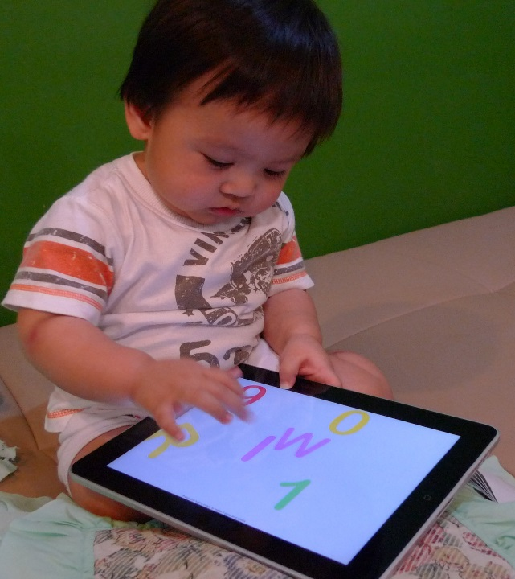
High Tech Tots
Ipads in kindergarten
Ipads yn y dosbarth meithrin

Slide 5
Pwysigrwydd?
Importance?
Mae technoleg yn rhan mor fawr o fywyd plant, fe fyddai amgylchedd dysu hebddo yn hen ffasiwn iawn
Ffyrdd newydd o rhyngweithio cymdeithasol
Ffyrdd newydd o gyfranogi
Cyfleoedd am ddychymyg a dysgu
Technology is such a part of children’s lives that a learning environment without it would be out of touch
New forms of social interaction
New forms of participation
Opportunities for imagination and learning
Berson & Berson ( 2010)

Slide 6
Toxic Childhood
Y Pentref Electronaidd
Cyfraith Moore
Y gwarchodwr electronaidd
O ddiffyg i gamweithredu?
Llyfrau v sgriniau
The Electronic Village
Moore’s Law
The electronic babysitter
From default to dysfunction?
Books v screens
( Palmer 2015)

Slide 7
Toxic Childhood
Ochr dywyll y pentref
Hunaniaeth, preifatrwydd a rhannu
Tyfu’n hŷn yn iau
Doethineb y pentref
The dark side of the village
Identity, privacy and sharing
Growing older younger
A question of rights
Village wisdom
( Palmer 2015)

Slide 8
TGCh yn yr ysgol
ICT in School
Y potensial i gael traweffaith positif ar ddysgu
Nodweddion unigryw TGCh
  Cyflymder
  Awtomatiaeth
  Capasiti
  Ystod
  Darpariaeth
  Rhyngweithio
Potential for positive impact on learning
Unique features of ICT
  Speed
  Automation
  Capacity
  Range
  Provisionality
  Interactivity
  ( Beauchamp, 2012)

Slide 9
TGCh yn yr ysgol
ICT in School
Symudedd
Cyfathrebu a chydweithio
Globaleiddio
Profiadau?
Rhwystrau?
Peryglon?
Mobility
Communication and collaboration
Globalisation
( Beauchamp, 2012)
Experiences?
Barriers?
Dangers?

Slide 10

Fframwaith Cymhwysedd Digidiol: 4 llinyn
Digital Competence Framework: 4 strands
Dinasyddiaeth – sy’n cynnwys:
  Hunaniaeth, delwedd ac enw da
  Iechyd a lles
  Hawliau digidol, trwyddedu a pherchnogaeth
  Ymddygiad ar-lein a seiberfwlio.
Rhyngweithio a chydweithio – sy’n cynnwys:
  Cyfathrebu
  Cydweithio
  Storio a rhannu.
Dysgu Cymru ( 2016)
Citizenship – which includes:
  Identity, image and reputation
  Health and well-being
  Digital rights, licensing and ownership
  Online behaviour and cyberbullying.
Interacting and collaborating – which includes:
  Communication
  Collaboration
  Storing and sharing.
  Learning Wales (2016)

Slide 11
Fframwaith Cymhwysedd Digidiol: 4 llinyn
Digital Competence Framework: 4 strands
Cynhyrchu – sy’n cynnwys:
  Cynllunio, cyrchu a chwilio
  Creu
  Gwerthuso a gwella.
Data a meddwl cyfrifiadurol – sy’n cynnwys:
  Datrys problemau a modelu
  Llythrennedd gwybodaeth a data.
Producing – which includes:
  Planning, sourcing and searching
  Creating
  Evaluating and improving.
Data and computational thinking – which includes:
  Problem solving and modelling
  Data and information literacy

Slide 12

Damcaniaethau Dysgu a TGCh
Learning theories and ICT
Ymddygiadaeth e.e. Skinner
Lluniadaeth e.e. Vygotsky
Dysgu seiliedig ar brofiad e.e. Dewey
Galluoedd lluosog e.e. Gardner
Behaviourism e.g. Skinner
Constructivism e.g. Vygotsky
Experience based learning e.g. Dewey
Multiple intelligences e.g. Gardner
( Beauchamp, 2012)

Slide 13

Tasg /
Task
Ystyriwch y damcaniaethau dysgu ar y sleid cynt
Trafodwch weithgareddau TGCh yn y dosbarth a fyddai’n adlewyrchu’r damcaniaethau hynny
Consider the learning theories on the previous slide
Discuss ICT activities in the classroom which would reflect those theories

Slide 14
Tasg/
Task
Mewn grwpiau, trafodwch os ddylai disgyblion ysgol gynradd gael yr hawl neu eu annog i ddefnyddio safleoedd rhwydweithio cymdeithasol yn ystod oriau ysgol
In groups, discuss whether primary school pupils should be allowed or encouraged to use suitable social networking sites in school time
( Beauchamp, 2012)

Slide 15

Trafodaeth
Discussion
Yn eich grwpiau trafodwch pa erthyglau/ adroddiadau sydd gennych am amser sgrîn
Pa werthoedd a drafodir / amlygir?
In your groups discuss what articles/reports you have found regarding screen time
Which values are discussed / promoted?

Slide 16

Aseiniadau
Assignments
Ystyriwch ddefnyddio materion amser sgrîn fel ffocws ar gyfer eich aseiniad
Materion
Camau nesaf
Consider whether screen time could be the focus for your assignment
Issues
Next steps

Slide 17

Sesiwn 4
Session 4
Edrychwch am drafodaeth gyfredol am Gynaladwyedd
Dewch â thystiolaeth
Byddwch yn barod i drin a thrafod
Look for current debate around Sustainability
Bring evidence
Be prepared to discuss and debate

Slide 18
Cyfeirnodau
References
Beauchamp. G. ( 2012) ICT in the Primary School: From Pedagogy to Practice. Harlow, Essex: Pearson
Berson, I.R. & Berson, M.J. ( eds) ( 2010) High Tech Tots : Childhood in a Digital World. Charlotte, North Carolina: Information Age Publishing
De Block, E. & Buckingham, D. ( 2007) Global Children, Global Media: Migration, Media and Childhood. Hampshire: Palgrave Macmillan
Learning Wales ( 2016) Digital Competence Framework. Available at http://learning.gov.wales/resources/browse-all/digital-competence-framework/?skip=1&lang=en ( Accessed 04.07.18)
Palmer, S. ( 2015) Toxic Childhood: How the Modern World is Damaging our Children and what we can do about ( 2nd edn) London: Orion Books
Image : The Best Toddler Learning Games Online ( 2015) Available at http://www.destinybaby.com/826/best-toddler-learning-games-online.html ( Accessed 4.11.15)
Image 2: Editor, M.B.C. ( 2013) Is Ipad good or bad for babies? Available at http://blog.mybabycart.com/is-ipad-good-or-bad-for-babies ( Accessed 4.11.15)

