Slide 1
Marketing Concepts and Strategies
LCMB7024
Week 1 – Session 2

Slide 2
Content of the Sessions
Marketing concepts.
Marketing environment
Micro-environment
Macro-environment
The Ansoff Matrix

Slide 3
Marketing Concepts (1 of 9)
According to Kotler et al. (2020), there are five marketing concepts:
  The production concept
  The product concept
  The selling concept
  The marketing concept
  The societal marketing concept

Slide 4
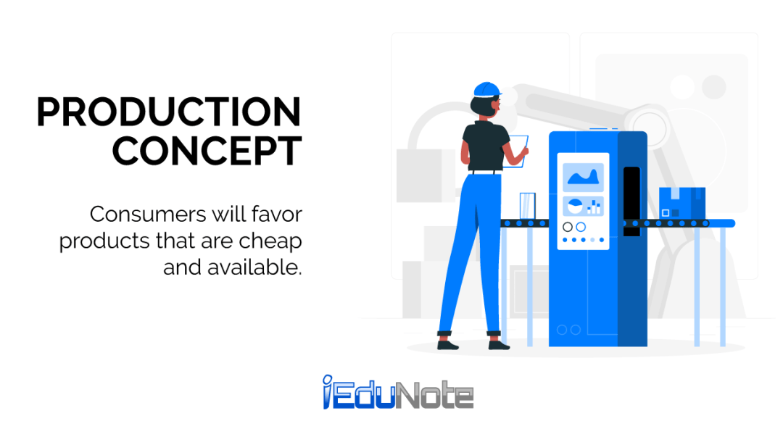
The Production Concept (2 of 9)
The production concept holds that consumers prefer products that are widely available and affordable. Therefore, the organisation should focus on improving production and distribution efficiency.

Slide 5
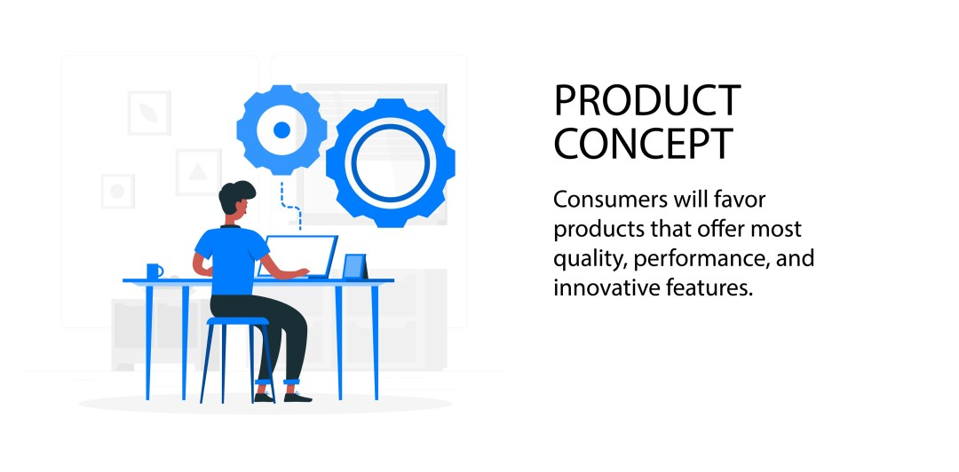
The Product Concept (3 of 9)
The product concept holds that consumers will favour those products that offer the most quality, performance, or innovative features. This means that organisation should be devoted to continuous product improvements.

Slide 6
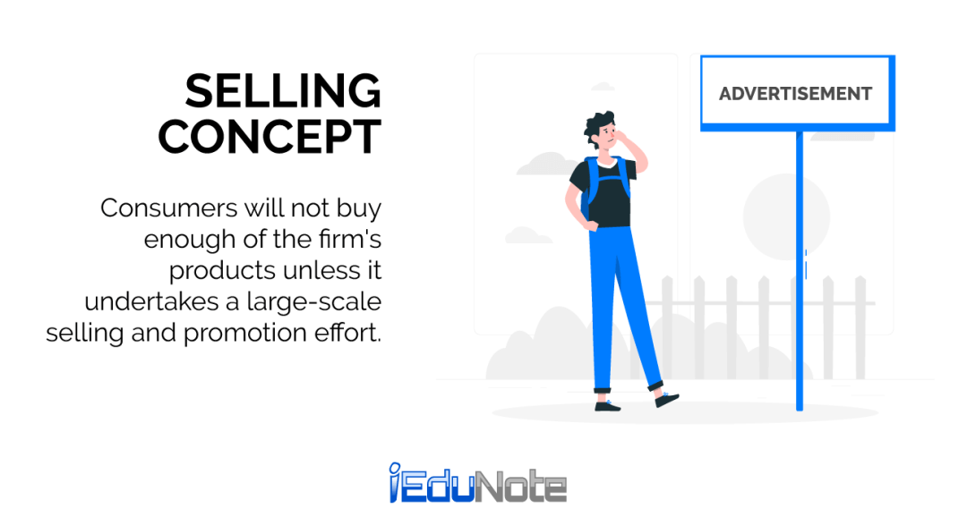
The Selling Concept (4 of 9)
The selling concept holds that consumers and businesses, will ordinarily not buy enough of the organisation’s products, if the it does not engage in large-scale selling and promotion efforts.

Slide 7
The Selling Concept (5 of 9)
The selling concept has four pillars:
Factory
Existing products
Selling and promoting
Profitability
(Kotler al., 2020)

Slide 8
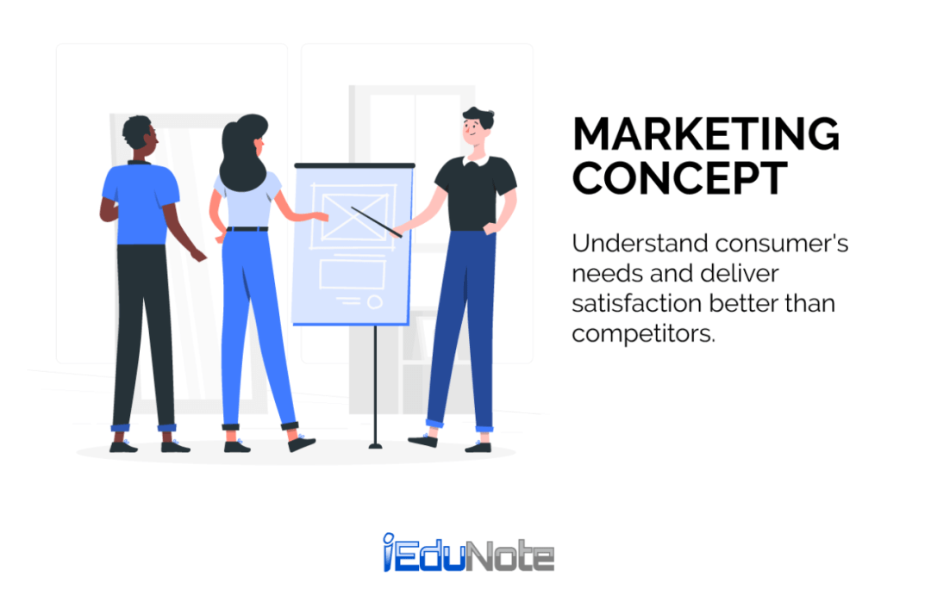
The Marketing Concept (6 of 9)
The marketing concept holds that the key to achieving its organisational goals, consists of the company being more effective than competitors in creating, delivering, and communicating customer value to its chosen target markets.

Slide 9
The Marketing Concept (7 of 9)
The marketing concept has four pillars:
Target Market
Customer Needs
Integrated Marketing
Profitability
(Kotler al., 2020)

Slide 10
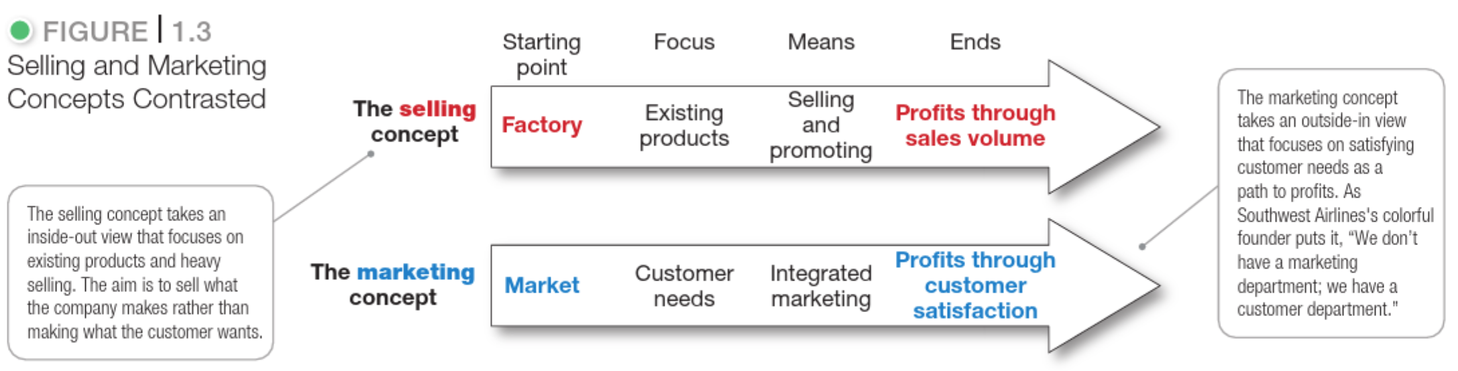
Difference between selling concept and marketing concepts (8 of 9)
(Kotler al., 2020)

Slide 11
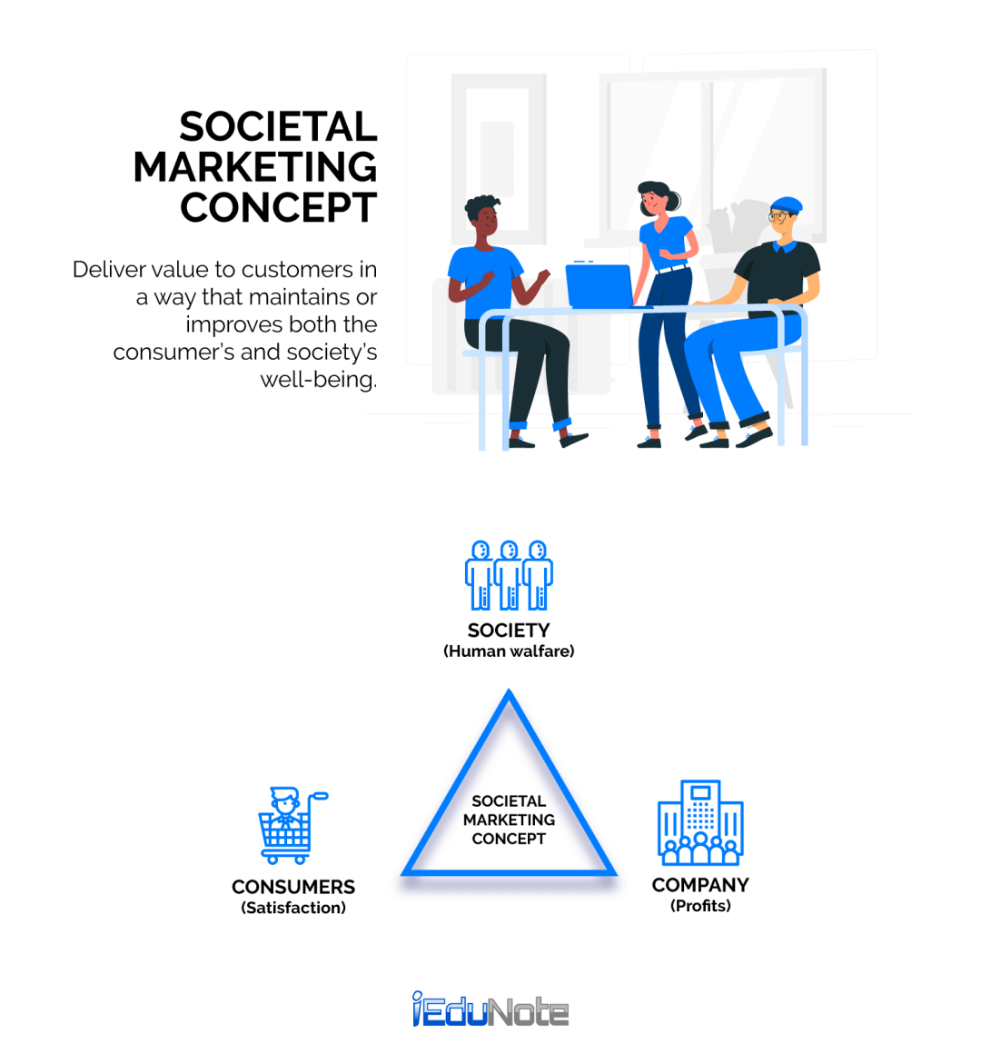
The Societal Marketing Concept (9 of 9)
The societal marketing concept holds that the organisation’s task is to determine the needs, wants and interests of target markets and to deliver the desired satisfactions more effectively and efficiently than competitors in a way that preserves or enhances the consumer’s and the society’s well-being.

Slide 12
Marketing environment (1 of 3)
Marketing operates in a complex and ever-changing environment and to develop effective strategies, a company must understand the environment in which it operates.
To do this, the company needs to analyse both its Microenvironment and Macroenvironment.

Slide 13

Microenvironment
The microenvironment refers to the factors close to the company that influence a company's ability to serve its customers, including the company itself, suppliers, marketing intermediaries, customer markets, competitors, and the public.
This will be explained in more details next session -> Week 2

Slide 14

Macroenvironment
The macroenvironment encompasses larger external forces that influence the microenvironment.
This will be explained in more details next session -> Week 2

Slide 15
Marketing Growth strategies (1 of 10)
Understanding and analysing marketing concepts lays the foundation for strategic decision-making in business growth.
The Ansoff Matrix can be applied to a company to develop an effective growth strategy by utilising its four strategies.

Slide 16
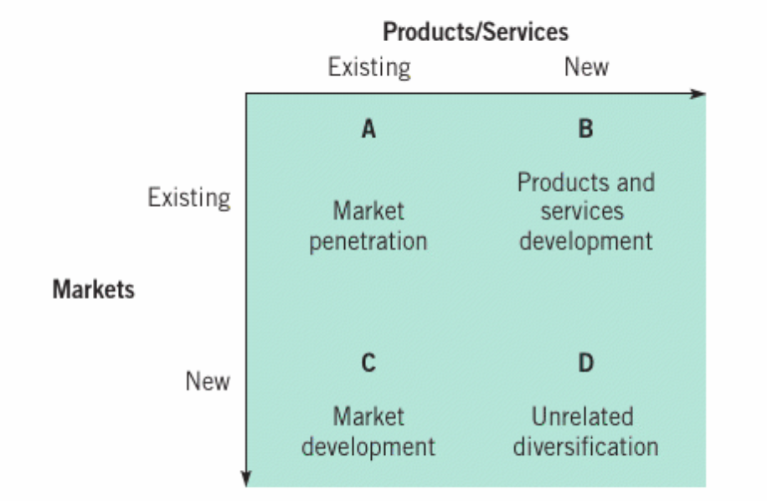
The Ansoff Matrix (2 of 10)
(Whittington et al., 2020)

Slide 17
Market Penetration (3 of 10)
Existing product, existing market.
The company try to encourage their existing customers to buy more of the same product.
Relationship marketing and promotion can be used.

Slide 18
Product Development (4 of 10)
Existing market, new product.
The company improve the quality or upgrade the technology of the existing product.

Slide 19
Market Development (5 of 10)
New market, existing product.
The company make their product available in new, undiscovered countries.
The company find a new target market for an existing product.

Slide 20
Diversification (6 of 10)
New market, new product.
The company produce products associated with a new industry.
There can be related or unrelated diversification.

Slide 21
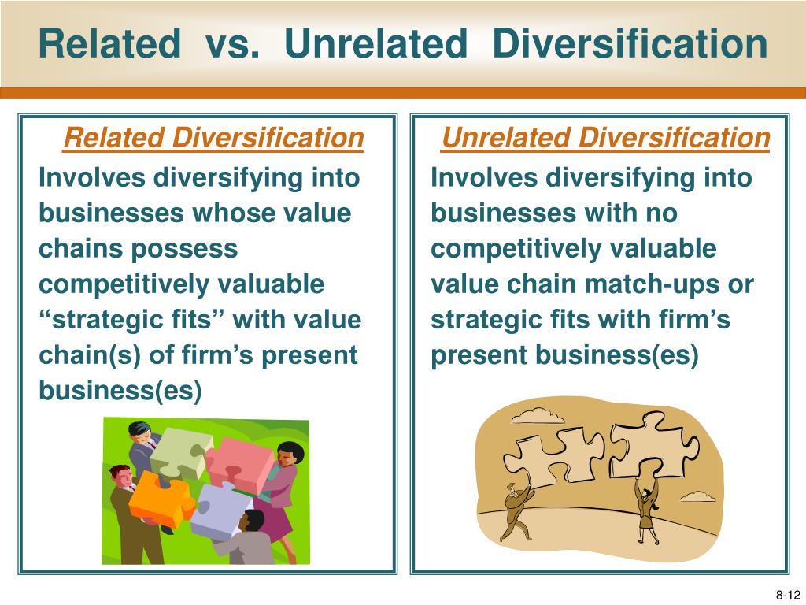
Different Types of Diversification
(7 of 10)

Slide 22
Vertical Integration
(8 of 10)
Vertical integration is a diversification strategy where a company expands its operations within its supply chain. This can be done in two ways:
Forward Vertical Integration
Backward Vertical Integration

Slide 23
Forward Vertical Integration
(9 of 10)
Forward Vertical Integration – A company moves downstream in the supply chain by gaining control over distribution or retail. For example, a manufacturer starts its own retail stores or acquires a wholesale distributor to sell directly to customers.

Slide 24
Backward Vertical Integration
(10 of 10)
Backward Vertical Integration – A company moves upstream by acquiring or establishing control over its suppliers. For instance, a car manufacturer purchasing a tire company to secure its supply of raw materials.

Slide 25
Group activity
The Kelly Bottling Company, located in a large metropolitan area of some five million people, produced and marketed a line of carbonated beverages consisting mainly of flavoured soft drinks (not including colas), soda water and tonics. They were sold in different types of packages and sizes to a wide variety of retail accounts.
In groups of 3-4, analyse how Kelly Bottling Company can expand its revenues using the four growth strategies in the Ansoff Matrix.

Slide 26
References
Hague, Paul. The Business Models Handbook: Templates, Theory and Case Studies. London, United Kingdom; New York, Ny, Kogan Page Limited, 2019.
Kotler, P., Armstrong, G., Harris, L. and Piercy, N. (2020) Principles of marketing. 8th European edn. Harlow: Pearson.
Whittington, R. et al. (2020) Exploring strategy: text and cases. Twelfth Edition. Harlow: Pearson.

