Slide 1


Evaluating 4 Theories Within Criminology
Comparing and contrasting their explanations of crime and their assumptions on Human behaviour.

Slide 2



Introduction:
The Theories we will be discussing today:
Right Realism: With a focus on intelligence
Left Realism
Labelling Theory
General Theory of Crime
The importance of such discussion on criminality and its causes is twofold:
Identifying the causes of crime allows for earlier intervention
Informs more effective punishments and deterrents for crime to protect society.

Slide 3

Right Realist Theories of Crime
Muncie (2004):
Right realist view on crime is one that focuses on crime as represented by official statistics. Believing that crime is caused by a lack of self-control.
The priority of right realists is the prioritisation of order through deterrents and retributive means of crime control.

Slide 4

Right Realism continued:
Crime control policies to be based on greater social controls, increased punishment to provide a deterrent. Theorists must think of what it is feasible for a government to do. Wilson (1975).
Intelligence: IQ effects likelihood of delinquent behavior. However. Regarded IQ as a poor example of a variable, no evidence that IQ has a direct impact on delinquency. Hirschi and Hindelang (1977)

Slide 5
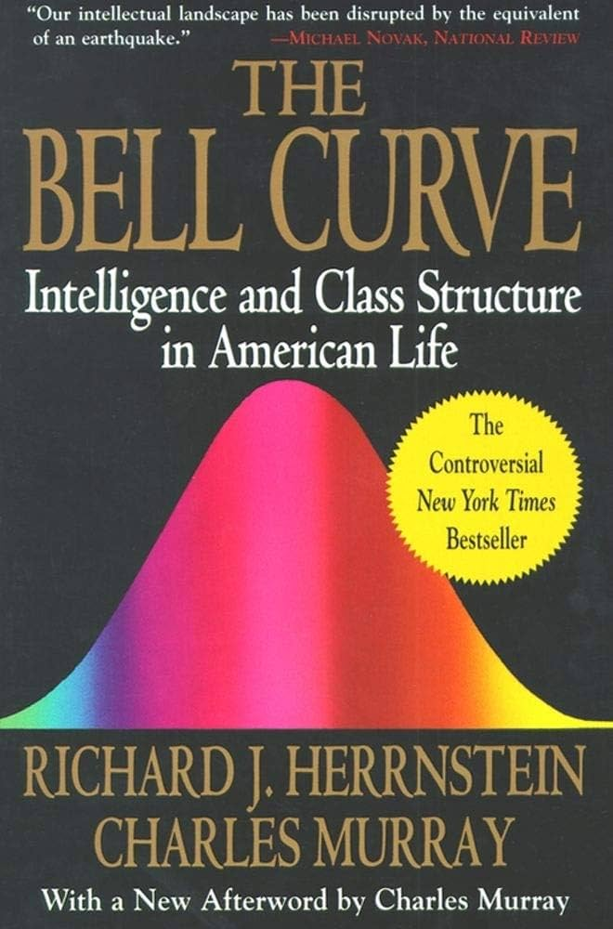
The Bell Curve
Herrnstein and Murray (1994)
Used data from National Longitudinal Survey of Youth.
Intelligence was the best indicator of Social behavior – including criminal behavior.
Lower IQ scores more likely to have reported criminal involvement.
Social and economic status thus not important when explaining criminal behavior.
Focuses on poverty and unemployment should instead be shifted to coping with cognitive disadvantages.

Slide 6


Discussion of Right Realism
Clear and observable impact on legal and political reactions to crime and criminal – Thatcher and Reagan administrations.
Regarded as "Naïve Realism" as it avoids conversations of 'deep structures' and 'root causes.' Matthews (2014).
Cognitive disadvantage plays only a minor role in crime causation. Lilly et al, (2002)

Slide 7
Left Realist Theories of Crime.
Primary focus on crime through the perception of victims, crime caused by relative deprivation, injustice and marginalisation.
Social justice through crime prevention programmes prioritised by left realists. Muncie (2004)

Slide 8
Four Main Strands
Development of an empirically based view of crime and its impact.
Significant focus on causal explanations of crime.
Exploration of offender and victim relationship and the formal/informal control.
Development of realistic policies with the aim of reducing the impact and frequency of victimisation.
Tierney, (1996).

Slide 9

Key differences to right realism.
The consideration of causes of crime and its impact are essential.
The victims of crime must be considered equally to the perpetrators.
A new approach to the politics of crime control is needed, not simply more punitive measures. Lea and Young (1984)

Slide 10
Discussion of Left Realism
Assumes that the power relationship of offender and victim is weighted in a way that the offender is always the more powerful. Ruggiero, (1992).
Heavy focus on the crime and victimisation within lower social economic communities, fails to account for the crimes of the powerful. Walklate, (1989). Thus, meaning it has a limited utility in explaining broader crimes. Making it an incomplete theory. Pearce and tombs, (1992)

Slide 11

Labelling Theories.
Preluded by the work of Tannenbaum (1938) on Juvenile delinquency.
Labelling theory shifts focus from the nature of deviant acts, and the nature of deviants, to the social reaction to deviants.

Slide 12
Individual commits an act of delinquency.
They are labelled as a deviant by society.
This initial reaction impacts the individual sense of self, identity and actions
Societal reaction to the individual harshens.
This feeds into the individual's behavior further.
Ultimately the individual is tagged as a delinquent.

Slide 13

Key concepts in labelling theory
Primary and Secondary Deviance, Lemert (1967).
Stigma, Goffman (1963).
Self-fulfilling prophecy, Merton (1968).
Folk devils and Moral Panics. Cohen (2002)

Slide 14
Key differences to Right Realism.
Places much greater significance on the reaction to crime.
Casts doubt on societal consensus of the rule of law.
Directly challenges a harsher punitive response as a focus of criminal justice intervention. Highlighted the dangers of this through Deviancy amplification, Wilkins (1964).

Slide 15
Discussion of Labelling Theory.
Clear impact on the criminal justice system in Britian, mostly within juvenile justice and the approach of social workers.
Much like right realism in failing to to accurately account for the influence of societal structures on the human experience. Downes and Rock (2003).
Argued to exaggerate the importance of societal reaction, implying without them, deviance would not be able to exist. Akers, (1967).

Slide 16
General Theory of Crime.
Gottfredson and Hirschi (1990)
Two key concepts:
Self-control which they define as 'concern for the long-term consequences of one's acts.'
Low self-control as well as opportunity must be present for offending behaviour to occur.

Slide 17
Discussing General Theory.
The authors argued that by focusing on individual self-control, their theory applies to all forms of criminality including white collar crime.
The concept of self-control is difficult to research empirically.
Control theory fails to fully understand the role of social economic factors in criminality. Currie, (1985).
Implicitly blames woman-dominated child-care for criminal behaviour, whilst also creating a false gender neutrality. Miller and Burrack, (1993)

Slide 18
Research timeline
WC 07/10/24
Began reading from the T. Newburn Textbook and lecture content of that week.
Created and initial plan of the structure for the presentation
WC 14/10/24 & 21/10/24
Used further reading using google scholar and articles available through the university's library. Selection was made on applicability and reputability of the publication.
Started to filter through the content to condense down 3 of the 4 theories that would be included in the presentation and continue finding further reading. The selection of right realism, left realism and labelling theory lent themselves to structure that highlighted key differences and blind spots of the theories.
WC 28/10/24
The final theory: General Theory was decided. Lecture material became available as a foundation and further reading highlighted that it would act as a suitable final theory due to the limitations of the ones discussed prior.
At this point, significant challenges had been encountered when finding relevant information to include that was relevant to criminological theory, for this reason research collected on genetic theories was abandoned due to fears of it not applying significantly to the topic at hand.

Slide 19
References.
Akers, R. (1967) ‘Problems in the sociology of deviance: Social definitions and behaviour’, Social Forces, 46, 455–465
Cohen, S. (2002) Folk Devils and Moral Panics, 3rd edn, London: Routledge
Currie, E. (1985) Confronting Crime: An American challenge, New York: Pantheon
Downes, D. and Rock, P. (2003) Understanding Deviance, 4th edn, Oxford: Oxford University Press
Goffman, E. (1963) Behavior in Public Places: Notes on the social organization of gatherings, Glencoe, IL: Free Press
Gottfredson, M.R. and Hirschi, T. (1990) A General Theory of Crime, Stanford, CA: Stanford University Press
Herrnstein, R. and Murray, C. (1994) The Bell-Curve: Intelligence and class structure in American life, New York: Free Press
Hirschi, T. and Hindelang, M. (1977) ‘Intelligence and delinquency: A revisionist view’, American Sociological Review, 42, 4, 571–587
Lea, J. and Young, J. (1984) What Is To Be Done about Law and Order? London: Penguin
Lemert, E.M. (1967) Human Deviance, Social Problems, and Social Control, Englewood Cliffs, NJ: Prentice Hall
Lilly, J.R., Cullen, F.T. and Ball, R.A. (2002) Criminological Theory: Context and consequences, 3rd edn, London: Sage
Matthews, R. (2014) Realist Criminology, Basingstoke: Palgrave
Merton, R.K. (1968) Social Theory and Social Structure, 2nd revised edn, New York: Free Press
Miller, Susan & Burack, Cynthia. (1993). A Critique of Gottfredson and Hirschi's General Theory of Crime. Women & Criminal Justice. 4. 115-134.
Muncie, J. (2004) ‘Youth justice: Globalisation and multi-modal governance’, in Newburn, T. and Sparks, R. (eds) Criminal Justice and Political Cultures, Cullompton: Willan
Ruggiero, V. (1992) ‘Realist criminology: A critique’, in Matthews, R. and Young, J. (eds) Rethinking Criminology: The realist debate, London: Sage
Pearce, F. and Tombs, S. (1992) ‘Realism and corporate crime’, in Matthews, R. and Young, J. (eds) Issues in Realist Criminology, London: Sage
Tannenbaum, F. (1938) Crime and the Community, New York: Columbia University Press
Tierney, J. (1996) Criminology: Theory and context, London: Harvester Wheatsheaf
Walklate, S. (1989) Victimology: The victim and the criminal justice process, London: Unwin and Hyman
Wilkins, L. (1964) Social Deviance: Social policy, action and research, London: Tavistock

