Slide 1





THE IMPORTANCE EMPLOYEE
ENGAGEMENT IN THE SUCCESS OF A HOTEL
Operating Hotel Facilities (BMIH4006)
Student Name: Ruksana Begum
Student Number: 2118820
Tutors Name: Tristan Hawkins

Slide 2



Contents Page
In this presentation, we’ll be going over the following:
1.Introduction
2.What is Employee Engagement?
3.ZINGER Employee engagement model
4.SCHMIT Model of employee engagement
5.Why Staff Engagement is Crucial?
6.Emotions in Engaging with Employees
7.Statistics
8.Conclusion
9.Reference list

Slide 3



INTRODUCTION…
This Presentation is going to be about the importance of Employee Engagement in the success of a hotel.
Strong employee engagements methods can help all firms because they improve the workplaces, low staff turn over, improve productivity, creates a positive work connection between managers, employees and it has positive impact on the guest experience. It creates a positive environment making it a happy place to be for everyone.

Slide 4



WHAT IS EMPLOYEE ENGAGEMENT…
Employee Engagement is a human resources (HR) concept that measures the level of dedication and enthusiasm an employee has for the organisation.
The concept “employee engagement” in the hotel industry of human resources (HR) relates to how passionate and dedicated an employee is to their work (Smith, 2020)
This is about how we create culture where employees can give more capability and potential” as stated by David MacLeod, 2021)
An example of a good employee engagement practise is taking part, making your self available to attend in daily team briefings, taking part in employee/ manager conferences, surveys, taking the time to attend training to further enhance your development on employee engagement, taking time to have 1-1 meetings with staff, getting your employee to engage through reward systems and recognition awards for them to thrive and succeed.
For example a good practise that premier inn, carry out to promote positive employee engagement is they have a firm belief that staff hold the key to success through positive engagement this is done by there win card bonus system. Employee Engagement is monitored as part of the win card. An engagement survey is held annually with a summary of the results given to every employee. “The company believes it provides employees with a great place to work with a great team around.”All of these actions has a positive impact in the hotel industry. (Whitbread PLC, 2018)

Slide 5

The Zinger Employee Engagement Model
THIS IS THE EMPLOYEE ENGAGEMENT PYRAMID TO ACHIEVE RESULTS CREATED BY DAVID ZINGER.
ZINGER STATES THAT ACHIEVEMENT IN EMPLOYEE ENGAGEMENT HAPPENS WHEN YOU CONCENTRATE ON THE 10 BLOCKS OF EMPLOYEE ENGAGEMENT
Figure 1: Zinger model (source: Zinger,2016: online)
1st block = To Achieve Results
2nd block =To maximise performance
3rd block =Find a path to progress
4th block = Teamwork and building relationships
5th block= To foster recognition
6th block = To Master the moments
7th block =To Leverage the strengths
8th block = To Make Meaning
9th block = To Enhance well being
10th block = To Enliven energy

Slide 6
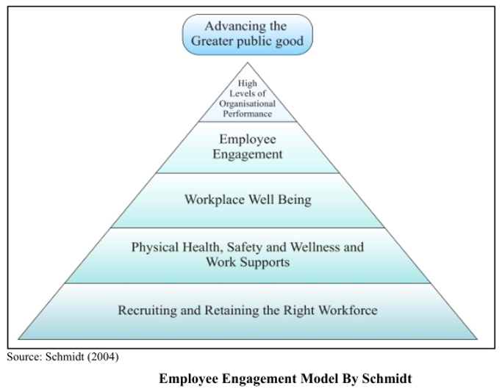
SCHMIT MODEL OF EMPLOYEE ENGAGEMENT
In this model the first step has been given to Recruiting and retaining the right workforce as employee engagement starts there, and then the physical health, safety and well being of the employee. Next step is workplace well being that means not only personal but workplace too the place should be safe to work, also the workplace condition should be workable. Following that the next step is employee engagement, here employees are engaged as company wants to look after their well being this could then potentially lead to good results at a high level of an organisation to perform your best for the company overall. (Anond, 2009).

Slide 7

WHY THE STAFF ENGAGEMENT IS SO CRUCIAL?
Reduces turnover, Increases productivity, Produce more revenue for the company. If we look at Hotel industry overall there is another example of a good practice like the Hilton hotel who are pioneer at employee engagement. They provide frequent awards, activities, and initiatives to recognise outstanding team members. Working effectively in Hilton, of course, is never overlooked. In addition, with a 92% participation rate, the firm's teammates survey serves as one of the contributing factors to their comprehensive people program.(Hrmagazine,2022)
As Forbes released an article about 3 things, managers can learn how to engage effectively with employees. These are aligning employees around the company purpose to keep goals mutual. Treat employees just like the visitors and guests at the hotel. Lastly, to be able to look after employees well being and health is also significantly important. (Forbes,2020).
This will enable the employees to be more engaged with the company.
They will know what they are doing, their moral will be increased and they will be more positive.
Overall it will be hugely beneficial for the company as well.

Slide 8

EMOTIONS IN ENGAGING EMPLOYEES:
Creating Positive emotion, Motivating your employee, will encourage them to be more passionate in their role within the hotel, making the employee feel Safe and secure, are all valuable assets to the firm, allowing for their voice and opinions being heard will make them feel they have a vital role within the hotel, making the employee aware of their worthiness through recognition of achievements and awards. (Bonfyre, 2017)
The opposite to this in being negative has a massive impact on the firm and the employee making them feel Insecure in the environment in which they are expected to work in, they will not be contempt, may lead the employees in being irritated, causing problems and negative situations between themselves, overall being unhappy and dissatisfied within their own work.

Slide 9
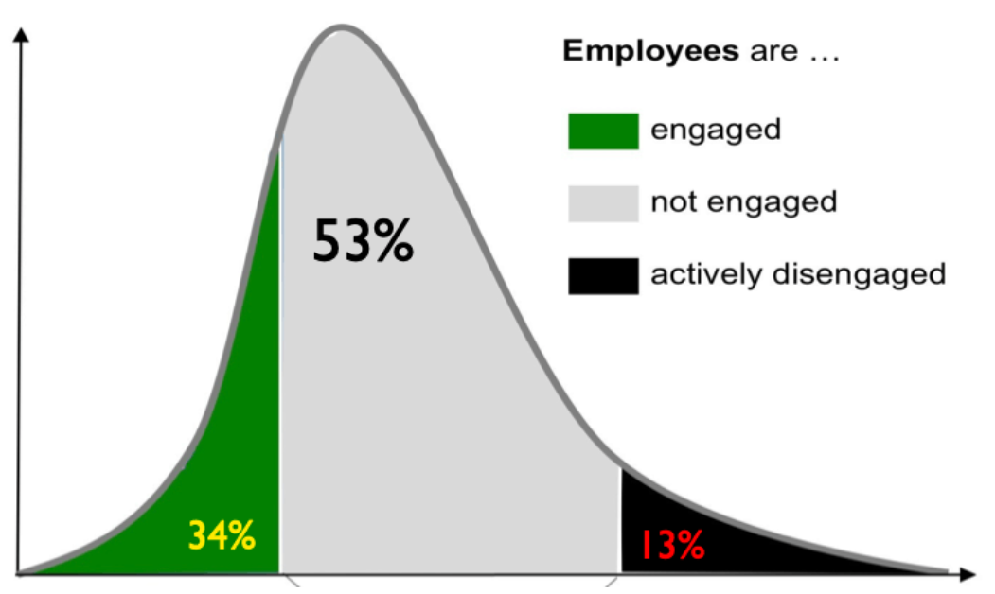
STATISTICS
According to a Gallup poll, by looking at statistic chart on this slide the hotel businesses with more employee engagement are 34% percent more engaged, 53% not engaged, and 13% actively disengaged, which is rather worrying percent on employee engagement, it is therefore more important than ever for firms to promote more productivity if not followed can substantially lower turnover. According to this study, 65 percent of all lost customers, could potentially be linked back to of had a negative experience with a disengaged employee. (Alicia Hoisington, July 2019)
(Alicia Hoisington, July 2019)

Slide 10
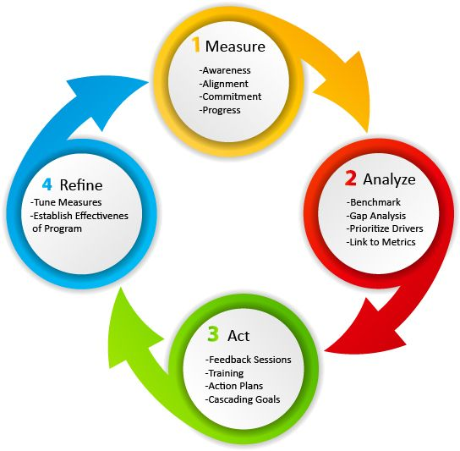
CONCLUSION...
In conclusion to my research i have found that there are lots of tools and systems in place for hotel industries for effective employee engagement. On this final slide I have from research discovered the employee engagement process system, which in my opinion is a good measurable tool to use within any hotel firms.
A breakdown of this system as follows:
1, TO MEASURE ( awareness, alignment, commitment and progress.)
2. TO ANALYSE (The benchmark, gap analysis, prioritise drivers, link to metrics
3. TO ACT (Give feedback sessions, provide training, implement action plans & goals)
4. TO REFINE( By making checks through measures and establish effectiveness of the program)

Slide 11
CONCLUSION CONTINUED...
EMPLOYEE ENGAGEMENT FOR SUCCESS
Having a good understanding and relationship between worker and organisation is crucial for employee engagement. Employees should be dedicated and enthusiastic towards their work. To get higher level of connection between employees and their firm there are lots of measures a company can take, to let the employees know, that they are valued and cared about to keep them positive motivated to work and most importantly comfortable and happy in their work environment.,their well being is something the company should take seriously and priorities at all times.
By employee engagement the company can not only increase their value, they can gain employee loyalty. This can result in high organisational performance and stakeholder value of the company. In the long term, by employee engagement both employee and company contribute to each other and each goal goes side by side. (Gangan,2016)

Slide 12
Reference
Alicia Hoisington ( 9 July 2019) https://www.hotelmanagement.net/human-resources/roi-people-employee-engagement-key-to-profitability [Accessed 19 November 2022]
Megan Thompson (2021). Employee Engagement Models and Theories. [online] WeThrive. Available at: https://wethrive.net/employee-engagement/employee-engagement-models-and-theories/#:~:text=An%20employee%20engagement%20model%20is.
Schmit Model of Employee Engagement. (2009). Available at: https://www.vskills.in/lms/wp-content/uploads/2020/09/Image-12-1.jpg [Accessed 10 Nov. 2022].
www.davidzinger.com. (n.d.). Zinger Model — ENGAGE with David Zinger. [online] Available at: http://www.davidzinger.com/zinger-model/.
Managementstudyguide.com. (2015). Zinger Model of Employee Engagement. [online] Available at: https://www.managementstudyguide.com/zinger-model-employee-engagement.htm.
Effector. (n.d.). Five employee engagement models. [online] Available at: https://www.effectory.com/knowledge/five-employee-engagement-models/.
Hrmagazine,com (2022). [online] Available at: https://www.hrmagazine.co.uk/content/features/creating-a-culture-fit-to-last-at-hilton/
Businessperspectives.org. (2022). [online] Available at: https://www.businessperspectives.org/index.php/journals?controller=pdfview&task=download&item_id=12242 [Accessed 8 Nov. 2022].
Forbes, 2020 [online] Available at: https://www.forbes.com/sites/serenitygibbons/2020/04/30/3-things-you-can-learn-from-marriott-about-taking-care-of-employees/?sh=5de6d64c2bca
Sinclair, S. (n.d.). Which Employee Engagement Model is Right for Your Business? [online] www.talkfreely.com. Available at: https://www.talkfreely.com/blog/employee-engagement-model.
Smith, T. (2020). Employee Engagement. [online] Investopedia. Available at: https://www.investopedia.com/terms/e/employee-engagement.asp.
David Macleod (2021). What is Employee Engagement? [online] Engageforsuccess.org. Available at: https://engageforsuccess.org/what-is-employee-engagement/.
firstup (2021). Why is Employee Engagement Important to Company Success? [online] Firstup. Available at: https://firstup.io/blog/employee-engagement-key-to-company-success/.
Bonfyre. (2017). 5 Emotions Show Impact of Employee Engagement on Performance. [online] Available at: https://bonfyreapp.com/blog/5-emotional-constructs-impact-workplace-engagement.
Officevibe (2022). The importance of employee satisfaction. [online] Officevibe. Available at: https://officevibe.com/blog/importance-employee-satisfactionZINGER,D(2016)THE ZINGER MODEL {ONLINE IMAGE} {ACCESSED ON 4TH DECEMBER 2022}
https://www.linkedin.com/pulse/employee-engagement-putting-stories-progress-david-zinger
GANGAN,S(2016)”Regarding engagement, yes we need to pay people more-pay them more attention! It’s not about the money!”[online]ACCESSED ON 5THDECEMBER 2022]available at:
https://www.linkedin.com/pulse/regarding-engagement-yes-we-need-pay-people-more-sumukh-gangan
Whitbread, PLC.(2018)Employee Engagement-best practise examples,[online]ACCESSED ON 4TH DECEMBER 2022} Available at: https://silo.tips/download/employee-engagement-best-oractise-examples-premier-inn-sun-microsystems

