Slide 1
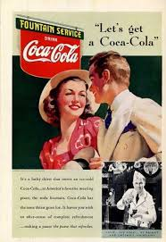
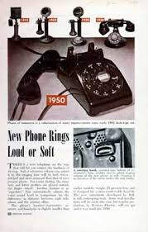
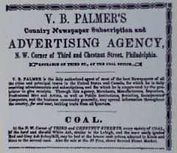

Marketing Past, Present and Future

Slide 2
Pre-lecture Work
Discuss the case study and answers to the questions

Slide 3
7 Era’s of Marketing
Simple Trade Era – Where everything was hand created and in a limited supply. Households would produce what they consumed.
Mass Production Era (1860s-1920s)- Products were produced in mass and at a low cost. businesses had the mindset of, “if produced, someone will buy” and thus increase profitability.
Sales Era (1920s-1940s) - As the market continued to become more saturated and intensify, competition increased among businesses.
Marketing Department Era (1940s-1960s) - Advertising, sales, promotions, and anything marketing related all grouped into one department.
Marketing Company Era (1960s-1990s) - the marketing department help guide a company’s direction. The customers become king and are now the main focus.
Relationship Marketing Era (1990s-2010) - The ultimate goal for businesses is to create customer loyalty.
Social/Mobile Marketing Era (2010-Present) - Due to technology, businesses and customers can communicate 24/7. The customer is in the driving seat now, not businesses.

Slide 4
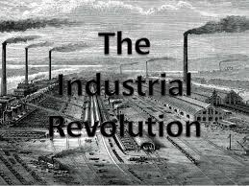

Slide 5
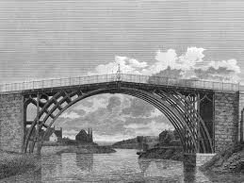
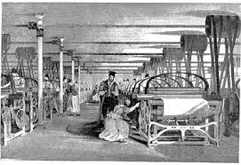
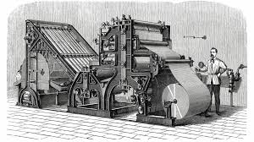
The Industrial Revolution
Urbanization (The growth of Cities)
Factories were born as was mass production
Transportation systems were created leading from mass production
Communication methods were invented – The telegraph and later the electronic telegraph cable
The banking sector was created as was the stock exchange, developing alternative payment methods and business structures
The invention of the printing press
Discussion: How could all of these things support the growth of the idea of Marketing?
Notes:
Before the advent of the Industrial Revolution, most people resided in small, rural communities where their daily existences revolved around farming. Life for the average person was difficult, as incomes were meager, and malnourishment and disease were common. People produced the bulk of their own food, clothing, furniture and tools. Most manufacturing was done in homes or small, rural shops, using hand tools or simple machines.
The transportation industry also underwent significant transformation during the Industrial Revolution. Before the advent of the steam engine, raw materials and finished goods were hauled and distributed via horse-drawn wagons, and by boats along canals and rivers. In the early 1800s, American Robert Fulton (1765-1815) built the first commercially successful steamboat, and by the mid-19th century, steamships were carrying freight across the Atlantic. As steam-powered ships were making their debut, the steam locomotive was also coming into use.
Communication became easier during the Industrial Revolution with such inventions as the telegraph. In 1837, two Brits, William Cooke (1806-1879) and Charles Wheatstone (1802-1875), patented the first commercial electrical telegraph. By 1840, railways were a Cooke-Wheatstone system, and in 1866, a telegraph cable was successfully laid across the Atlantic.
The Industrial Revolution also saw the rise of banks and industrial financiers, as well as a factory system dependent on owners and managers. A stock exchange was established in London in the 1770s; the New York Stock Exchange was founded in the early 1790s. In 1776, Scottish social philosopher Adam Smith (1723-1790), who is regarded as the founder of modern economics, published “The Wealth of Nations.” In it, Smith promoted an economic system based on free enterprise, the private ownership of means of production, and lack of government interference.

Slide 6
Market Revolution
  In America this post-industrial revolution era was known as market revolution as it was known to expand the market, through technological advances, communication capabilities and mass production.
  https://www.youtube.com/watch?v=S9is84O248c

Slide 7
Summary
Mass Production created many products that consumers wanted or needed.
Distribution channels were established via advances in infrastructure
Advertising became possible due to printing and telegraph advances
Suddenly there was an increase in demand, so more products were manufactured to meet demand.

Slide 8
Social Change and the Industrial Revolution
https://www.youtube.com/watch?v=6As8AIbKK5Q

Slide 9
Activity
Consider an issue tackled by the previous video that could have been the subject of a contemporary Social Marketing campaign.
What is the issue you wish to tackle?
What would the strategy look like?

Slide 10
Sales Era 1920-1940
Following on from the Industrial revolution there was now lots of mass produced products to sell….
This lead to increased competition, focus on getting rid of products, convincing customers to buy their products, not at all considering the needs of the customer base.
Supply was starting to be greater than demand
Everything was based around price and not quality.
https://www.youtube.com/watch?v=0ygxXff3fOc

Slide 11
Marketing department Era 1940-1960
Marketing functions were brought together under one department.
All adverts and advertising for all products were distributed from one place.
Short term planning

Slide 12
Marketing Company Era 1960-1990
Whole companies set up to create marketing campaigns.
These could be for companies or products, even governments in some cases.
Customer is king
Shift to providing what the customer needs rather that convincing them to purchase something.
Companies have the ability to conduct research and make recommendations.

Slide 13
Relationship Marketing Era 1990-2010
https://www.youtube.com/watch?v=BKOrVpaP6eY
CASE STUDY
https://www.expertmarket.co.uk/crm-systems/apple-crm-case-study
ACTIVITY
In groups, discuss how and why Apple do what they do? Can you think of any other companies who have adopted a similar policy

Slide 14
Social/Mobile Marketing Era 2010-present
https://www.youtube.com/watch?v=3LJvodmYu3Q

Slide 15

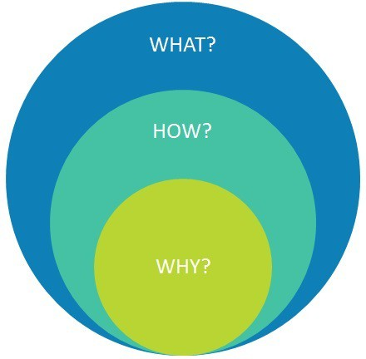
The Future……
Where is marketing going from here…
Has the 4 P’s been replaced People don’t buy products
with the 4E’s? Anymore, they buy experiences
and emotions.

Slide 16
Pre-lecture Work
Conduct some research into the different perspectives and opinions of where the future of Marketing lies.
Lots of companies and theorists have opinions, come to lecture prepared to discuss the future of marketing.

