Slide 2
ECAY5005:
Health and Social Care: Disability and Wellbeing
Anti- Oppressive Practice
2023

Slide 3
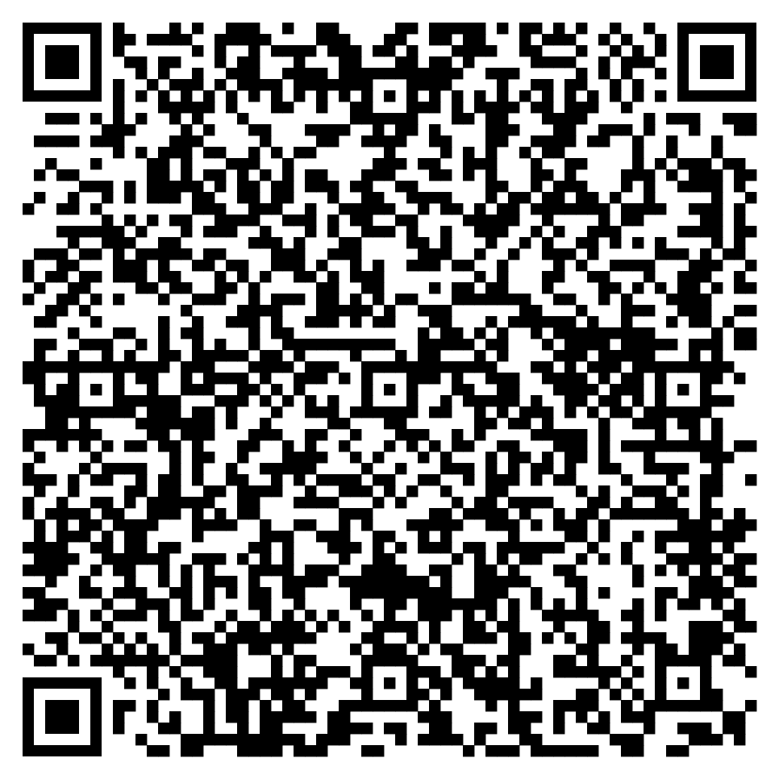
QR Code to Module evaluation
and feedback

Slide 4

What do you think of when you hear
‘anti-oppressive’ practice?

Slide 5
Understanding Oppression
(Thompson, 1993 cited in Nzira and Williams, 2009, p. 18)
Thompson (1993) introduced the ‘PCS’ model of oppression and discrimination
P: personal and psychological level
  Interactions with others/thoughts/beliefs/values/stereotypes/prejudices
C: cultural level
  Patterns of shared values/behaviours stemming from consensus and conformity within a particular society or culture
S: the structural level
  How power and resources are used in society to maintain or tackle divisions
The P, C, S levels interreact to maintain and influence each other

Slide 6
What is ‘anti-oppressive practice?’
Respect and welcome diversity
Rid ourselves, as far as possible, or stereotypes and prejudices through gaining accurate knowledge of people or groups
Use any power and privilege we have to benefit people and ‘wound’ them through social devaluation
Work for communality, sharing and equality
Be aware of negative aspects the culture and structures in society in which we live and try to change them
Recognise the perviousness and seriousness of oppression in the world, and commit ourselves to positive action to remedy this
Study first-hand accounts by those who experience oppression, to understand its reality, nature and prevalence, and to gain authentic knowledge for tackling it
(Nzira and Williams, 2009, p. 39)

Slide 7
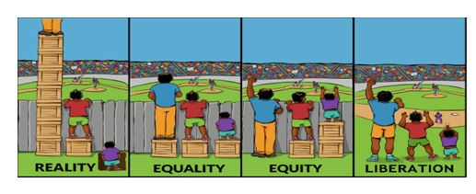

Slide 8
Anti-oppressive practice in mental health:
‘Power Threat Meaning Framework’
The following slides have been adapted from Johnstone and Boyle (2019)

Slide 9
Contributors to the project over a 5-year period
Lucy Johnstone, Mary Boyle, John Cromby, Jacqui Dillon, Dave Harper, Peter Kinderman, Eleanor Longden, David Pilgrim, John Read, with editorial/research support from Kate Allsopp
  Consultancy group of service users/carers
  Critical reader group to advise on diversity
  Other expert contributions including examples of good practice
Notes:
This is a co-produced document and the core team consists of psychologists and survivors (Jacqui and Eleanor). In addition it benefited from input from a SU/carer consultancy group (details in Chapter 7 of main document.) and expertise from a range of others – total group of about 40. Launched in London in January 2018.

Slide 10
The Power Threat Meaning Framework
An attempt to outline an alternative to the diagnostic model of distress and unusual experiences
A set of ideas and a conceptual resource, not formal recommendations or ‘how to’ manual
Funded by the Division of Clinical Psychology of the British Psychological Society but not an official DCP or BPS model
Co-produced with experts by experience, both within the core project team and as an advisory group
Not a replacement for all current models and practices. It offers a wider overall framework to support and enhance them...
..... as well as suggesting new ways forward, both within and beyond services
Notes:
Of the total project group of about 40, approximately one third had experience of receiving mental health services. There was also a group advising on Diversity issues.

Slide 11
The Power Threat Meaning Framework
Relevant to a wide range of stakeholders, for e.g., public health, social policy, mental health, acute healthcare, education, criminal justice settings, social care, peer supporters, experts by experience, carers, health commissioners, researchers, voluntary sector workers, teachers and trainers, policy makers, academics, journalists, and the general public
The documents are a first stage, subject to ongoing development in the light of evaluations and feedback from particular settings.
The PTMF has attracted national and international interest, although controversial in some quarters
Notes:
Emphasise that people are free to take exactly what they want from the workshop/day – anything from deciding it’s not for them, to reading further about it, to thinking about translating some of the ideas into practice at any level, however small. The end of the day will allow time for thinking about what that might look like.

Slide 12
The PTM Framework and trauma-informed approaches
Draws on this research (ACEs, neurobiology of stress etc) but also on a much wider range of philosophical, sociological and psychological literature
Non-diagnostic (‘PTSD’, ‘Complex Trauma’ etc..)
Prefers ‘adversity’ (less risk of decontextualised shorthand)
Suggests patterns of distress not only related to obvious ‘trauma events’ but also to more insidious factors including inequality, social exclusion, discrimination, devalued identities etc..
Explicit links to wider institutional and organisational contexts, macro political and socioeconomic structures and ideologies
Importantly, suggests non-diagnostic alternatives for welfare access, commissioning, legal work, research….etc..
Notes:
Optional slide – how the PTMF draws on, but also critiques and goes further than, trauma-informed practice (although of course trauma-informed practice varies.)

Slide 13
Moving beyond the ‘DSM mindset’… i.e., the medical model
Away from medicalisation – assuming that models designed for understanding bodies can be applied to people’s thoughts, feelings and behaviour.
Instead, a framework that understands people in their relational, social and political environments….
……and sees them as people acting and making meanings, within their life circumstances.

Slide 14
The Power Threat Meaning Framework
Going beyond non-diagnostic ways of working one to one (such as formulation) ...
.... to suggest a framework for describing wider evidence-based patterns of distress and unusual experiences....
.....which help to construct individual/family/group/social narratives, inside or outside services, supported or not by professionals…..
…as well as suggest alternative ways of fulfilling the other functions of diagnosis.
Notes:
Medical diagnosis is based on pattern identification, based medical on research using appropriate theoretical frameworks. General medicine has been pretty successful in identifying the patterns of bodily dysfunction that support a diagnosis of (say) diabetes, or heart disease. Giving a diagnosis is a process of matching a particular person’s complaints to one of these research-based patterns. The PTMF attempts to identify different kind of patterns, appropriate for emotional distress, and in doing so, to support and set the scene for a general shift away from the diagnostic model, with narrative at its heart. This is what takes the PTMF further, we hope, than being simply another way of constructing narratives (although it can be used in that way too.)

Slide 15
As well as fulfilling the expected functions of diagnosis, these are the aims of the PTMF:
Recognising that emotional distress and troubled or troubling behaviour are, ultimately, understandable responses to a person’s history and circumstances
Restoring the link between distress and social injustice
Increasing people’s access to power and resources
Creating validating narratives which inform and empower people, groups and communities by restoring these links and meanings
Promoting social action
Notes:
Diagnosis severs the link between social injustice and personal distress. The PTMF aims to restore this link. Narratives – a term that is deliberately wider than formulation, since it can encompass all the many ways humans make meaning across the world – art, poetry, song, dance, and community myths, rituals and ceremonies.

Slide 16
The Power Threat Meaning Framework poses these core questions
'What has happened to you?’
(How is Power operating in your life?)
‘How did it affect you?’
(What kind of Threats does this pose?)
‘What sense did you make of it?’
(What is the Meaning of these experiences to you?)
‘What did you have to do to survive?’
(What kinds of Threat Response are you using?)
Notes:
The complex document hangs on four simple key questions – (the PTMF version of the questions is in the brackets.) These are essentially an expansion of the survivor slogan ‘Instead of asking “What’s wrong with you?” ask “What happened to you?”’ The following slides take us through these questions, and give us an idea of the main principles of the PTMF.

Slide 17

In one to one clinical, peer support or self help work this then leads to the questions:
What are your strengths?’ (What access to Power resources do you have?)
…..and to integrate all the above: ‘What is your story?’
Notes:
The core questions are a way of indicating the essential aspects of distress that need to be explored. There is no suggestion that they have to be asked in this order, or in these words. (Eg – sensitivity is needed before asking about some of the more difficult Power aspects of a person’s life.) But these are areas that do need awareness at some point. Everyone is free to adapt these questions for their settings and purposes.

Slide 18

What do you think of the concept of the PTMF?

Slide 19
“What has happened to you?”
(How is POWER operating in your life?)
Power is everywhere in human affairs, yet explicit definitions are rare. PTMF defines power as:
  The means of obtaining security and advantage
  Being able to influence your environment to meet your own needs and interests
Notes:
We will now work through the questions, starting with Power. This is because Power is the aspect that is most often missing – from psychiatric models, but also from many psychological and psychotherapeutic models. All of them can be individualising, which is why the PTMF critiques (some) psychological models as much as psychiatric ones. (NB The PTMF is not about psychiatrists, or psychiatry as a system, specifically. It is about ways of thinking that are found across professions and systems.)
We know that people who end up in MH system tend to be least powerful – but also that distress can happen to anyone – we are all subject to forms of Power. These are 2 possible definitions.

Slide 20
'What has happened to you?’
(How is Power operating in your life?)

Slide 21
Power can operate in many different ways:
Legal power - coercion, or rules and sanctions supporting or limiting other aspects of power, offering or restricting choices
Economic and material power - the means to obtain valued possessions and services, to control others’ access to them and to pursue valued activities
Interpersonal power -power within close relationships, the power to look after/not look after or protect someone, to leave them, to give /withdraw /withhold affection etc
Coercive power or power by force - any use of violence, aggression or threats to frighten, intimidate or ensure compliance

Slide 22
Power can operate in many different ways
Biological or embodied power - the possession of socially valued embodied attributes e.g.,: physical attractiveness, fertility, strength, embodied talents and abilities, physical health
Social/cultural capital – a mix of valued qualifications, knowledge and connections, often related to class, race and gender, which ease people’s way through life and can be passed indirectly to the next generation
Ideological power - involves control of language, meaning, and perspective

Slide 23
Ideological power
Probably the least obvious and least acknowledged form of power
Part of every other form of power
Operates when our thoughts, beliefs and feelings are manipulated, ignored, or disbelieved, and alternative interpretations are offered or imposed
In everyday life, it shapes the sense we make of our circumstances. In mental health and criminal justice systems it can:
  turn social problems into individual ones
  diagnose or define people as ‘bad or mad’
Notes:
The Framework places a great deal of emphasis on the central role of ideological power. Maybe give examples of what an ‘ideology’ is? Eg a set of beliefs – a bit like austerity policies, or neo-liberalism in general – which are not easily open to proof or disproof, but which exert their influence through the use of language and meaning. Thus, there may be a strong emphasis on individual responsibility, people on benefits may be described as ‘scroungers’, and these terms and ideas may be used to justify dismantling welfare systems. Often, ideologies work to increase the power of already more privileged groups at the expense of those that are already less privileged.
This is a good article on the austerity narrative: https://www.theguardian.com/commentisfree/2019/aug/05/blame-scroungers-migrants-austerity

Slide 24
Ideological Power
Many people, especially those in less powerful positions, may be deprived of sound alternative frameworks to make sense of their own and others’ distressing or unusual experiences
This ‘epistemic injustice’ is experienced by groups who lack shared resources to understand their experiences, due to unequal power relations (Miranda Fricker, 2007)
From the PTMF perspective, the imposition of a diagnosis, with no alternatives offered, is an example of epistemic injustice.

Slide 25
Power
The less access you have to conventional or approved forms of power, the more likely you are to adopt socially disturbing or disruptive strategies
Power also operates positively and protectively
  friends, partners, family, communities, material resources, social capital, positive identities, education and access to knowledge

Slide 26
Some consequences of the negative operation of power . . .
Unpredictability and lack of control over your life
Feeling trapped in damaging environments
Conflict: internal, relationships, social
Negative views and stereotypes about you and/or your social group
Repeated exposure to many forms of abuse and violence, along with humiliation, criticism, racism and other forms of discrimination etc.

Slide 27
‘How did it affect you?’
(What kind of Threats does this pose?)

Slide 28
Threats
Relationships:
threats of rejection, abandonment, isolation
Emotional:
overwhelming emotions, loss of control
Social/Community:
loss of social roles, social status, community links
Economic/material:
threats to financial security, housing, meeting basic needs

Slide 29
Threats
Environmental
threats to safety and security, or to links with the natural world e.g. living in a dense urban or high crime area
Bodily
threats of violence, physical ill health
Value based
threats to core beliefs and principles
Meaning making
threats to ability to create your own valued meanings, imposition of others’ meanings

Slide 30
Threats
The threat (or operation of Power) may be less obvious because it is subtle, cumulative, and/or socially acceptable.
The threat is often distant in time.
The threats may be so numerous, and the responses so many and varied, that the connections between them are confused and obscured.
There may be an accumulation of apparently minor threats and adversities over a very long period of time
The threat response may take an unusual or extreme form that is less obviously linked to the threat; for example, apparently ‘bizarre’ beliefs, hearing voices, self-harm, self-starvation.
Notes:
Optional slide of the various reasons that the link between threat and threat response may be obscured. (If time is short – briefly acknowledge that links are not always obvious, that it may take a long time to understand what happened to people, and so on.)

Slide 31
‘What sense did you make of it?’
(What is the Meaning of these experiences to you?)

Slide 32
“What sense did you make of it?”
(What is the MEANING of these experiences?)
We actively make sense of our world, and our behaviour is purposeful and meaningful. We cannot understand any aspect of Power, Threat or Threat Response separately from their meanings.
But what do we mean by ‘meaning’?
Meaning is never just freely chosen, it is always both ‘made and found’ (Shotter, 1993)
Notes:
‘Meaning’ is the thread that holds all the other aspects of the PTMF together. Most MH professionals will be used to reflecting on meaning with their clients in one form or another – e.g. through therapy. But the project expands on traditional understandings of ‘meaning’ as something that is created and happens mainly verbally in our heads (NB this is not a universal assumption, and in fact some cultures do not make the typically Western distinction between thinking and feeling. Nor does this actually make sense when we consider people’s distress – shame, guilt, fear etc are an integration of cognitive, emotional AND bodily responses.) Meaning arises out of many aspects of our experiences.

Slide 33
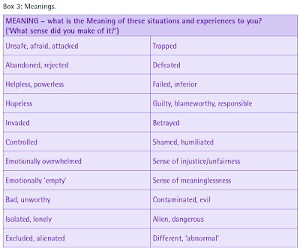
Being powerless is uncomfortable and often highly distressing.
Common feelings ('meanings') that arise from lack of power include:

Slide 34
Some of these may be seen as ‘normal’ or even desirable (overwork, perfectionism, ruthlessness with colleagues, etc..)
They are likely to be to some degree culture-specific (self-starvation in Westernised countries; so-called ‘culture-bound syndromes’.)
Threat responses are there for a reason, and it makes more sense to group them by function – what purpose do they serve? than by ‘symptom.’
Both the function and the meaning of the response vary over time and across cultures, but there are common themes.
Notes:
From a PTMF perspective it makes little sense to ask (or research into) questions like ‘What causes depression/hallucinations/eating disorders?’ Threat responses, which may be described as ‘depression’ or ‘anorexia’ or whatever, may serve different functions/purposes at different times for different people (albeit with some common themes.) It makes more sense to see them in terms of the function or purpose they are serving in any given situation.

Slide 35
Meaning
Personal meanings are never purely individual
  Language is shared with others
  Memories reflect lived experience
  Bodily reactions and feelings are shaped by learned habits
  Environments differ, and resources are unequally distributed
  How we ‘should’ feel is shaped by cultural norms
  Thus, meanings are shaped by adverse power relations, threats, social norms, ideologies, cultural assumptions etc.
Notes:
The PTMF encourages us to look more widely at the origins of these meanings.

Slide 36
Personal perceptions of meanings
The person in distress may not be aware of the link themselves, since memory loss, dissociation and so on are part of their coping strategies.
The person in distress might have become used to overlooking possible links, because acknowledging them felt dangerous, stigmatizing or shaming
Overlooking or ignoring the links may be encouraged by:
  Messages about personal blame, weakness, culpability etc.
  Messages about personal responsibility, not complaining, being strong etc.
Notes:
Optional slide of the various reasons that the link between threat and threat response may be obscured.

Slide 37
Restoring the link between Threats and Threat Responses – a main purpose of the Framework
The Power Threat Meaning Framework shows how we can restore the links between threats and threat responses as an alternative to the diagnostic lens which obscures them.
At one level this is common sense. We all know that people living in poverty are more likely to feel miserable (‘depression’); we recognize that abuse and trauma makes it more likely that people will hear voices (‘psychosis’ or ‘schizophrenia’); and that Indigenous people have many reasons for despair.
But a number of factors combine to conceal these links – from the person and from society as a whole.

Slide 38
‘What did you have to do to survive?’
(What kinds of Threat Response are you using?)

Slide 39
Some examples of Threat Responses
Preparing to fight, flee, escape, seek safety
Giving up (‘learned helplessness’, apathy, low mood)
Being hypervigilant
Having flashbacks, phobic responses, nightmares
Experiencing rapid changes in mood and emotions
Amnesia/fragmented memory
Hearing voices, dissociating, holding unusual beliefs
Restricting our eating, using alcohol or drugs, self-harm
Denial, avoidance
Overwork, perfectionism
Notes:
A rough hierarchy of threat responses, from more biologically-based to those that are experienced as under greater conscious control. Threat Responses are more traditionally called ‘symptoms’ (or ‘survival strategies’ in TIA.) However, within PTMF, socially valued reactions such as overwork can also, in some contexts, be seen as threat responses. Conversely, some experiences that are almost invariably seen as ‘pathological’ can be seen from a PTMF perspective as valued aspects of someone’s life (eg hearing voices) and not necessarily a threat response.

Slide 40
Threat responses and the medical model
The use of diagnosis by professionals obscures the link between threats and threat responses, and imposes a narrative of individual ‘illness’ instead
There is widespread resistance to recognizing the reality and impact of threats and the negative impacts of power
There are many vested interests (personal, family, professional, organizational, community, business, institutional, economic, political) in disconnecting threats from threat Responses - and thus preserving the diagnostic model.
Notes:
Some of the more central reasons explaining why and how links between threats and threat responses are obscured. Obviously, professionals are not doing this deliberately and consciously. Rather, this is a bigger problem of ideological power operating (in this case) through diagnostic language and its assumptions. We find ourselves back at ideological power again!

Slide 41

Summary
The Power Threat Meaning Framework can be seen to challenge the biomedical understanding of mental health
By linking it to the individual's response to systemic issues
  A person has experienced unequal POWER
  This posed a THREAT and a THREAT RESPOPNSE
  People may struggle to make MEANING between their experiences of powerlessness, threats and their threat responses
  The medical model individualises and pathologizes the threat response and disconnects it from the systemic circumstances

Slide 42

What are your thoughts of the PTMF? Could you imagine using it?
Group Discussion

Slide 43
References
Johnstone, L. and Boyle, M. (2019) The British Psychological Society: Documents and Training Materials. Available at: https://www.bps.org.uk/power-threat-meaning-framework/resources-training/training-materials (24th June 2020)
Nzira, V. and Williams, P. (2009) Anti-Oppressive Practice in Health and Social Care. London: Sage

