Slide 1
Sales and Merchandising

Slide 2
Promotions and merchandising
Point of Sale (POS)
Point of Purchase (POP)

Slide 3
Sales Promotions
Rewards loyal customers
Reinforces other communications – IMC
Example ref: Lagae, W (2005) Sports sponsorship and Marketing Communications. Harlow: Prentice Hall
Technique | Example
Monetary Incentive | Discounts on market price of specific products
Cash refund | Refunds in cash when buying products
Contest | Meeting sponsored athletes as the award
Lottery | Tickets to a game as a competition prize
Premium | Free gift when buying products
Savings card | Merchandised items received as a result of purchasing a number of products
Sampling | Free trial product

Slide 4
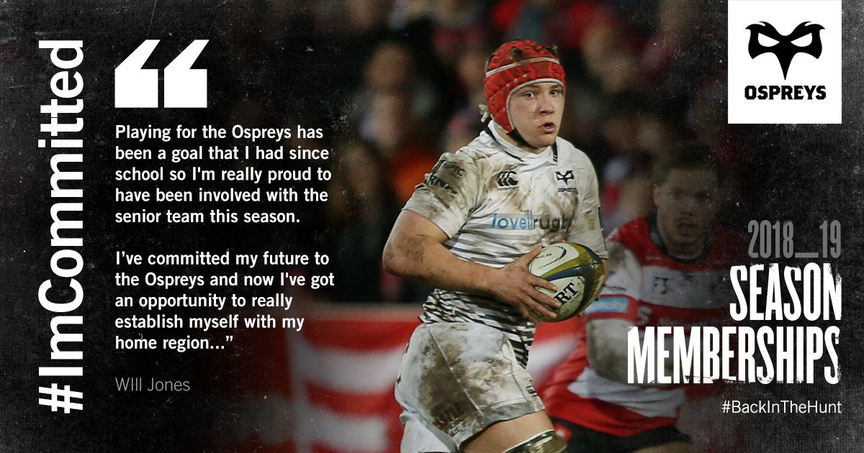
Sales and Merchandising
Sales of merchandise rely on strong involvement and identification of the fan with the sports brand
Brand value
Brand loyalty
Strong brand - Champions League - Stars, Olympics - Rings, Wimbledon, NBA

Slide 5
Things to consider
Licensing and merchandising rights
Distribution via club shops and through general retailers and via the internet!
Geographical implications - no boarders
Over merchandising – brand stretch

Slide 6
Task
What sales metrics might the organisation used for task 1b use? Provide examples.

Slide 7
Sales Metrics……
Revenue by product or product line
Percentage of revenue from existing customers (cross selling, up selling, repeat orders)
Average lifetime value of customer (LTV)
Net Promoter Score (NPS)
Marketing measurements

Slide 8
Sales and Merchandise in Practice

Slide 9
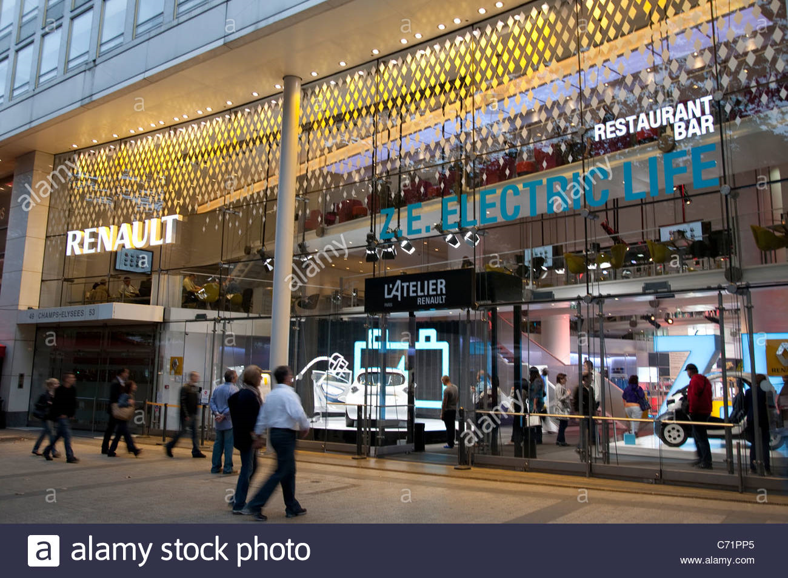
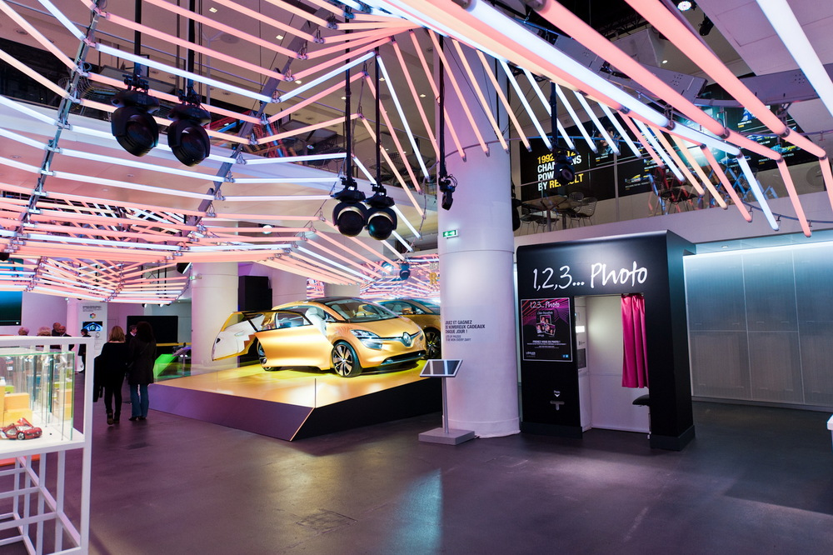
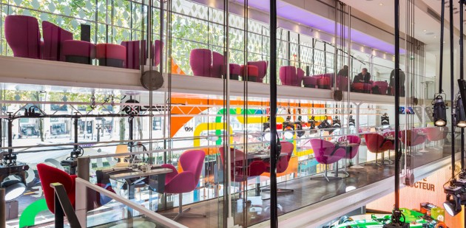

Slide 10
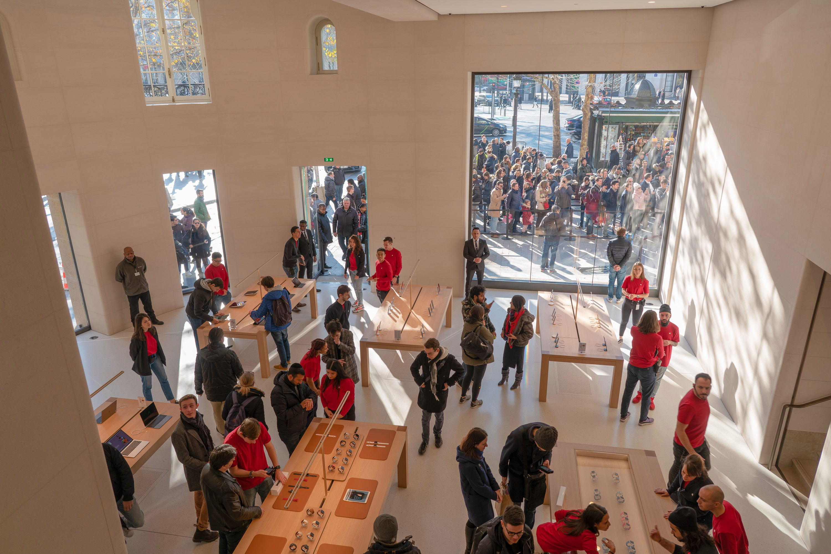
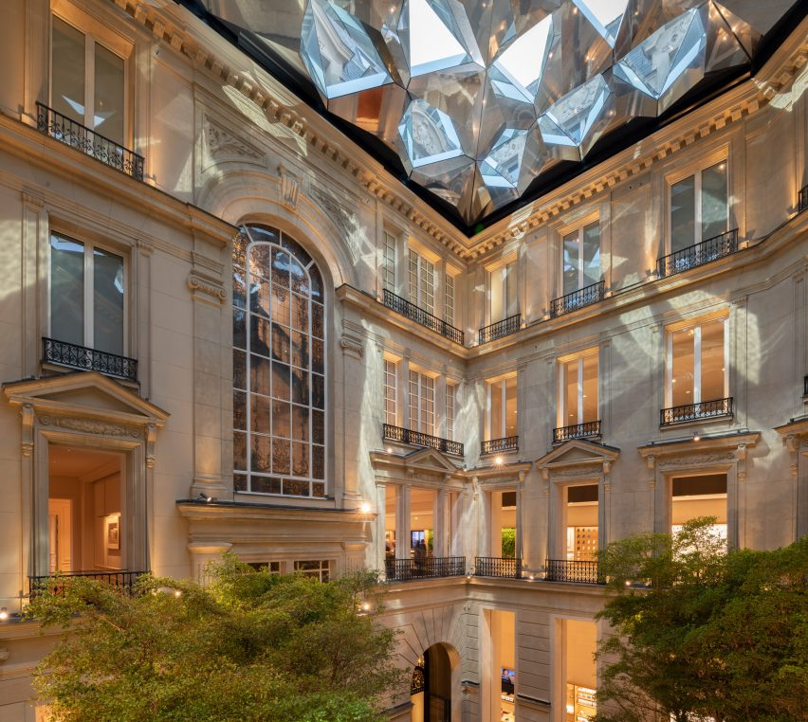
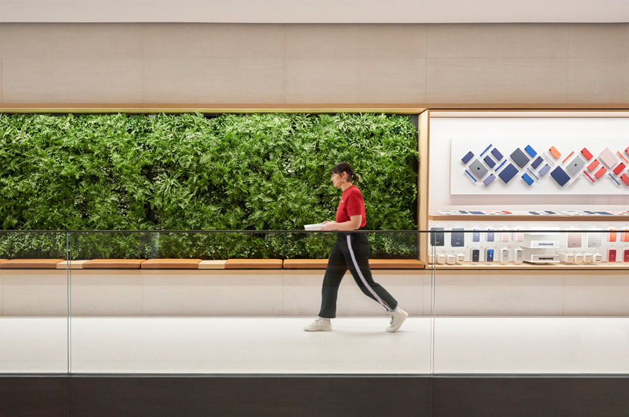

Slide 11

Application
How can we apply what we know?

