Slide 1
Student name : Frentusca Ana-Maria
Student number : 2120534
Module name : Food and Beverages Operations
(BMIH4002)
Module tutor : Steve Jones
Food and Beverage Operations
Menu Engineering

Slide 2


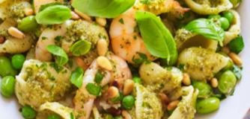
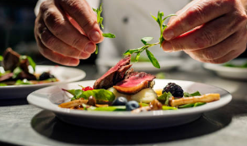
Hotel Trinity Limited Menu Card
Coast in Swansea, South Wales
Beverages
Café Latte (250 ml) £1.50
A creamy rich espresso coffee with a touch of cocoa powder and mixed with steamy milk
Earl Grey Tea (250 ml) £1.35
A great blend of flavourful tea that is quintessentially made with the oil of bergamot orange
Strawberry Prosecco cocktail (250 ml) £2.3
A fun-filled perfect drink that goes with any occasion and is light, bubbly with a tinge of freshness
Limoncello Mojito (250 ml) £2.46
An intense flavour of vodka martini with the citrus taste of lemon punched together for a chilled shot
Main course
Howtowdie served with bread £13.40
A Scottish classic with a simple recipe of boiled chicken with spinach and poached eggs
Paella served with rice £15.6
Brings the taste of Spain through the traditional dish made with rice, green beans, rabbit, chicken, duck, and butter beans
Veggie Moussaka served with tortilla £12.3
A tangy dish that is prepared with roasted eggplant, zucchini, and potatoes with the chunky taste of the tomato-lentil sauce
Celeriac and tahini potato gratin served with rice £13.45
A delicious dish made with creamy gratin along with the twist of crisp salad on top
Starters
Chicken Caeser Salad £6.67
A great combination of divergent tastes with main flavours coming from Parmesan cheese, anchovies, Romaine lettuce, and garlic
Sweet and Sour Prawns £7.15
Succulent seafood dish made with ginger, pink pepper, stir-fried with bell peppers in a tangy honey sauce
Anglesey Eggs £5.20
A Welsh classic that comes with mashed potatoes with hard-boiled eggs, baked in cheese sauce
Burrata Bruschetta £5.35
A new twist on bruschetta, topped with burrata, sugar snap peas, mint, broad beans, and chilli
Vegetable Gyoza £5.98
Dumplings in-house cooked with special veggie fillings wrapped up in a thin sheet of dough
Baked feta £6.01
A great combination of flavours comes from the taste of salty cheese and sweet honey that is both rich and decadent with the serving of warm pitta

Slide 3
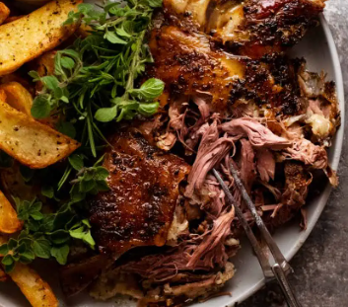

Hotel Trinity Limited Menu Card
Coast in Swansea, South Wales
Desserts
Strawberry fool £6.60
A popular dessert in the Great Britain that has the fun of creamy fresh strawberries with another surprise of a creamy base comes with a soft serve
Knickerbocker Glory £6.34
Britain’s traditional ice-cream sundae with red and white stripes is served with raspberry sauce in a tall glass with a nice long spoon
Banoffee Pie £6.3
A sweet way to beat the summer’s heat with the extra layers of milk caramel, topped with banana cream, shaved with chocolate and buttery graham cracker crust
Sticky Toffee Pudding £6.67
Dark dense sponge cake, a traditional British dessert that has chopped dates along with a sweet toffee sauce
Chef’s special
Slow-roast lamb and rice with red wine £20.38
The beauty of sizzling and delicious lamb meat prepared with a special mix of spices that melts in the mouth and surprises the taste palate; served with rice and paired with Cabernet Sauvignon red wine
Pasta salad with pesto and prawns £20.55
A wonderful and zingy prawn dish made with homemade special herbs and pesto to make it extra special; paired with Albariño white wine
Kid’s special
Rainbow fried rice with prawn and fried eggs with raspberry lemonade slushies £20.38
A delicious dish that brings the best of creativity skills using rice, eggs, and prawns; satisfy the cravings for something cool to drink while eating the hot dishes with this blend of joy prepared with the essence of lemonade and raspberries
Baked vegan korma with strawberry
smoothie £20.55
An amazingly aromatic dish, prepared with different vegetables like French beans, onions, nuts, spices, tomatoes, peas, and potatoes; pair up this dish with the refreshing strawberry smoothie that also has the punch of orange and banana juice
Location: Coast of Swansea, South Wales Allergens Statement: Attention to customers with food allergies. Please do note and be aware that our food may contain common food allergens like eggs, dairy products, wheat, seafood, and nuts Food hygiene statement: Each food item is prepared by aligning with the compliances of the Food Safety Act 1990 and all the regulations under it. Our food quality is superior and has been audited by the FDA. All the utensils, equipment, and processors that are used in our kitchen have undergone a thorough cleaning process. A core sanitization process has been carried out for the overall kitchen as well as the equipment. The cooks and chefs of our kitchen prepare the food by maintaining personal hygiene. Calories per dish: 50-400 (2-6 calories for beverages) Time availability: 13:00 to 22:00 Contact details: We are open to accept orders via the telephone or through our online app. Online orders will be delivered by UberEats to the provided location. Contact no.: XXXXXX0698 Collection: Guests can collect the takeaway orders directly from the hotel location, but it is mandatory to maintain the rules of social distancing; must wear masks and use sanitisers before collecting the deliveries while they are here for collecting the orders in person or are sending someone else for order collection. Contactless delivery: Instructions for contactless delivery- Deliveryman will be wearing masks and gloves for ensuring no contact Upon arriving at the provided location, the customer will be called for confirming the order Order will be placed at the front door Customers are requested to kindly keep their phones with themselves Payment options: We accept only digital payments through mobile wallets and bank cards, but not cash.

Slide 4
References List :
BBC Good Food (2022) Burrata bruschetta. Available at: https://www.bbcgoodfood.com/recipes/burrata-bruschetta-summer-beans (Accessed: 16 June 2022).
BBC Good Food (2022) Chicken Caesar Salad. Available at: https://www.bbcgoodfood.com/recipes/chicken-caesar-salad (Accessed: 16 June 2022).
Soon, J.M. (2019) ‘Food allergen knowledge, attitude and practices among UK consumers: A structural modelling approach’, Food Research International, 120, pp.375-381.
Zutshi, A. (2019) ‘How to develop well-informed and assured teams to embed food safety compliance in the UK catering and hospitality industry’, Perspectives in Public Health, 139(6), pp.294-295.

