Slide 1
Contemporary Themes in the Hotel &Hospitality Sector (M6X01931)
Session 1

Slide 2
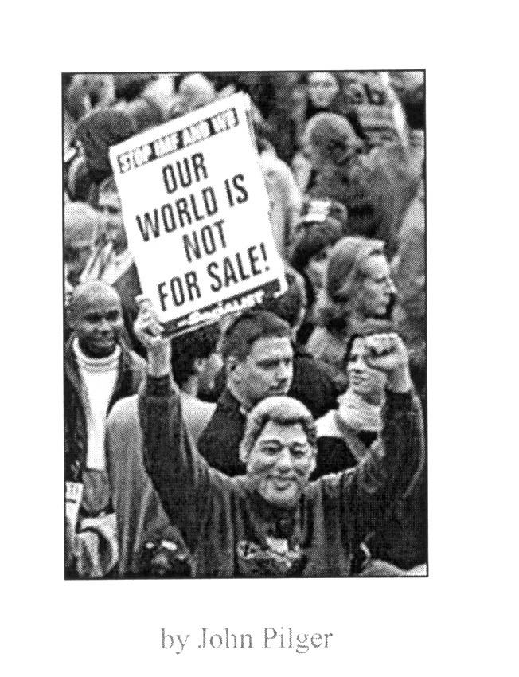
Stakeholder Conflict
Avoidance and Resolution

Slide 3
Learning Outcomes
By the end of this session:
Understand the complexity of the hospitality and tourism issues
Analyse the role of the stakeholders in the planning process
Appreciate the degree of power and influence in the system
Understand the levels and need for Collaboration

Slide 4
Definitions
‘Any group or individual who can affect or is affected by the achievement of a corporations purpose’
Freeman (1984) cited in Gretzel 2010, p237)

Slide 5
Conflict Avoidance
Avoid the undesirable in:
Friction and unnecessary competition between individual tourism operators/hostile and unfriendly attitudes of locals towards tourists/damage or undesirable, permanent alteration of natural features and historical resources.
Loss of cultural identities / the loss of market share / the stoppage of unique local events and activities
Overcrowding, congestion & traffic problems/pollution/high seasonality/other factors

Slide 6
Complexity
A destination environment is a complex dynamic, fragmented by several firms and organisations which have numerous linkages and interdependencies.
Difficult for one organisation to control
Rodriguez and Rodriguez (2008)

Slide 7
Sustainable Development/Tourism – issues to consider
Political
New World Order
Trade systems
Ethical practices?
Economic
Power/ownership
of resources?
Benefits to locals?
Can these coexist?
Environmental Economics?
Ethical practices?
Power struggles
Local empowerment?
Ethical practices?
Population = degradation of the environment?
Poverty = improvement in the environment?
Can we achieve social equity?
Environmental
Socio-cultural

Slide 8
Class Exercise
Identify and comment on the potential conflicts between different stakeholder groupings during the tourism development process
Local Government
Local Developers/
Investors
Special Interest
Groups
Conflict?
Local Employers
Local Communities
Local Employees
Tourists

Slide 9
Areas of common conflicts in hospitality and tourism development
“There is considerable scope for tension between those with
the power to grant or withhold planning permission, the
planning authorities; and those wishing to construct new
developments, the developers and operators.”
Davidson & Maitland (1997:175)
“Opposition to the growth of tourism in an area or the
establishment of specific tourism developments often arises
because access to common resources … is coveted by other
users with different, often incompatible interests”
Hall (2000:182)

Slide 10
Tourism and Cultural Heritage Management
` It is not surprising that tourism and cultural heritage management view each other with suspicion for they share very little in common apart form their resource base’
Mc kercher & Du Cros (2002:13)

Slide 11
Conflict situation Resolution Methods
Joint management agreement / co-management scheme
Consultation and bargaining
Education
Arbitration
“Conflict resolution can take a number of forms, ranging from
information exchange to mediation involving a neutral third party,
through to binding arbitration in which a decision- making function
is mutually given to a third party by the affected stakeholders.”
Hall (2000:183)
“Much conflict resolution, particularly in terms of land-use planning,
is based on the interests of the stakeholders engaged in the
conflicts. Such a process of consultation and bargaining assumes
that stakeholders have clearly defined specific interests which are
amenable to negotiation.” Hall (2000:184)

Slide 12
Comparing Cultural Heritage Management and Tourism
Cultural heritage Management Hospitality/Tourism
Structure: Public sector Private
Goal: Social goals Commercial goals
Key Stakeholders: Community/ethnic groups Business groups/non-residents
heritage groups
Economic Attitude to Assets: Existence value/conserve Use value Employment background social science/ arts Business
Use of Asset: value to community a brand/product
International Bodies/Political: UNESCO/NGO’S WTO/Tourism

Slide 13
Peaceful Co-existence
`Productive working relationships can exist at both high visitation or low visitation, provided that they are managed for such use levels’ Mc Kercher and Du Cros 2002 p. 19
Power relationships remain stable
Agree on preserving historic buildings
(tourism and tourists may justify the preservation)

Slide 14
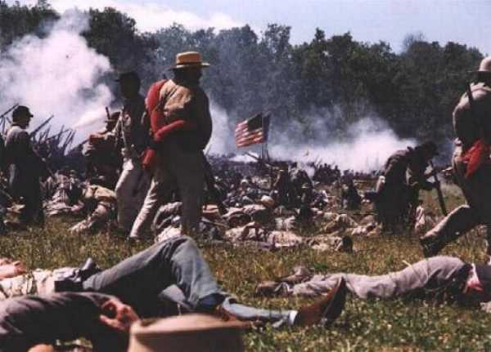

New Interest can cause conflicts/commercial use
Open conflict
Perceived conflict exist on how the different stakeholders view the assets.
For example
Disneyfication of the Gettysburg battlefield site

Slide 15
Factors influencing conflict situation in tourism development
Multi-motivational nature of tourism
Extent of cultural diversity
Economic reconstruction
Appropriateness of development
Rate of development
Structural and institutional arrangement
Extent of pressure on resources
Robinson, 1999 & Wall, 1999

Slide 16
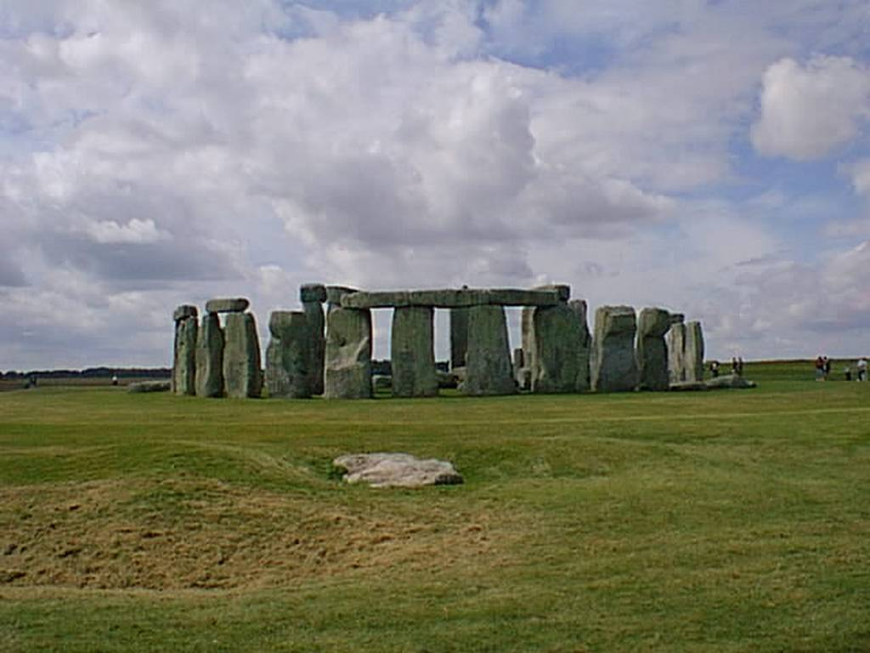
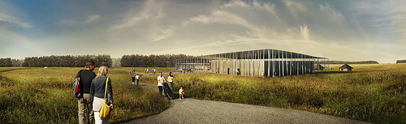
Stonehenge
Stakeholder Conflict

Slide 17
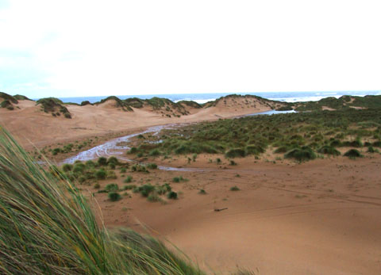
New Golf Proposal in Scotland
Aberdeenshire

Slide 18
Stringent Controls
Tough planning regulations can also cause conflict
loss of power among tourism stakeholders
Lake District example
Or local unrest over perceived power of large organisations-------Supermarkets

Slide 19
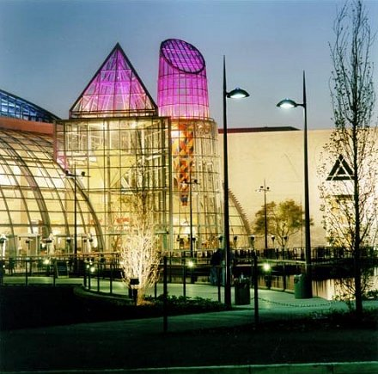

New Shopping Developments
.
In your stakeholder groups prepare a short argument that presents your case for/against the building of a new supermarket by a select coastal resort

Slide 20
Avoidance of conflict situation
Through the implementation of an effective tourism planning
procedure which ensures that all stakeholder views are taken
into consideration at the vision creation phase. The intention
must be to create a sense of shared ownership of the strategy.
The stakeholders views and perceptions must continue to be
sought and valued through the ensuing cycle of strategy
development and implementation .
Sustainable
approach
Top-down/
bottom-up
approach
Community-
based
approach
Russell (2000)

Slide 21
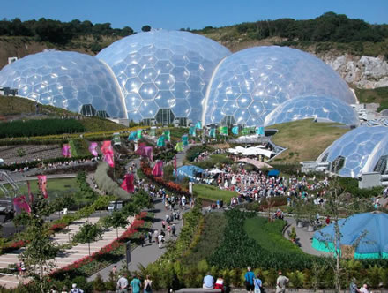
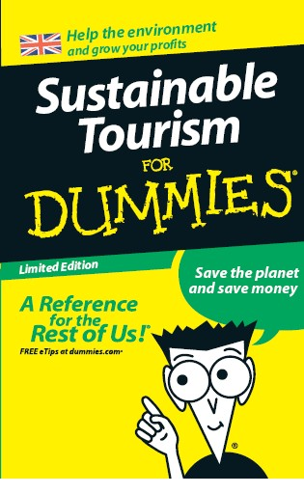
Future Foot Prints http://www.futurefootprints.org.uk/ffprints.php?stylesheet=style&page=localgov
Tourism is big business and therefore adoption of sustainable practices can deliver huge gains.
Chris Hines

Slide 22
Reform decision-making systems
It is impossible to prescribe exactly how each tourism enterprise should develop in ways that best fit with livelihoods. The most important principle is therefore to enhance participation by the poor in decision-making. Systems are needed that allow local livelihood priorities to influence tourism development. Three different ways of doing this can be identified:
Strengthen rights at local level (e.g. tenure over tourism assets), so that local people have market power and make their own decisions over developments.
Develop more participatory planning.
This material that has been provided by the Overseas Development Institute
PRO-POOR TOURISM: PUTTING POVERTY AT THE HEART OF THE TOURISM AGENDA
Caroline Ashley, Charlotte Boyd and Harold Goodwin, Number 51, March 2000

Slide 23
References
Mowforth, M and Munt. I (2008) Tourism and Sustainability, Development Globalisation and New Tourism in the Third World: Taylor and Francis
Mc Kercher and Du Cros (2002) Cultural Tourism The Partnership between tourism and culture: Routledge
Gretzel, U et al, (2010) Information and Communication in Tourism: Springer
Davidson, R. & Maitland, R. (1997) Tourism Destinations, London: Hodder & Stoughton
Hall, C.M. (2000) Tourism Planning, Harlow: Pearson Education Ltd
Page, S. (1995) Urban Tourism, London: Routledge
Robinson, M. (1999) Tourism development in de-industrializing centres in the UK in Tourism and cultural conflicts, Robinson, M. and Boniface, P. (eds.), Oxon: CABI
Russell, P. (2000) “Community-based Tourism” Travel & Tourism Analyst, no 5, pp 87-114
Wall, G. (1999) Partnerships involving indigenous people in the management of heritage sites in Tourism and cultural conflicts, Robinson, M. and Boniface, P. (eds.), Oxon: CABI

