Slide 1
MODULE NAME: PROBLEM SOLVING AND DECISION MAKING
MODULE CODE: LCLM 4004
STUDENT NAME: SVITANA KOMAROVA
STUDENT ID: 2431408
LECTURER: TOYIN ADISA
Assignment 1: PRESENTATION

Slide 2
overview
Introduction
Company background
Problem : nature and scope
PESTLE ANALYSIS : Green Haven Florists
Cause and effect analysis : Fishbon diagram
Conclusion
References

Slide 3
INTRODUCTION
Adapting to Change: Green Haven Florist Case Study
In this study we will observe "Green Haven Florist", it is the sovereigh, independet flower shop,which based in city Norwich, built by family, couples and stands on good reputation, on stability,famous for custom-made floral design and good quality.
But unfortunately, not long time ago, this business has been facing a significant 30% drop in their store sales of flowers and met increasing pressure from online competitors and flower sellers,rising cost of transportation.

Slide 4
Adapting to change: Green Haven Florist Case Study
In this presentation I will investigate all fundamental problems and reasons which caused this fall in sales and will study outside factors which made such performance of investigated flower
The main purpose of the research is to give clear vision for helping company "Green Haven" form and adapt their retail and productivity in modern rival environment.

Slide 5
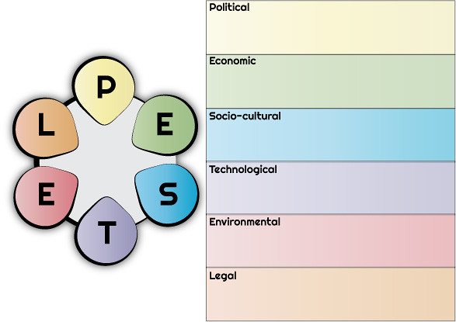
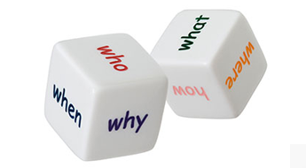
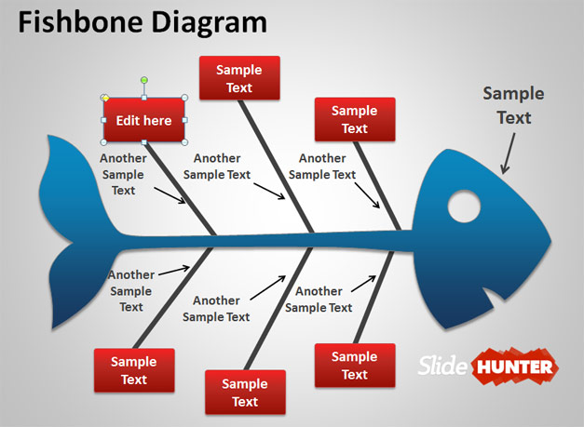
Adapting to change: Green Haven Florist Case Study
I will use famous business tools in analysis like PESTLE Analysis, 5W2H , and Fishbone Diagram
It will help us to estimate the situation of that company.
ThePhoto, автор: PhotoAuthor лицензируется в CCYYSA.

Slide 6
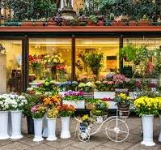
Company Background
GREEN HAVEN FLORISTS
Company was created and
established in early 2016, like
family owned business.
The founders of this business are
couples Priya Patel and Liam Patel
In city Norwich, United Kingdom.

Slide 7
Green Haven Florists:
This business focused in eco-friendly and custom-made, bespoke floral arrangements.
In their town this shop famous for stable, sustainable and strong community links.
In recent time, business faced 30% in decreasing sales of flowers.
Rasing competition, rising cost and lowering profitability also made significant problems.

Slide 8
Problem: nature and scope
5W2H Analysis:
What: Significant decrease of 30% in sales and profit
Why: Huge online competition and growing costs, old website and absence of online marketing
Where: Located in Norwich town, high street

Slide 9
5W2H Analysis
When: Main problems appeared in last year
Who: Family of two couples Liam and Priya, many competitors, local and regional customers
How: Not developed delivery system, tiny digital marketing, rising cost of materials
How much: Around 30% dropped in sales, also price of import increased

Slide 10
PESTLE Analysis
Political: Mostly affected by Afetr-Brexit problems with import.
Economic: Increasing inflation make supply cost higher and decrease profits for company.
Social: Create online selling, develop digital marketing.

Slide 11
PESTLE ANALYSIS
Technological: Old and non-functional website and feeble online items.
Legal: Wrapping and packing, tradingactivities rise cost.
Enviromental: Eco-friendly operations with other values and additional expenses

Slide 12





CAUSE AND EFFECT ANALYSIS
Fishbone Diagram
Place
People
Materials
Big decline in profit of shop
Small team in company
Growing cost of supplies and import
Decreased high-street traffic
Restricted in digital skills
Increasing costs for eco-friendly materials
Lack of online deliveries
Pressure from online competitors
Feeble marketing
Poor online shopping
Old, outdated website
Poor social media work
Technology
Equitment
Marketing

Slide 13
CONCLUSION
In the end of presentation i would like to pay attention on root causes like obsolete website, higher cost, feeble marketing, and rivalry.
Opportunities are digital change, online subscriptions and collaborations.
Directions for this shop should be combine sustainability with tech-driven advantages

Slide 14
REFERENCES
Chartered Institute of Personal and Development (2021) PESTLE analysis factsheet. London: CIPD. Avaiable at: htts: https://www.cipd.org/globalassets/media/knowledge/knowledge-hub/factsheets/pestle-analysis-factsheet_20221230T092611.pdf. (Accessed: 6 November 2025).
BGMC(2024) Exploning the Fishbone Diagram: Types, Advantages, Drawbacks and Revealing the Six M's of Change. Available at: https://bgmcgroup.com/exploring-the-fishbone-diagram-types-advantages-drawbacks-and-revealing-the-six-ms-of-change/. (Accessed: 6 November 2025).
Weitao,L., Xijian,Y., Jirong,L.(2023) "Application of 5W2H Analysis in the Training Management of the "Cantonese Cuisine Master" Project", Journal of Human Resource Development, 5(3), pp. 1-7. Available at: https://scholar.google.com/scholar?hl=ru&as_sdt=0%2C5&q=5w2h+method&oq=5W2H. (Accessed: 6 November 2025)

Slide 15
REFERENCES
Nagyova,A.,Palko,M.,Pacaiova,H. (2015), Analysis and Identification of Nonconforming Products by 5W2H Method. Avalable at:https://www.cqm.rs/2015/cd1/pdf/papers/focus_1/006.pdf. (Accessed: 7 November 2025)
Christodoulou,A., Cullinane,K. (2019), Identifying the Main Opportunity and Challenges from the Implementation of a Port Energy Management System: A SWOT/PESTLE Analysis. Available at: https://www.mdpi.com/2071-1050/11/21/6046 . (Accessed: 7 November 2025)

Slide 16

THE END
THANK YOU
QUIESTIONS

