Slide 1
Introducing the Modern Workplace
LCBB4003
Assessments guidance
Hoang Nguyen

Slide 2
Assessments 1 - Guidance
There are three important factors that affect organisational goal attainment: organisational structure, organisational culture, and individual motivation.
You have been tasked to select an organisation in the UK and submit a 2000-word report addressing the following:
How are the organisation structure and culture related to its performances?
How are its employee motivated?
Remark: It is expected that your report uses relevant concepts, theories and frameworks introduced by this module.

Slide 3
Assessments 1 - Guidance
Define the concepts and why they are important (use academic sources, use those provided by the modules if possible).
Identify the different types of the phenomenon (if any).
Use examples to illustrate your points.
Minimize the similarity index. Avoid direct quotation if possible (paraphrase if possible).
Word count: 2,000±10%

Slide 4
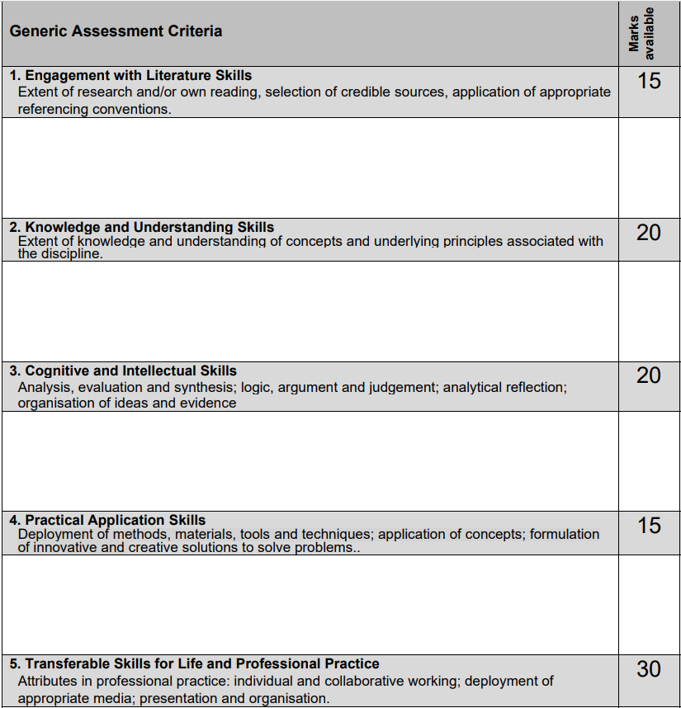
Assessment criteria
How to meet these criteria?

Slide 5

Don’t
Jump to conclusion!
Findings & conclusion
Use the theories to analyse the data
Find reliable, updated data
Identify and define relevant theories
Notes:
Use theories properly

Slide 6
Assessments 2 - Guidance
You have recently joined as a Manager in the strategic planning department of an airline (UK) and you are tasked to give a group presentation (4 to 5 members) to your board of directors. You are expected to bring contemporary approaches of organisational behaviour and scope of their application in your organisation. You are required to:
To perform an in-person group presentation.
To submit an individual reflective report of 1,000 words .

Slide 7
Assessments 2 - Guidance
Word count: ± 10%
Weight: 50% presentation, 50% individual reflection report
Individual reflection report: critically describes your personal experience in producing the presentation. E.g.: what you have learned, what went well, what was difficult, who was able to help who and how, etc.
The list of group members, with group leader identified, must be provided to the lecturer at least 2 weeks before the final presentation.
The group leaders will submit the presentation slides. Each student submit their own individual reflective report.
Students who are absent in the presentation will NOT have their individual reflection report marked.

Slide 8
Assessment criteria
How to meet these criteria?

Slide 9
Don’t
Remember
Jump to conclusion!
Findings & conclusion
Use the theories to analyse the data
Find reliable, updated data
Identify and define relevant theories
Notes:
Use theories properly

Slide 10
Assessments – General considerations
Make sure to have sufficient time to prepare and develop your work.
Stick to the assessment criteria as you develop your work.
Use the module’s materials in your work.
Minimise the similarity index.
Please direct your questions, if any, to your lecturer/tutor.

