Slide 1

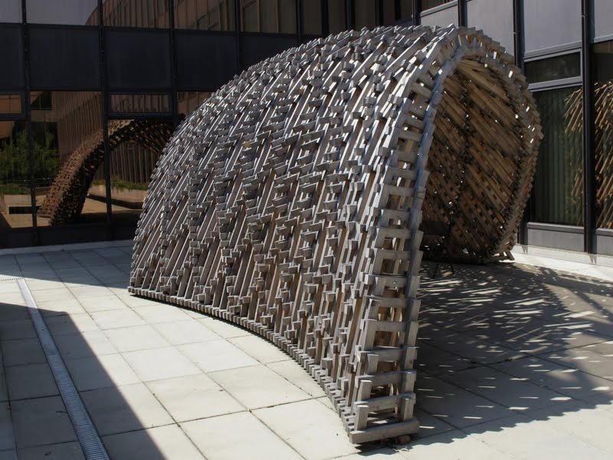
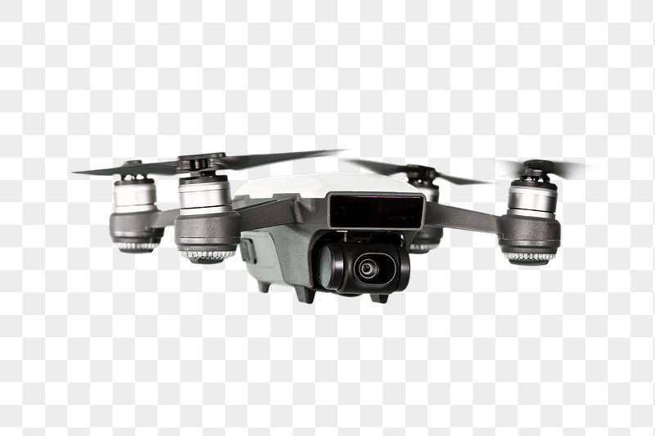

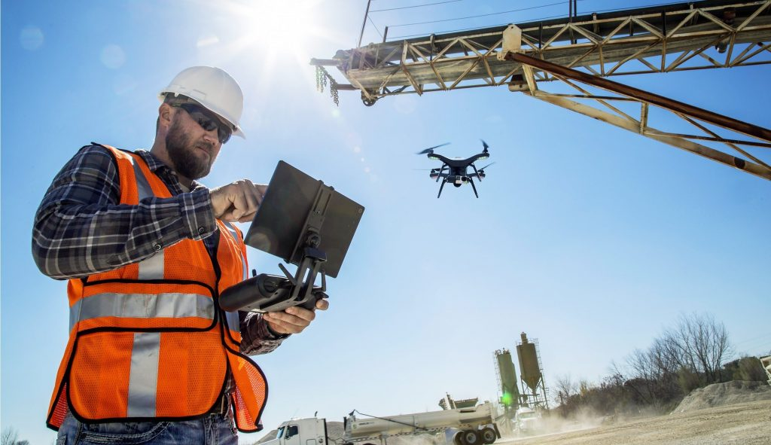


INCREASED
PROFITS
M
I
S
S
E
D
D
E
A
D
L
I
N
E
S
D
I
G
I
T
A
L
C
O
N
S
T
R
U
C
T
I
O
N
I
N
D
U
S
T
R
I C
AO
L N
I S
Z T
E R
D U
C
T
I
O
N
B
I
M
T
E
C
H
N
O
L
O
G
Y
P
RO
D
U
T
I
V
I
T
Y
Driven by technology and the need to enhance
TOP IC BENEFITS
Safe site 0.81
Efficiency 0.81
Reduced cost and rework 0.78
Project Duration 0.79
Increase in profits o.76
Reduced errors
DIGITAL WHEN ITS
CRITICAL FOR DETAIL.
DIGITAL RECORDS
NEW TEAM ROLES.
NEW TEAM GOALS.

