Slide 1
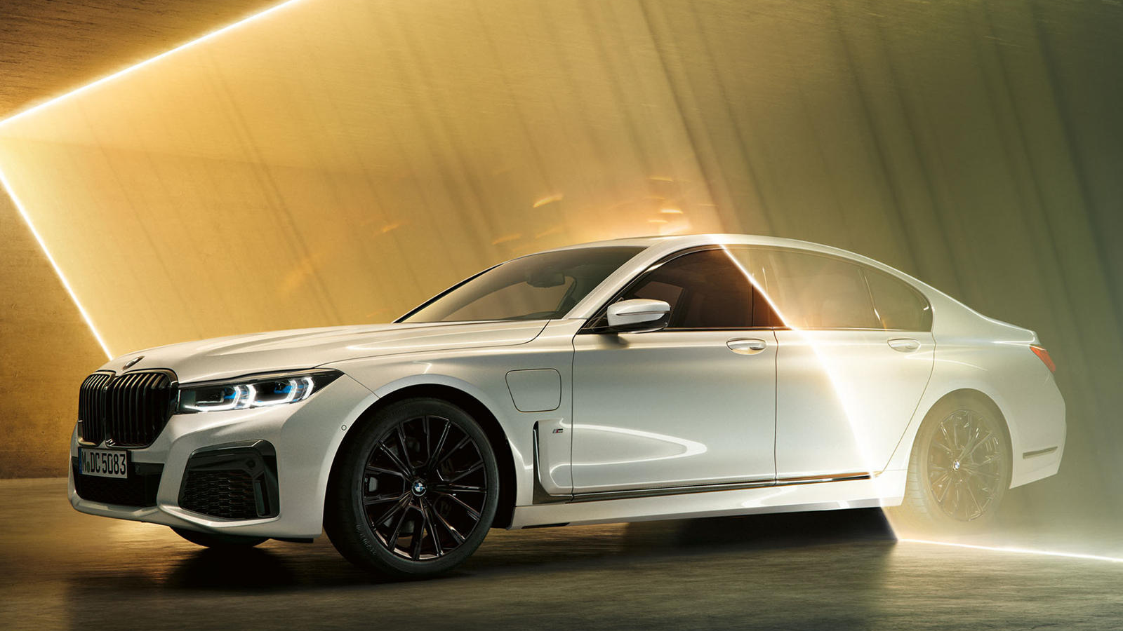
GLOBAL BUSSINES ENVIRONMENT
PRESENTATION

Slide 2
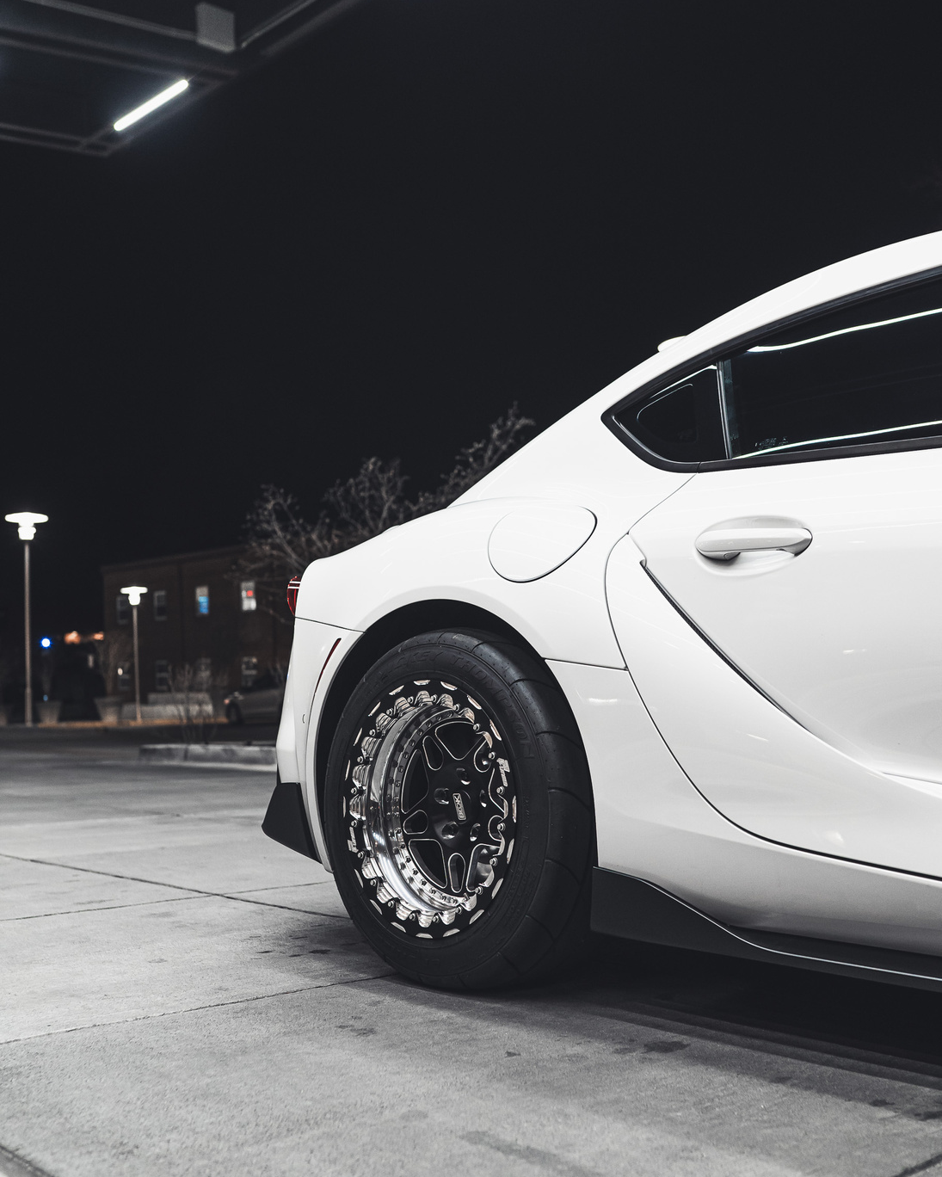
INTRODUCTION
Right now BMW Group sees difficulties in different regions, including political vulnerabilit, a cooling worldwide economy (part of the way because of global exchange clashes,rising creation expenses to meet administrative necessities, swapping scale impacts and rising unrefined components costs.

Slide 3



BMW Analysis
The qualities of BMW takes a gander at the critical parts of its business which gives it upper hand on the lookout. A few significant elements in a brand's assets incorporate its monetary position, experienced labor force, item uniqueness and immaterial resources like brand esteem.
QUALITIES
1.Solid Brand with excellent financial performance.
2.High demand of electric vehicles and motorcycle.
3. Growing production and international distributio.

Slide 4
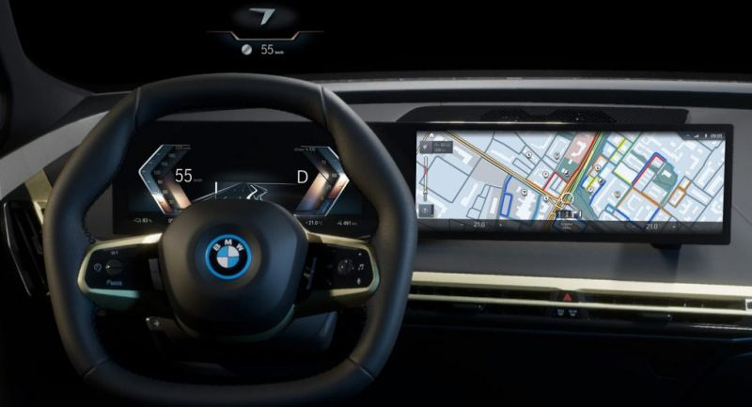
NEW HORIZONT
Developing business sectors across the globe are incredible open doors for the achievement and maintainability of BMW. The gigantic monetary development and improvement in China and India is an extraordinary road to control the genuinely necessary development in BMW. India and China are potential worldwide business sectors which will drive worldwide interest.

Slide 5
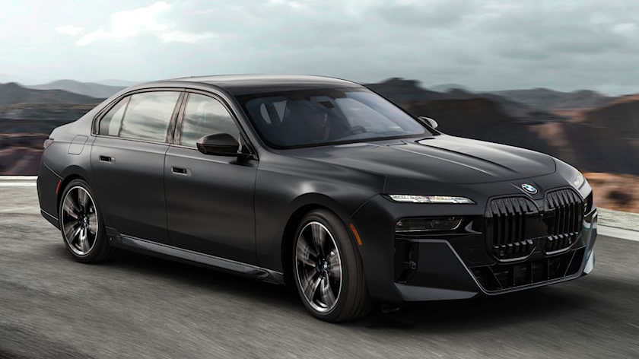
KEY CHOICES FOR BMW
1.BROADENING SYSTEM
2.COST AUTHORITY AND THE EVALUATING SYSTEM
3.ITEM SEPARATION
4.CUSTOMER SATISFACTION

Slide 6

INNOVATION INITIATIVE
PERFORMANCE
Awards and Achievement
Professional Automotive Tools and Client Relationship
Our High Quality Tools
BMW has each commitment to show productivity and maintainability in its activities. As to this viewpoint, the organization can accomplish accomplishment by effective money management enormously on innovation and developments.
Client relationship is a part of key worry in the contemporary business stage. One of the principal approaches in client relationship the board is foundation of a client care division.
In this time of worldwide contest in the car business, BMW can accomplish accomplishment by embracing item separation system.

Slide 7


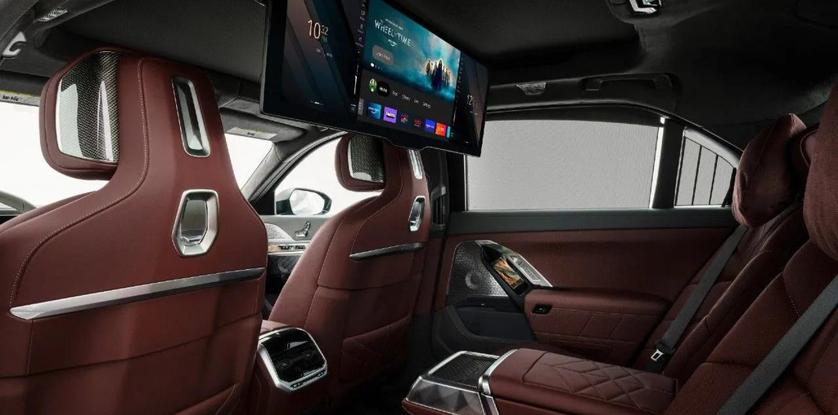
The key methodologies including mechanical administration, cost authority, evaluating system, market expansion, item separation, and client relationship the executives ought to be placed in pace. By taking into account the above talked about essential choices, BMW will actually want to understand its development and benefit expansion targets.
OUR DISTRIBUTION CHAINS
OUR DISTRIBUTION CHAINS

Slide 8
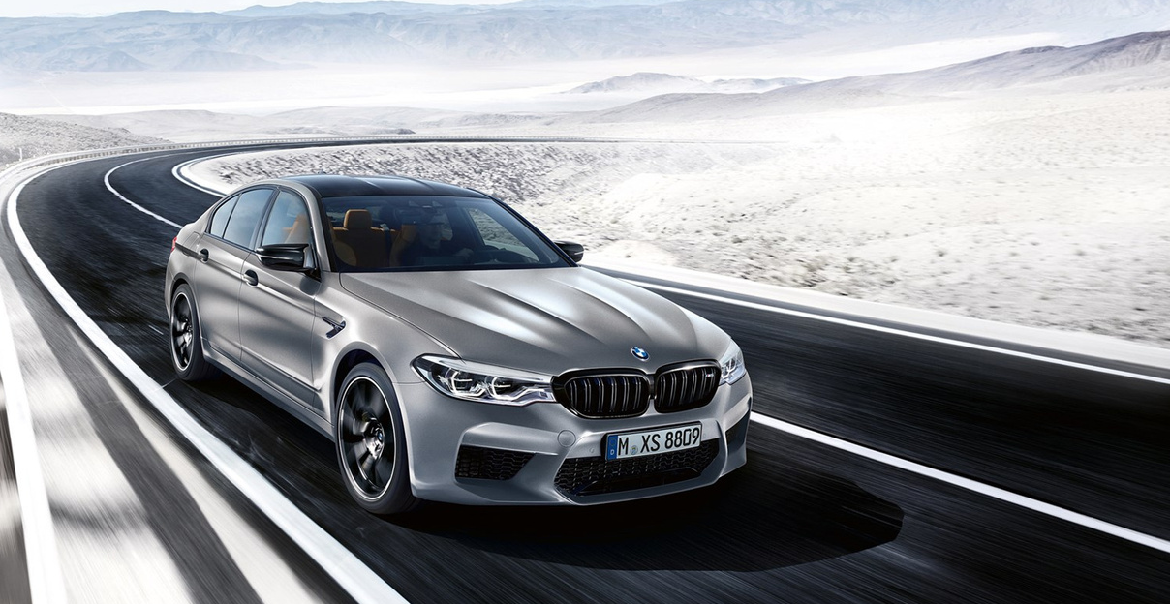
WEAKNESSES AND
THREATS
The rising costs of aluminum and steel which are the essential unrefined substances for vehicle creation is compromising the outcome of the organization.
The tough outflow guidelines laid out in the car business has uncommon repercussions on the auto business by which BMW isn't excluded.

Slide 9
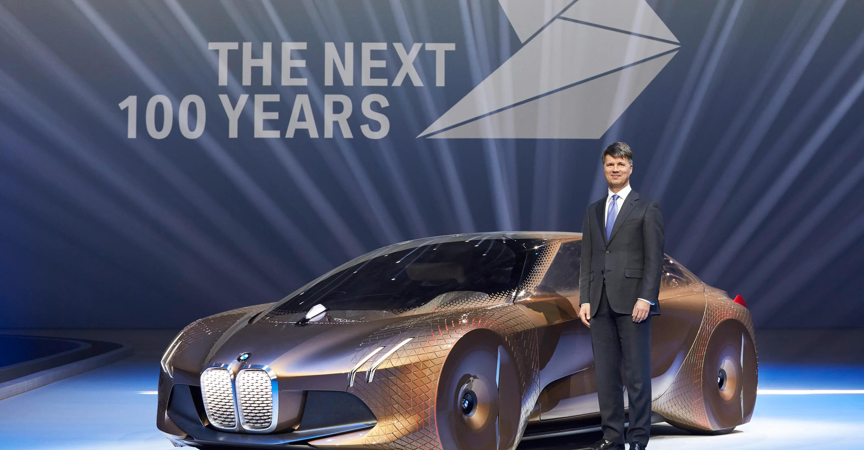
CONCLUSION
In light of the above conversation and examination of the ongoing circumstance of BMW it is obvious that the organization is capability of supporting its prosperity, despite Covid-19.

Slide 10
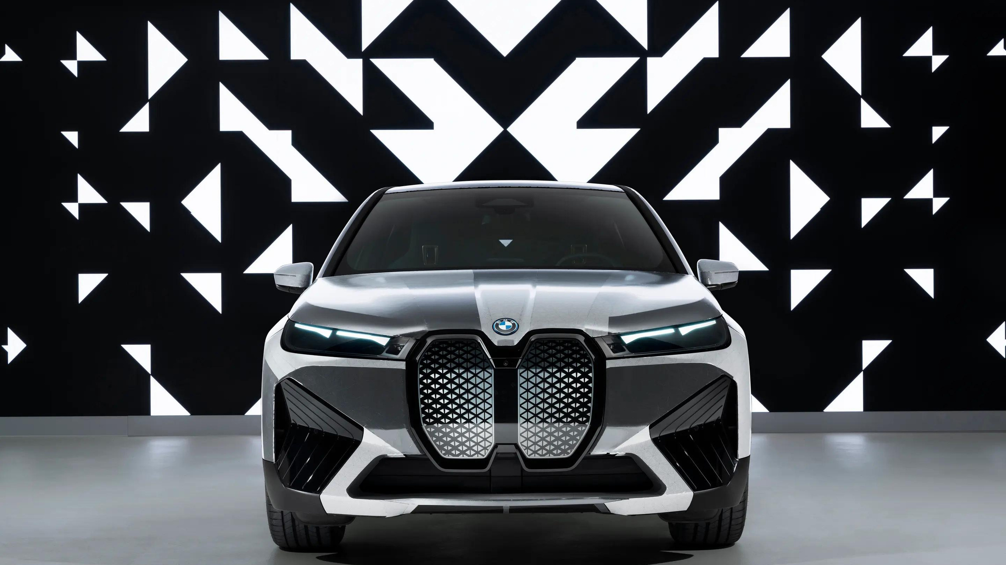
THANK
YOU
STEFAN BAEV

Slide 11

References
1.Ferrell, O. furthermore, Hartline, M. 2010, Promoting Technique, South-West School Distributers, New York.
2.Gerry, J. et al 2008, Investigating Corporate Methodology, Pearson Instruction, New York.
3.Paley, N. 2006, The Trough's Manual for Cutthroat Advertising Procedures, Thorogood, London.
4.Palmer, I. furthermore, Tough, C 2000, Pondering Administration, Sage, London.
5.Pettigrew, T. furthermore, Whittington, T. 2002, Handbook of System and The board, Sage, London.

