Slide 1
Ancestors, Death and Burial: case study- burial practices in England, 600-1900CE

Slide 2
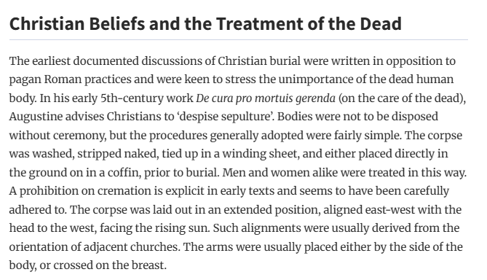
O’Sullivan 2013 in Oxford Encyclopedia of the Archaeology of Death
https://doi-org.uwtsd.idm.oclc.org/10.1093/oxfordhb/9780199569069.013.0015

Slide 3
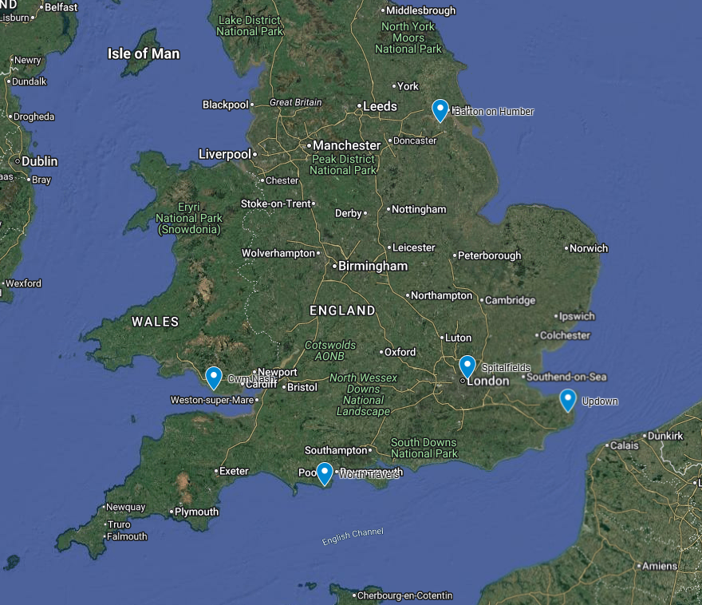
Outline
Anglo-Saxon burials
  Updown, Eastry, Kent and Worth Matravers, Dorset
  Premodernist lecture on Africans in Anglo-Saxon England
Medieval burials
  Spitalfields Charnel House
    Jessica The museum Guide
  St Peter’s Barton-on-Humber
Post-medieval burials
  Spitalfields Christ Church crypt
  St Peter’s Barton-on-Humber
  Cwm Nash

Slide 4
Things to watch for
Practice – norm and variations
Physical evidence of beliefs, social context
Change over time

Slide 5
Anglo-Saxon burials
Terminology – Dark Ages / Anglo-Saxon / Early medieval / Post-Roman
Debate about invasions and population
New aDNA techniques clarify relationships and origins
Evidence of burial practices
Christianity – Augustine 597CE

Slide 6
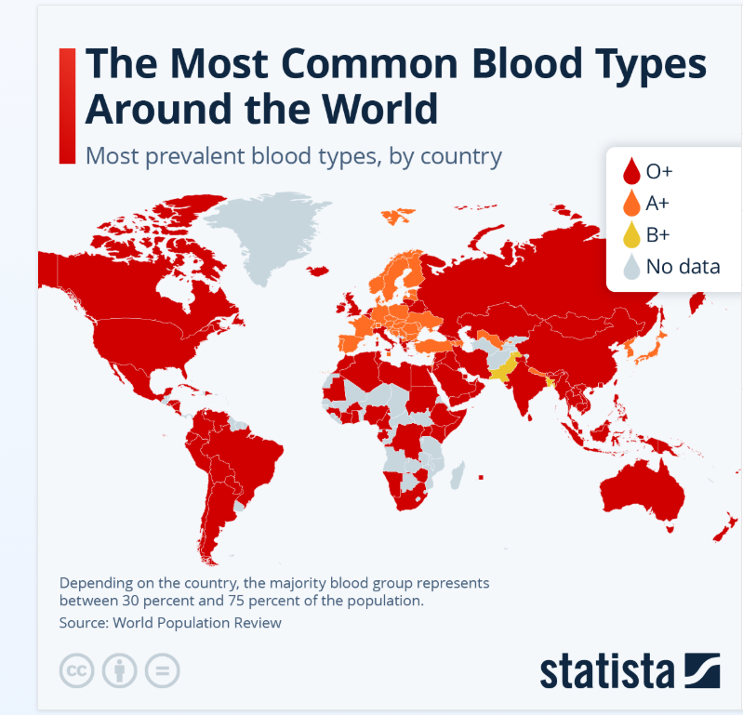
Race and ethnicity
Race is socially constructed
Ethnicity – group sharing common culture and/or ancestry
Haplogroups - group sharing some degree of common ancestry

Slide 7
Lecture on Africans in Anglo-Saxon England
youtube.com/watch?si=NlQSxNZF9SSsKGUO&v=dnfBYO53jhg&feature=youtu.be

Slide 8
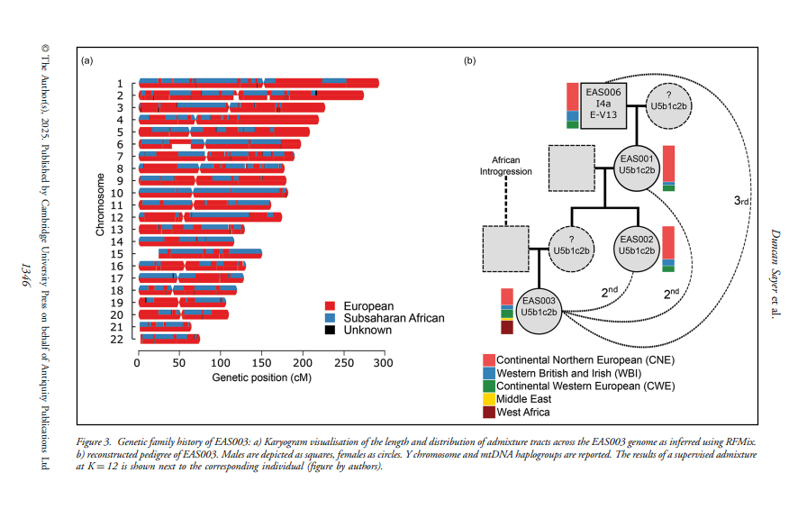
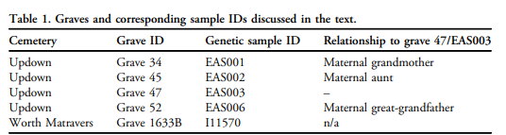
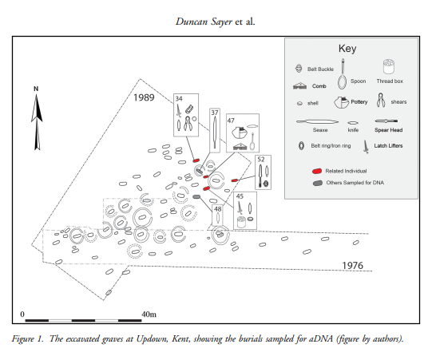
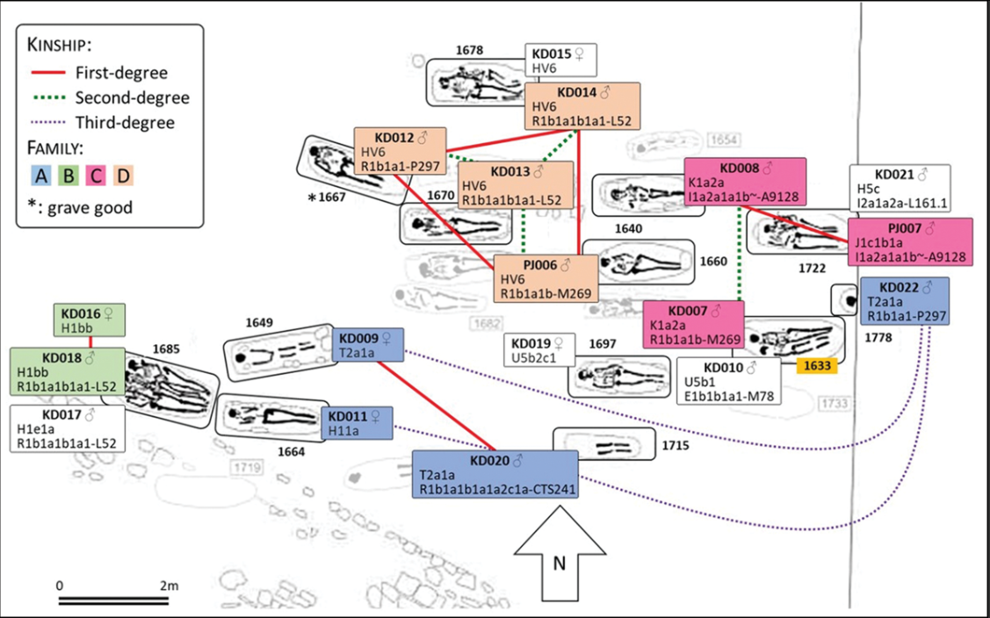
Foody 2025 Worth Matravers

Slide 9
Funerary practices
Minimal grave goods (anchor stone, comb, pot)
Aligned east-west
Buried near kin (paternal and maternal)
Organised placement (not intercutting)
Coffins? Shrouds?
Evidence of maternal immigration from northern Europe and France
Evidence of paternal immigration from northern Europe, Italy/Greece and West Africa

Slide 10
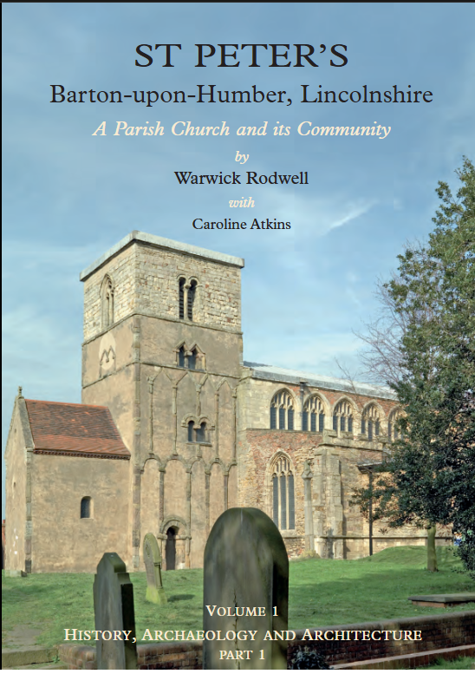
Medieval burials
Spitalfields Charnel House
St Peter’s Barton-on-Humber

Slide 11
Tour of Spitalfields’ Medieval Charnel House
https://www.youtube.com/watch?v=EsWx0XElYZQ

Slide 12
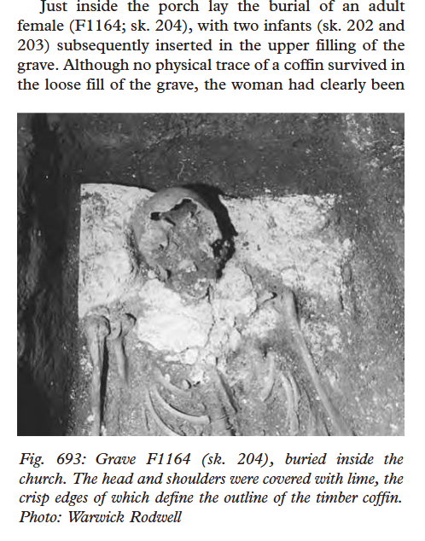
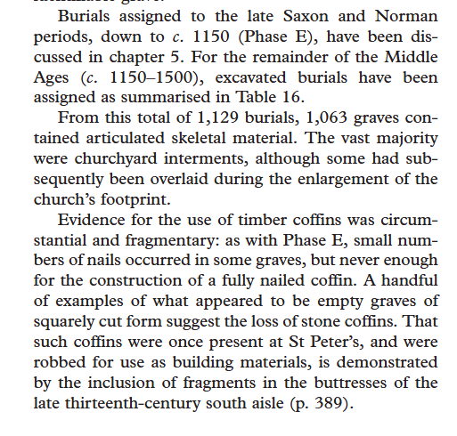
Barton-on-Humber: medieval

Slide 13
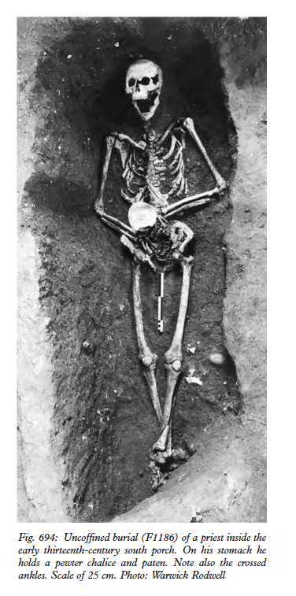
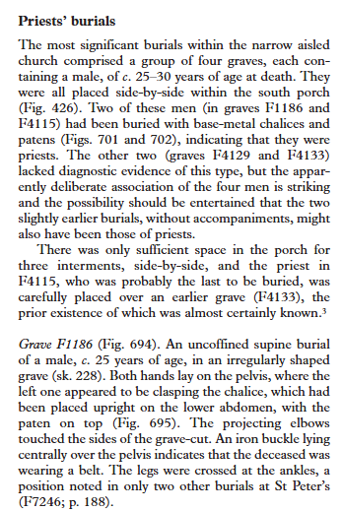

Slide 14
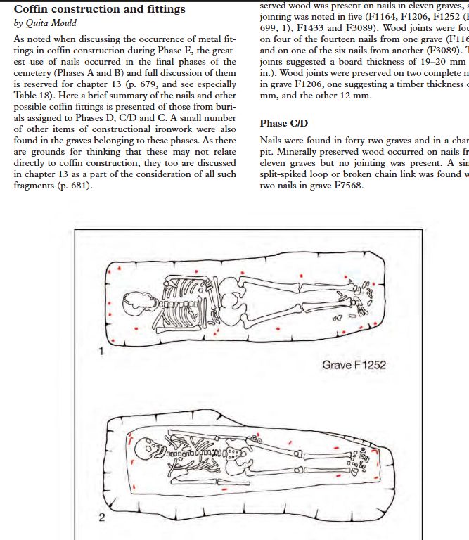
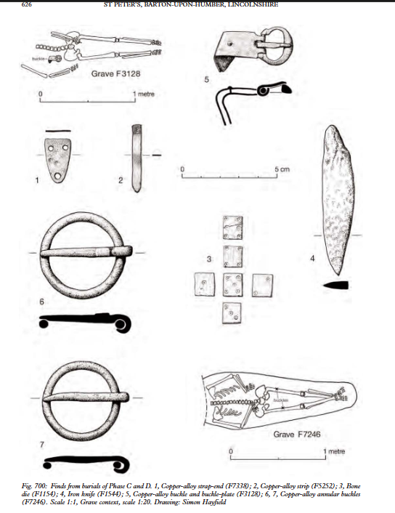

Slide 15
Changes in belief
Catholic
Purgatory after death
Bodily resurrection at the Second Coming
Protestant
Immediately go to heaven
Bodily resurrection at the Second Coming ?
  Strata Florida “Lament for a leg”

Slide 16
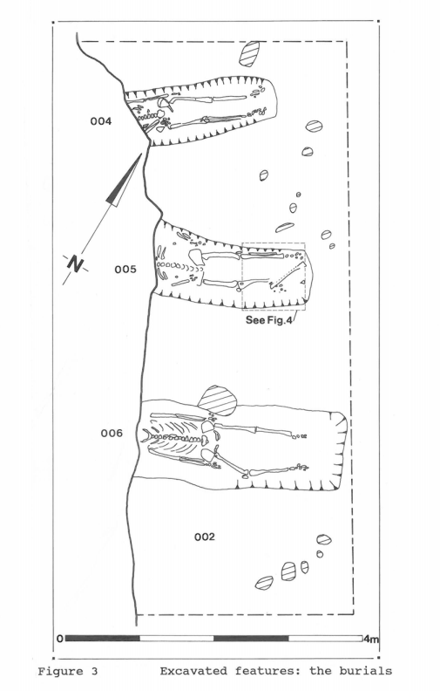
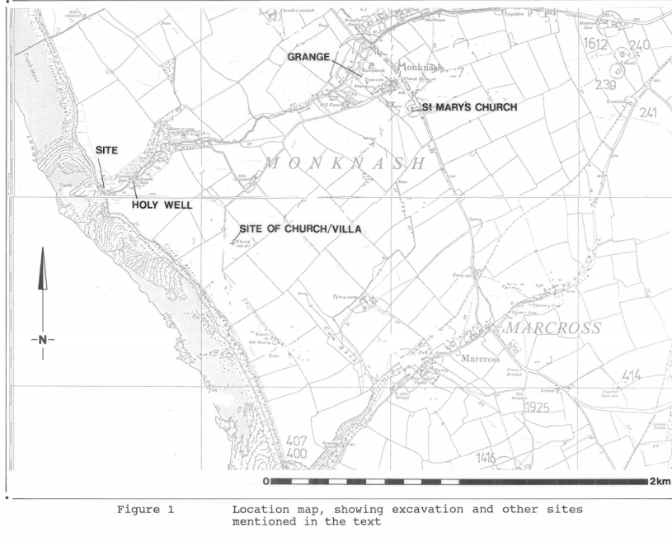
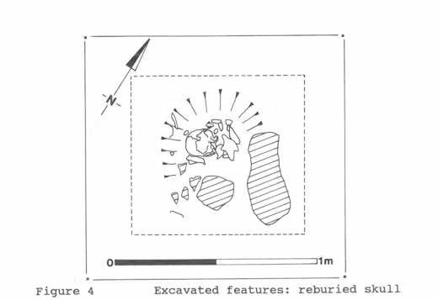
Cwm Nash, Monknash, Glamorgan
Locock, M 1993 Excavations at Cwm Nash, Monknash, South Glamorgan (GGAT 93/068)

Slide 17
Radiocarbon date and pottery – 17th century
Extraparochial / semi-official burial ground
Shroud pin
Main burials
  16-17, male, very robust
  24-26, male, robust
  30ish, male, robust, manual labour
Other individuals (reburied loose bones)
  22-23, male, dental caries, rough diet
  18-20, male, refined diet
  18-20, male
  25-30, male
  50 +

Slide 18
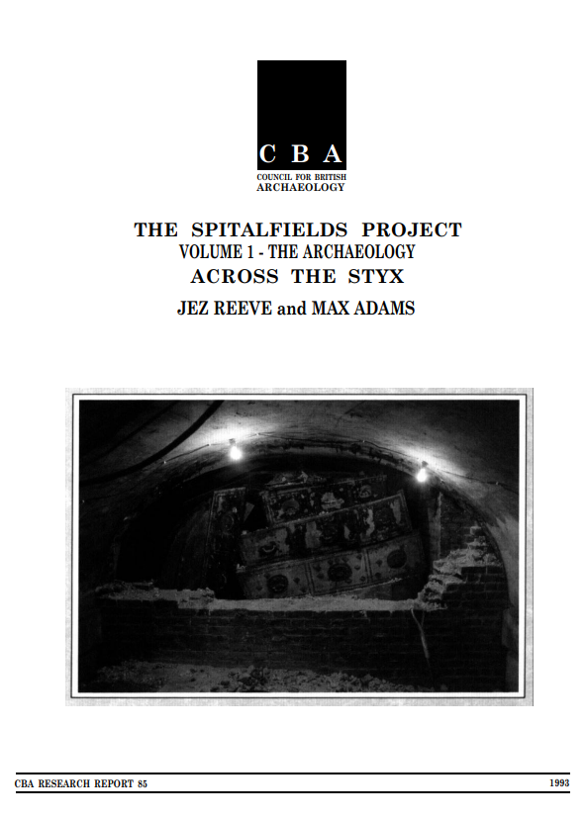
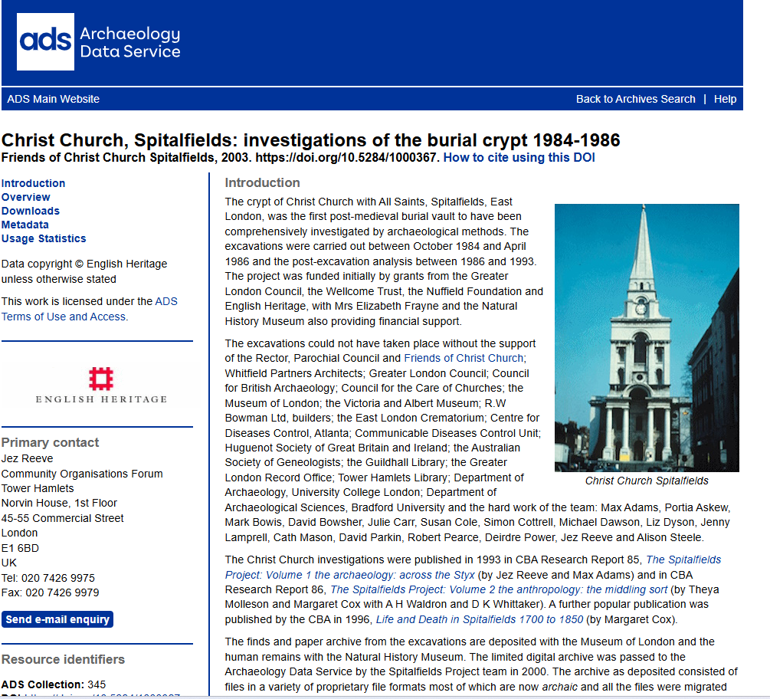
Post-medieval burials
Burials 1729-1850
Family crypts and public

Slide 19
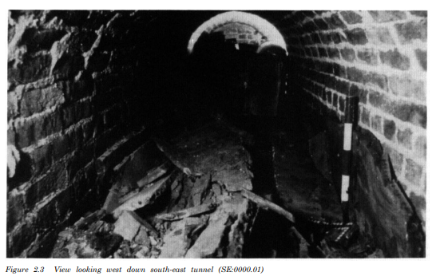
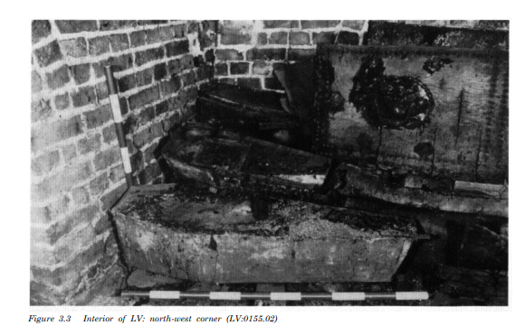

Slide 20
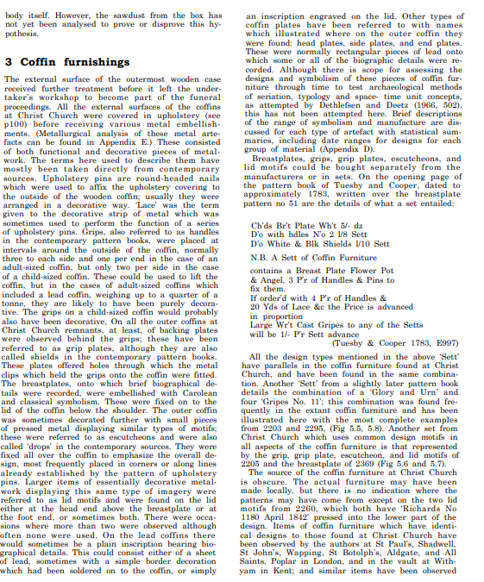
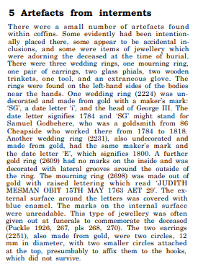
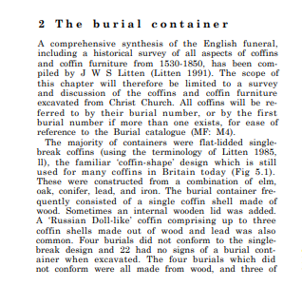

Slide 21
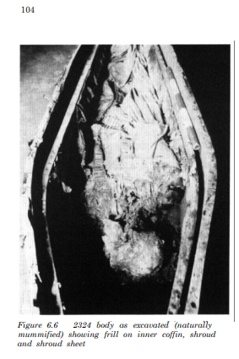

Slide 22

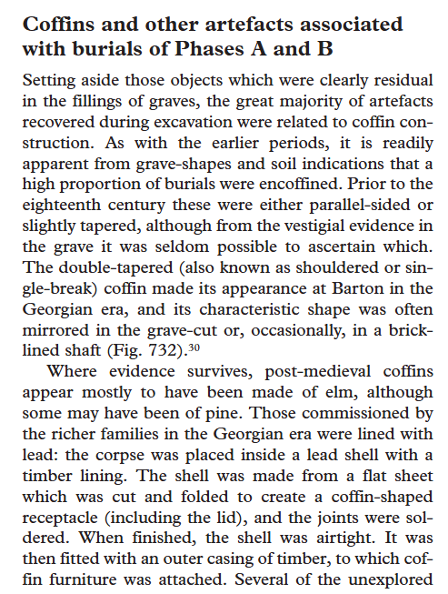
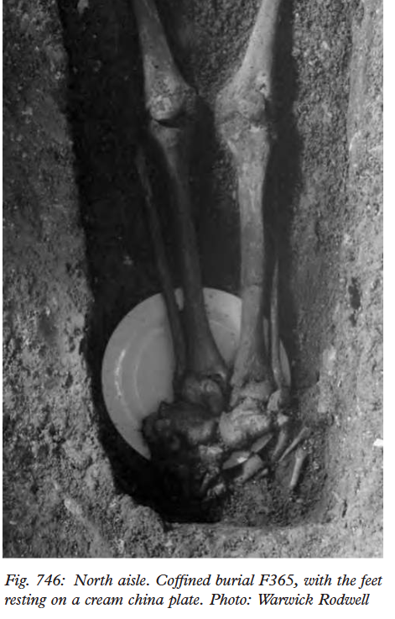
Rodwell p. 677 ‘lost jewellery’

Slide 23
Post-medieval burials
Coffin
Shroud
Other objects?
Process

Slide 24
Overview
Archaeological evidence of change in doctrine/belief?
Evidence for funerary practices?
Evidence for social status / occupation?
Changes in memorialisation

