Slide 1

Cross-Cultural Negotiations:
UK and China
Name: Brigitta Horváth
Student ID: 2213952
Modul number: LCBB6001
Lecturer: Afzal Munna

Slide 2
Table of content
Introduction
Cultural differences
Hofstede: UK and China
Chinese business culture
Possible solutions
Conclusion
References

Slide 3

Introduction
The content will cover the cultural differences between the UK and China, exploring Hofstede's theory to highlight the contrasts between key business cultures. It also suggests practical ways to overcome these challenges to foster successful partnerships.

Slide 4
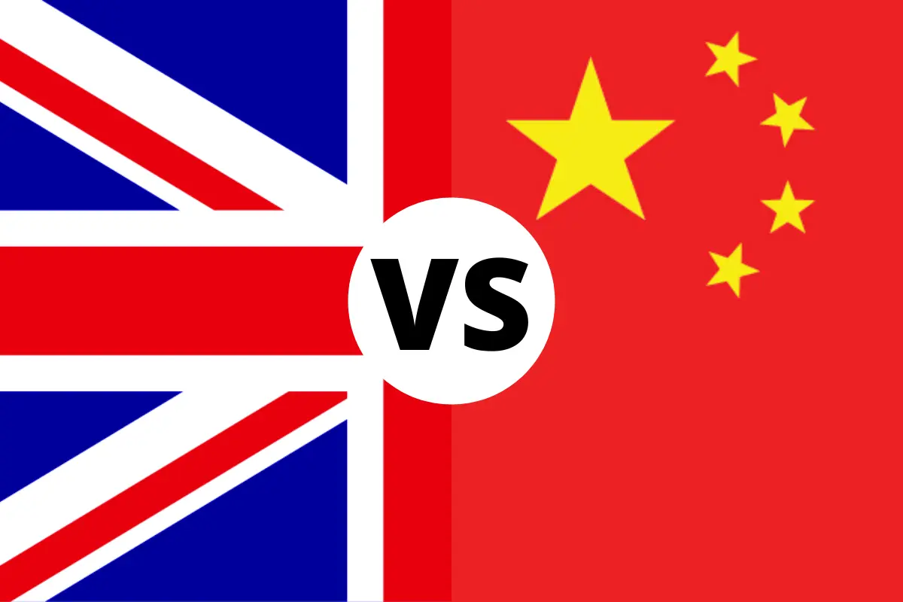
Differences
Communication style
Decision-making
Working hours and holidays
(Ashiq, 2020)

Slide 5
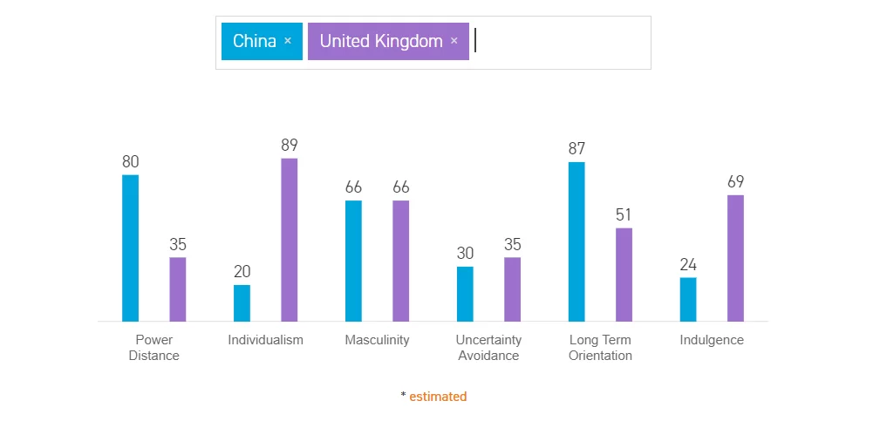
Hofstede: UK and China
Individualism vs collectivism
Power distance
Uncertanity avoidance
(Uta, 2021)

Slide 6

Chinese business culture
Power and hierarchy
Relationships and trust
Communication style
(HSBC,2024)

Slide 7

Possible solutions
Research and Understand Local Culture
Adapt Your Approach
Build Relationships and Trust
Flexibility and Patience
(Kompass, 2023)

Slide 8

Conclusion
Successful UK-China business partnerships depend on understanding cultural differences, such as communication styles and hierarchies. In China, relationship building is priority over business meetings, whereas in the UK it is more direct. Adaptation, patience and mutual respect are the keys to long-term success.

Slide 9
Reference list
Ashiq, W. (2022) Differences between UK and Chinese work culture, Great British Mag. Available at: https://greatbritishmag.co.uk/student-guide/differences-between-uk-and-chinese-work-culture/ (Accessed: 2 December 2024).
HSBC (2024) HSBC Business Go. Available at: https://www.businessgo.hsbc.com/en/article/a-guide-to-chinas-business-culture-and-etiquette (Accessed: 2 December 2024).
Iulia-Cristina Uța (2023) What is Hofstede’s cultural dimensions theory? UK vs China, a comparison, BRAND MINDS. Available at: https://brandminds.com/what-is-hofstedes-cultural-dimensions-theory-uk-vs-china-a-comparison/ (Accessed: 2 December 2024).
Kompass (2023) How to deal with cultural differences during international expansion? · Kompass blog, Kompass Blog. Available at: https://www.solutions.kompass.com/blog/how-to-deal-with-cultural-differences-during-international-expansion/ (Accessed: 2 December 2024).

