Slide 1
Module Title: Professional Career Development within H&SC
Module Number: LCHS 4009 (LON)
Assignment No: ASSIGNMENT 1
Student Name:Lulit Hailu
Student ID: 2435932
Lecturer’s Name: DR Christopher Mafuva

Slide 2
INTRODUCTION
I WILL talking about– communcation health and social care today I will also go through some of impotants
Skill Chosen: Communication
What it means
Why Communication is Essential in Health and Social Care
Model: Tuckman’s Team Development Model
Job role and setting
Why this skill matters

Slide 3

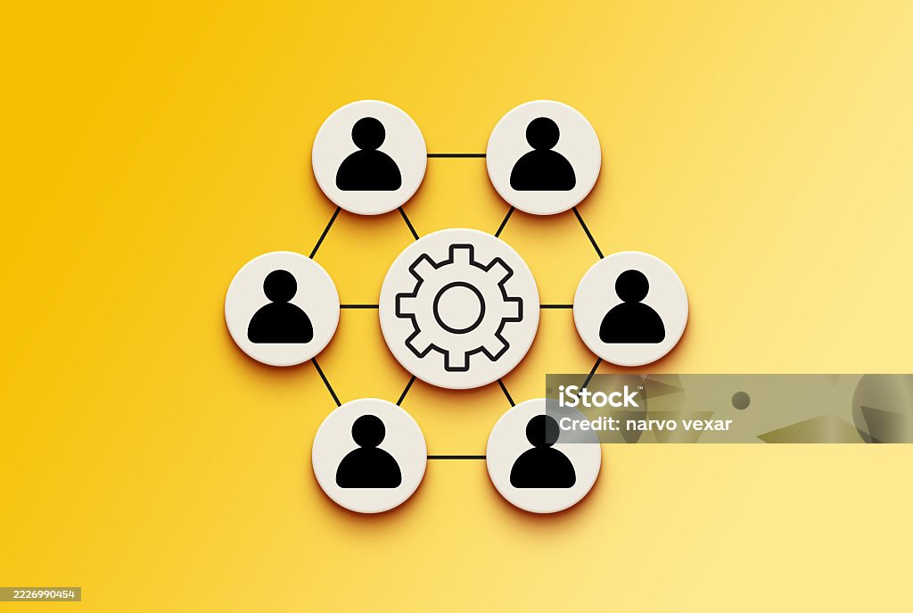
Skill Chosen: Communication
What it means
Communication is sharing information, ideas, or feelings so others can understand . It includes speaking, listening, writing, and body language (Skills for Care, 2023).
In everyday practice
It includes listening mindfully , speaking clearly, and making sure others understand. In health and social care it helps when talking with patients, patients, and colleagues.
How I developed this skill
I growth is skill through my studies and working with others. I exercise listening carefully and explaining things clearly during discussions and group work.

Slide 4

Why Communication is Essential in Health and Social Care
Communication is important because it helps coworker understand service user’ needs and provide safe and productive care. Clear communication helps reduce mistakes and ensures important information is shared between staff (Bridges et al., 2020).
Benefits Service users / patients
Feel listened and cared to and respected
Better understanding of their care
Staff and colleagues
Better teamwork
Clear sharing of information
Organisation
Higher quality care and support
Less errors and complaints
If communication is poor
Important information may be missed which can cause bigger issue
Mistakes in care can happen

Slide 5

Model: Tuckman’s Team Development Model
What is this model?
Tuckman’s Team Development Model explains how teams develop and work better together over time. It shows the stages groups usually go through before they become effective and work well as a team.
Key stages
Forming – Co workers meet and start learning about their roles
Storming – Different ideas may cause disagreements
Norming – The team begins to cooperate and set clear ways of working together
Performing – The team works effective together and communicates effectively
How this model supports communication in practice
This model helps staff to understand how teamwork develops and why good communication is important at each stage. Clean communication helps solve disagreements,develop trust, and improve teamwork for stuff . This supports better teamwork between staff and helps provide safer, higher-quality care for patients.

Slide 6

Job role and setting
Care assistant in a care home.
Situation
A service users is feeling unwell but finds it difficult to explain what is wrong.
How the skill is used
The care assistant listens carefully, asks simple questions, and speaks calmly to support the client explain their symptoms. They also clearly pass this information to the nurse or other staff.
How the skill guides actions
clear communication helps the care assistant understand the resident’s needs and make sure the right information is given with the team.
Impact on care
Patient / service user experience
The resident feels listened to and supported and confident
Safety and quality of care
Staff receive clear information
The resident can receive the correct care quickly.

Slide 7

Why this skill matters
Employability: Makes you stand out to employers and boosts confidence in the workplace.
Future role in health & social care: Helps you provide better care, communicate effectively, and work well in a team.
Reflection
Strength? I am confident in this skill and use it regularly.
Development: I want to keep improving to be fully ready for practice.
Learning link: Supports readiness for practice, personal growth, and career planning.

Slide 8
Conclusion
In conclusion, communication is a really important skill in health and social care. It helps staff understand patients’ needs, work better as a team, and provide safe and high-quality care. Good communication can prevent mistakes and make patients feel listened to and supported. From my learning and experience, I feel confident in this skill, but I know I still need to keep improving. Developing strong communication skills will help me in my future role and make me a better care worker.

Slide 9
REFERENCE LIST:
Skills for Care (2023) Effective communication in health and social care. Available at: https://www.skillsforcare.org.uk (Accessed: 16 March 2026).
Full reference (Harvard style):
Bridges, D.R., Davidson, R.A., Odegard, P.S., Maki, I.V. and Tomkowiak, J., 2020. Interprofessional collaboration: three best practice models of interprofessional education. Medical Education Online. Available at: https://www.tandfonline.com/doi/full/10.3402/meo.v15i0.5035 (Accessed: 16 March 2026).

