Slide 1

Student Name: Jayson Anthony Luba
Student Number: 2245377
Recipient: Kathryn Flynn
Submission Date: 19 May 2025
Module Code and Name: BMIH6007 – International Meetings Management for the Hotel Industry
AI Acknowledgement Guidance
I confirm that I have not used any AI tools in the research and creation of this
assignment. I confirm that I have not presented any AI generated materials as my own
work. I confirm I have copies of my drafts, notes, and other resources

Slide 2

LORD – Legends of Regal Dragons
Visit Wales = Year of Croeso 2025
INTRODUCTION
௹ Welsh Mythology LORD is a festival inspired Welsh mythology and culture, by celebrating 'Croeso' (welcome) and 'hwyl' (fun) as part of The year of ‘Croeso 2025’. | ௹ Immersive Experiences The festival features multi-sensory technologies and live performances, including VR dragon flights and knight tournaments. | ௹ Family Focus Designed as a family- orientated, three-day cultural festival, it offers engaging experiences rooted in storytelling and discovery.

Slide 3

Event Content and Key Experiences
VR Dragon Flights Soar through the skies on a virtual dragon, immersing yourself in welsh mythology. Experience the thrill of flight. | Theatre Knight Tournaments Witness live knight tournaments that showcase medieval skills and bravery. Engage with the rich history of Welsh legends.
Sacred Storytelling Walks Join guided walks that share ancient tales and folklore. Connect with the cultural heritage of Wales. | Artisan Markets Explore markets featuring local artisans showcasing their crafts and products. Discover the creativity and talent within the welsh community.

Slide 4
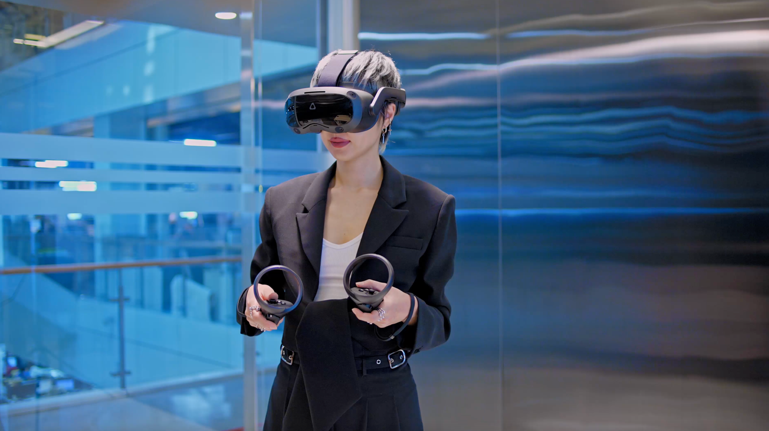
Market Analysis and Targeted Audience
Gen-Z
Gen-Z families increasingly seek immersive and educational travel experience

Slide 5
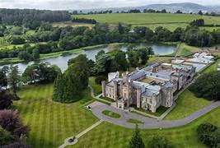
Operational Feasibility of Hensol Castle
Stregnths of Hensol Castle Hensol Castle provides the perfect backdrop for the LORD festival. It has a lot of historical charm and enhances the cultural experience. The venue operates a flexible booking system to support multi-day events. Convenient transport links and accommodation options are available. | Potential Challenge’s Hosting the LORD event will require a team of skilled professionals including events coordinators and digital technicians. Effective logistics support is needed to manage parking and dining facilities. Weatherproof programming is necessary to ensure a seamless experience for attendees. The extensive outdoor space may pose challenges in terms of setup and coordinations.

Slide 6

Funding Table: Income and Expenditure
Venue hire (Hensol Castle, 3 days): £12,000
VR/AR installations and equipment: £18,000
Stage, lighting, and sound infrastructure: £10,000
Staff (logistics, security, technical, performers): £15,000
Marketing and promotion (international and local): £8,000
Insurance and permits: £2,000
Miscellaneous (signage, waste, transport): £3,000
Total projected cost: £68,000

Slide 7

LORD – Legends of Regal Dragon
General admission tickets (1,500 guests x £25): £37,500
Sponsorships from cultural and tourism partners: £15,000
Food & merchandise vendor fees: £6,000
Government/tourism grants (Visit Wales): £12,000
Total projected revenue: £70,500
This results in a projected net surplus of £2,500. It supports the festival’s feasibility and leaves room for minor budget deviations.

Slide 8

Gantt Chart: Event Timescales
Concept Development
* Brainstorm themes for festival.
*Engage with local cultural and tourism partners.
Event Planning
*Plan logistics and scheduling in detail.
*Coordinate with performers and vendors.
Execution Phase
*Set up the venue and installations.
*Manage event operations and guests experiences.
Post-Event Review
*Evaluate event success and gather guest feedback
*Analyse financial performance and document lessons learned.

Slide 9

Marketing Challenges and Strategies
* Competition Analysis: The event targets families from the U.K. and international cultural tourists looking for authentic, Story-led experiences.
* Audience Engagement: The success of events like FOCUS Wales and the Urdd Eisteddfod demonstrates a clear demand for cultural content in a festival format.
* Budget Constraints: Total projected cost for the event is 68,000, which is within the expected revenue of 70,500
* Marketing P’s Utilization: The campaign is urging tourism providers to embrace the ideas of ‘Croeso’ (welcome) and ‘hwyl’ (fun).
* Promotional Strategies: Partnerships with the Meet portal allow access to logistics support and marketing collaboration opportunities.

Slide 10
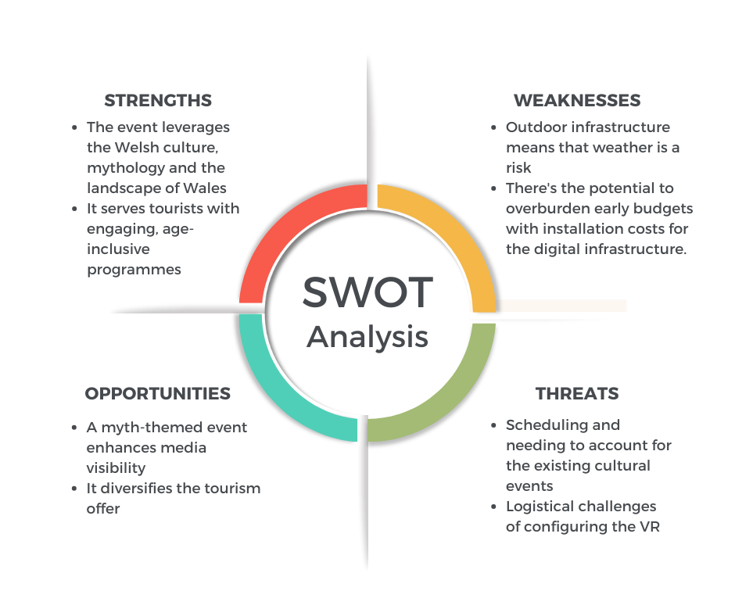
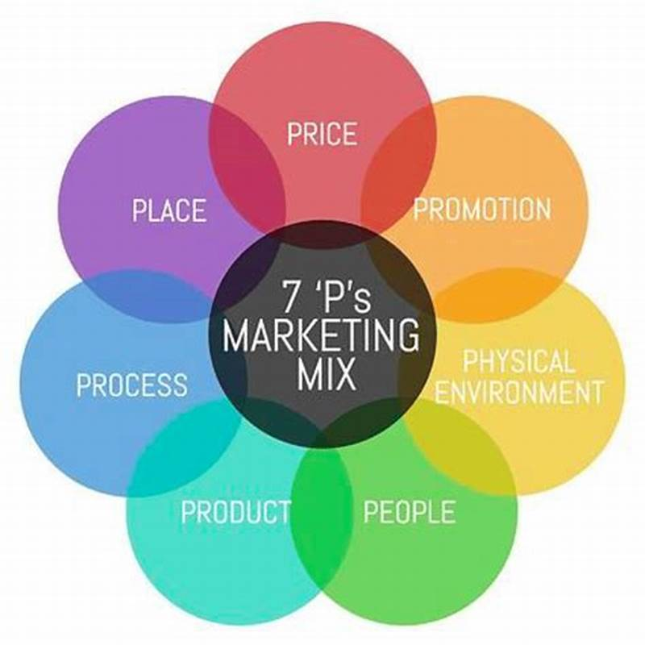
According to the 7Ps of event marketing (Bowdin et al., 2012) the marketing mix for Legends of Regal Dragons is developed to perceive the event as a distinct cultural immersive experience for multiple stakeholders such as local families and international MICE delegates. Product, Price, Place, Promotion, People, Process.

Slide 11

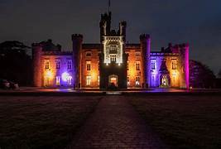
Visitor Demand and Economic Impact
Economic Benefits
It supports local economic growth by benefiting SME’s and artists.
Visitor Demand Trends
There is an increasing demand for authentic, story-led experiences among visitors.
Cultural Tourism Growth
LORD offers immensive storytelling experiences that attract cultural tourists.

Slide 12


Future Vision and Long –term impact for LORD Festival
1. Annual Editions The legacy of the festival may include recurring annual editions. This will help maintain interest and engagement in Welsh culture | 2. Reusable Infrastructure The aims to create reuseable infrastructure events. This approach promotes sustainability and cost-effectiveness. | 3. Cultural Awreness LORD will strengthen international awareness of Wales as a myth-rich destination. It will promote an interest in local history, language, and culture. | 4. Economic Support The festival will economically benefit SME’s , artists, and regional tourism players. It aims to create a positive impact on the local economy. | 5. Local Engagement The event will foster community involvement and participation. This engagement will enhance the cultural fabric of the region.

Slide 13
Summary of Key Insights and Recommendations
Festival Concepts The concept is a three-day interactive cultural festival taking place at a derelict Welsh castle. The experience will bring mythical beasts, medieval habits, and ledgends to life with multi-sensory technologies and live performances. | Market Demand The event targets families from the U.K and international cultural tourists seeking authentic, story-led experiences. There is a growing demand for immersive and educational travel experiences, especially among Gen-Z families. | Future Vision LORD aligns with trends in tourism and MICE, focusing on digital experiences and sustainability. This positions Wales as av forward-thinking host for events, embracing hybrid formats.

Slide 14
References
Unique DMC. (2024, December 18). MICE trends for 2025: What to look out for. https://www.uniquedmc.com/2024/12/18/mice-trends-for-2025-what-to-look-out-for/
University of Wales Trinity Saint David. (2025). Events feasibility and development: From strategy to operations. https://librarysearch.uwtsd.ac.uk/discovery/fulldisplay?docid=alma99100655536402421
Visit Wales. (2024). Figures on the visitor economy in Wales. https://industry.visitwales.com/research-and-insights/industry-research/figures-visitor-economy-wales
Visit Wales. (2024). Overnight visits to Wales by GB visitors. https://industry.visitwales.com/research-and-insights/overnight-visits-wales-gb-visitors
Visit Wales. (2025). Tourism and hospitality industry engagement events. https://industry.visitwales.com/get-involved/industry-engagement-events
Visit Wales. (2025). Year of Croeso 2025 – Themed year campaigns. https://industry.visitwales.com/get-involved/visit-wales-themed-year-campaigns/year-croeso
Wales Tourism Alliance. (2025). News updates. https://www.wta.org.uk/news.html
Welsh Government. (2024). Tourism barometer: February 2024 wave. https://www.gov.wales/tourism-barometer-february-wave-2024
Welsh Government. (2024). Wales visitor economy profile: 2024. https://www.gov.wales/wales-visitor-economy-profile-2024-html
Welsh Government. (2024). £1 million fund to boost Welsh tourism – come rain or shine. https://www.gov.wales/new-1-million-fund-boost-welsh-tourism-come-rain-or-shine
Wikipedia contributors. (2025). Urdd National Eisteddfod. Wikipedia. https://en.wikipedia.org/wiki/Urdd_National_Eisteddfod

Slide 15
References
Unique DMC. (2024, December 18). MICE trends for 2025: What to look out for. https://www.uniquedmc.com/2024/12/18/mice-trends-for-2025-what-to-look-out-for/
University of Wales Trinity Saint David. (2025). Events feasibility and development: From strategy to operations. https://librarysearch.uwtsd.ac.uk/discovery/fulldisplay?docid=alma99100655536402421
Visit Wales. (2024). Figures on the visitor economy in Wales. https://industry.visitwales.com/research-and-insights/industry-research/figures-visitor-economy-wales
Visit Wales. (2024). Overnight visits to Wales by GB visitors. https://industry.visitwales.com/research-and-insights/overnight-visits-wales-gb-visitors
Visit Wales. (2025). Tourism and hospitality industry engagement events. https://industry.visitwales.com/get-involved/industry-engagement-events
Visit Wales. (2025). Year of Croeso 2025 – Themed year campaigns. https://industry.visitwales.com/get-involved/visit-wales-themed-year-campaigns/year-croeso
Wales Tourism Alliance. (2025). News updates. https://www.wta.org.uk/news.html
Welsh Government. (2024). Tourism barometer: February 2024 wave. https://www.gov.wales/tourism-barometer-february-wave-2024. https://en.wikipedia.org/wiki/Urdd_National_Eisteddfod
Welsh Government. (2024). Wales visitor economy profile: 2024. https://www.gov.wales/wales-visitor-economy-profile-2024-html
Welsh Government. (2024). £1 million fund to boost Welsh tourism – come rain or shine. https://www.gov.wales/new-1-million-fund-boost-welsh-tourism-come-rain-or-shine
Wikipedia contributors. (2025). Urdd National Eisteddfod. Wikipedia

