Slide 1
Student Name: ANNIE ZIMBA
Student Number: 2325571
BMHP6029_BIRM – Component 1 – Poster Presentation –
Lecturer – Neale Haddon
Submission Date: 9th March 2026
Title of Poster: SCHIZOPHRENIA

Slide 2
TITLE: SCHIZOPHRENIA
Introduction and Historical Context::
Originally termed as Dementia Praecox by Emil Kraepelin (late 19th Century, focusing on its chronic, deteriorating nature. Eugen Bleuler later coined ‘schizophrenia’ (1908) emphasizing the split between different mental functions.
The Asylum Era: For much of 20th century, treatment focused on containment in large psychiatric hospitals. Methods were often invasive (e.g. insulin shock therapty
Critical Analysis: Social, Cultural, and political Factors
-Stigma and Media: Schizophrenia is often unfairly linked to violence in news and film. Leading to social exclusion and self –stigma where patients
Internalise these negative vies
-Inequality and ethnicity:
-Politics of funding
The Deiinstitutionalization movement
(1960s-80s): Driven by the advent of first-generation antipsychotics (e.g. Chlorpromazine) and political shift toward civil liberties, patients were moved from asylums to ‘Community Care’. However, this was often underfunded, leading to revolving door hospital admissions.
Care: Provisional Care pharmacotherapy
Psychosocial Interventions ; Cognitive Behavioral Therapy for Psychosis
Early intervention in psychosis
Physical Health and Metabolic Monitoring
[Text]
Recommendations for Future Practice
1.Maintain and enforce access standards to help people with first-episode psychosis start NICE recommended treatment within two weeks :
2. Evidence based interventions – Ensure all services routinely provide the full NICE package: antipsychotic medication, CBT for psychosis and family interventions
3.Workforce training and data – Invest in multidisciplinary staffing (psychiatry, psychology, nursing , social work, peer support) and ongoing training in early psychosis, trauma-informed care, and physical management

Slide 3
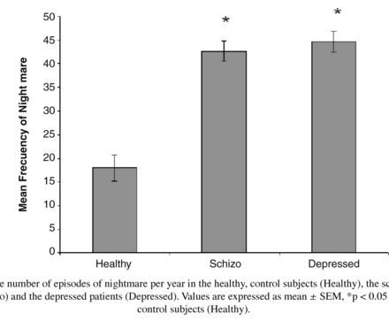
NICE guideline context page
National Institute for Health and Care Excellence (2013) Psychosis and schizophrenia in children and young people: recognition and management (CG155) – Context. Available at: https://www.nice.org.uk/guidance/cg155/chapter/context (Accessed: 7 March 2026).
This Photo by Unknown Author is licensed under CC BY-NC

Slide 4
Reference List
Moskowitz A, Heim G. Eugen Bleuler's Dementia praecox or the group of schizophrenias (1911): a centenary appreciation and reconsideration. Schizophr Bull. 2011 May 10.1093/schbul/sbr016. PMID: 21505113; PMCID: PMC3080676.
World Health Organisation (2024) ICD-11 for Mortality and Morbidity Statistics: 6A20 Schizophrenia.
Meyer, J.M. and Stahl, S.M., 2009. The metabolic syndrome and schizophrenia. Acta Psychiatrica Scandinavica, 119(1), pp.4-14.
Vancampfort, D., Knapen, J., Probst, M., van Winkel, R., Deckx, S., Maurissen, K., Peuskens, J. and De Hert, M., 2010. Considering a frame of reference for physical activity research related to the cardiometabolic risk profile in schizophrenia. Psychiatry research, 177(3), pp.271-279.
NICE guideline context page
National Institute for Health and Care Excellence (2013) Psychosis and schizophrenia in children and young people: recognition and management (CG155) – Context. Available at: https://www.nice.org.uk/guidance/cg155/chapter/context (Accessed: 7 March 2026).
NICE final scope
National Institute for Health and Care Excellence (2013) Psychosis and schizophrenia in children and young people: final scope. Available at: https://www.nice.org.uk/guidance/cg155/resources (Accessed: 7 March 2026).
NAMI overview
National Alliance on Mental Illness (2025) Schizophrenia: symptoms, causes & treatment options. Available at: https://www.nami.org/about-mental-illness/mental-health-conditions/schizophrenia/ (Accessed: 7 March 2026).
Cleveland Clinic page
Cleveland Clinic (2023) Schizophrenia: what it is, causes & symptoms. Available at: https://my.clevelandclinic.org/health/diseases/4568-schizophrenia (Accessed: 7 March

Slide 5
Reference List
-Rashid, B. and Calhoun, V., 2020. Towards a brain‐based predictome of mental illness. Human brain mapping, 41(12), pp.3468-3535.
-World Health Organization (2024) ICD-11 for Mortality and Morbidity Statistics: 6A20 Schizophrenia.
American Psychiatric Association, 2020. The American Psychiatric Association Practice Guideline for the Treatment of Patients with Schizophrenia. 3rd ed. Washington, DC: American Psychiatric Publishing.

