Slide 1
Contrasting Images of the Crucifixion
Neve Pule

Slide 2
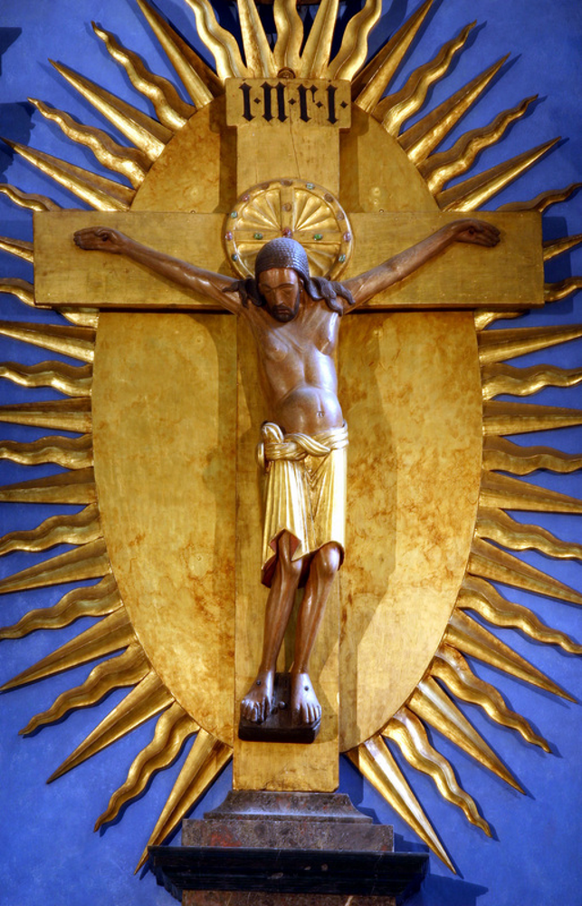
The Gero Cross
Christ’s expression of suffering and depiction of the weight from his hanging arms was unique in this period.
Aspects of Carolingian art are included but adapted to create an art piece that contrasted with traditional Byzantine depictions of the crucifixion.

Slide 3
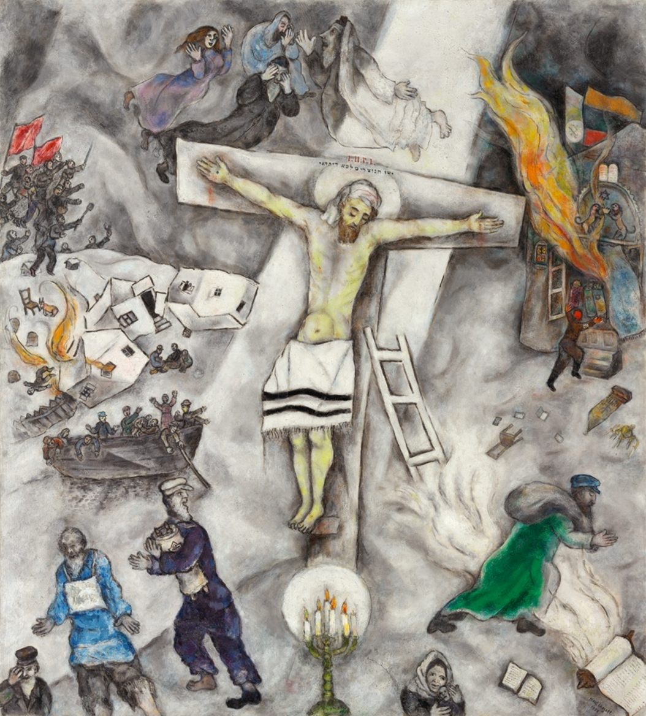
White Crucifixion, Marc Chagall
Chagall depicts the crucifixion displaced from its traditional context and instead surrounded by images of persecution of Jewish people.
Emphasis is placed on Jesus’ Jewish heritage through his clothing and symbols of Jewish religion such as the ladder and Torah.

Slide 4
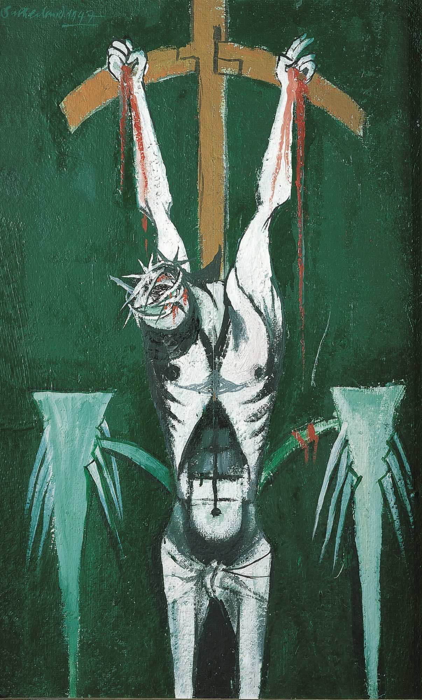
Crucifixion, Graham Sutherland
Jesus is portrayed in a depersonalised manner, with obscured face and physical characteristics, to emphasise the agony in crucifixion as a method of execution.
This painting is unusual in its use of colour and highly stylised depiction of Jesus’ body to underline his suffering.

Slide 5
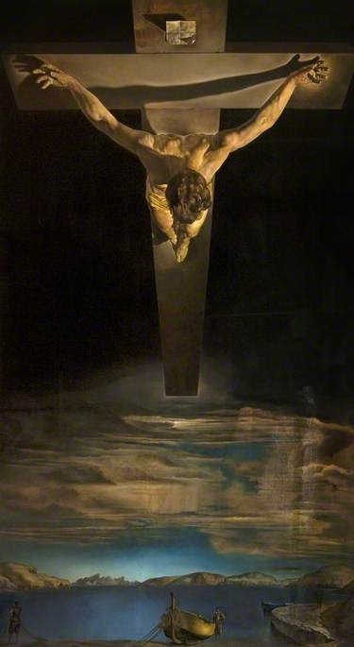
Distinctive perspective places the viewer looking down at Jesus from above.
Christ of St John on the Cross, Salvador Dali
Jesus appears unharmed and positioned high above the human world, suspended in the heavens.

Slide 6
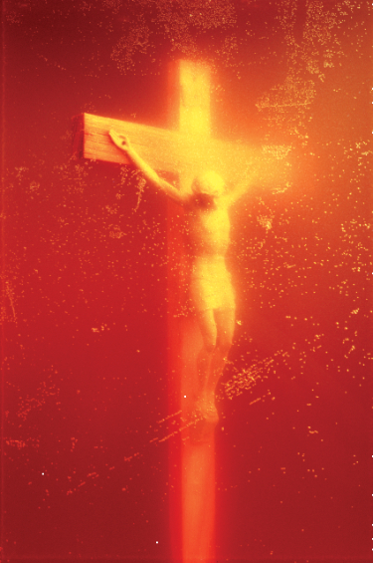
Piss Christ, Andres Serrano
Serrano exhibited this subversive photograph of a crucifix suspended in urine.
This image generated a great deal of controversy and debate around the implications of artwork considered offensive and the significance given to religious symbols.

Slide 7
Concluding Remarks

