Slide 1
ENTREPRENEURSHIP
PRESENTATION
NAME:SHAHINA YUSUFBHAI PATEL
STUDENT NUMBER:1710755
MODULE TITLE:SBMA7111 ENTREPRENEURSHIP
ASSIGNMENT TITLE:ENTREPRENEURSHIP ASSESSMENT-2
LECTURER’S NAME:RICHARD SMALL

Slide 2
Table of content
Title | Page No.
Introduction | 3
Market trend | 4
Industry and market analysis | 5-6
Business model | 7
Financial consideration | 8
Conclusion | 9
References | 10

Slide 3
Introduction
The report provides a clear understanding of the opportunity of a new venture in the potential market.
the chosen company for this assignment is kebabs & curries restaurant.
Kebabs and curries restaurant is the local fast food chain in India that offers a variety of foods to the potential customers.
Vision
The vision of the company is to become a leading Indian restaurant in all over the world
Mission
The mission of the company is to establish a chain of Indian restaurants in order to provide a wide variety of Indian kebabs at a reasonable price to the customers.

Slide 4
Market trend
India is considered as one of the key markets for future growth.
The consumers have a greater tendency to spend money rather than save it (Deaton, & Drèze, 2009).
Indian spend a high proportion of their income on groceries and food as compared to the other countries.

Slide 5
Industry and market analysis
Microenvironment analysis
Political factors: The government regularly check the quality of ingredients and food.
Economic factors: the economic factors affect restaurants industry due to the government fiscal policies.
Social factors: the social factors also influence restaurant industry in the Indian market. it is because consumers are more health conscious about the quality of food (Alabi, et. al., 2006).

Slide 6
Technological factors: the use of IT technology, television helps to attract customers.
Environmental factors: in India, there are some ecological external factors which are implied in the restaurants to focuses on the environmental issues.
Legal factors: government working for the regular supply and quality of the food products.

Slide 7
Businessmodel
Objective
The major objective of the company is to have successful growth of the business by offering the customers the reasonable rate of dishes at restaurant.
Assumptions
It will make increase in its revenue up to 10% from the starting month.
It will also expand its market in other locations.

Slide 8
Establish business
There are various reasons to select the target market as it will be suitable for the new venture.
In the starting stage of the company it is necessary for the company to target the market and build up the strong relationship with the customers (Papadopoulos et al., 2011).

Slide 9
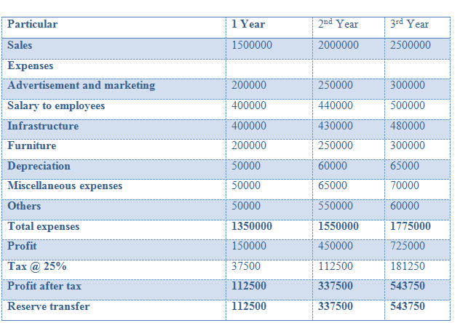
Financial consideration
Profit projections for three years

Slide 10
Conclusion
On the basis of above analysis it can be concluded that market analysis is significant in order to know the internal as well as external analysis where the organization is establishing its business. It has been analyzed that political environment is stable in the country India but there is problem in the economic factor as if the rate are increased of the food products or any kind of changes in the taxes or the government policies then it may impact the restaurants profits.

Slide 11
References
Deaton, A., & Drèze, J. (2009) Food and nutrition in India: facts and interpretations. Economic and political weekly, 42-65.
Alabi, D. A., & Alausa, A. A. (2006) Evaluation of the mineral nutrients and organic food contents of the seeds of Lablab purpureus, Leucaena leucocephala and Mucuna utilis for domestic consumption and industrial utilization. World Journal of Agricultural Sciences, 2(1), 115-118.
Papadopoulos, N. and Martín Martín, O. (2011) International market selection and segmentation: perspectives and challenges. International Marketing Review, 28(2), pp.132-149.

