Slide 1





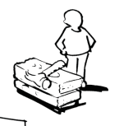



Business Model Canvas – Fusion Attire
Key Partners Clothing resellers e.g. ASOS Shopify Fashion Bloggers Suppliers – e.g. Hawthorn | Key Activities Shipping Taking orders Creating Website Online Advertising | Value Propositions Free shipping for orders over £30 High Quality products for reasonable prices Student Discount A guarantee of quality on our products |  | Customer Relationships High engagement on social media Fast response times to queries and complaints Keep an up to date blog on the website | Customer Segments Men ages 16-30 Online Browsers Students
 | Key Resources Social Networks Storage Website |  |  | Channels Website Social Media Word of Mouth Networking Events Mobile App
Cost Structure Advertising Website and App maintenance Staff Payment to resellers Materials |  |  | Revenue Streams Sales of Product
http://www.businessmodelgeneration.com

Slide 2
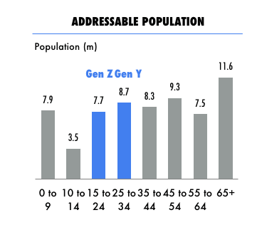
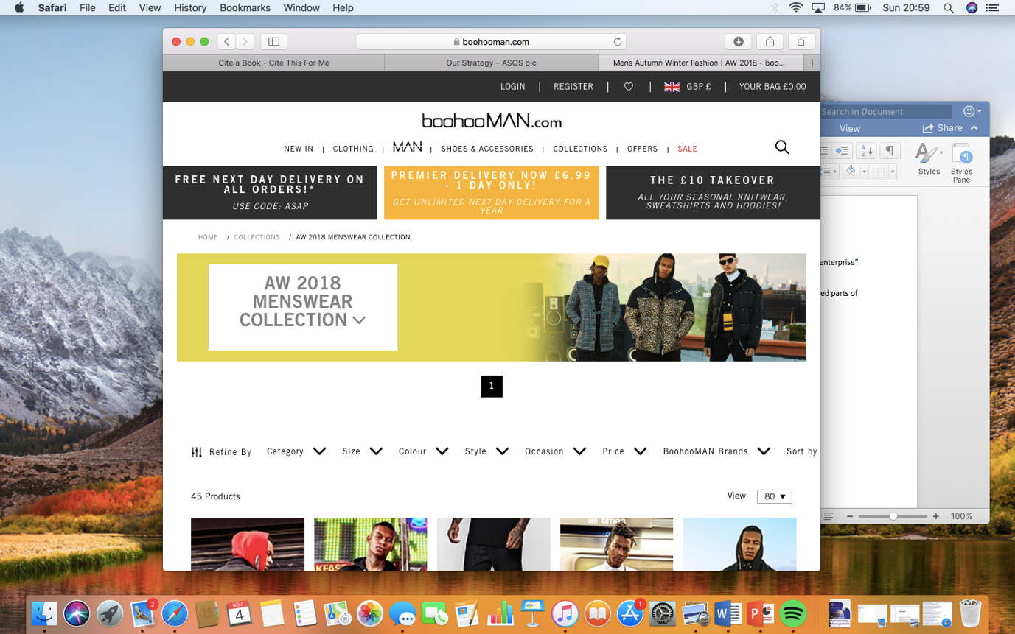
References
Key partnerships
“Some activities are outsourced, and some resources are acquired outside the enterprise” (Osterwalder , Pigneur, & Clark, 2010)
ASOS: The image to the right shows that ASOS’s target audience is the
blue highlighted parts of the graph.
Boohoo man: This image is taken straight from the Boohman website
Value Propositions: “Describes the benefits customers can expect from your products and services” (Osterwalder, Pigneur, Bernarda, & Smith, 2015)
Channels: “A marketing channel is a set of practices or activities necessary to transfer to the ownership of goods, and to move goods, from a point in production”. (Rosenbloom, 2013)

