Slide 1

Title: (Infinity Marketing)
Lecturer-Thomas Adeyemi

Slide 2
Managing Enterprise in the 21st Century
BMSW4006
Share Holders | Responsibilities
Emilian Triboi | CEO/Operator
Cristina Girnet | CEO/Operator
George Mihaita Arsene | Co-chief Executive
Violeta Zisu | Chief Financial Officer
Joanna Kowalik | Chief Operating Officer

Slide 3
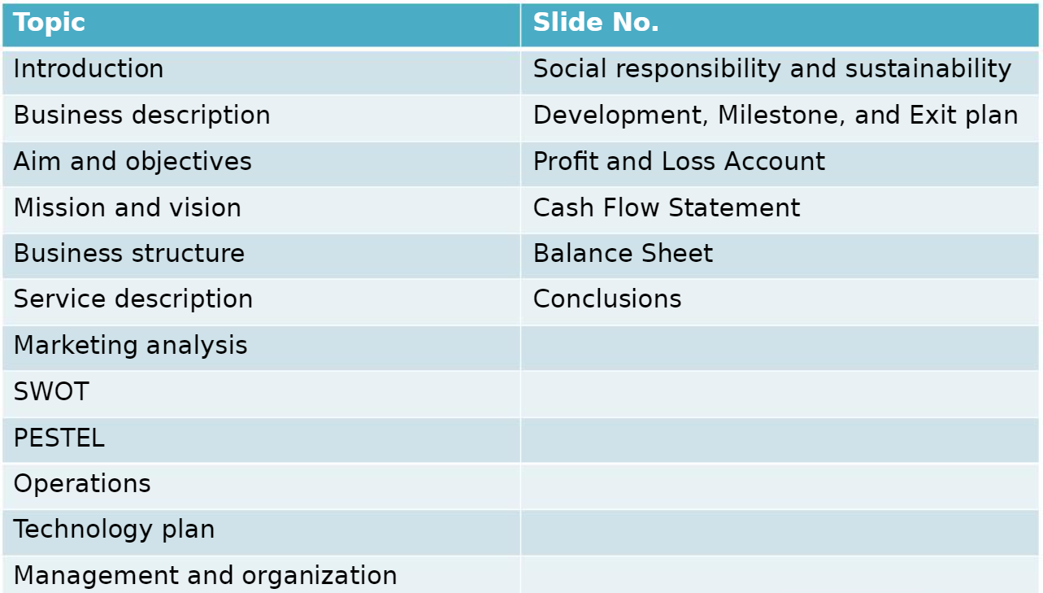
Table of Contents

Slide 4
Introduction
The overall summary of such a business plan of Infinity Marketing is going to be presented in this presentation. This presentation will discuss the concept of business description, products and services, management, marketing, and technology of a business, named Infinity Marketing.
Notes:
The business plan is such a plan that envisages lots of business-related issues of the business (Maravilhas, 2019). A business plan considering digital marketing and advertising service business, named Infinity Marketing has been prepared. Now, the overall summary of such a business plan is going to be presented in this presentation. This presentation will discuss the concept of business description, products and services, management, marketing, and technology of a business, named Infinity Marketing.

Slide 5
Business Description and History
In 1996, Infinity Marketing has been formed by some key people,
Its 26 years of journey in the digital marketing and advertising service sector has become an inspiring issue for exploring the entire market.
The leaders can help develop the growth of the performance.
Notes:
In 1996, Infinity Marketing has been formed by some key people whose dedication still inspires the employees in this business. As a result, unity is found in the field of providing services to the targeted customers. Its 26 years of journey in the digital marketing and advertising service sector has become an inspiring issue for exploring the entire market. It has some dedicated key leaders in the top-level management who have been leading the entire business toward the ultimate goals of the business. Initially, it started its journey with few services but now it has a great range of services that attract lots of potential clients for this small private limited business (Maravilhas, 2019). The leaders in the management always keep inspiring the employees toward the ultimate goals of the business and for this, the leaders prioritize several impactful issues that can help accelerate the existing performance and develop the growth of the performance.

Slide 6
Aim and Objectives
Aim
This digital marketing and advertising service business aims at ensuring 100% quality and effectiveness in the services considering the existing needs and demands of the customers that can help obtain loyalty.
Objectives
Its objectives include increasing sales turnover, raising brand awareness, and obtaining a lucrative position in the market that can help draw the attention of potential customers for the business.
Notes:
This digital marketing and advertising service business aims at ensuring 100% quality and effectiveness in the services considering the existing needs and demands of the customers that can help obtain loyalty. That means it also aims at obtaining customer loyalty through effective services to the customers and a market position that can make a difference from others in the market.
Its objectives include increasing sales turnover, raising brand awareness, and obtaining a lucrative position in the market that can help draw the attention of potential customers for the business. Its objective makes it focus on enhancing the operation in divergent fields of digital marketing services.

Slide 7
Mission and Vision
Vision
The business has a vision that will make it the number-one brand in the sector that will help obtain a majority share in the market.
Mission
In the mission statement, Infinity Marketing will focus on being the leading brand in the sector and will be considered a role model for other businesses.
Notes:
Vision: The business has a vision that will make it the number-one brand in the sector that will help obtain a majority share in the market. In the long run, this business will pave the way for obtaining several learning skills and potential experiences.
Mission: Its mission is to form a unified and diversified workforce in the same workplace where different people having diversity will keep working simultaneously at the end of the day. In the mission statement, Infinity Marketing will focus on being the leading brand in the sector and will be considered a role model for other businesses. Besides, this business will keep increasing the productivity and profitability of the business as well as raising brand awareness

Slide 8
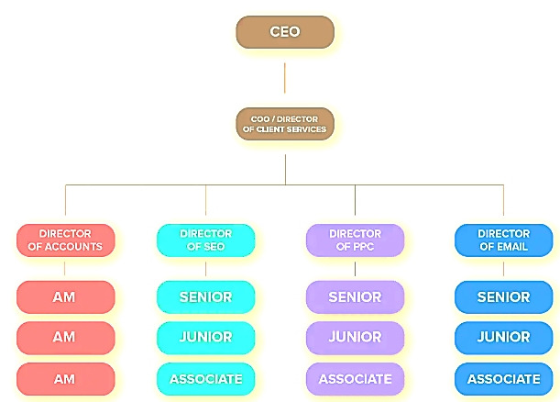
Business Structure
Infinity Marketing is a private limited company that has a mixed hierarchy in its organizational structure.
Figure 1: Management structure of Infinity Marketing
Source:(Weaver, 2022)
Notes:
Infinity Marketing is a private limited company that has a mixed hierarchy in its organizational structure. The CEO, Cristina is the top leader of this business who keeps monitoring the performances and overall activities of the employees. In this business structure, different departments are found in the field of operating the overall business functions that have distinct directors for getting work done by several employees in each department.
This private business needs to follow the UK’s taxation acts, health, and safety activities that help ensure protection and safety for the employees, and the data protection act for the business at the end of the day (Maravilhas, 2019). Legal compliances and bodies are part of the entire organization that helps form the business following the industrial legislation.

Slide 9
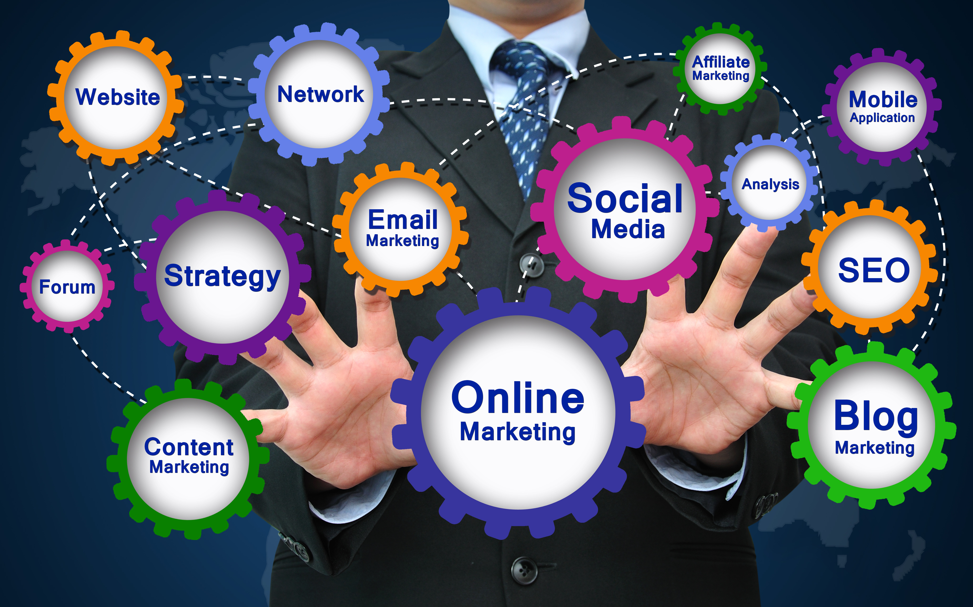
Product or Service Description
Digital marketing agency
SEO
Social media marketing
Notes:
Infinity Marketing is based on digital marketing and advertising services. This is the core service of this business that includes several sub-services, such as search optimization, social media services, online ads, and so on. That is why it assists in asking corporate clients including small businesses, especially how much they want the services.
The digital marketing agency will assist corporate clients in terms of reaching and converting the targeted clients via the marketing channels and for this, it focuses on running ads for several businesses that can bring lucrative charges as the revenues for this business.
SEO is another service that will be provided by this business. In this case, Infinity Marketing will help prepare and build up effective strategies for the clients that will focus on boosting their distinct SEO and obtaining authorization (Stokes, 2016).
Social media marketing will include services on different social media platforms including Facebook marketing, Instagram marketing, email marketing, and so on. This will also include 24/7 hours analytics, custom and creation, and so on.

Slide 10
Marketing Analysis and Trends
Brains Marketing, Tiga Creative Marketing, CEEK, Reflect Digital
It also considers competitor analysis for ensuring appropriate evaluation
Customers: Small, medium, and large organizations are the customers of this business.
Notes:
For assessing the market conditions, this business has also some market competitors that include Brains Marketing, Tiga Creative Marketing, CEEK, Reflect Digital, and so on. All of these businesses indulge in providing digital marketing and advertising services to small businesses that bring a competitive edge to them at the end of the day.
It also considers competitor analysis for ensuring appropriate evaluation of the areas that helps manage diversification and business development (Brenner, 2022). That is why Infinity Marketing keeps concentrating on collecting reviews and looking for outstanding functions that can help enhance all sorts of possibilities for this business in the targeted market.
Customers: Small, medium, and large organizations are the customers of this business. In this case, diverse strategic procedures are followed for obtaining a competitive edge in the market. Besides, the customer evaluation procedure is also essential for implementing and improving the possibilities in the business and this can accelerate the development of this business in the market.

Slide 11
SWOT Analysis
Strengths | Weaknesses
Diverse procedures, manage training procedures, and collaborative practices in the business. | Poor management and effective collaboration
Opportunities | Threats
Exploring itself in the market Obtaining more loyal customers | Marker competition, additional margin costs, etc.
Notes:
Strength: It helps enhance diverse procedures, manage training procedures, and collaborative practices in the business. It makes the process of monitoring the functions of the client’s businesses. Appropriate strategic control and managerial activities are also strengths of this business.
Weaknesses: It does not have appropriate management practices. Besides, poor management, control, and collaborative practices are also weaknesses (Brenner, 2022). It is also difficult to ensure strategic direction activities.
Opportunities: By managing and collaborating with some particular practices, this business can explore itself in the market. It can be the loyal partner of several small and medium enterprises.
Threats: Market competition is the major threat to this business. Market segmentation and higher margin cost of Infinity Marketing can also threaten the existence of this business.

Slide 12
PESTLE Analysis
Political: The changes in political conditions, new legislative issues, business formulation procedures, etc.
Social: Norms, social values, guidelines, and a diverse workforce.
Technological and bringing new technology
Economic: The inflation rate and purchasing power of consumers.
Environmental: Sustainability
Legal: Legislative issues including phases, procedures, laws, and diverse legal obligations
Notes:
Political: The changes in political conditions, new legislative issues, business formulation procedures, etc. have significant impacts on businesses.
Economic: The inflation rate keeps rising after the post-pandemic situation that has been affecting the price level and purchasing power of consumers.
Social: Norms, social values, guidelines, and practices are the major issues in this case. Infinity Marketing can utilize social guidelines for managing a diverse workforce.
Technological: technological advancement is one of the major issues in this case (Brenner, 2022). Bringing new technology or updating the existing one can be the most effective issue in this case.
Environmental: Sustainability is the most crucial issue that requires the procedures of the environment, customer services, etc. are the most confidential issues that have significant impacts on the business.
Legal: Legislative issues including phases, procedures, laws, and diverse legal obligations are the major legal factors for the business. Besides, health and safety are other crucial issues.

Slide 13
Operations
It indulges in offering digital marketing and advertising services to customers. Its business operation is based on the internet and online platform.
It considers both hardware including computers, Wi-Fi, etc., and software applications. Its operations include taking orders from clients; based on their specific orders, Infinity Marketing specifies a particular digital marketing service tool for providing services to customers.
Notes:
It indulges in offering digital marketing and advertising services to customers. Its business operation is based on the internet and online platform.
It considers both hardware including computers, Wi-Fi, etc., and software applications. Its operations include taking orders from clients (Gelashvili, 2021); based on their specific orders, Infinity Marketing specifies a particular digital marketing service tool for providing services to customers.

Slide 14

Technology Plan
Its decision-making process considers software, hardware, social media, SEO, etc.
Notes:
This business has chosen digital marketing concepts and activities that can help conduct client service procedures and secure a technology development for Infinity Marketing (Gelashvili, 2021). It utilizes technology for having a more competitive edge in the market.
Its technology includes segmentation procedures, management of the factors, social media marketing, resource evaluation procedures, and so on. Its decision-making process considers software, hardware, social media, SEO, etc.

Slide 15

Management and Organization
A traditional structure is followed that prioritizes a top-down approach is envisaged for ensuring a decentralized decision-making process in the business.
Notes:
A traditional structure is followed that prioritizes a top-down approach is envisaged for ensuring a decentralized decision-making process in the business.
In top-level management, the CEO, Co-CEO, and managing directors always belong who take the ultimate internal decision for the business.
Mid-level management focuses on accomplishing the guidelines of the business (Weaver, 2022); and for this, it prioritizes the guidance provided by the top-level management and that is why they get work done by the low-level managers.

Slide 16
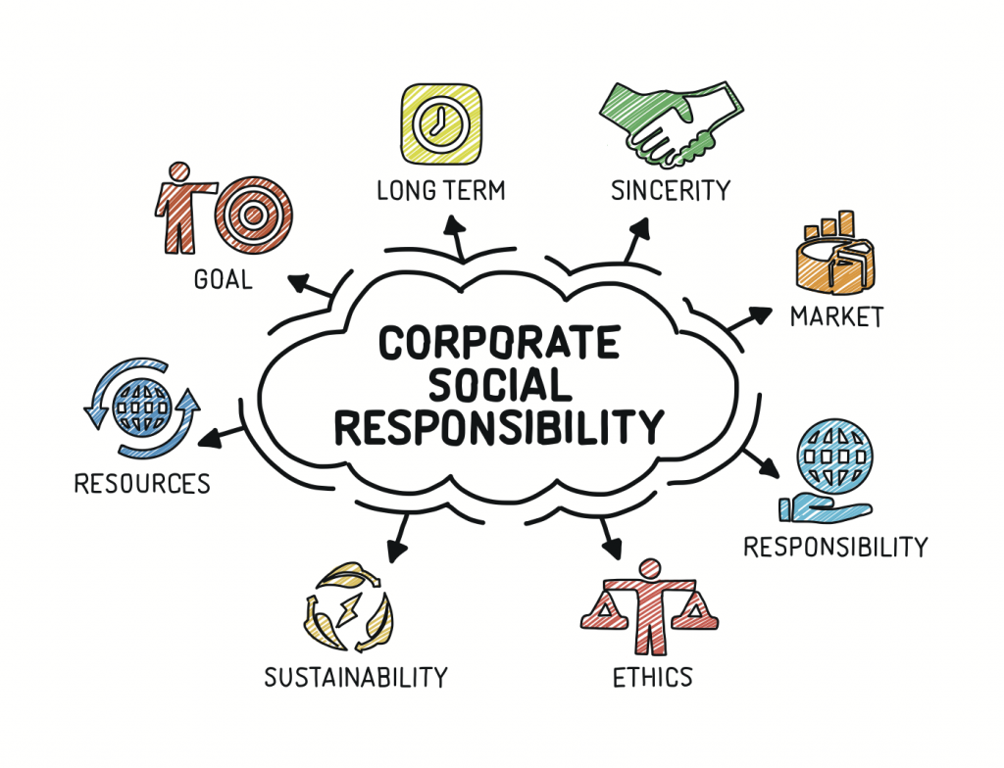

Social Responsibility and Sustainability
Infinity Marketing is bound to act sustainably and for this, it does not involve any kind of unethical and immoral activities that can hamper environmental acts.
Notes:
Like others, this business is also socially responsible. It is bound to act sustainably and for this, it does not involve any kind of unethical and immoral activities that can hamper the environmental acts. Each activity is quite sustainable.

Slide 17
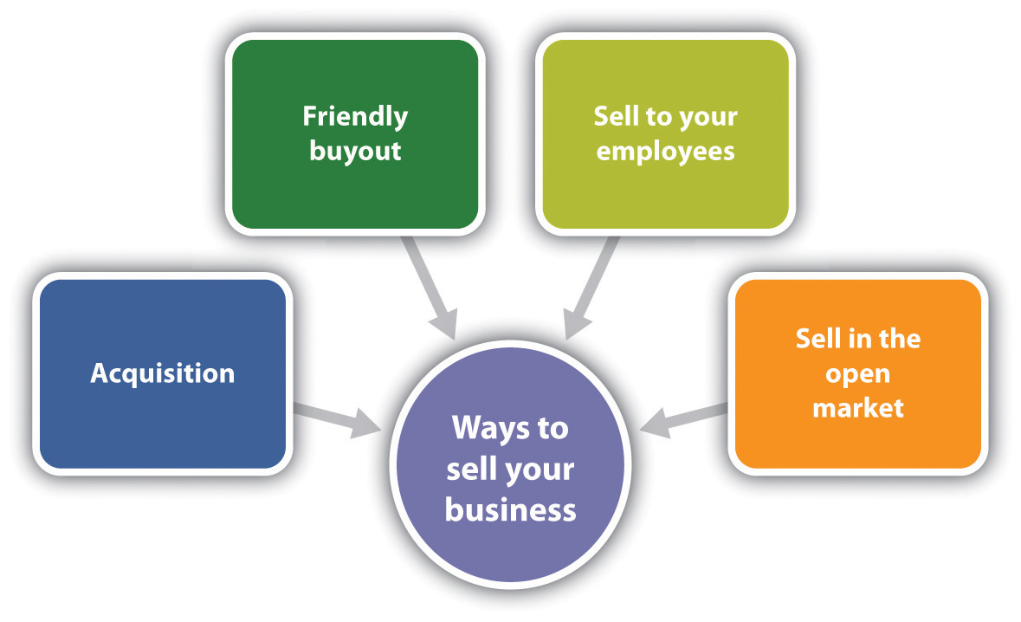
Development, Milestone, and Exit plan

Slide 18
Financial Data

Slide 19
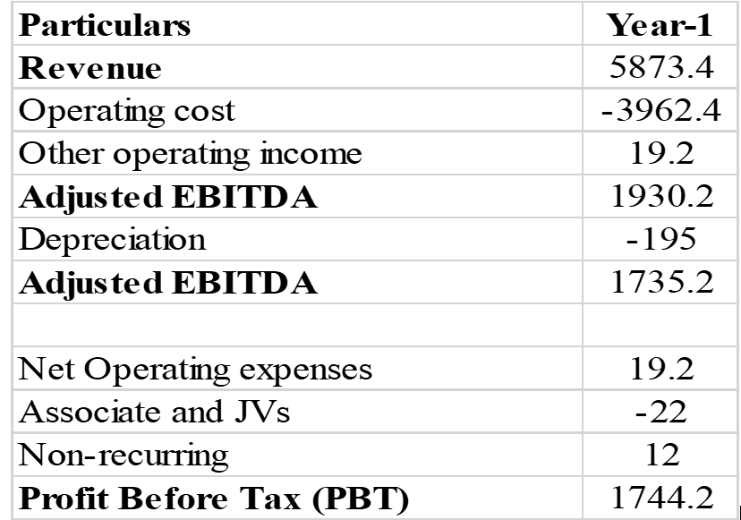
Profit and Loss Account

Slide 20
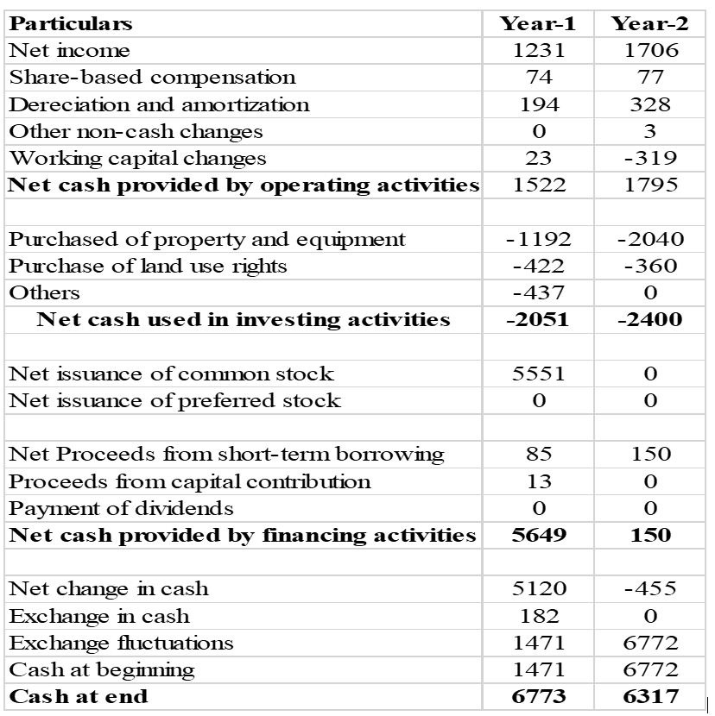
Cash Flow Statement

Slide 21
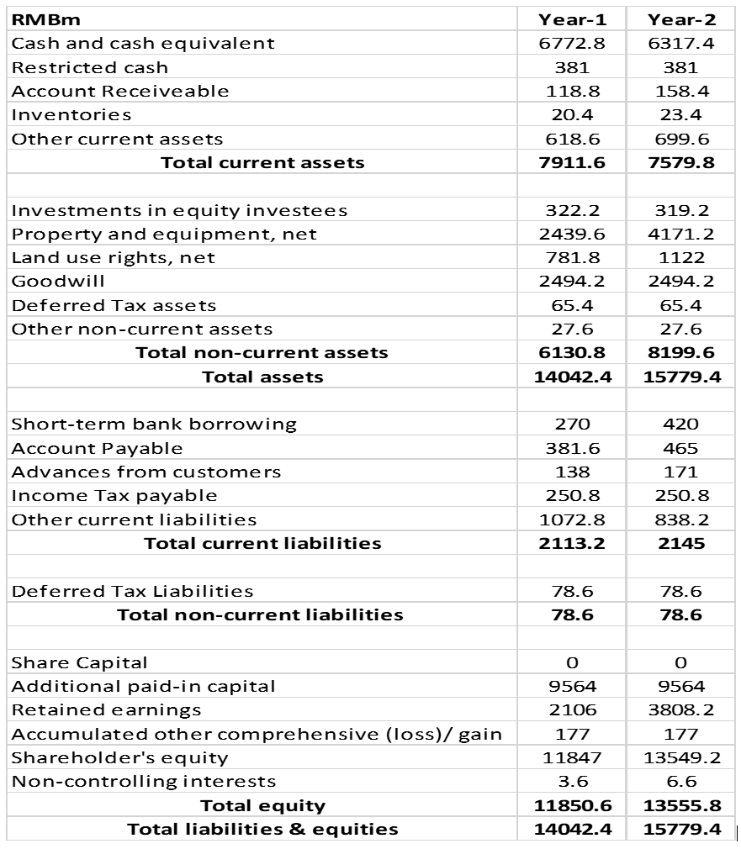
Balance Sheet

Slide 22
Conclusion
This presentation has presented the overall summary of the elements of a business plan. This discussed the business description, products or services, management, marketing and technology trends in the market.

Slide 23
References
Brenner, M. (2022) The Future of Digital Marketing: Predictions for 2023 and beyond, Marketing Insider Group. Available at: https://marketinginsidergroup.com/content-marketing/the-future-of-digital-marketing-predictions-trends/ (Accessed: December 10, 2022).
Chaffey, D. and Ellis-Chadwick, F. (2022) Digital Marketing. Upper Saddle River: Pearson.
Gelashvili, V. (2021) “Digital Marketing vs. traditional marketing,” Advances in Marketing, Customer Relationship Management, and E-Services, pp. 34–50. Available at: https://doi.org/10.4018/978-1-7998-8003-5.ch003.
Maravilhas, S. (2019) “Marketing and marketing plan for information services,” Advances in Marketing, Customer Relationship Management, and E-Services, pp. 620–632. Available at: https://doi.org/10.4018/978-1-5225-7766-9.ch048.
Stokes, P. (2016) Organizational management: Approaches and solutions. London: Kogan Page.
Weaver, B. (2022) The 3 most common advertising agency hierarchies, Instapage. Available at: https://instapage.com/blog/advertising-agency-hierarchy (Accessed: December 10, 2022).

Slide 24


Notes:
24

Slide 25

ANY QUESTIONS?

