Slide 1

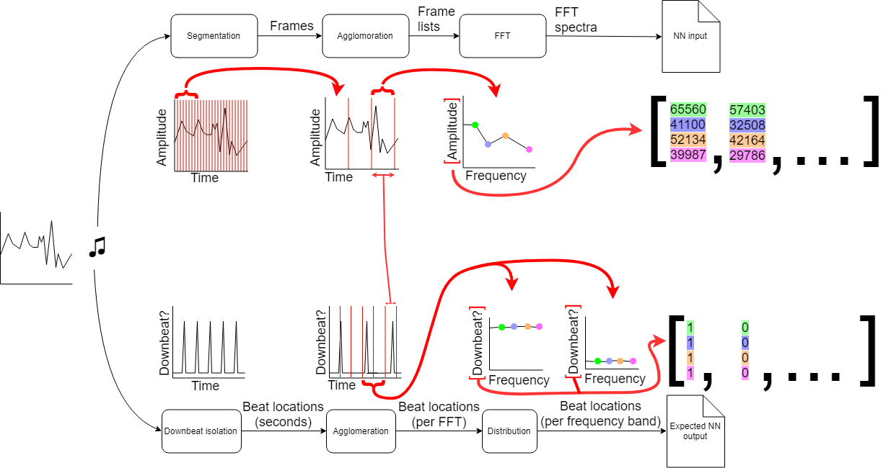
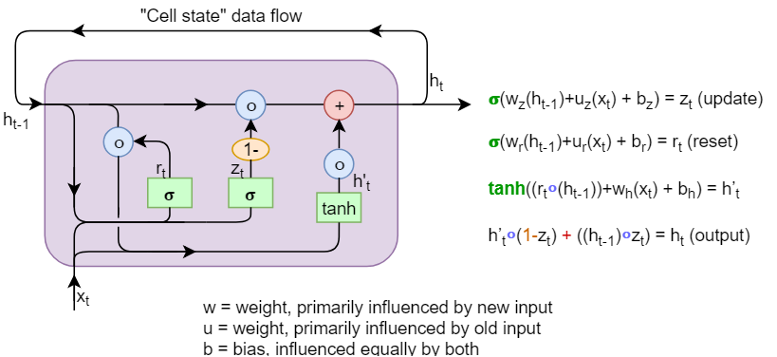
Realtime downbeat recognition using neural networks
Jack Hinton - p147676 jhinton.147676@student.uwtsd.ac.uk
The aim of this project was to determine the feasibility of a system that could keep time when music is played to it. This could then be combined with a drum machine to allow musicians to use a drum track that keeps time with them, rather than the other way around. This presented unique challenges, as it was necessary for the feedback to be both accurate and instantaneous. It was thus decided that a neural network and feature extraction architecture could provide the necessary rapidity and accuracy. A neural network can be thought of as a ‘net’ or ‘chain’ of simple processes that feed their output into other processes and thus allow the system to ‘learn’. [1] Single neurons typically have an imprecise binary or floating point output but when many are networked together, the potential for subtlety and precision is greatly increased. They can also have the ability to ‘learn’ from stimulus, thus allowing one to ‘train’ a neural network to give the correct output when the function is not easily expressed in objective terms. To accomplish this, a system of weighting is used whereby neurons that produce correct results are given higher influence over the end result. Thus, a neural network that is given many examples and correct outcomes will eventually learn to reliably give the correct output. The architecture[2] of the neural network used in this project is shown below: | In order to process a data stream it is sometimes necessary to split it up into discrete units that may be individually addressed, rather than trying to continuously process the data in real time [3]. The neural network used is trained using music that is segmented into chunks 0.128s long with accompanying downbeat data. This is performed using the system above. After segmentation has been achieved, the resulting segments must then be processed in order to extract the data pertaining to the presence of a musical downbeat. There are many methods for doing this, the four most reliable of which were trialled. These methods were as follows: Analysis of Chroma change, analysis of low frequencies, spectrum analysis, and melodic constant-Q transformation. [4] The output from the aforementioned data extraction method is then fed into a neural network, which will have been previously trained using the samples obtained. The neural network will then detect the downbeats from this data.
 |  | References
1 | M. W. Pedersen, “Training recurrent networks,” in Neural Networks for Signal Processing VII. Proceedings of the 1997 IEEE Signal Processing Society Workshop, Amelia Island, FL, USA, pp. 355–364.
2 | J. Chung, C. Gulcehre, K. Cho, and Y. Bengio, “Empirical Evaluation of Gated Recurrent Neural Networks on Sequence Modeling,” arXiv [cs.NE], 11-Dec-2014.
3 | A. M. Stark and M. Davies, “Real-time beat-synchronous analysis of musical audio,” Proceedings of the 12th Int, 2009.
4 | S. Durand, J. Bello, B. David and G. Richard, "Robust Downbeat Tracking Using an Ensemble of Convolutional Networks", IEEE/ACM Transactions on Audio, Speech, and Language Processing, vol. 25, no. 1, pp. 76-89, 2017.

