Slide 1

ECGE7005P Week 5 Wednesday
Analysing Data and Presenting Findings

Slide 2
What is Data?
[OALD]:
Data n.
1. facts or information, especially when examined and used to find out things or to make decisions.
2. information that is stored by a computer

Slide 3
Types of Data?
Interview
Questionnaires and surveys (close-ended and open-ended)
Focused groups
Observation
Case studies
Document analysis
What kinds of data can you collect through these methods?
Quantitative and/or qualitative.

Slide 4
Qualitative Research (Wellington, 2020)
Qualitative research produces large amounts of data – mostly in the form of words.
Avoid over-collect and under-analyse.

Slide 5
Qualitative Data Analysis
Organising findings
Methodological tools for analysis
Content analysis and grounded theory

Slide 6
The Constant Comparative Methods and ‘continuous refinement’ of categories
Data divided into ‘units of meaning’.
Units grouped/classified into categories.
New units of data subsumed under these, or used to develop new categories (assimilation and accommodation).
Search for similar categories (could two be merged into one?).
Examine large, amorphous categories (could one be split into two?).
Checking: (a) Do the categories cover all the data? (exhaustive)
(b) Are they different, not overlapping? (mutually exclusive).
Integrating: Looking for connections, contrasts and comparisons between categories.
(Wellington, 2020, p. 263)

Slide 7
Stages of Qualitative Data Analysis (Wellington, 2020, p.267)
Immersion
Reflection, standing back
Analysing:
- dividing up, taking apart
- selecting & filtering
- classifying & categorizing
Synthesizing, re-combining
Relating to other work, locating
Reflection back (return for more data?)
Representing, disseminating sharing

Slide 8
Organising Findings – Qualitative Data
Ways of organising qualitative data analysis
  By groups – groups the data and enables themes, patterns and similar to be seen at a glance. (more suitable for single-instrument approach - interview, questionnaires, observations etc., or organise instrument by instrument).
  By individuals – presenting and analysing total responses of a single participant and then move on to the next. (if the researcher is interested only in individual responses, it preserves coherence and integrity, enables whole picture of that individual to be presented, however).

Slide 9
Organising Findings – Qualitative Data
  By issues - present all the data relevant to a particular issue. (economical in making comparisons across respondents, i.e. data reduction through careful data display vs wholeness, coherence and integrity of each individual respondent). Be cautious of deciding issues pre-ordinately prior to data collection:
    losing integrity and wholeness of individual data;
    data can be decontextualised – some data needs to be understood with other preceding comments; can fragment data and lose their interconnectivity;
    The analysis may be unresponsive to additional relevant factors, which the researcher would need to analyse residue data for other additional important issues.

Slide 10
Organising Findings – Qualitative Data
  By research question – all relevant data are collated to provide a collective answer to the research question.
  By instrument – present all interview data, questionnaires data, documentary data, field notes etc., and for further analysis, it is typically used in conjunction with another approach, i.e. by issue or by people, to analyse the content of the responses. (risk of adding unnecessary level of analysis and losing connections between data)

Slide 11
Qualitative Data
Though qualitative data, compared to quantitative data is less a completely accurate representation, as it is interpretive.
Reflexivity: 'researcher may be selective in his or her focus, or that the research may be influenced by the subjective features of the researcher.' (Cohen et al., 2007, p. 469)
Caution and self-awareness must be exercised by the researcher in conducting qualitative data analysis, for the analysis and the findings may say more about the researcher than about the data. (ibid.)

Slide 12
Presenting Findings
Presenting data
  Text
  Tables
  Bar charts
  Pie charts
  Line charts
  Scatter plots
  (consider data reduction through careful data display and commentary)

Slide 13
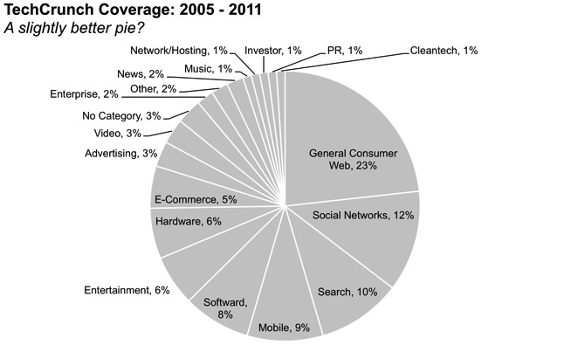
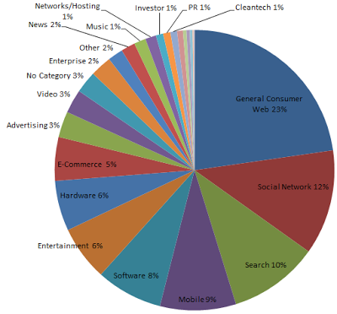
Is this good data representation?
Source: (Nussbaumer, 2011)

Slide 14

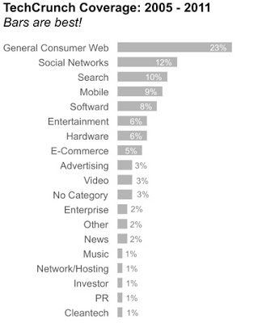
Is this better?
Source: (Nussbaumer, 2011)

Slide 15
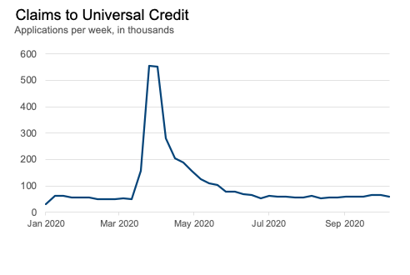
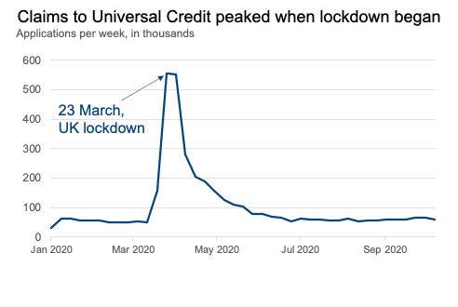
What about this?
(Source: Civil Service, 2021)

Slide 16
Methodological Tools for Analysing Qualitative Data
Analytic Induction
Constant Comparison
Typological Analysis
Enumeration
(LeCompte and Preissle,1993, p.253 & Bogdan and Biklen, 1992, p.72, cited by Cohen et al., 2007, pp. 472-474)

Slide 17
Content Analysis
A strict and systematic set of procedures for the rigorous analysis, examination and verification of the contents of written data (Flick, 1998, p.192; Mayring, 2004, p.266)
An alternative to numerical analysis of qualitative data.
Including the coding of open-ended questions in surveys, the revealing of the focus of individual, group, institutional and societal matters, and the description of patterns and trends in communicative content (statistical techniques needed).(Weber, 1990)
Highest quality content-analytic studies use both quantitative and qualitative analysis of texts. (ibid.)

Slide 18
Content Analysis
The process of content analysis:
  Breaking down text into units of analysis;
  Undertaking statistical analysis of the units;
  Presenting the analysis in as economical a form as possible.

Slide 19
Content Analysis
11 steps of content analysis:
Define the research questions to be addressed by the content analysis.
Define the population from which units of text are to be sampled.
Define the sample to be included.
Define the context of the generation of the document.
Define the units of analysis.
Decide the codes to be used in the analysis.

Slide 20
Content Analysis
7. Construct the categories for analysis.
  these can include: subject matter; direction (how a matter is treated – positively or negatively); values; goals; method used to achieve goals; traits (characteristics used to describe people); actors (who is being discussed); authority (in whose name the statements are being made); location; conflict (sources and levels); and endings (how conflicts are resolved)

Slide 21
Content Analysis
8. Conduct the coding and categorizing of the data.
9. Conduct the data analysis.
10. Summarizing.
11. Making speculative inferences.
Example: Cohen et al., 2007, pp.502-506.

Slide 22
Grounded Theory
‘Grounded theory is a general methodology for developing theory that is grounded in data systematically gathered and analysed’. (Strauss and Corbin,1994, p.273)
‘Grounded theory is the systematic generation of a theory from data'. (Glaser, 1996)
Use inductive reasoning – the truth of the conclusion is probable based upon the evidence given.

Slide 23
Grounded Theory
Features of grounded theory:
Theory is emergent rather than predefined and tested.
Theory emerges from the data rather than vice versa.
Theory generation is a consequence of, and partner to, systematic data collection and analysis.
Patterns and theories are implicit in data, waiting to be discovered.

Slide 24
Further Reading
Chapter 9, Creswell, J.W. and Poth, C.N. (2023) Qualitative inquiry and research design : choosing among five approaches. Fifth edition. Thousand Oaks, California: Sage.
Chapter 9 & 10, Creswell, J.W. and Creswell, J.D. (2018) Research design : qualitative, quantitative and mixed methods approaches. 5th edition. Los Angeles: SAGE.
Part 4 & 5, Denscombe, M. (2021) The good research guide : research methods for small-scale social research projects. Seventh edition. London: Open University Press.

Slide 25
Quantitative Data Analysis
No greater or lesser importance than qualitative data.
Fitness for Purpose.
Often associated with large-scale research and experiments.

Slide 26
Quantitative Data Analysis
Nominal scale denotes categories, nominal data denote discrete variables, entirely separate categories.
  For example: sex, age group (26-30, 31-35), subject taught, type of school and so on.
Ordinal scale classifies and introduces an order into the data.
  For example: 1= strongly disagree; 2 = disagree; 3 = neither agree nor disagree; 4 = agree; 5 = strongly agree (5-point rating scale)
Interval scale introduces a regular and equal interval between each data point (a metric), it classifies and introduces an order into the data, and tells 'precisely how far apart are the individuals, objects or events that forms the focus of our inquiry.' (Cohen and Holliday, 1996, p.9)
  Equal interval scales (exact interval between each data point): degrees Celsius.
  There is no true zero, does not work for Fahrenheit, IQ test points, as they do not start at zero.
  In practice, the interval scale is rarely used.

Slide 27
Quantitative Data Analysis
The ratio scale – classification, order and an equal interval metric, as well as true zero. This enables the researcher to determine proportions easily - 'twice as many as', 'half as many as', 'three times the amount of' and so on. All the arithmetical processes of addition, subtraction, multiplication and division are possible.
The consideration of which statistical test to use is dependent on the scale of data.

Slide 28
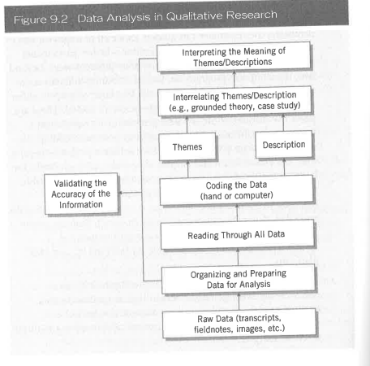

Slide 29
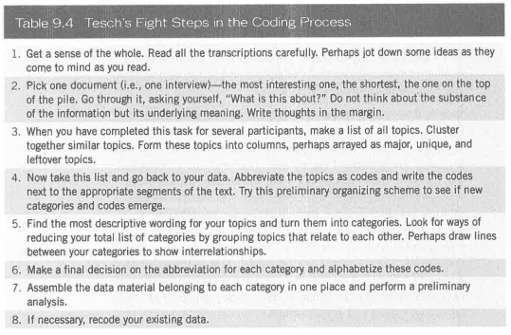

Slide 30
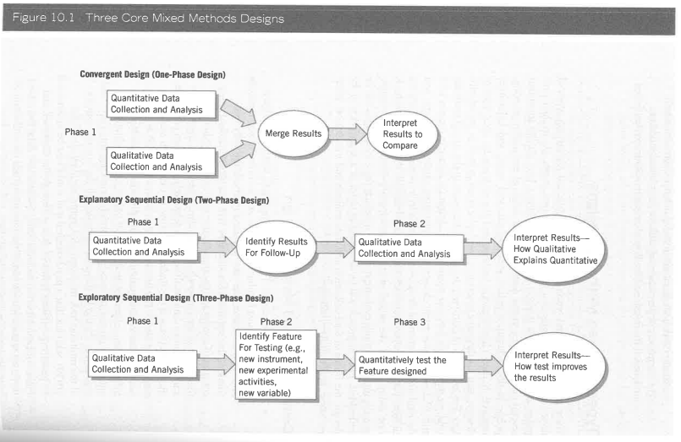

Slide 31
Other Useful Resources
Academic Phrasebank | Discussing findings (manchester.ac.uk)
Analysing and Presenting Data - Research Skills - The Library at Leeds Beckett University
Ch.11, Educational research : contemporary issues and practical approaches (Wellington, 2022, pp.259-278).
7. The Results. USC Libraries Research Guides.
Using Non-Textual Elements. USC Libraries Research Guides.

Slide 32
Reference List
Civil Service (2021) Presenting data: 5 tips for making your data understandable. Available at: https://dataingovernment.blog.gov.uk/2021/03/02/presenting-data-5-tips-for-making-your-data-understandable/ (Accessed: 04/10/2024).
Cohen, L, Manion, L. and Morrison, K. (2007) Research Methods in Education, 6th edn. London and New York: Routledge.
Creswell, J.W. and Creswell, J.D. (2018) Research design : qualitative, quantitative and mixed methods approaches. 5th edition. Los Angeles: SAGE.
Creswell, J.W. and Poth, C.N. (2023) Qualitative inquiry and research design : choosing among five approaches. Fifth edition. Thousand Oaks, California: Sage.
Denscombe, M. (2021) The good research guide : research methods for small-scale social research projects. Seventh edition. London: Open University Press.
Nussbaumer, C. (2011) Death to Pie Charts. Available at: https://www.storytellingwithdata.com/blog/2011/07/death-to-pie-charts (Accessed: 04/10/2024).
USC Libraries (2024) Organizing your social sciences research paper. Available at: https://libguides.usc.edu/writingguide (Accessed: 05/11/2024).
Wellington, J. J. (2020) Educational research : contemporary issues and practical approaches. 2nd edn. London, England: Bloomsbury Academic. Available at: https://doi.org/10.5040/9781474236966.

