Slide 1
And We’re Back..
Unit 2
Content and function

Slide 2
ADPA4001: Component 1 +2

Slide 3
Component 2 details discussed
Please see Module Handbook for details of the PDP and Video assignments.

Slide 4
Unit 2
Before we continue, I always encourage active questioning for critical insight.
This means considering the (by now) common questions:
What does this mean for me?
What am I first?
Would this pass the CRAAP/ RADAR test?
Notes:
Currency Relevance Authority Accuracy Purpose
Rationale Authority Date Accuracy Relevance

Slide 5
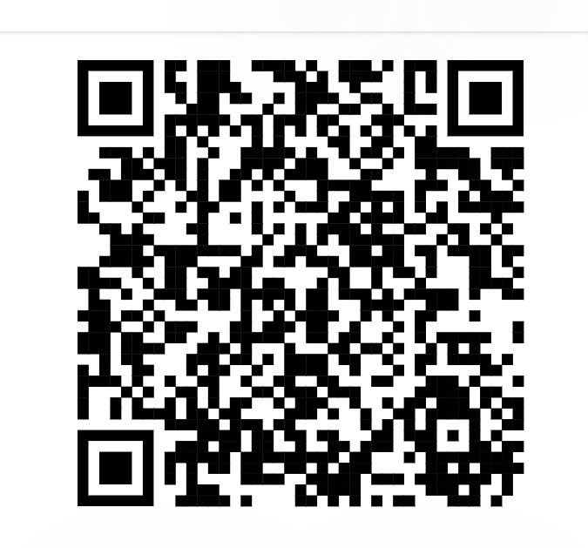
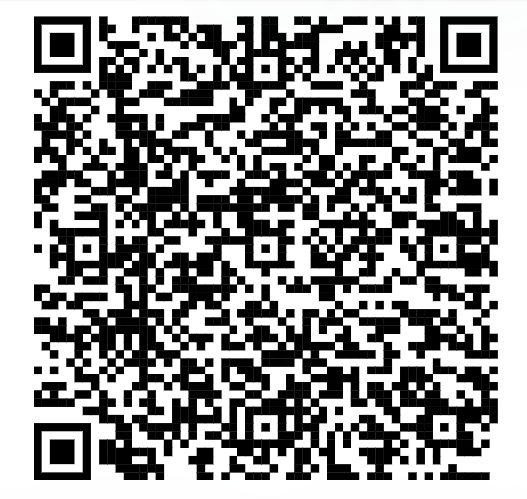
Some news…

Slide 6
Some news… (just in case my tech falls off)
https://www.theguardian.com/stage/2023/oct/05/national-theatre-wales-may-close-in-six-months-after-funding-cut
https://www.bbc.co.uk/news/entertainment-arts-63512050
Notes:
https://www.theguardian.com/stage/2023/oct/05/national-theatre-wales-may-close-in-six-months-after-funding-cut
https://www.bbc.co.uk/news/entertainment-arts-63512050

Slide 7
Some more news…
What are the multiple impacts of this decision?
And what do they have to do with us?
Notes:
https://www.bbc.co.uk/news/entertainment-arts-63512050

Slide 8
Previous questions considered in context of arts investment
Art Council Wales Investment Review 2023:
https://arts.wales/investment-review
Adolygiad Busnes Cyngor Celfyddydau Cymru 2023:
https://arts.wales/cy/adolygiad-buddsoddi

Slide 9
Them, Us, We.
Audiences are excellent examples of individuality - two people sat next to each other might or will be different, have individual reasons for being at the production etc.
From video:
'Ultimately, the world will always present itself differently to each individual based on how we filter what's going on in front of us'

Slide 10
Them, Us, We.
Your beliefs - ideas you hold to be true
Your values - what's important to you
Your attitudes - how you treat others and approach situations.
Impacts - your behaviour - how you act.
Notes:
As you work through Unit 2 you’ll be encouraged to consider:

Slide 11
Them, Us, We.
Othering the opposite of belonging?
Tolerance and inclusivity will combat ‘othering’ – but is that realistic?
What are your experiences of belonging and what are your experiences of ‘othering’?
Notes:
Othering -

Slide 12
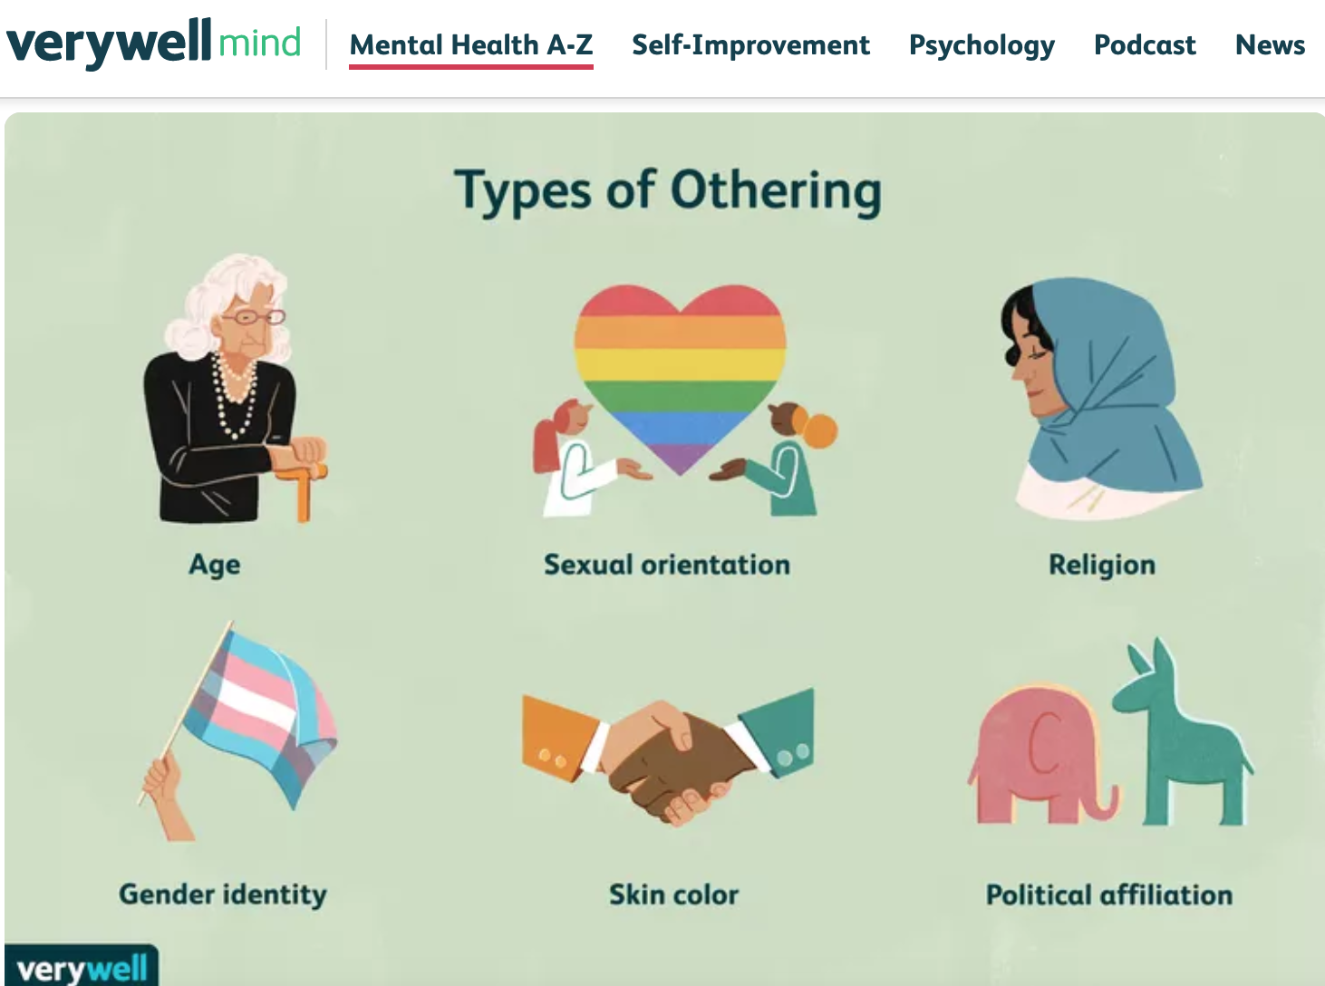
Othering
Notes:
https://www.verywellmind.com/what-is-othering-5084425

Slide 13
What Is Othering?
Othering is a phenomenon in which some individuals or groups are defined and labelled as not fitting in within the norms of a social group. It is an effect that influences how people perceive and treat those who are viewed as being part of the in-group versus those who are seen as being part of the out-group.
Notes:
https://www.verywellmind.com/what-is-othering-5084425

Slide 14
What Is Othering?
Othering also involves attributing negative characteristics to people or groups that differentiate them from the perceived normative social group.
It is an “us vs. them” way of thinking about human connections and relationships. This process essentially involves looking at others and saying "they are not like me" or "they are not one of us."
Notes:
https://www.verywellmind.com/what-is-othering-5084425

Slide 15
How we see ourselves
Equality Act 2010
Everyone has the right to be treated fairly, and not to be discriminated against or harassed as they go about their everyday lives.
Discrimination means treating someone differently and unfairly because of a particular characteristic they may have, or are believed to have.
Notes:
https://www.peoplefirstinfo.org.uk/money-and-legal/legal/equality-act-2010/#:~:text=Everyone%20has%20the%20right%20to,or%20are%20believed%20to%20have.

Slide 16
What does this mean for me?
The Sections in Unit 2 will encourage you to think:
Everybody has the right to their opinion and their individual experience of life. There is no right or wrong way to experience something. Where things can get complicated is when an individual’s opinion is ethically questionable, and the moral judgements that stem from this.

Slide 17
What does this mean for me?
The Sections in Unit 2 will encourage you to:
‘Take some time to think about how factors that contribute to your identity and sense of place could impact on effective teamwork, either positively or negatively.’

Slide 18
Greater Good…
The trolley problem:
A runaway train carriage is speeding down the track and has lost control. The driver cannot operate the brakes, as the handle has snapped off.
There are five people on the track who are in imminent danger.
You just happen to be in a position where you can throw a lever that makes the carriage move onto another track.
However, in saving the five people standing on the left track you would kill the one person on the right track.

Slide 19
Greater Good…
The trolley problem
What are you going to do?
What is the outcome – dissonance / disruption / disagreement – what kinds of situation could cause this in your field?
Conflict…?

Slide 20
Communication
Effective communication is a key life skill. However, this does not just mean exchanging information – it is about understanding the intentions behind the information, paying attention to non-verbal signals such as body language, and engaging by listening as well as speaking.
Notes:
Lots of you have already identified this as a key skill – well done.

Slide 21
Communication: Semiotics
Sender / message / channel / receiver – simple model + complicated people
What is sent is not always what is received.
‘Noise’ at a certain point (in the channel or the medium that is used to ‘move’ the message) can complicate the message transmission.
Notes:
Lots of you have already identified this as a key skill – well done.

Slide 22
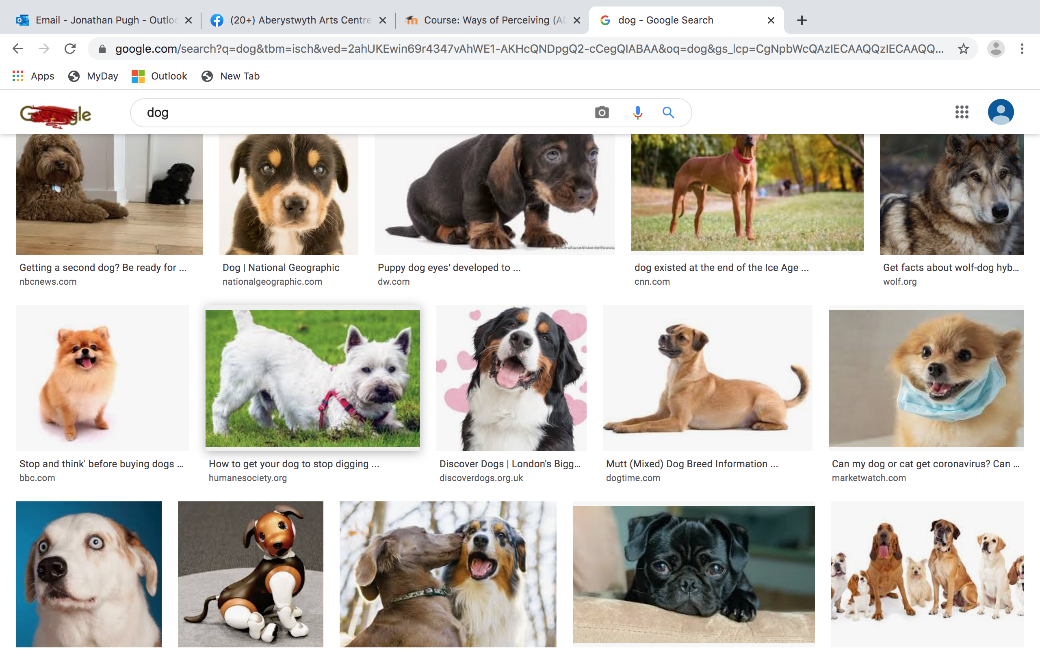

Slide 23
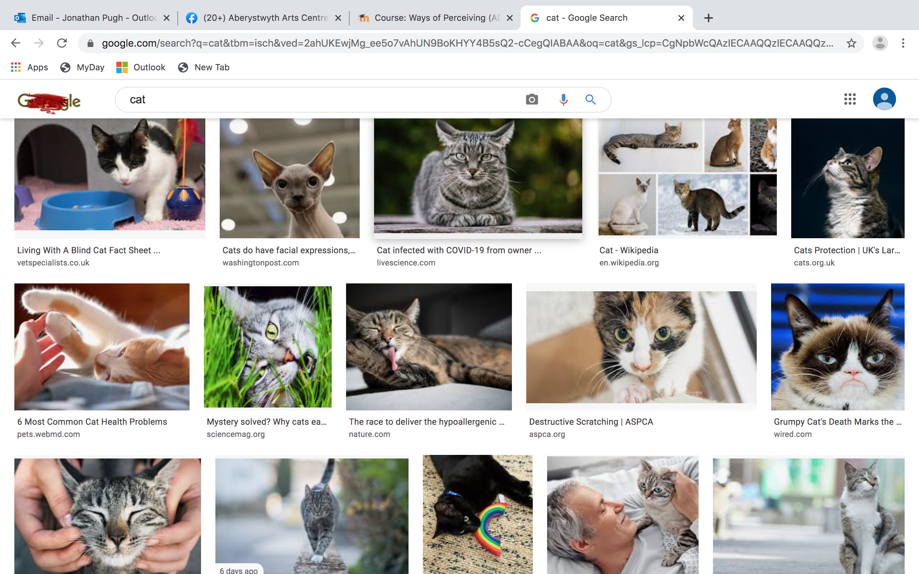
Samuel Beckett

Slide 24
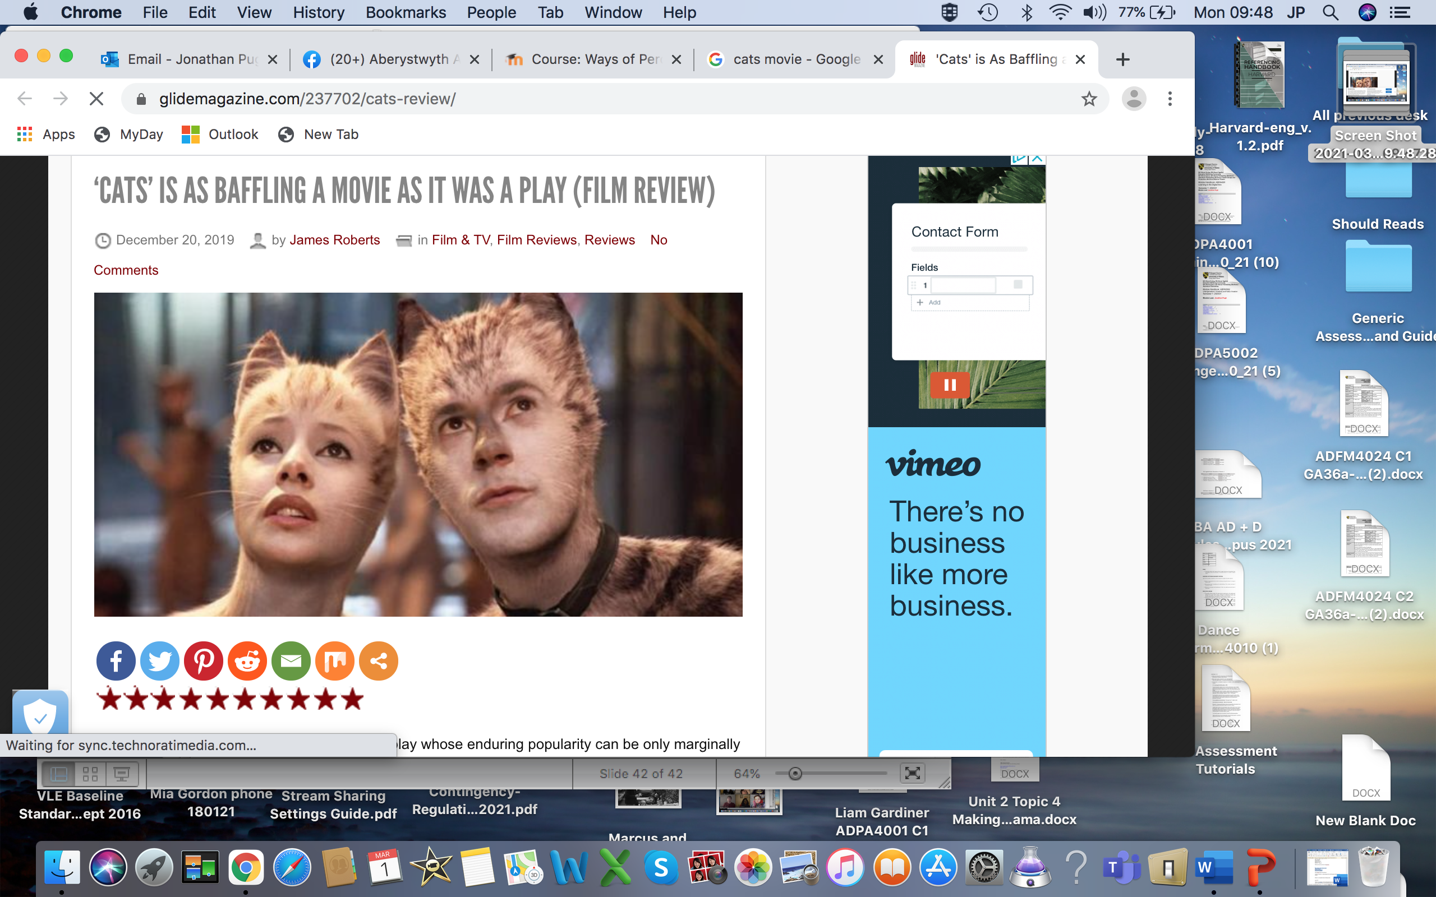
Samuel Beckett

Slide 25
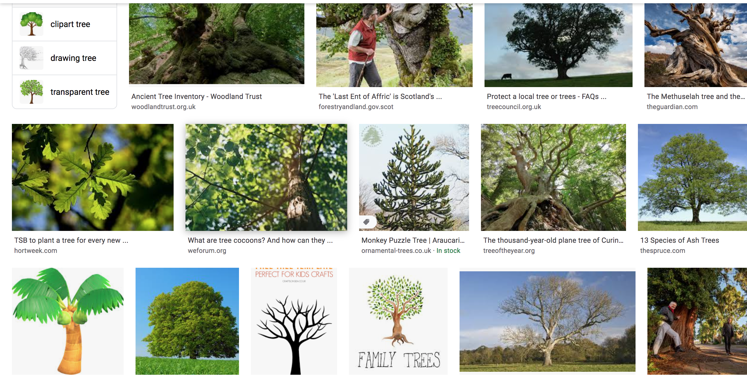

Slide 26
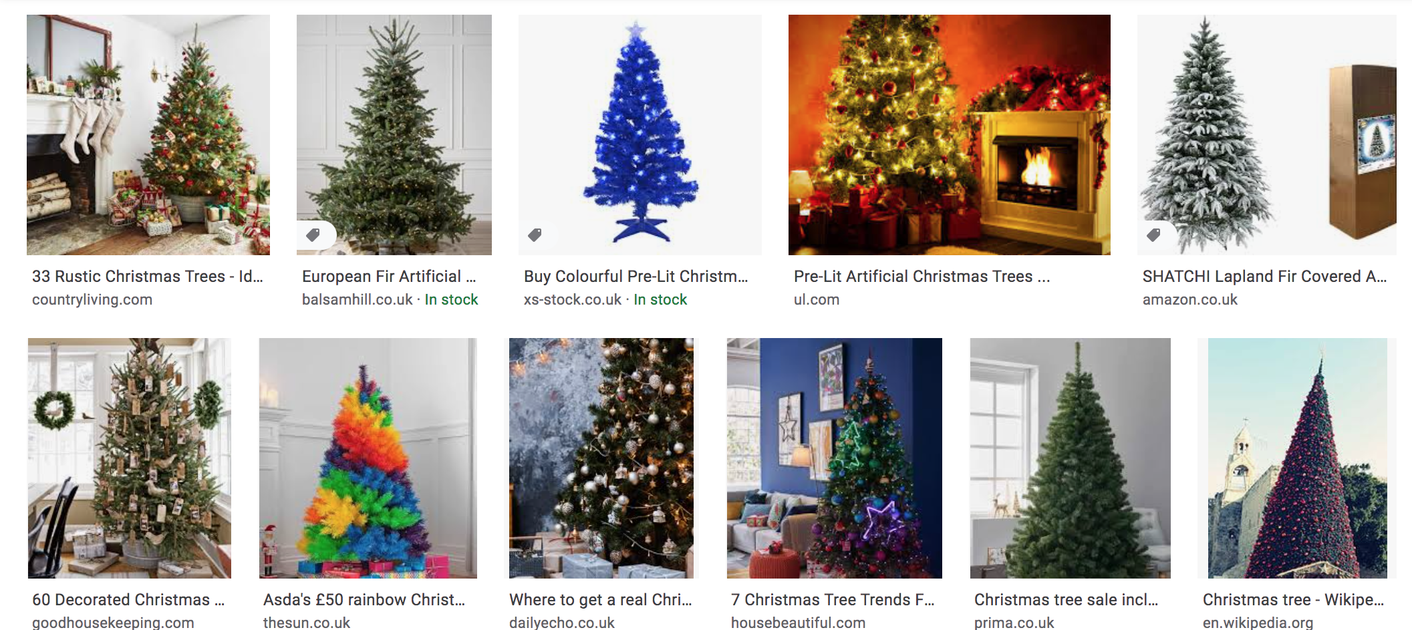
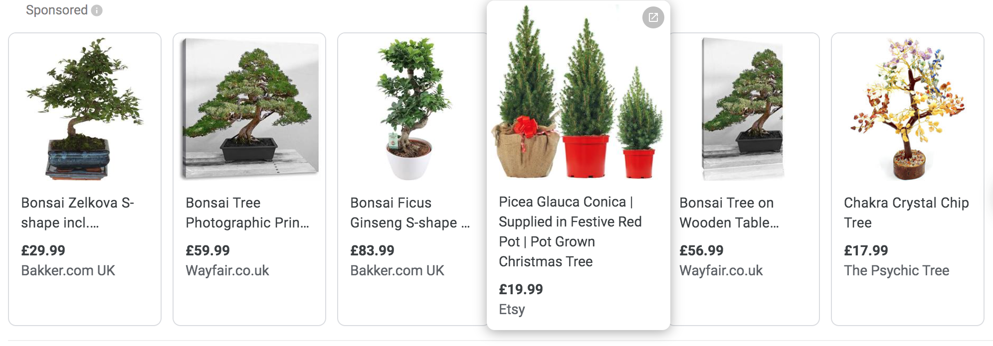

Slide 27
Communication
Do you and your peers use visual / written / verbal/ non-verbal communication?
Notes:
Lots of you have already identified this as a key skill – well done.

Slide 28
Terms
Semiotics – denote and connote
Denote means ‘to be a sign of’; ‘indicate’.
A denotation means that there is a direct ‘exactly’ link.
Connote means ‘imply or suggest (an idea or feeling)’ in addition to the literal or primary meaning. A connotation ‘implies’ a link.

Slide 29
Terms: Eg
Armour on a character denotes ‘soldier’ connotes ‘bravery’.
Suggest some signs that connote and denote information in theatre.

Slide 30
Terms
Suggest some signs that connote and denote information in theatre:
Beyond the key ‘conventions’ that we have discussed previously might be:
Accent, stature, pitch of voice, ability, speed of movement.
These aspects can work as metaphor too.

Slide 31
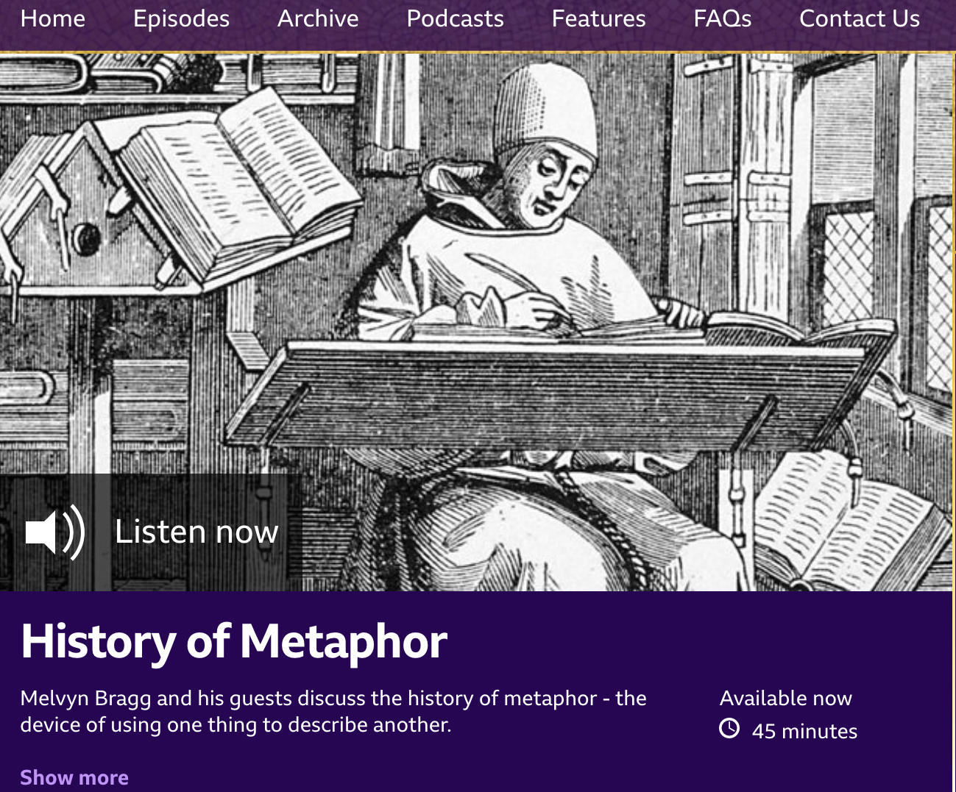
Metaphor
In Our Time – BBC Radio 4 series:

Slide 32
Session Task
Look at the charity websites that work within, and, on behalf of the disciplines represented in our group.
Some of the links share funding information, others share project and support information but all are related to an application of your intended professional skills-base in your intended discipline for good causes.
What could you do to contribute and support their work, and how can you contribute to the greater good that the links show can connect the charitable work to your chosen field of study?

Slide 33
Session Task
So, your task is to choose a charity or company that you would like to work with and to read more about their contributions to their target communities. Familiarise yourselves with the positive impact that they have upon the lives of others.
Consider how all individuals involved can benefit from the charitable work, and how you can identify personal input to support future issues that impact your discipline and its output.
Notes:
*If you feel that you have a favourite discipline specific charity that you would like to use for this task then please do.

Slide 34
Session Task
How you would use your skillset to support, contribute, or lead a project with your chosen company?
Please provide an explanation as to ‘why’ you have chosen the charity.
*From an absolutely subjective point of view – identify a company that you use / buy from / or like – that you think would work well with your chosen charity.

Slide 35
Session Task
Throughout the process of reading, thinking, researching and writing you will be reflecting and describing how you could contribute towards these charities and companies, you should consider your own values and beliefs honestly.
Try to identify what attracts you to contribute with some projects – and what deters you from working with other projects.
In doing this work you will be engaging with the learning outcomes in a discipline specific manner and building upon the module content from section 2 ‘Values and Beliefs’.

Slide 36
Links list
Children in Need
Arts Emergency
People Speak Up
Create Arts
Adventure Therapy
The Theatrical Guild
Makers Guild Wales
The Actors Children’s Trust
Acting For Others

Slide 37
Session Task Feedback
What did you choose ‘to do’?
Why did you choose that action or activity?
What impact would your choice have?
Why is that important?
Can you see a connection between your choices and your understanding of the learning outcomes?

Slide 38
Learning Outcomes
How can I connect this activity to the Learning Outcomes which are (By the end of the module I will be able to):
Demonstrate the foundational skills required to be a resilient and healthy independent learner.
Practise the principles of learning agility
Use suitable technology to support and enhance their learning experience within the discipline area

Slide 39
Task 2 of 4 - to be submitted by 10th November, on Turnitin.
Watch a film, live stage production, livestreamed / recorded production, or visit an art gallery and consider critically the message that you take away from the work.
Consider the content of Unit 2 and connect the content to your observations about the production that your viewed.
You might want to consider your ideas about self, nationality, philosophy, and other people in your response.

Slide 40
Task 2 of 4 - to be submitted by 10th November, on Turnitin.
Then create a mind map that demonstrates how the main themes from the production you viewed, and concepts covered in Unit Two of the online module are interconnected - both to your personal beliefs and attitudes, and to your programme of study.
How do your personal attitudes contribute to your preparation work in a collaborative discipline?

Slide 41
Task 2 of 4 - to be submitted by 10th November, on Turnitin.
Your mind map should be no more than 250 words, and can be hand drawn or produced using MS Word, PowerPoint or an appropriate technology such as Mind Meister available at: www.mindmeister.com/
For more information about the benefits of mind-mapping, check out these links:
AYOA Website
YouTube: Tony Buzan
The resources covered in Unit Two of this module will help you to complete this task.

Slide 42
Task 2 of 4 - to be submitted by 10th November, on Turnitin.
This task allows you to consider the impact of creative representation of concept and context through an individualised lens.

Slide 43
Task 2 of 4 - to be submitted by 10th November, on Turnitin.
As you think about the reasons ‘why’ you enjoyed (e.g.) a film, you may find that you align ideologically with your understanding of the message of the film (heroic identities, positive representation, accessibility without simplification etc may support social ideals.)
You may also dislike the content of a (e.g.) film and still use your response to underpin your identity positively via your mind-map (calling out anti-social message, prejudice driven dialogue, overly complex plots etc might represent your intention to spread positive messages through your art).

