Slide 1

sustainable Cities
Sustainable Development Goals
Make Cities and Human Settlements Inclusive, Safe, Resilient and Sustainable
Trace King

Slide 2
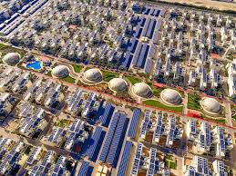
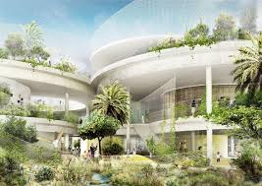
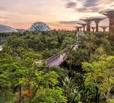

What is a Sustainable City?
Sustainable Cities SDG aims to reduce the impact of cities on the environment, and make life for people living in them better all round. Cities consume over two-thirds of the world's energy and account for more than 70% of global CO2 emissions. And with 90 percent of the world's urban areas situated on coastlines, cities are at high risk from some of the devastating impacts of climate change, such as rising sea levels and powerful coastal storms
When we think of Sustainable Cities, we almost always think of big domes, filled with greenery and neat symmetrical high-tech buildings.
We imagine the future, a time so obviously set apart from now that we barely even stop to consider the work happening to our current cities to change them from smog filled metropolis to green healthy oasis.
A sustainable city relies on everything from safe, clean housing, green energy, low traffic pollution, and reduction in excessive CO2 emissions

Slide 3
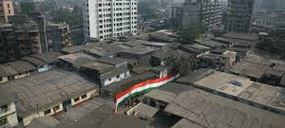
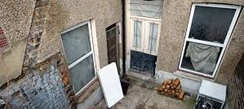
Accommodation
Many people who live in cities do so in conditions of squalor, slums not suitable for human habitation, controlled by landlords. Damp, cold, expensive to heat, creating undesirable situations, and feeding into further issues.
With much of these tenants income being spent on rent and heat, it leaves very little for them to be actively conscious of their carbon footprint.
In the Sustainable Cities and Development Goal, targets 2030 to ensure access for all to adequate, safe and affordable housing and basic services and upgrade slums
over 90% of COVID-19 cases in Urban Areas
The number of slum dwellers reached more than 1 billion in 2018, which represents 24 per cent of the urban population, up slightly from 23 per cent in 2014. The number of people living in urban slums is highest in Eastern and South-Eastern Asia (370 million), sub-Saharan Africa (238 million) and Central and Southern Asia (226 million).

Slide 4
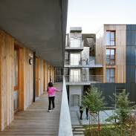
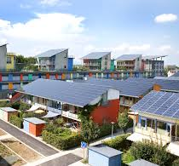
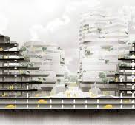
How to Progress
With rapid urbanization how can this be reduced?
better internal coordination to ensure that staff working on urban development and the private sector are aware of and able to make the most of each other’s programs and supporting governments to change policies on land access, approval rates for inclusive developments and formal banking systems that cater for low income communities.
A positive relationship between economic growth and reducing inequalities cannot be assumed and ICAI recommend that DFID needs to specifically address poverty reduction in its urban development work, including targeting marginalized groups.
Retrofitting existing buildings to more energy efficient standards and holding landlord accountable for their properties and tenants health and wellbeing.
INDICATORS
Proportion of urban population living in slums, informal settlements or inadequate housing

Slide 5
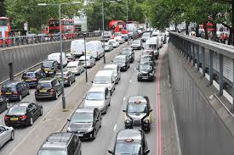
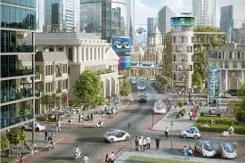
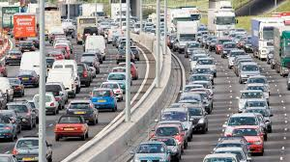
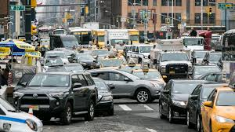
Transport
With millions of people packed in tight, transport is a major contributiary factor to pollution in cities. Single travellers being a large cause of this, and delivery vehicles.
Many cities have put restrictions in place, such as London with it’s tariff but this does little to deter or reduce traffic. Even with its world renowned underground network, its not enough more needs to be done.
11.2 aims to provide access to safe, affordable, accessible and sustainable transport systems for all, improving road safety, notably by expanding public transport

Slide 6
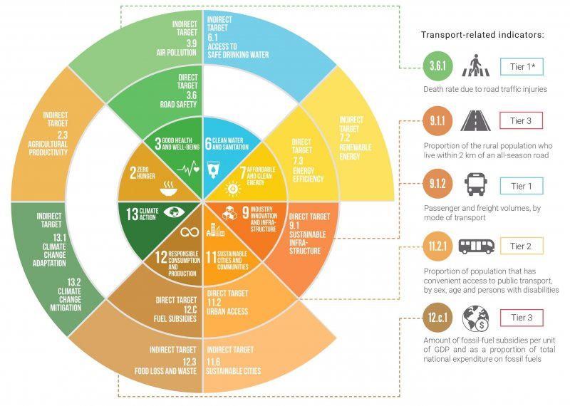
The Impact of Transport on City Development
A huge shift toward improved public transport infrastructure is necessary worldwide, not just in cities and urban developments.
Almost all SDG’s contain transport related improvements
92% of VNR’s highlighted improvements to the transport sector, and its impact on other SDG’s
Growth cannot happen without transport and sustainable transport is expensive.
INDICATORS
Proportion of population that has convenient access to public transport, by sex, age and persons with disabilities

Slide 7
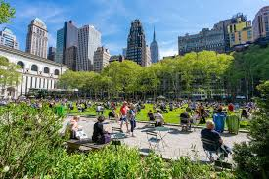
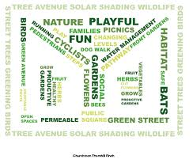
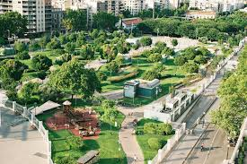
Safe, Green Spaces
47% of urban population has access to open public spaces within 400 meters.
provide universal access to safe, inclusive and accessible, green and public spaces, in particular for women and children, older persons and persons with disabilities.
positive links between the effects of accessible green space and increased mental health benefits.
INDICATORS
Average share of the built-up area of cities that is open space for public use for all, by sex, age and persons with disabilities
Proportion of persons victim of physical or sexual harassment, by sex, age, disability status and place of occurrence, in the previous 12 months

