Slide 1
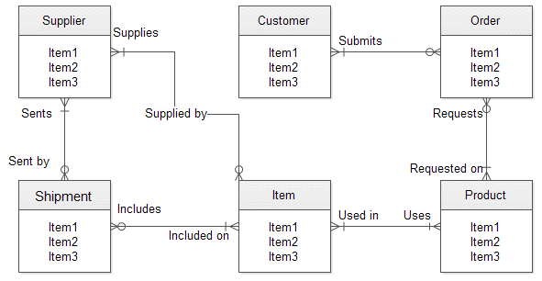
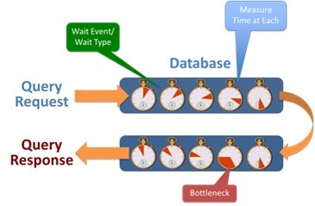
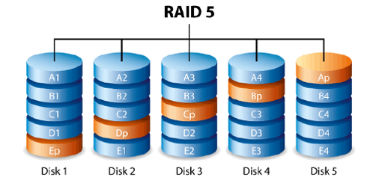
Database Performance analysis
Performance of DBMS
Database management Systems
The performance of DBMS is very important when it comes to online transaction processing applications whose response time is stringent when there are high through puts for example airline reservation systems. The relational database model is important for the application of decision support.
Database management Systems (DBMSs) are used to handle data for commercial applications that include scientific and engineering data, images, geographical information systems among others
Hardware on database performance
Database Benchmarks
The performance of database is affected by hardware resources. This include factors such as the workload, the query optimizer and the database design among others.
Hardware resources can always be improved through a well-balanced allocation of data on Disk through striping.
There are several benchmarks for database most of which target relational database
However, they only show the speed of hardware, system software efficiency as well as the proficiency of bench marking team.
The main measure of performance in a database is the maximum system throughput where there are certain percentile of transaction response does not exceed the value that has been pre-specified.

