Slide 1
Energy Consumption for
Cooling Loads
By
Andrew Thorn

Slide 2
Design of Maximum Cooling Load in an Occupied Building
Factors to consider
Solar heat gain through glazing, which is instantaneous
Conductive heat gain through the opaque of the building
Infiltration of outdoor air
Indoor heat gains such as sensible and latent heat gain from the occupants, and heat gains from equipment and lighting

Slide 3
Cooling Loads
The cooling load for solar and conductive heat gains is calculated from Peak conditions in the summer when the refrigeration plant may be required
Low altitude solar heat gains through glazing in the winter months can be offset by the use of blinds or shading or introducing fresh air
Refrigeration plant should not be used

Slide 4
Energy Consumption for Cooling Loads
The cooling load required to offset internal heat gains may be required throughout the year if base temperature is lower than 16°C
The basis upon which estimates of the seasonal cooling load are made for external heat gains is from the use of cooling degree hours

Slide 5
Total Cooling Load
The total cooling load for a building therefore is the sum of the seasonal or external heat gains Q_{S} and the indoor heat gains Q_{g}
Q = Q_{S} + Q_{g}
Q = Total heat gains

Slide 6
Limitations of Cooling Degree Hours
This applies when they are associated with solar and conductive heat gains:
The air-conditioning cycle can include reheating the air after dehumidification and this is not accounted for
The extent of free cooling, like, for example, using ambient air ventilation at night to cool the building structure is not accounted for

Slide 7
Annual Energy Demand
The annual energy demand for a given design cooling load to offset the effects of solar and conductive heat gain can be calculated from
AED = Q x SDH / dt
Q = Total heat gains
SDH = Standard degree hours
dt = (t_{ao} - t_{ai})

Slide 8
Annual Energy Consumption
Annual energy consumption for vapour compression central cooling plant
AEC = 0.5 (AED)
Annual energy consumption for distributed cooling plant:
AEC = 0.78 (AED)

Slide 9
Annual Energy Consumption
The constants for converting AED to AEC are taken from BSRIA and account for the coefficient of performance (COP) of the refrigeration plant and the seasonal efficiency of the electrical plant

Slide 10
Example 1
Determine the annual energy consumption for a distribution cooling plant design load of 150 kW which includes 50kW of indoor heat gains to a building that uses 3681 cooling degree hours and temperatures at 30°C outdoors and 23°C indoors
AED = Q x SDH/dt
AED = 150 x 3681 /(30 – 23) = 78,879 kWh
AEC = 0.78 x AED
AEC = 0.78 x 78,879 = 61,526 kWh

Slide 11
Example Comments
The solution does not account for free night time cooling that may be part of the design
The months of March, April, May and October are included in the annual degree hours
If free cooling is available for these months the annual degree hours is reduced to 3339hrs

Slide 12
Sol-air Temperature
Sol-air temperature, t, is defined as the outdoor air temperature which in the absence of solar radiation would give the same temperature distribution and rate of heat transfer through an external wall or roof as exists with the actual outdoor air temperature and the incident solar radiation

Slide 13
Sol-air Temperature
Accounts for the high temperatures achieved on the external surfaces of buildings exposed to solar radiation
The effects inside the building on the mean radiant temperature are delayed and depend upon the construction of the building envelope
For buildings with massive walls 0.5m or more of stone, with outer surface painted a brilliant white and with small areas of recessed glazing, the thermal inertia is considerable and the thermal response factor is high

Slide 14
Sol-air Temperature
The effects of a day of high intensity solar radiation will not be felt indoors until the evening
Conversely a steel frame building with concrete floors and lightweight external wall panel will have a very low thermal inertia
The thermal response will ensure that the effect on mean radiant temperature indoors from solar radiation incident upon the external walls will be almost immediate

Slide 15
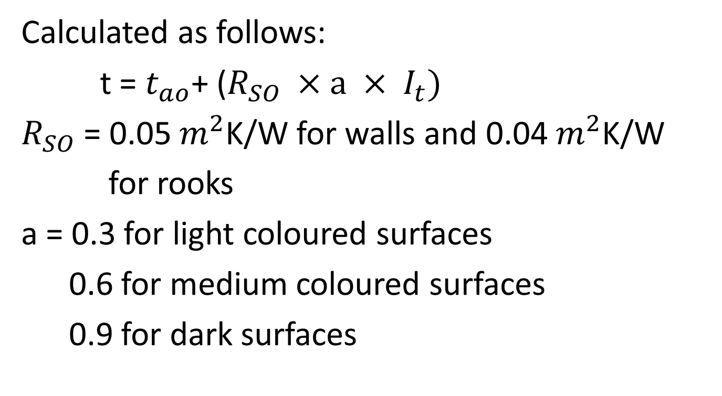
Sol-air Temperature
Calculated as follows:
t = $t_{ao}$+ ($R_{SO} ×a × I_{t})$
$R_{SO}$ = 0.05 $m^{2}$K/W for walls and 0.04 $m^{2}$K/W
for rooks
a = 0.3 for light coloured surfaces
0.6 for medium coloured surfaces
0.9 for dark surfaces

Slide 16
Conductive Heat Gains
Like heat input to a building during the winter prior to occupation, conductive heat gains resulting from solar radiation take time to penetrate the building envelope
The length of time is dependent upon the thermal inertia of the building and hence its thermal response
It is also dependent upon the location of the thermal insulation sandwich within the building envelope

Slide 17
Conductive Heat Gains
For conductive heat gains in the summer it can be argued that the best location for the thermal insulation is at the outside surface
This will reduce the impact of solar heat gains indoors and have a beneficial effect on the energy consumption required for seasonal cooling

Slide 18
Conductive Heat Gains
It should come as no surprise therefore to frequently find the insulation sandwich located midway in the external walls of buildings in temperate climates
Conductive heat gains through the opaque element of the building envelope are accounted for in the determination of the maximum design cooling load to offset solar heat gains

Slide 19
Solar Heat Gain Through Glazing
Heat gain resulting from solar radiation through glazed windows is instantaneous
BSRIA gives approx. figures of 150 W/m² of glass for south-facing windows from June to September and 250 W/m² for east-west facing windows assuming in both cases internal blinds are in use

Slide 20
Solar Heat Gain Through Glazing
This is accounted for in the determination of the maximum cooling load to offset solar heat gains
The peak seasonal heat gain occurs when the sum of the instantaneous heat gain through the glazing and the heat gain through the opaque portion of the building envelope is a maximum

Slide 21
Shading
Shading from the effects of solar radiation can take a number of forms: -
Shade provided by the effects of recesses in the external envelope of the building
Shade provided by static or moveable external blinds
Transient shading provided by the orientation of the building
Permanent shading provided by surrounding buildings, screens or vegetation

Slide 22
Reducing External Heat Gains
If the building is unoccupied at night, an office block for example, the seasonal cooling load can be reduced by the provision of full fresh air mechanical ventilation at night to cool the building structure
The external envelope of course must be designed to delay the effect of the outdoor heat gains on the mean radiant temperature indoors until the evening
If this is done the refrigeration plant will normally only be required to offset the instantaneous solar heat gains through the glazed window

Slide 23
Reducing External Heat Gains
With suitable external blinds and choice of glass, the peak seasonal cooling load for the building can be reduced substantially
You can see that in this scenario the building structure requires designing with energy conservation in mind

Slide 24
Estimation of the Indoor heat gains
Indoor heat gains are calculated from the heat gains within the building. These include sensible and latent heat gains from the occupants, heat gains from lighting and equipment, which is in fairly continuous operation
The heat gains from occupants is better estimated from the number normally in the building and upon the activity since it can vary from a total of 100 to 400 W

Slide 25
Determination of Base Temperature
Base temperature for cooling is that temperature outdoors at and below which the operation of cooling plant is not required
With Cooling Degree Hours the lower the base temperature the higher will be the annual degree hours and hence the higher the energy consumption

Slide 26
Data for Calculation of Indoor
Heat Gains
Internal heat gain | Load/unit floor area (W/m²)
Sensible and latent heat gains from the occupants | 20
Lighting | 10 – 25
Office equipment | 20 – 40
Small power | 5

Slide 27
Determination of Base Temperature
Base temperature
t_{b} = t_{i} – d (°C)

Slide 28
Determination of Base Temperature
d = Qg / (Qs / dt)
Qs = external (solar) heat gains (kW)
Qg = indoor heat gains (kW)
dt = t_{ao} - t_{ai}

Slide 29
Performance Indicator for a building
PI = AEC/ (floor area) (kWh/m²)
CFI = Q/ (floor area) W/m²
CFI = cooling flux indicator

Slide 30
Example Question
A five story office block situated in London has a floor area of 450m² per floor and has an occupancy of one person per 8m² of floor. The heat gains are 130 W/person, light 12 W/m² and those from the office desktop computer are 20 W/m². The air-conditioning plant is centralised with air cooled condensers positioned on the roof. External heat gains to the building are 80 kW and summer design indoor and outdoor air temperatures are 23 and 28°C respectively

Slide 31
Example Question
You are required to:
Estimated the annual energy consumption
Calculate the annual energy costs of cooling assuming electrically costs 10p/kWh
Determine a performance indicator for the building
Calculate the Carbon Dioxide indicator using a factor 0.43 for electricity

Slide 32
Solution (1)
Number of occupants = (450 x 5)/8 = 281
Heat gains from occupants = 281 x 130 = 36.53kW
Heat gains from lighting = 12 x 450 x 5 = 27kW
Heat gains from office equipment = 20 x 450 x 5 =
45kW
Total indoor heat gains = 36.53 + 27 +45 = 108.53kW

Slide 33
Solution (2)
Total heat gains Q = Q_{S} + Q_{g}
= 80 + 108.53
= 188.53kW
AED = 188.53 x 8235/(28 – 23) = 310,509 kWh
(i) Annual Energy Consumption (AEC)
= 0.5 x 310,509 = 155,255 kWh
(ii) Annual energy costs
= 155,255 x 10/100 = £15,526

Slide 34
Solution (3)
(iii) Performance Indicator (PI)
PI = AEC / Floor area
PI = 155,255 / (450 x 5) = 69 kWh/m²
(iv) Carbon dioxide indicator (CDI)
CDI = PI x Fuel type factor
CDI = PI x 0.43
PI = 69 x 0.43 = 30Kg CO₂/m²
Annual carbon emissions = 30 x (450 x 5) = 67.5 tonnes

