Slide 1
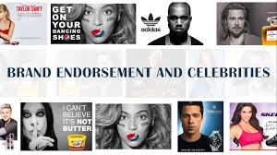
Celebrity Endorsement on Business Marketing

Slide 2
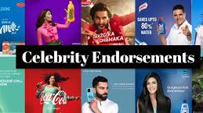

Why Celebrity Endorsement Matters
In an ever-growing digital marketplace, companies looks for position to capture the customer's attention.
Celebrity endorsements enable companies to differentiate themselves by providing them with existing audience reach (Knoll & Matthes, 2017).
Celebrity endorsements are a means by which brands establish a brand's identity and create cultural relevance for the products they sell (Halonen-Knight & Hurmerinta, 2010).
While digital influencers have increased in popularity, celebrity endorsement continues to be an effective tool for marketers (Wang & Liu, 2023).

Slide 3
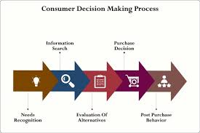

Key Findings
Attention: Celebrities can quickly engage consumers through their initial attraction to them (Knoll and Matthes, 2017).
Attraction: The positive characteristics associated with celebrities often lead consumers to associate positive qualities with the brand (Osei-Frimpong et al., 2019).
Affinity: The emotional connection fans have with celebrities increases the level of trust they have towards that brand (Halonen-Knight and Hurmerinta, 2010).
Action: The better aligned a celebrity is with a brand, the more likely consumers are to purchase products from that brand (Nzuva, 2021).
Research indicates that when there is a close relationship between a celebrity and the company they endorse, his or her endorsement can be an effective marketing tool (Wang and Liu, 2023).

Slide 4
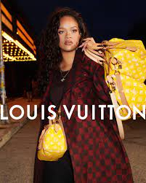
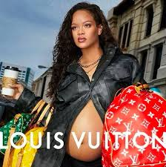
Real example
The use of Rihanna as a campaign ambassador for Louis Vuitton creates excitement and interest worldwide. The combination of Rihanna’s influence over culture and the high level of creativity associated with both Louis Vuitton and she supports and enhances their communications.
Strong meaning transfer occurs due to Rihanna’s style and how it supports and builds upon LV’s message (Halonen-Knight & Hurmerinta 2010).
Because of the strong relationship between Rihanna and Louis Vuitton, it was a very successful campaign.
It generated more awareness and desirability for Louis Vuitton (Knoll & Matthes 2017).
Despite its success, there still exists some risk, as the campaign relied on the reputation of the celebrity (Nzuva 2021).

Slide 5
References
Halonen-Knight, E. and Hurmerinta, L., 2010. Who endorses whom? Meanings transfer in celebrity endorsement. Journal of Product & Brand Management, 19(6), pp.452–460.
Knoll, J. and Matthes, J., 2017. The effectiveness of celebrity endorsements: a meta-analysis. Journal of the Academy of Marketing Science, 45(1), pp.55–75.
Nzuva, S.M., 2021. Celebrity endorsement: Is it still useful as a strategic marketing tool? International Journal of Economics and Management Studies, 8(5), pp.10–14.
Osei-Frimpong, K., Donkor, G. and Owusu-Frimpong, N., 2019. The impact of celebrity endorsement on consumer purchase intention: An emerging market perspective. Journal of Marketing Theory and Practice, 27(1), pp.103–121.
Wang, S. and Liu, M.T., 2023. Celebrity endorsement in marketing from 1960 to 2021: A bibliometric review and future agenda. Asia Pacific Journal of Marketing and Logistics, 35(4), pp.849–873.
https://www.semanticscholar.org/paper/Celebrity-endorsement-in-business-markets-Canning/5bae0b125e6f64ecbf27c3f31df008557cee5ee0

