Slide 1

Liberal Judaism and Political Zionism
Caitlin Vivian 1800517

Slide 2




Contents
The foundations and origins of Liberal Judaism
The ideology of Liberal Judaism
Liberal Judaism today
What is political Zionism?
Origins and ideology of Political Zionism
The relationship between Liberal Judaism and Political Zionism.

Slide 3
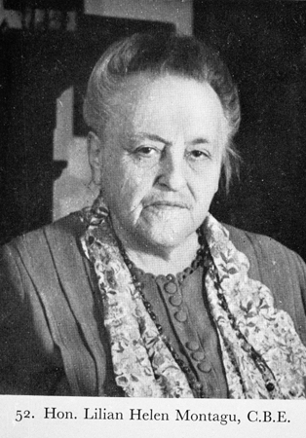
The Origins of Liberal Judaism
Liberal Judaism is a denomination of Judaism founded in 1902 by Lily Montagu and Claude Montefiore in the United Kingdom.
Lily Montagu and Claude Montefiore were very important figures in British Jewish history. Particularly, Montagu who was significant in female rabbinical history.
They founded various organisations together associated with liberal or progressive Judaism, with the intention of providing education without bias to gender or class. For example:
The West Central Jewish Girls' Club – established in 1893 (now The Jewish Girls Brigade)
Jewish Religious Union
Fig 1. Lily Montagu, The Jewish Museum of London (available at: https://jewishmuseum.org.uk/event/object-talk-lilian-lily-montagu/)
UMANSKY, ELLEN M. "The Origins of Liberal Judaism in England: The Contribution of Lily H. Montagu." Hebrew Union College Annual 55 (1984): 309-22. Accessed June 2, 2021. http://www.jstor.org.ezproxy.uwtsd.ac.uk/stable/23507618.

Slide 4
The ideology of Liberal Judaism
Liberal Judaism is focused on the enhancement of society for everyone.
Members of Liberal Judaism live by an affirmation:
"Judaism has never stood still. It has always moved forward, sometimes slowly, sometimes faster. Its history is a history of continuity and change." (Affirmation 23)
The leaders of Liberal Judaism encourage education and inter-faith dialogue within the community, from an early age. On topics such as Shoah (the Holocaust), the liberal Jewish community believes in a positive outlook and education of future generations will prevent it from happening again.
'What is Liberal Judaism? - Liberal Judaism' (2021), available at https://www.liberaljudaism.org/who-we-are/what-is-liberal-judaism/ [assessed 2 June 2021]

Slide 5
Liberal Judaism today
Liberal Judaism has 41 communities across the globe (United Kingdom, Republic of Ireland, Holland, Denmark and America)
In Britain, 8.7% of Jewish families belong to a Liberal Jewish congregation.
It was the first Judaism denomination to allow single-parent households into the congregation in the 1950's.
In addition to this, it was the first denomination to allow same-sex marriage and there are many education programs on LGBTQ+ and Judaism such as Rainbow Jews (launched 2012)
In Liberal Judaism, marriage and divorce is equal. You not do require a Get (bill of divorce) to divorce and the woman is not classed as a chained woman once widowed.
Goldberg, David, 'Where we stand on Jewish Marriage‘ via LiberalJudaism.org
Cohen, Benjamin, 'Liberal Judaism lauches gay marriage cermonies' (2005), available at: https://www.pinknews.co.uk/2005/11/25/liberal-judaism-launches-gay-marriage-ceremonies-in-britain/

Slide 6
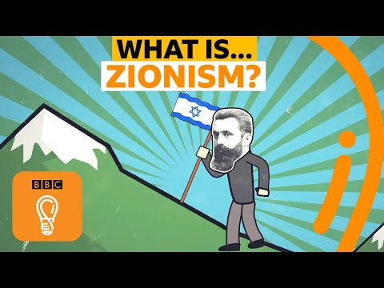
Zionism Video
Available at:
What is Zionism? What does Zionism mean? | A-Z of ISMs Episode 26 - BBC Ideas - Bing video

Slide 7
What is Political Zionism
Coined by Nathan Birnbaum in 1890, the general definition of Zionism is the return of Jewish people to their home, the State of Israel. Israel was originally called the Canaan Land and is where God promised them.
In 1948, a State of Israel was established in the region and claimed Jerusalem as its capital.
There are many types of Zionism, some more extreme than others:
Religious Zionism: Aims to re-install Judaism and religious education into mainstream education and wants to establish Judaism as the main religion as a part of nationhood.
Political Zionism: Most topical. Stresses Jewish total political ownership of the State of Israel, recognised by world leadership. Progressive Zionism has developed a 'melting-pot' ideology.
Territorial Zionism: Very extreme. Disbanded Zionist movement where Jewish Zionists would try and claim other countries' land based on self-rule. The Balfour Declaration made this outdated.
Socialist Zionism: Associated with national liberation to secure a future for all Jewish classes.
Divine, Donna Robinson. "Zionism and the Politics of Authenticity." Israel Studies 19, no. 2 (2014): 94-110. Accessed June 1, 2021. doi:10.2979/israelstudies.19.2.94.
A Definition of Zionism (jewishvirtuallibrary.org), available at https://www.jewishvirtuallibrary.org/a-definition-of-zionism [assessed 2 June 2021]

Slide 8
Problems of Political Zionism
Since the establishment of the State of Israel in 1948, there have been problems with Political Zionism.
Topical, some types are extreme
Fractured leadership
Does not have a real agenda anymore
The problem of Palestinian refugees:
Thousands of Palestinian people live in Israel.
Unrealistic plans:
Uprooting the Palestinian natives is problematic for other countries
Isseroff, Ami, Political Zionism, zionism-israel.com (2008) assessed 2 June 2021

Slide 9
Liberal Judaism and Zionism
Liberal Judaism has adopted a progressive outlook on Zionism.
According to their website, Liberal Judaism supports a coalition nation in where Israeli and Palestinian-Arab communities exist peacefully.
In 2017, Liberal Judaism showed support for Israel and created the first Israel Desk, with the task of finding a solution and common ground with Palestine.
There is a Pro-Zionist group called LJY-Netzer, which is the youth movement for education and awareness of Liberal Judaism.
Liberal Judaism has an education program called 'Hot Potatoes' where young people discuss and debate Zionism
https://youtu.be/lbGIV4vdUvw - Hot Potatoes Debate on Liberal Zionism (May 2020)
Israel & the Diaspora - Liberal Judaism (2020), https://www.liberaljudaism.org/what-we-do/israel-and-the-diaspora/

Slide 10
Thank you.
Any Questions?

