Slide 1
Demonstrate your engagement with current political events, legislation and manifesto from a Wales, UK and World perspective.
1501524
ECSS6002

Slide 2
Contents
Introduction
Definition of political events
Listening to the people of Britain
Brexit
Change in PM’s
General Election
Article 50
Effects on Britain/Wales
Legislation
Donald Trump
My Engagement
Conclusion
Reference List

Slide 3
Introduction
Throughout this PowerPoint presentation I will demonstrate my engagement with current political events, legislation and manifesto from a Wales, UK and World perspective.

Slide 4
Political events
This is defined by a decision that is made by the people in government, for the benefits of the people in the country (Reverso Dictionary, 2018).
Notes:
An example of this would be where the people with power come together and help make decisions to improve infrastructure (rail links, transport., road links and so on) To encapsulate employment skills from a wider geographical area.

Slide 5
Listening to the people of Britain
David Cameron (PM) called the referendum for Britain leaving the EU after listening to the demands of the population with their concerns of increasing demands on health care, and social benefit systems in Britain because of the ever increasing migration of European migrants which would inevitably lead to an unsustainable level of financial funding commitment by the government (BBC News, 2016).
Notes:
(PM) current one for the referendum… ending.. This is increasing problems for services such as the ever increasing waiting times in the nhs , lack of job opportunities due to the increase in population, and housing problems due to the lack of investment in building new homes.

Slide 6
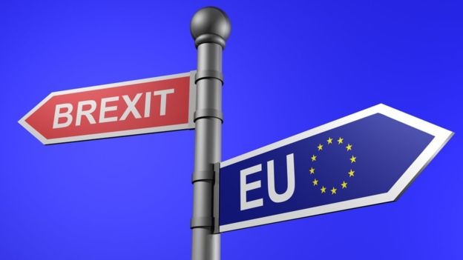
Brexit
On 23rd June 2016, Britain voted in a referendum on whether they wanted to remain or leave the EU.
51% voted to leave
48% voted to remain
(BBC News, 2018)
(Image of Brexit, 2016)

Slide 7
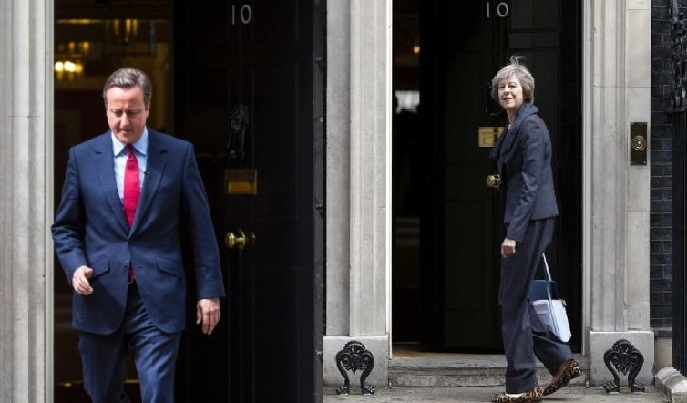
Change in Prime ministers
Due to the result of Brexit, David Cameron later resigned his post as PM because he wanted to remain this is where Theresa May was appointed as the new PM of Britain
(Downing St image, 2016)

Slide 8
General Election
Theresa May called a general election, so that she would win the overall majority in the House of Commons. Without the result she expected she then had to create a coalition with the Irish National Party (DUP) to form the majority of seats to enable them to begin Brexit negotiations (BBC News, 2017).

Slide 9
Article 50
On March 28th 2017, Article 50 was triggered, Theresa May had signed this to begin negotiations for Brexit to happen within two years (Laura Hughes and Robert Midgley, 2017).
Notes:
At this point the people of Britain are still wandering what is actually going to happen after she’s signed the article.

Slide 10
Brexit effecting wales/Britain
Britain
  importing/exporting, stock exchange and legislations.
Wales-
EU funding to wales
example: Flying Start, highway maintenance, community projects and promoting welsh language.

Slide 11
Legislation
The EU have created all legislation which is now making people questions whether any current legislation will still be adhered too an example of the current legislation that many people adhere too is:
  Equality Act 2010
  Disability Discrimination Act 1985
  (European Union, 2018).
Notes:
Go into more detail about acts.

Slide 12
Donald Trump
Donald Trump is the Prime Minister of the USA
The political problems that Trump wants to improve is building a wall across the Mexican border to avoid immigration, due to funding issues he is still trying to encourage Mexico to pay for this wall (Phillips and Phillips, 2018).
Kim Jong-Un is the North Korean dictator and he is currently looking at threatening Trump with his weapons, which has now resulted in North Korea being a no fly zone (Carey, 2018).
Notes:
In a nutshell he wants to ensure that it doesn’t affect any funding to do with the USA.
Jong-Un is continuing to push the boundaries on a regular basis.

Slide 13
MY Engagement with Political Events
Girlguiding House of Commons tour which resulting in meeting up with the local MP of Llanelli; Nia Griffith.
World perspective- volunteering in India

Slide 14
Conclusion
My conclusion on political events is that there is something ongoing on a daily occurrence, it is very hard to keep up with all the events, I believe that as you get knowledge about politics it changes/ gets updated regularly.

Slide 15
Reference List
BBC News. (2016). Cameron defends Brexit vote decision. [online] Available at: http://www.bbc.co.uk/news/uk-politics-38261534 [Accessed 25 Jan. 2018].
BBC News. (2017). May and DUP deal: What you need to know. [online] Available at: http://www.bbc.co.uk/news/election-2017-40245514 [Accessed 25 Jan. 2018].
Carey, J. (2018). Trump BANS US flights from North Korea airspace after MISSILE almost hits passenger plane. [online] Express.co.uk. Available at: https://www.express.co.uk/news/world/877748/North-Korea-Donald-Trump-Kim-Jong-un-Pyongyang-China-Washington-President-USA-Japan [Accessed 25 Jan. 2018].
Downing St image. (2016). [image] Available at: https://www.google.co.uk/search?q=david+cameron+and+theresa+may&rlz=1C1AZAA_enGB748GB775&tbm=isch&source=iu&ictx=1&fir=0Mm-hxz0Tn49xM%253A%252CHZUl1j2ssKu0RM%252C_&usg=__cuoftY30H83wkPUnfPyz4FX3miE%3D&sa=X&ved=0ahUKEwisiuzOm_PYAhWOL1AKHePTA90Q9QEIKzAB#imgrc=PwtABhPIb8ACBM: [Accessed 25 Jan. 2018].

Slide 16
Reference List (2)
Image of Brexit. (2016). [image] Available at: https://www.google.co.uk/search?q=brexit+pictures&rlz=1C1AZAA_enGB748GB775&tbm=isch&source=iu&ictx=1&fir=jBtZIjOZOdreeM%253A%252C03PfZM4-HWLeSM%252C_&usg=__gH5nFJd3j8ta4dBE2pCDcIj263E%3D&sa=X&ved=0ahUKEwi1_bbvjfPYAhVnI8AKHSJXBDYQ9QEIKTAA#imgrc=GtkdfgxlkEmaiM: [Accessed 25 Jan. 2018].
Laura Hughes and Robert Midgley (2017). How was Article 50 triggered and what happens now?. [online] The Telegraph. Available at: http://www.telegraph.co.uk/politics/0/article-50-triggered/ [Accessed 25 Jan. 2018].
Phillips, A. and Phillips, A. (2018). Analysis | 6 months of President Trump, in 7 issues. [online] Washington Post. Available at: https://www.washingtonpost.com/news/the-fix/wp/2017/07/20/6-months-of-president-trump-in-7-issues/?utm_term=.afddef88cb0c [Accessed 25 Jan. 2018].
Reverso Dictionary. (2018). Political Events. [online] Available at: http://dictionary.reverso.net/english-definition/political%20events [Accessed 25 Jan. 2018].

