Slide 1
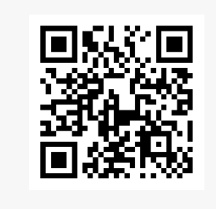
Online Assignment Skills Programme (Week 6)
Finding and Using Information – Unit 4 Section 1: Critical Awareness
moodle.uwtsd.ac.uk/mod/scorm/player.php?a=7587&currentorg=articulate_rise&scoid=16546&sesskey=5oaPZ4GIHd&display=popup&mode=normal

Slide 2
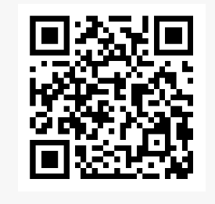
Online Assignment Skills Programme (Week 7)
Finding and Using Information Unit 3 Section 5: Searching with AI
moodle.uwtsd.ac.uk/mod/scorm/player.php?a=7736&currentorg=articulate_rise&scoid=17025&sesskey=u7KUpwQeqC&display=popup&mode=normal

Slide 3
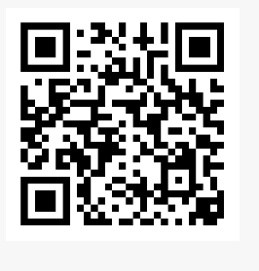
Online Assignment Skills Programme (Week 8)
Finding and Using Information Unit 3 Section 2: Searching the Internet
moodle.uwtsd.ac.uk/mod/scorm/player.php?a=7715&currentorg=articulate_rise&scoid=16963&sesskey=u7KUpwQeqC&display=popup&mode=normal

