Slide 1
University of Wales Trinity Saint David Roderic Bowen Library and Archive: A Reflective and Evaluative Report
Max Morgan

Slide 2
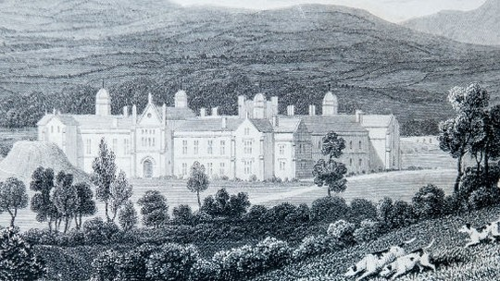
History of libraries at St. David’s College
In 1807, contributions to a formation of a new college were asked for.
Original collection donated primarily by Bishop Thomas Burgess and Thomas Phillips
Difficult past - donated through colonialism
Collection moved about and saw different iterations (Morgan-Guy, 2022, pp. 1-18):
  Welsh library
  Old library
  Founders library
(University of Wales Trinity Saint Davids, no date)

Slide 3
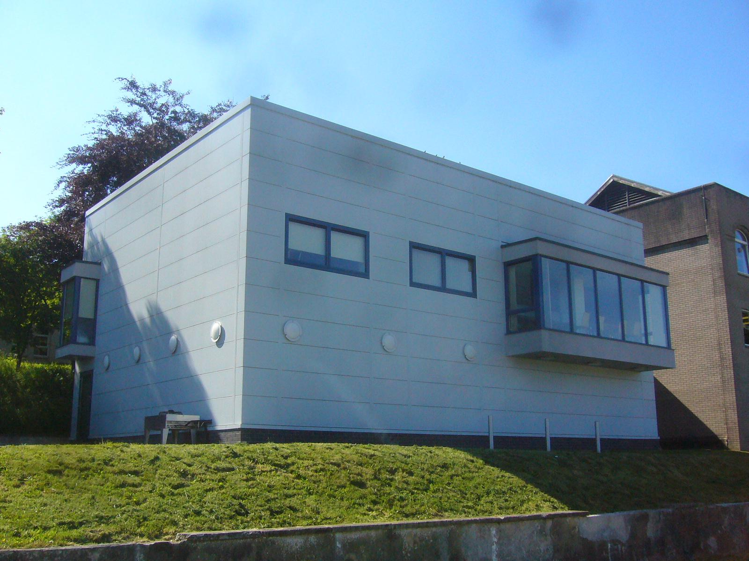
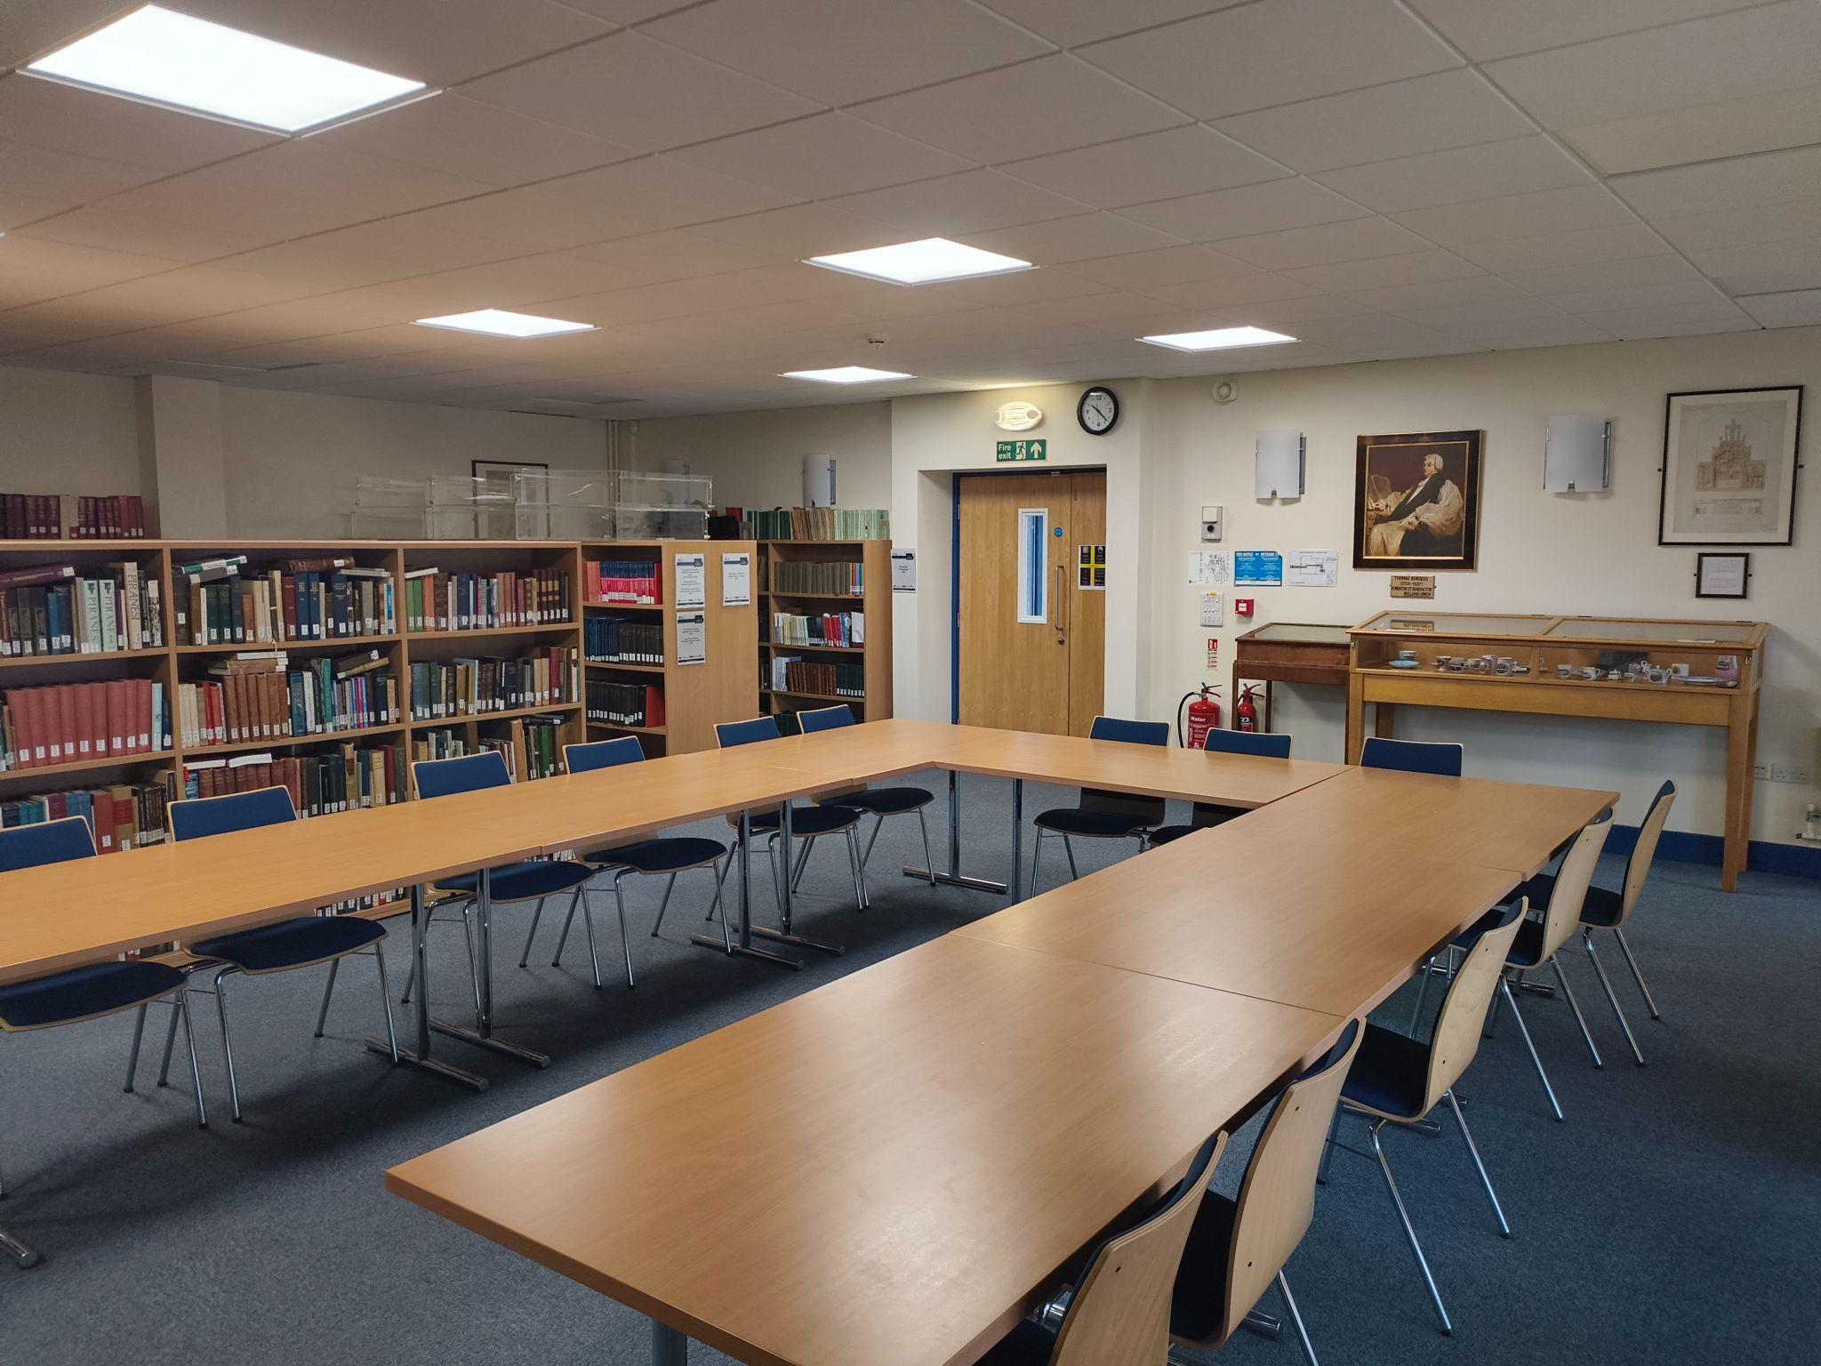
Roderic Bowen Library
Decided in the 2000s that the former Founders Library was unsuitable due to poor estate susceptible to leaking (Morgan-Guy, 2022, pp. 16-18).
2008 saw the opening of the new Roderic Bowen Library and Archive (RBLA), attached to the main library
State of the art estate with climate controlled basement and reading room.
“The Special Collections include over 35,000 printed works, 8 medieval manuscripts, around 100 post medieval manuscripts, and 69 incunables” (University of Wales Trinity Saint David, no date).
(Alosel, 2010)
(Author’s own, 2025)

Slide 4
Roderic Bowen Archive
Archives of Lampeter moved about and were kept by a number of different academics as a part time role
Notably kept in the history department for years up until the opening of the new RBLA
Small collection secured in a strong room under same climate controlled conditions as library
Today, there is a full time Special Collections Librarian Ruth Gooding and Archivist Nicky Hammond

Slide 5
Methodology

Slide 6
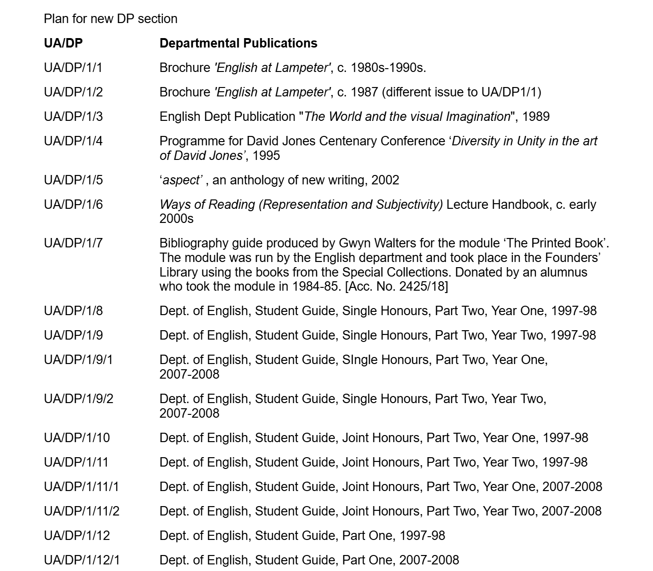
Cataloguing
70 hours of work experience for Professional Placement module were undertaken specifically within the archive
Re-cataloguing and adding additional material to Departmental Publications section of the archive catalogue
  Lack of consistency in the naming of items
  Renumbering items into more sensical departments
(Author’s own, 2025)

Slide 7
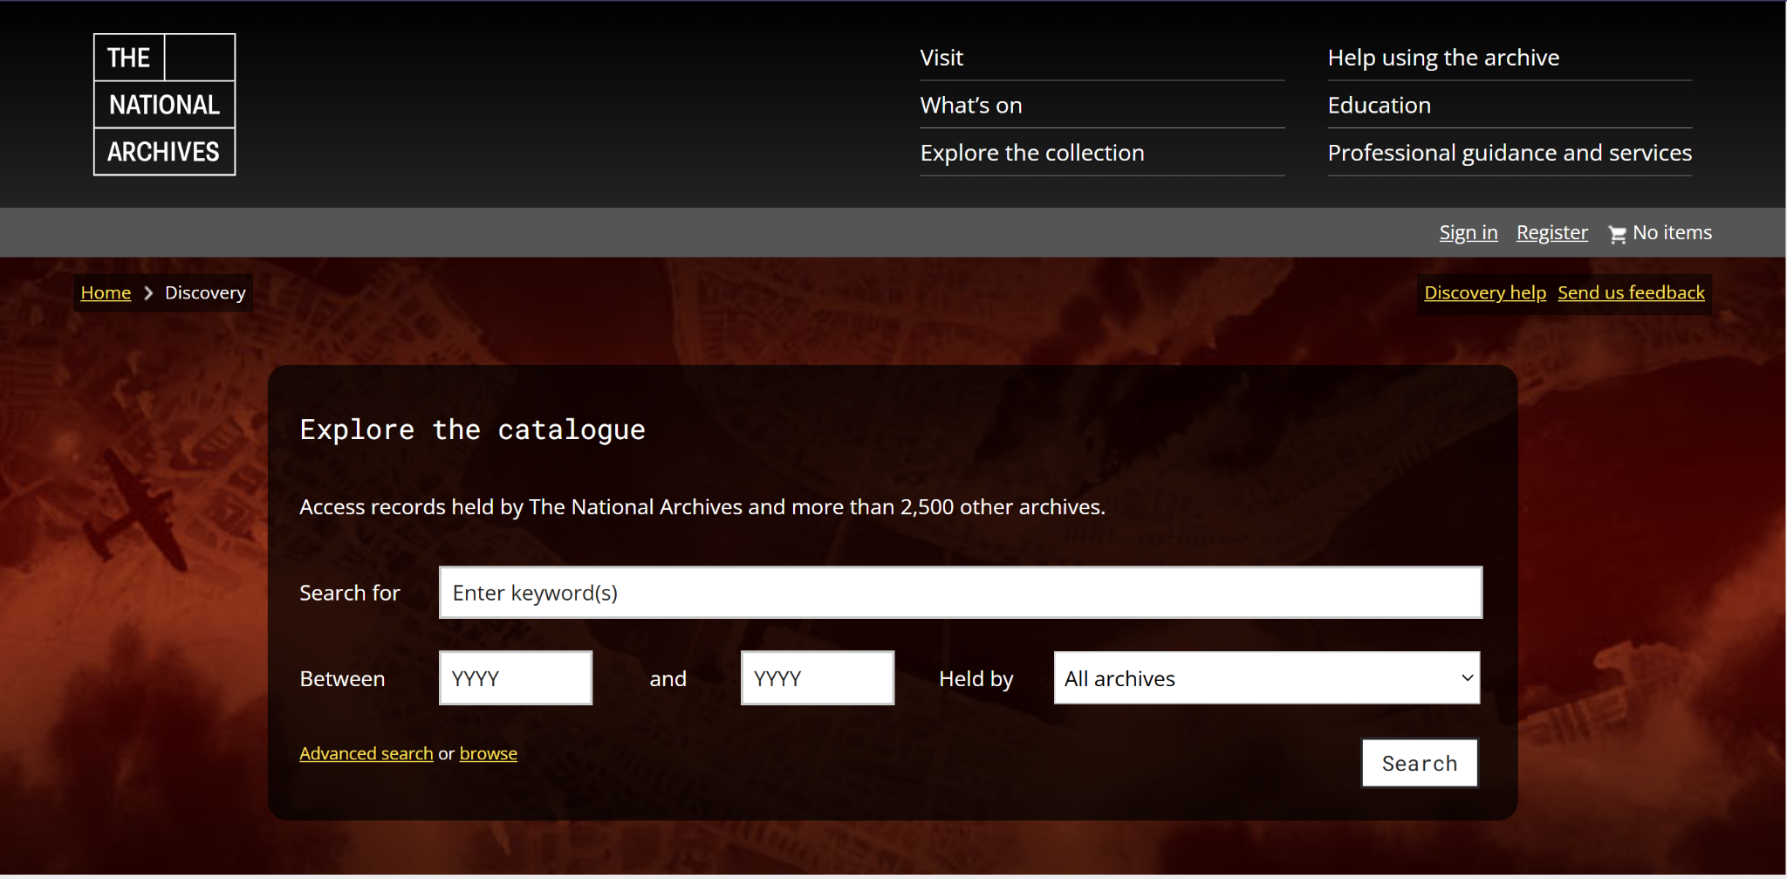
The National Archives Discovery and Service Accreditation
Work was relevant to a current focus of the RBLA:
  To add catalogue to Discovery website
  To achieve National Service Accreditation
Reflective of archival work that is done at the RBLA
Direct outcome that will assist the RBLA
(The National Archives, no date)

Slide 8
Discussion

Slide 9
How a treasured special collection and archive situate themselves within a historical university during turbulent times.
Their role is to promote the Special Collections & Archives both within the university and the community, to support teaching and to expand the archives.
Historical contributions:
  Supported academic publications such as Trivium
  Previously integrated with libraries department and focused on academic support
Shifting focus:
  Aligned with national trends, focusing on community engagement and genealogy (Craven, 2008, p. 17)

Slide 10
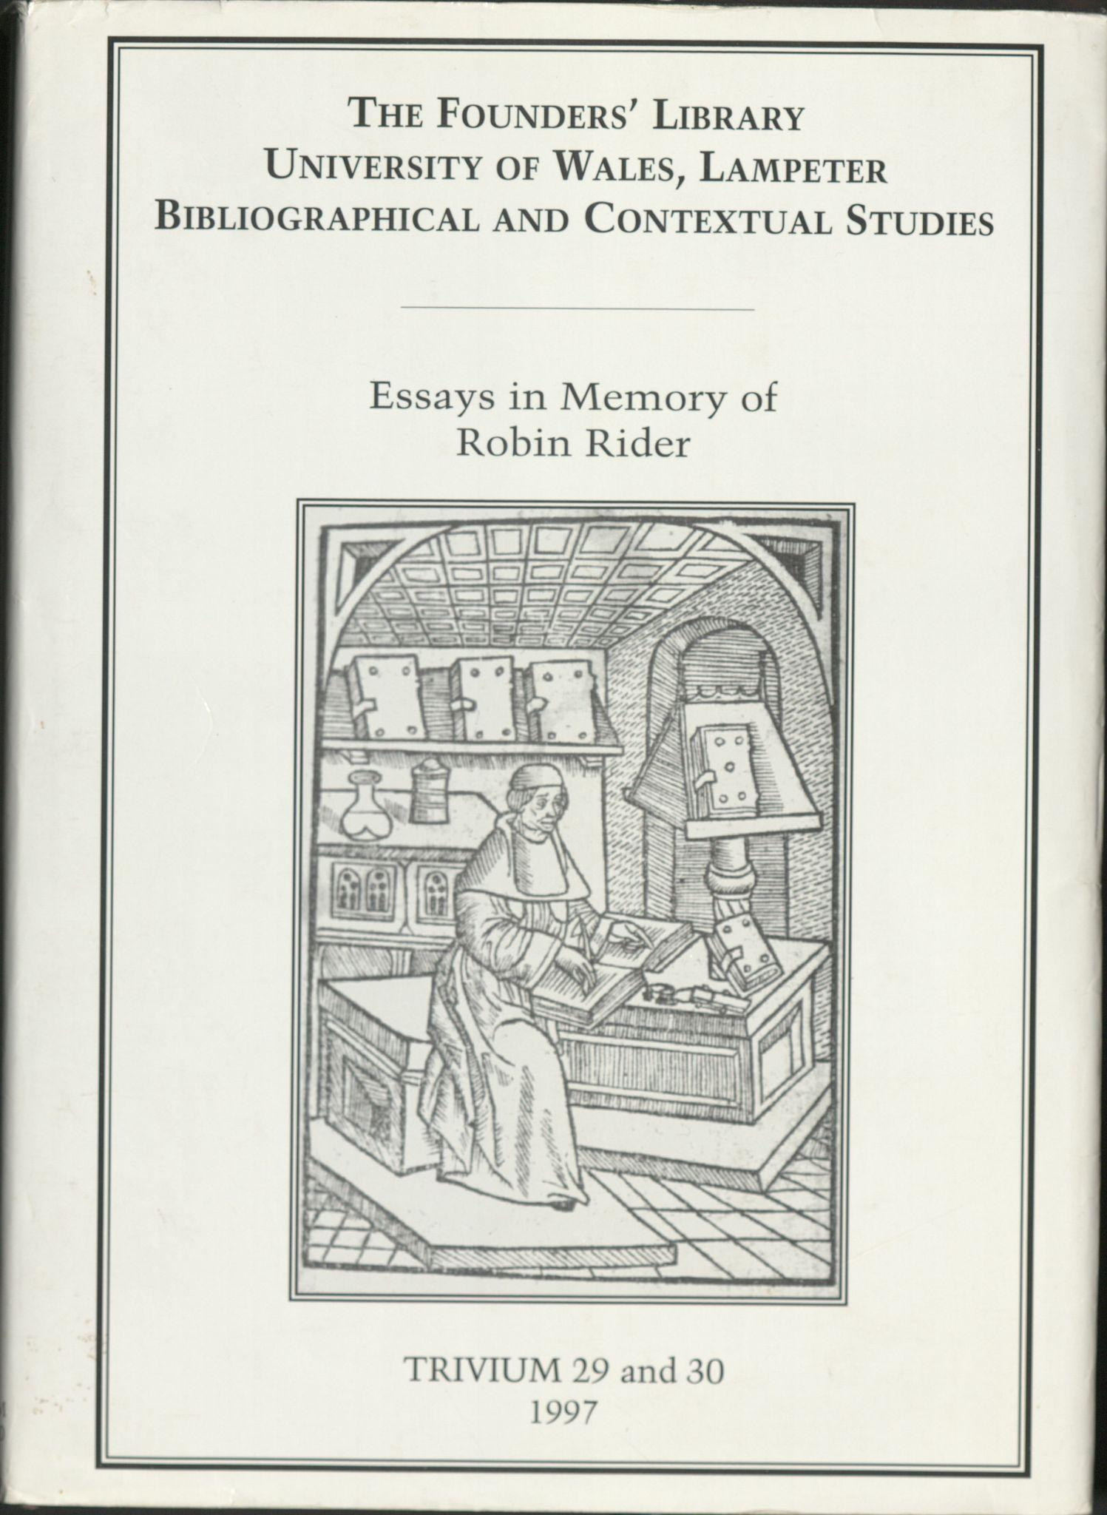
How a treasured special collection and archive situate themselves within a historical university during turbulent times.
Lampeter campus’ financial cuts and restructuring:
  Movement of teaching to Carmarthen
  Most departments facing cuts
  The RBLA is not facing these but will visitations will become appointment-only
Future plans:
  Still focusing on expansion
  Particularly Swansea archives are possibly being acquired
(Marx, 1997)

Slide 11
Representation and Engagement
Advertising and merchandise:
  Booklets, postcards, bookmarks, calendars, bags, Christmas cards and “200 Biographies” volumes (either free or sold)
  University uses materials, particularly illustrations to promote both the RBLA and UWTSD.
Community engagement:
  Hosts local history groups, church groups, school visits as well as events such as Open Doors with Cadw
Alumni collaboration:
  Contributes articles to The Link and Belonging
Collaboration with other archives:
  Limited but had recent involvement with Crowd Cymru project

Slide 12
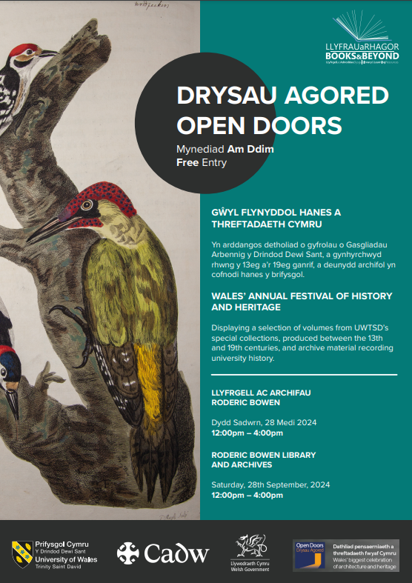
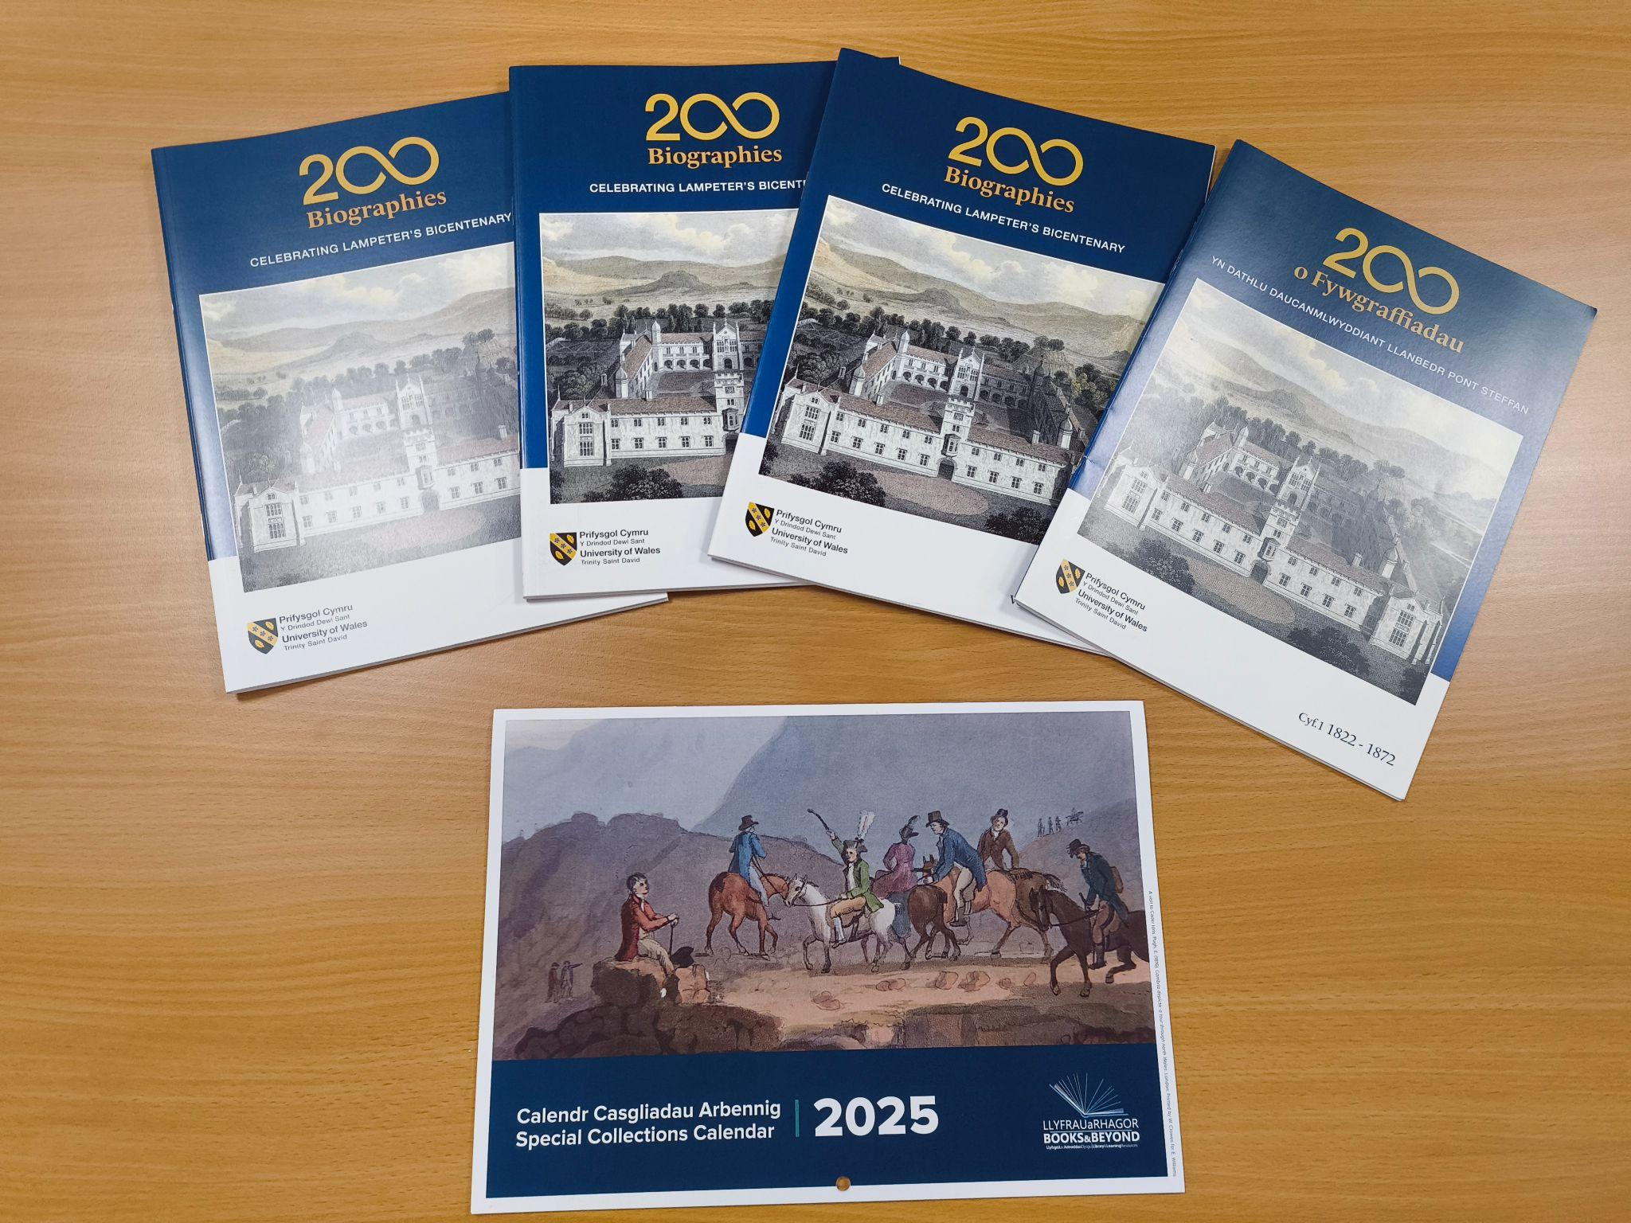
(Author’s own, 2025)
(University of Wales Trinity Saint David Special Collections Department, 2024)

Slide 13
Strengths of a special collection and archive within the oldest university in Wales.
Unique heritage:
  Located at Wales’ oldest university it contains a unique collection that holds historical and hereditary value to both Lampeter and Wales
Specialised appeal and academic value:
  Attracts researchers and students to rare historical materials
  Family history inquires, particularly of past students
Accessibility:
  Small size enables quick virtual responses and easy access to materials

Slide 14
Weaknesses of a special collection and archive within one of the smallest higher education campuses in the UK.
Low footfall:
  Limited interest in collection
  Caused by declining student numbers, reduced national interest in humanities and rural location
Lack of virtual estate:
  In the past, had a website with an online catalogue to allow ease of browsing, accessibility and advertisement
  Craven (2008, p.8) discusses that an online catalogue and website are standard requirements
Social media presence:
  UWTSDLib on Facebook and X post advertising of collection and events regularly

Slide 15
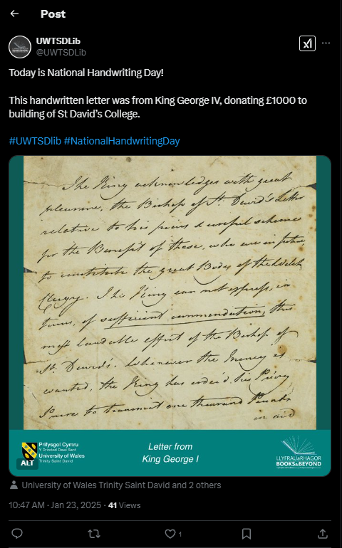
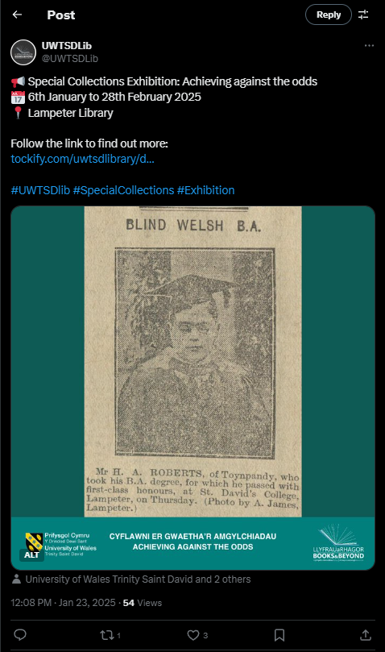
(UWTSDLib, 2025a)
(UWTSDLib, 2025b)

Slide 16
Opportunities of a bespoke special collections and archive facility within a multi-campus institution.
Academic potential:
  Historical value of collection could be used to support academia
Centralised UWTSD archives:
  Already houses archives of Carmarthen Trinity college and Lampeter university
  Potential to house archival material of Swansea campus and prior institutions, allowing the RBLA to become the centralised archives for all campuses
  However, this brings forth questions of geographical significance of archives
Revitalising Lampeter:
  Could provide a purpose for Lampeter campus with its uncertain future

Slide 17
Opportunities of a bespoke special collections and archive facility within a multi-campus institution.
National Archive Service Accreditation:
  A focus of the RBLA currently is to achieve accreditation
    Ensures they follow best practices and follow industry standards
    Financial incentive: grants and donors
  Measures already implemented include:
    Deposit guidelines detailing what they do or don’t accept
    Accession forms that allow a detailed trail of where material comes from

Slide 18
Threats of an institution within a university campus that will be lacking in students.
Decline in engagement:
  The tumultuous future of Lampeter threatens an even lower level of engagement
    Exacerbated by the closure of the main library, where the entrance to the RBLA is
  Plan to make access to appointment-only
Questioning purpose:
  The RBLA risks losing its relevance within a future of Lampeter with no students or teaching
  Potential to be reduced to a static conservation site, becoming a financial strain on the university
Rural location:
  Within a campus that doesn’t involve teaching in rural Wales may hinder visitation and academic use.

Slide 19
Conclusion

Slide 20
An uncertain future with an opportunity for expansion.
Historical and hereditary significance:
  The RBLA holds unique texts and archival material that solidify the historical importance of the university
Current challenges:
  Issues surround the potentially waning purpose of the collection with undergraduate teaching moving to Carmarthen
  Small footfall - will this move of teaching effect this?
  Lack of virtual estate may potentially affect the potential footfall of the RBLA
Opportunity for growth:
  Give a renewed purpose to the Lampeter campus
  Potential for growth with Swansea’s archives
Need for protection:
  This institution must be protected to ensure the survival of the heritage of the university and the town

Slide 21
Reference list
Craven, L. (2008) What are Archives?: Cultural and Theoretical Perspectives: A Reader. Aldershot: Ashgate Publishing.
Marx, W. (1997) (ed.) Essays in Memory of Robin Rider: Trivium Volumes 29 and 30. Lampeter: Trivium Publications
Morgan-Guy, J. (2022) Treasures: The Special Collections of the University of Wales Trinity Saint David. Cardiff: University of Wales Press.
The National Archives (no date) Discovery. Available at: https://discovery.nationalarchives.gov.uk/ (Accessed on 11th of February 2025).
University of Wales Trinity Saint David (no date) Special Collections and Archives. Available at: https://www.uwtsd.ac.uk/library/special-collections-and-archives#:~:text=Thomas%20Burgess%2C%20bishop%20of%20St,particularly%20classics%2C%20literature%20and%20theology. (Accessed on 10th of February 2025).
University of Wales Trinity Saint David Special Collections Department (2024) Open Doors Event poster. University of Wales Trinity Saint David: unpublished.

Slide 22
Reference list
UWTSDLib (2025a) [X] 23rd of January. Available at: https://x.com/UWTSDLib/status/1882379678583083167 (Accessed on 11th of February 2025).
UWTSDLib (2025b) [X] 23rd of January. Available at: https://x.com/UWTSDLib/status/1882399975315030356 (Accessed on 11th of February 2025).

Slide 23
Bibliography
Accredited Archive Service (2018) Archive Service Accreditation Standard. Available at: https://cdn.nationalarchives.gov.uk/documents/archives/archive-service-accreditation-standard-june-2018.pdf (Accessed on 7th of February 2025).
The Archive-Skills Consultancy (2003) ISAD (G): The Basics. Available at: https://www.archive-skills.com/infobytes/isad-g.pdf (Accessed on 7th of February 2025).
Hammond, N. (no date) Deposit Guidelines. University of Wales Trinity Saint David Special Collections Department. Unpublished.
Hammond, N. (2023) ‘Update: The Roderic Bowen Library and Archives’, The Link, 81, pp. 14-15.
Hammond, N. (2024a) Internal Transfer Accession Form. University of Wales Trinity Saint David Special Collections Department. Unpublished.
Hammond, N. (2024b) Deposit Agreement Form. University of Wales Trinity Saint David Special Collections Department. Unpublished.
Hammond, N. (2025) Collection of screenshots of Special Collections data. University of Wales Trinity Saint David Intranet. Unpublished.

Slide 24
Bibliography
The National Archives (no date a) Archival Service Accreditation. Available at: https://www.nationalarchives.gov.uk/archives-sector/archive-service-accreditation/ (Accessed on 30th of January 2025).
The National Archives (no date b) Archive Service Accreditation: Frequently Asked Questions. Available at: https://cdn.nationalarchives.gov.uk/documents/archives/archive-service-accreditation-faqs.pdf (Accessed on 12th of February 2025).
The National Archives (no date) Cataloguing archive collections. Available at: https://www.nationalarchives.gov.uk/archives-sector/advice-and-guidance/managing-your-collection/cataloguing/cataloguing-archive-collections/#:~:text=Archive%20catalogues%20have%20a%20hierarchical,'item'%20being%20the%20narrowest. (Accessed on 7th of February 2025).
The National Archives (2016) Archive Principles and Practice: an introduction to archives for non-archivists. Available at: https://cdn.nationalarchives.gov.uk/documents/archives/archive-principles-and-practice-an-introduction-to-archives-for-non-archivists.pdf (Accessed on 7th of February 2025).
Sinclair, B. (2025) ‘University education at Wales' oldest campus ends’, BBC News. Available at: https://www.bbc.co.uk/news/articles/c78x4l9lk43o (Accessed on 3rd of February 2025).

Slide 25
Bibliography
Thamm, K. (no date) Archival hierarchies: a comprehensive exploration of description levels. Available at: https://www.navigating.art/articles-from-navigatingart/archival-hierarchies-art-researchers#:~:text=For%20example%2C%20in%20an%20artist's,and%20the%20series%20as%20a (Accessed on 7th of February 2025).
University of Wales Trinity Saint David (2023) Belonging, 1, p.1.
University of Wales Trinity Saint David (no date) Lampeter Campus Life. Available at: https://www.uwtsd.ac.uk/lampeter (Accessed on 6th of February 2025).
UWTSD - Library and Learning Resources (no date) UWTSD - Library and Learning Resources. Available at: https://www.facebook.com/UWTSDLib (Accessed on 6th of February 2025).
UWTSDLib (no date) UWTSDLib. Available at: https://x.com/UWTSDLib (Accessed on 6th of February 2025).
UWTSDLib (2025a) [X] 6th of February. Available at: https://x.com/UWTSDLib/status/1887470513842208986 (Accessed on 6th of February 2025).
UWTSDLib (2025b) [X] 24th of January. Available at: https://x.com/UWTSDLib/status/1882745183051112576 (Accessed on 6th of February 2025).

Slide 26
Bibliography
UWTSDLib (2025c) [X] 23rd of January. Available at: https://x.com/UWTSDLib/status/1882399975315030356 (Accessed on 6th of February 2025).
UWTSDLib (2025d) [X] 23rd of January. Available at: https://x.com/UWTSDLib/status/1882379678583083167 (Accessed on 6th of February 2025).
UWTSD Students’ Union (2024) Initial response to talks around Lampeter's future. Available at: https://www.uwtsdunion.co.uk/articles/initial-response-to-talks-around-lampeter-s-future (Accessed on 3rd of February 2025).

