Slide 1
Culture, Identity and education
Gender, ethnicity & identity

Slide 2
recap
Quizizz

Slide 3
When looking at the topic of gender, there are various things which can be considered:
Society’s perceptions of gender.
Gender throughout history
Gender prejudice and/or discrimination
Gender within the media
Gender within schools
Gender within employment

Slide 4
Throughout history, the perceived roles of men and women were very categorised.
Men would:
Be the rulers.
Be the fighters (in most cultures).
Be farmers.
Be builders.
Be merchants.

Slide 5
Women would:
Be the housewife
Cooking
Cleaning the home
Be the mother
Stay at home birthing and raising children
Nurses

Slide 6
Women stayed in this role for many years.
Women began to have enough of following ‘traditional norms’ and began rebelling against their husbands and against the rules of society.
Suffragettes
Susan B. Anthony
Ellen Johnson-Sirleaf
Dr Elizabeth Blackwell
Sally Kristen Ride

Slide 7
Sir Ian McKellen
Harvey Milk
Patrick Stewart
RuPaul

Slide 8
Patriarchal
Matriarchal

Slide 9
Gender discrimination
Do you think children would unknowingly participate in gender inequality?
https://www.youtube.com/watch?v=S1Onniy08AY

Slide 10
Gender discrimination, also known as ‘sexism’, is the discrimination towards an individual or a groups of individuals because of their gender.
This type of discrimination can be seen a lot within places of work and in some cases, it can be seen within education.
Sexism can be seen to arise from social norms, cultural norms and cultural customs.

Slide 11
As this type of discrimination happens frequently within employment, gender inequality is one of the major factors of this discrimination.
‘Gender pay gap’ is the term used for the difference in earnings per annum between the sexes.
Due to a new law, organisations with over 250 staff must show evidence of their gender pay gap.
In 2019, the overall gender pay gap percentage decreased from 17.8% to 17.3%.

Slide 12
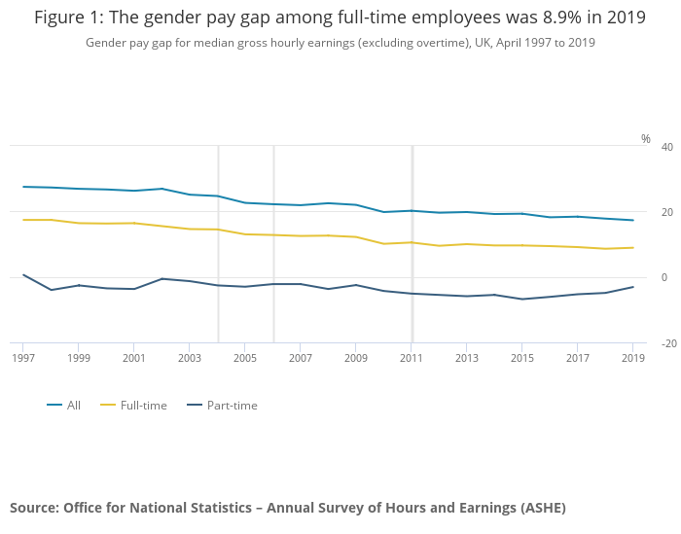
(Office for National Statistics, 2019)

Slide 13
Cultural differences
Children living within the UK must attend compulsory school between the ages of 5 – 16.
Children can attend either state schools (free mainstream schools) or private schools which are funded independently.
These schools are primarily mixed schools for both girls and boys, however there are same sex only schools within the UK.
During their education, the students will follow a compulsory curriculum called ‘The National Curriculum.’
Within this curriculum, the subjects are all the same topics for both sexes.

Slide 14
Gypsy and Traveller children tend to leave school at a much earlier age than in other ethnic groups.
This can be due to a number of different reasons.
Gypsy and Traveller children often drop out of school around 11 years old, in order to work and help their parents out.
Girls often drop out of school to help their mothers with the ‘home’ work.
Whilst boys often help their dads with work and looking after the animals.

Slide 15
Fa’afafine
Also known as the ‘third gender.’
This is part of Polynesian culture, particularly in Samoa.
The term ‘Fa’Afafine translates to ‘in the manner of a woman.’
This culture are biologically men at birth but behave in feminine ways as they grow up.
This has became a cultural norm within Samoan society, even bringing its own laws.

Slide 16
In traditional Samoan style, the boy’s preference for feminine tasks will usually be recognised at an early age.
Once the child becomes recognised as a Fa’Afafine, they will then adopt feminine traits.
Dressing as a woman.
Dancing the Siva (a traditional female dance usually performed wearing a feathered headdress).
Undertaking feminine roles within the village.
Fa’Afafine are accepted as feminine, but they also undertake masculine men’s roles when wanted.

Slide 17
Can you see any cultural differences within these children talking about gender?

Slide 18
Gender in the media
Can anybody think of examples of gender being stereotyped in the media?

Slide 19
Gender in Disney
Many of Disney’s films have been branded as ‘sexist’ throughout the years.
Disney’s older films always rely on a man to save a woman in order for the woman to survive.
The majority of the older films within Disney are made up of:
The men being the heroes.
The women being helpless or at a loss.
The men being royalty.
The princesses all being portrayed as beautiful, young women.
The older women being portrayed as the villains or hags.

Slide 20
Any questions

Slide 21
references
Jimmy Kimmel Live (2016) Kids explain why women are paid less than men. [Online] Available at: https://www.youtube.com/watch?v=S1Onniy08AY (Accessed: 09/03/2020)
National Geographic (2016) Hear Kids' Honest Opinions on Being a Boy or Girl Around the World | National Geographic. [Online] Available at: https://www.youtube.com/watch?v=2B3ea7IGwLA (Accessed: 09/03/2020)
Office for National Statistics (2019) Gender Pay Gap in 2019. [Online] Available at: https://www.ons.gov.uk/employmentandlabourmarket/peopleinwork/earningsandworkinghours/bulletins/genderpaygapintheuk/2019 (Accessed: 06/03/2020)

