Slide 1

Introduction to Counselling Skills
Wednesday, 29th March

Slide 2

Check in – Warm up exercise
Reflective Process – Assessment 2
Demonstration of Skills
Group Work
Closing Round

Slide 3
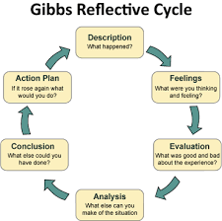
Reflective process – Gibbs Model
Assessment 2 Overview with examples

Slide 4

What do you Notice
Contracting
Boundary Setting
Attending Skills - Minimal encouragers – body position.
Paraphrasing, reflecting Skills
Questions
Other
Summarising

Slide 5
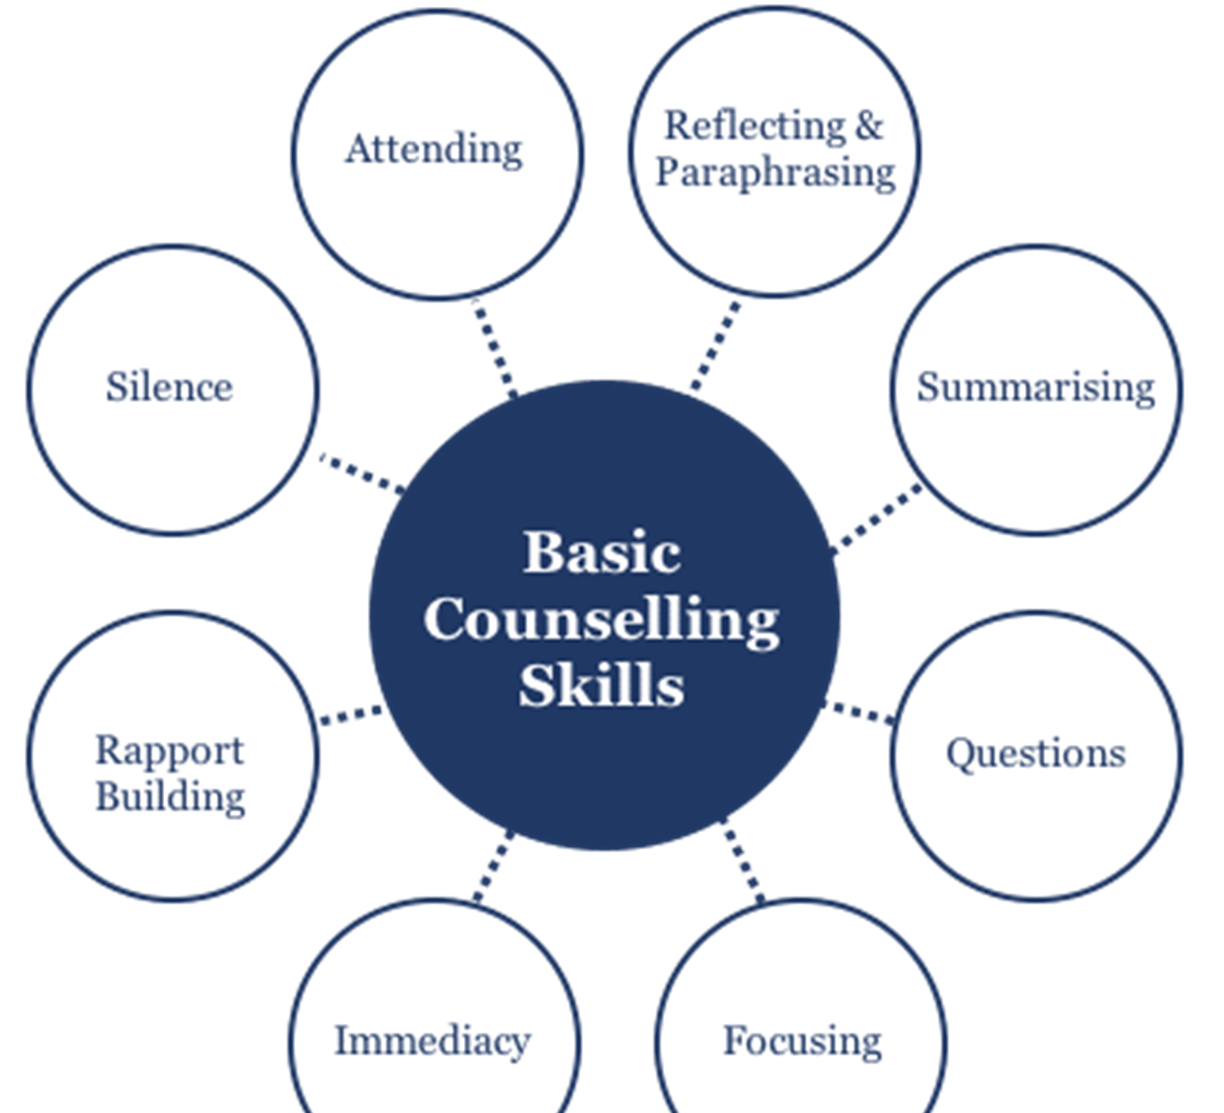
Demonstration of Skills

Slide 6

Small group work

Slide 7

Next Session Wednesday 26th April – Skills Workshop
Evaluation of the Module

Slide 8

Closing Round

