Slide 1
Fair Trade and Ethical Consumption

Slide 2

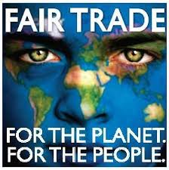
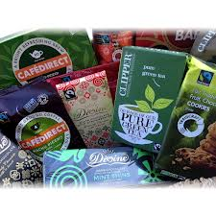

Slide 3
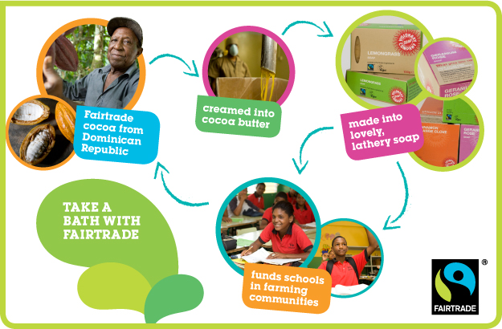

Slide 4
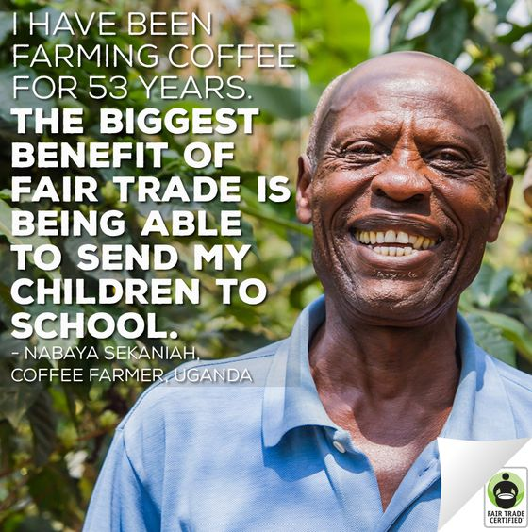

Slide 5
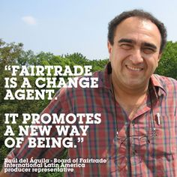

Slide 6


Slide 7
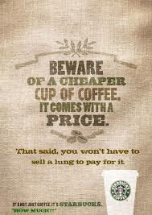
Can we think of Fair Trade…..
As a brand?
As a status symbol?
As a way of alleviating middle-class guilt?
As a value-add / price premium?
As a route for carving a niche market?
As a mechanism for obscuring the inequities of capitalism?
As greenwashing?

Slide 8
Goodman et al (2011)
Visual economies of fair trade
Not mere marketing tools
“as semiotic intermediaries situated between consumers and producers of fair trade goods, they are, in essence, indispensible in creating the meanings of fair trade” (209-10, original emphasis)
Trace multiple stages and developments of this visual economy

Slide 9
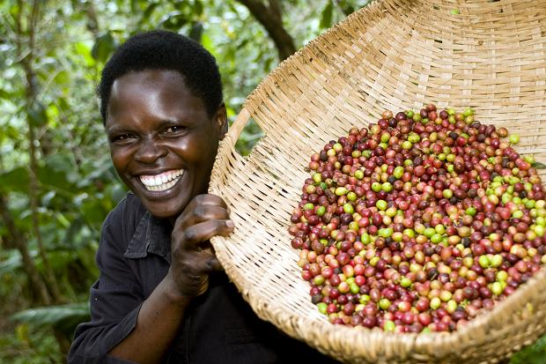
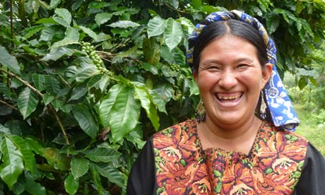
1 Pictures of Growers

Slide 10
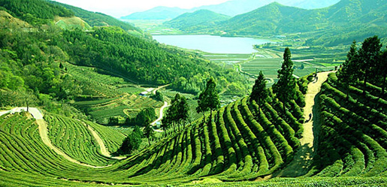
2. Romantic Landscapes

Slide 11
Shift to quality
Farmers were ‘too fair trade’ for quality products
Focus on place
  In line with narrative of ‘quality’ foods
Focus on taste and quality
  Rather than the impact on producer

Slide 12
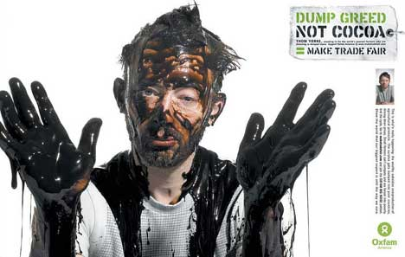
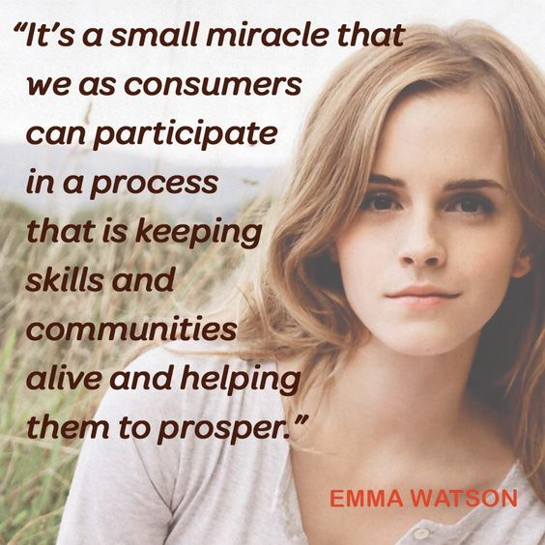
3. Celebrity Culture

Slide 13
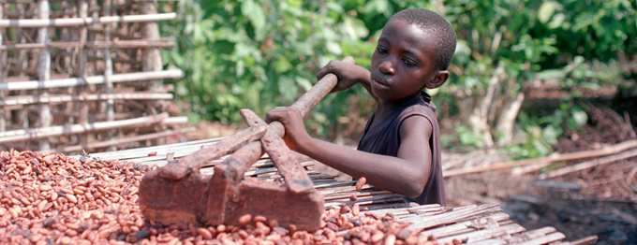
4. Labour and technologies

Slide 14
5. Narratives
Enter the farmer’s world
‘we are the growers and you can taste it’ (2011: 219)
See www.fairtrade.org..uk

Slide 15
Coles and Crang (2011)
Ethical consumption in Borough Market, London
Place and displacement
Place and place-making are central to ‘alternative construction’
Ethical consumption operates in real-world settings
  Various kinds of ‘better’ (and knowledges of better) knit together
  ‘Semantic leakiness’
Fetishistic character of de-fetishization (double commodity fetish)

Slide 16
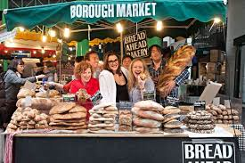
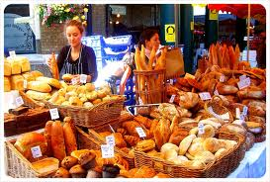
Placing
Ethical consumption is not an abstract form of knowledge
Products are wrapped with multiple layers
Provide additional ‘knowledge’
Mediation between people, place and commodities

Slide 17
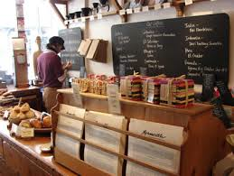
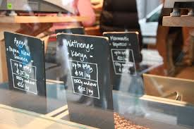
Displacement
Place is also opened up
Reconnection between consumer and ‘other’ places
Reaches beyond the parochial
Just as much as it opens, it also localises and bounds

Slide 18
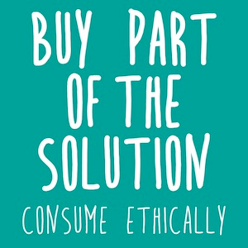
Ethical consumption as commodification of care?

Slide 19
Guthman(2003)
Care for self and society
Emergence of organic salad market in California
The materiality of salad not incidental
  Low calorie food
  Conflates with value placed on slim bodies
Associated with higher class
  ‘yuppie chow’
Social aspirations

Slide 20
Responsibilised consumers and social expression
“Eating organic salad mix was in some sense performative of an elite sensibility, albeit rather an unusual one. Organic salad mix was strongly coupled with – indeed helped to animate – the figure of the ‘yuppie’, the San Francisco Bay area of which was not wholly devoid of social conscience….but not shorn of gentrified aspirations either” (2003: 52).

Slide 21
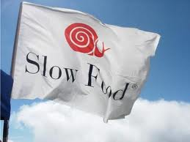
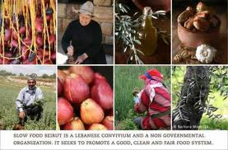
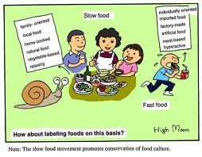
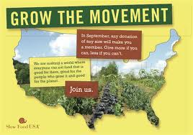
The Slow Food Movement

Slide 22
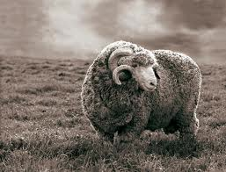
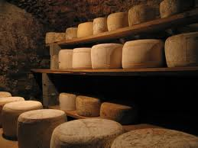
West & Domingos (2012)
Serpa Cheese Presidia, Alentajo, Portugal
Producers have to follow three procedures
  Milk from indigenous breeds
  ‘Traditional’ methods of maturing
  Age the cheese for longer period

Slide 23
Critical of Slow Food as Elitist
Producers shifted from these ‘traditions’
  Not economically viable
Slow Food ignores historical political and economic relations
Set up a narrative of a timeless, artisan, local producer
Motivated middle-class ideology
Doesn’t challenge consumerism, but creates ‘good’ and ‘bad’ consumerism

Slide 24
Lyon (2010)
Fair trade and organic coffee co-operative in Guatemala
Co-operation is hard work
Need to acquire new skills (and new debt)
Increased surveillance
Newcomers challenge existing systems of social prestige
But, it does give small farmers a louder voice

Slide 25
Next Week
Biographical objects, intimacies and memory
Not outward expressions but personal layers of meaning
Key Reading:
  Gell (1986)– ‘totalising biographies’
You can also reflect on Janet Carsten (Cooking Money) and how this relates

