Slide 1

DOES THE INNOVATION CONCEPT PROVIDE A BUSINESS ADVANTAGE ?
By: Laura Bucurean

Slide 2
TABLE OF CONTENTS
Slide 3: Introduction
Slide 4: Reflective model: Gibbs Cycle
Slide 5-10: Application of Gibbs cycle
Slide 11: Conclusion
Slide 12: References

Slide 3



Slide 4
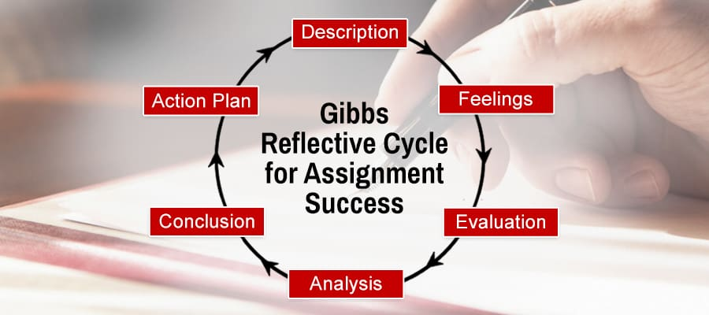
Model of reflection
(Gibbs' Reflective Cycle, 2020)

Slide 5






Reflection on Learning
What is Innovation?
What is Creativity?
Models of Innovation
Week 1
Week 2
Week 3
The Innovative Organisation
Where do Ideas Come From?
Leadership and Management
Week 4
Week 5
Week 6
Notes:
Looking back at the learning seasons in my opinion the innovation. concept over the years has resulted in increasing the possibility of business advantage for many organisations
This is because the difference between the type of business and the nature of innovation being generated by the employees.
Based on the session about creativity
Models of innov
Exploring The organisationl innovation study have realised that by introducing new ideas or services may not neccesaryly involve innovation as many org change their structure without being innovative.

Slide 6


Slide 7

CREATIVITY

Slide 8
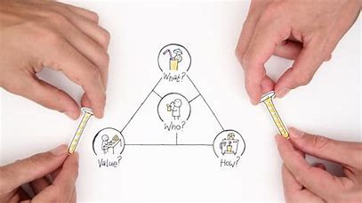
Closed Innovation is developed in a self-contained company environment.
Open Innovation incorporates external knowledge.
MODELS OF INNOVATION

Slide 9

WHERE DO THE IDEAS COME FROM ?

Slide 10

  LEADERSHIP & MANAGEMENT

Slide 11


Slide 12

Does Creativity and Innovation Provide a Business Advantage?

Slide 13
REFERENCES
1) Amoako, G.K., Bonsu, G.A., Caesar, L.D. and Osei-Tete, F., 2020. Finding the nexus between green supply chain practices
and sustainable business advantage: an emerging market perspective. Management of Environmental Quality: An International Journal.
2) Distanont, A. and Khongmalai, O., 2018. The role of innovation in creating a competitive advantage. Kasetsart Journal of Social Sciences.
3) ed.ac.uk 2020. Gibbs' Reflective Cycle. Available at: https://www.ed.ac.uk/reflection/reflectors-toolkit/reflecting-on-experience/gibbs-reflective-cycle (Accessed: 6 April 2021).
4) Fernández-Caramés, T.M. and Fraga-Lamas, P., 2018. A Review on the Use of Blockchain for the Internet of Things. Ieee Access, 6, pp.32979-33001.
5) Indartono, S. and Wibowo, F.W., 2017. VRIO and THES based development of university competitive advantage model in formulating university strategic plan. International Information Institute (Tokyo). Information, 20(10A), pp.7275-7283.
6) Noonan, A 2019. The real reasons why Thomas Cook will no longer 'take off', Realbusiness.co.uk. Available at: https://realbusiness.co.uk/the-real-reasons-why-thomas-cook-failed/ (Accessed: 6 April 2021).
7) Amabile, T., Conti, R., Coon, H., Lazenby, J. and Herron, M., 1996. Assessing the Work Environment for Creativity. Academy of Management Journal, 39(5), pp.1154-1184.
8) 2018 Open Innovation vs. Closed Innovation. [Blog] Available at: <https://www.lead-innovation.com/english-blog/open-innovation-vs.-closed-innovation> [Accessed 12 April 2021].
9) The Economic Times. 2021. What is Autocratic Leadership? Definition of Autocratic Leadership, Autocratic Leadership Meaning - The Economic Times. [online] Available at: <https://economictimes.indiatimes.com/definition/autocratic-leadership> [Accessed 18 April 2021].
10) Verywell Mind. 2020. The Components and Psychological Study of Creativity. [online] Available at: <https://www.verywellmind.com/what-is-creativity-p2-3986725> [Accessed 21 April 2021].

Slide 14


